Slide 1
Small Business Brown Bag Series
2018

Slide 2
Selling on eBay Part II
Laura Greenfield
eBay PowerSeller
Director of Seller Happiness at SellHound

Slide 3
Becoming an eBay Business
Have you made some eBay sales this past month?
Getting ready to go from
Hobby to Business
Business– Designed for profit
Online Garage Sales
Selling personal goods

Slide 4
Why eBay?
168 million buyers
eBay is “where the world shops”
Technology and tools to grow your business
Buyer and Seller protection
Feedback and reputation systems

Slide 5
Feedback System History
“Most people are honest. And they mean well. Some people go out of their way to make things right. I've heard great stories about the honesty of people here. But some people are dishonest. Or deceptive.”
“But here, those people can't hide. We'll drive them away. Protect others from them.”
Pierre Omidyar
Founder of eBay
February 26, 1996

Slide 6
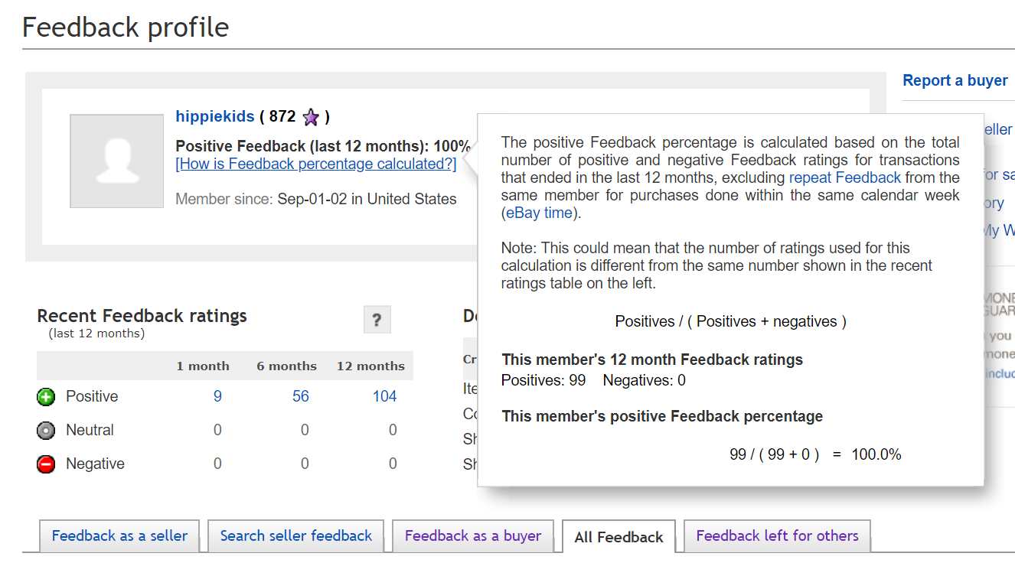
Your eBay Reputation
Feedback: Given by both Buyers and Sellers
Sellers can not leave negative or neutral feedback for Buyers
Buyers can leave negative or neutral or Positive feedback for Sellers

Slide 7
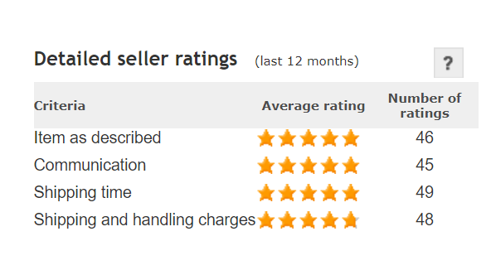
Your eBay Seller Rating
Detailed Seller Ratings
Buyers Rate Sellers
1-5 Stars for Services

Slide 8
Seller Dashboard

Slide 9
Qualify as a Top Rated Seller
An eBay account that's been active for at least 90 days.
100 or more transactions and $1,000 in sales during the last 12 months with US buyers.
A defect rate less than or equal to 0.5%, with three or fewer defects from unique buyers.
Cases closed without seller resolution less than or equal to 0.3%, and two or fewer cases.
A late shipment rate less than or equal to 3%, and five or fewer late shipments.
Tracking uploaded within your stated handling time, and carrier validation for 90% of transactions to US buyers.

Slide 10
Benefits of Top Rated Seller Status
$30 credit toward Promoted Listings each quarter
Special pricing on eBay USPS label prices

Slide 11
Top Rated Seller Plus
Qualifications:
Same or one-business-day handling, and
A 30-day or longer free return period with money back option.
Benefits:
The Top Rated Plus seal, displayed prominently in search results and the listing description.
A 10% discount on final value fees.

Slide 12
Opening an eBay Store!
Store Homepage with your own branded company design. Custom categories for your listings!
For your monthly fee you get:
More Free Listings
Insertion fee credits for auction sales
Final Value Fee Discounts available
Coupon for free shipping supplies with Basic Store and up
Markdown Manager for Sales
Promoted Listings (Paid Advertising)
Business Service Discounts
Vacation Holds

Slide 13
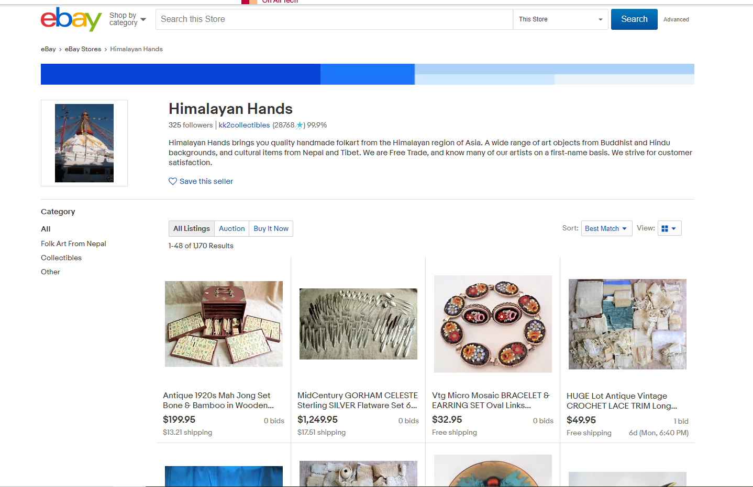
eBay Store Format

Slide 14
Promotions Manager

Slide 15
Store Promotions
Order size discount:
Buy 2 Get 1 50% Off
Markdown sale: Save up to 30% Off
Shipping discounts: Free shipping on orders over $99
Codeless coupons: 20% for Friends & Family

Slide 16
Resources for Selling
Social Media- Facebook, Instagram, Twitter
eBay Groups including Meetups
eBay Open Conferences
eBay Community Discussion Boards
Seller Hub : Central place for managing your eBay business

Slide 17
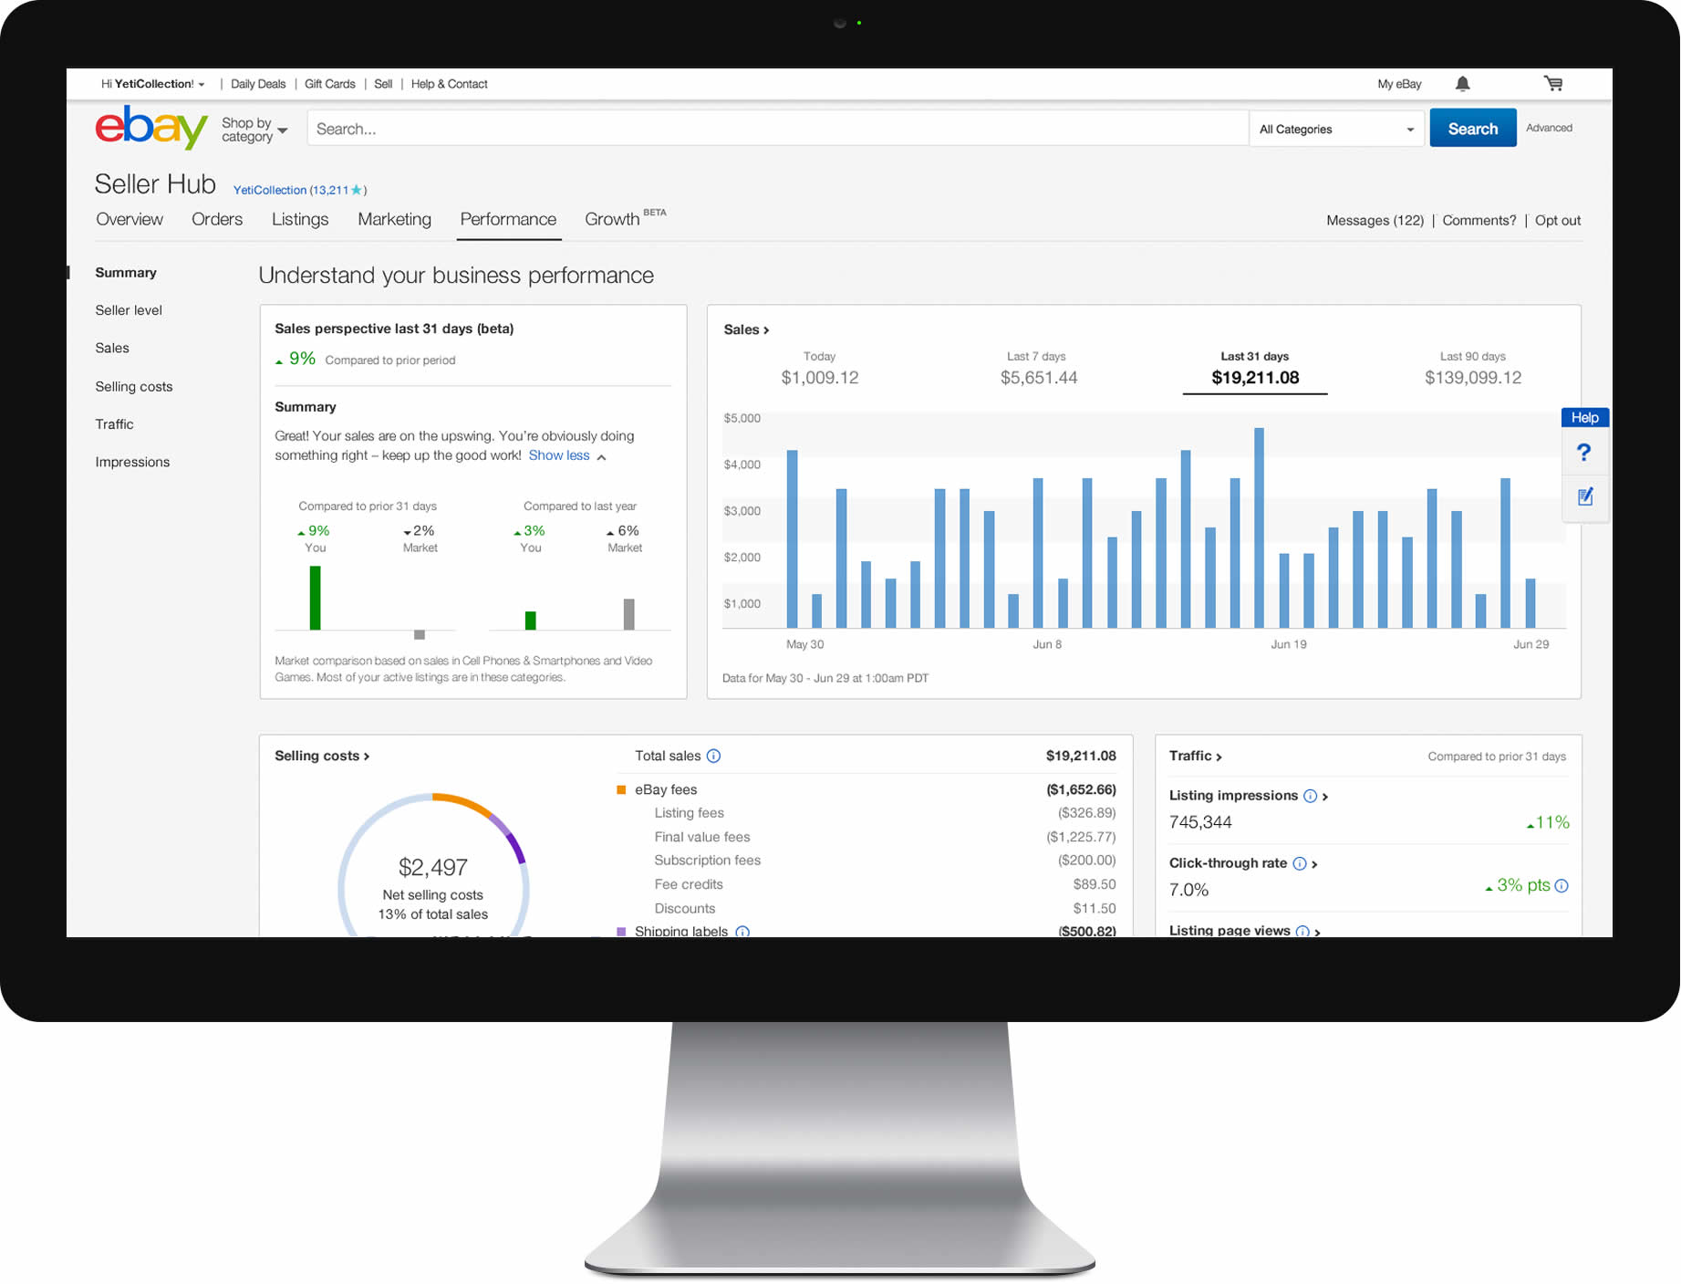
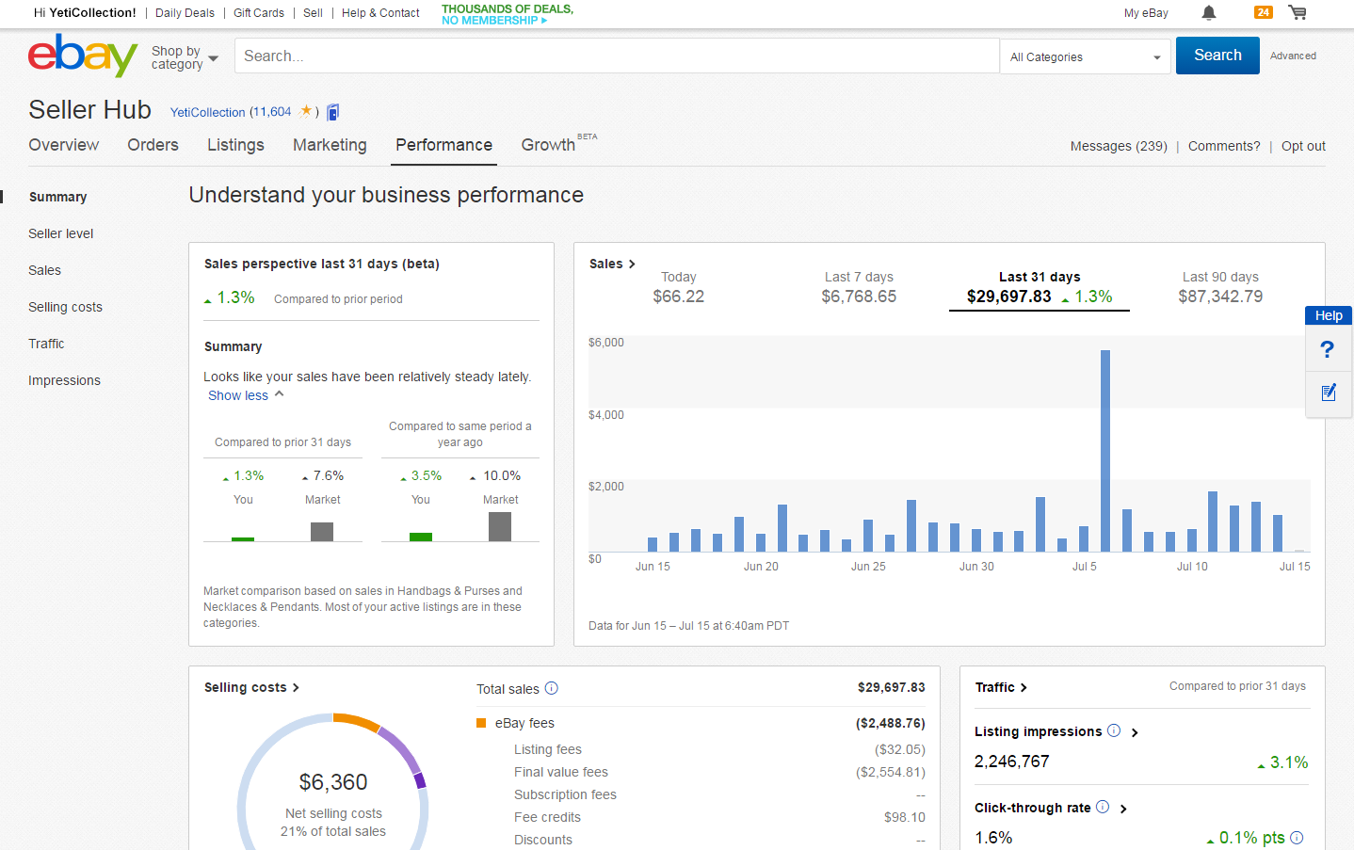

Slide 18
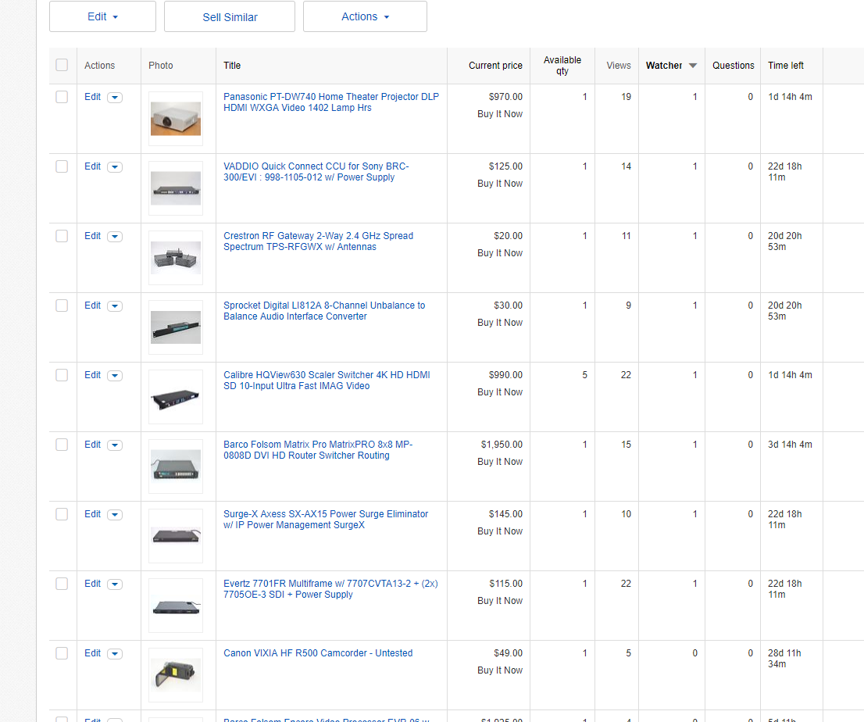
Follow Active Listings Views & Watchers

Slide 19
Impressions and Page Views

Slide 20
Nitty Gritty Growing an eBay Business Consult with a tax advisor!
Business Expenses:
Cost of Goods Sold or COGS,
Shopping trips (miles/use of car/parking/entry fees)
Space- Storage / Use of Home
Utilities/Phone/Internet/Computer
Packing Materials- Tape, Boxes
Shipping Costs
Training Costs
Subscriptions
eBay Fees
PayPal Fees
Photography Expenses

Slide 21
PayPal Income Reported to IRS
A seller has to exceed both IRS thresholds ($20,000 in gross payment volume and 200 separate payments) in a calendar year before a Form 1099-K is provided by PayPal.
his Photo by Unknown Author is licensed under CC BY-NC-SA

Slide 22
California Sales and Use Tax Reseller Permit
Obtain
Obtain Seller’s Permit from California Department of Tax and Fee Administration CDTFA
Charge Collect
Pay Taxes
Charge and Collect Tax on eBay Sales
File and Pay California Sales by Mail or Online
Keep Records

Slide 23
eBay Site Preferences Selling Preferences Sale Tax Table

Slide 24
SELLING TIP! Pricing research is critical to your success.
Has this item sold on eBay before?
Look at SOLD price on eBay!
When looking at the sold prices, note condition and format (Fixed or Auction)
Is this item currently listed by another seller?
What makes your item competitive?

Slide 25
Third Party Pricing Research Tools
SellHound - Local Santa Cruz Startup www.sellhound.com
Free Comparison Search Engine (90 Day history Multiple Marketplaces including eBay)
Terapeak - Subscription Service (one year history eBay sales)
Worthpoint – Subscription Service (4+ years of Data from eBay and auction houses)

Slide 26
Advice for your new business EVOLVE
What is your passion?
What can you sell?
Dream Big
Find your niche

Slide 27
Thank you to our Sponsors! Please complete the evaluation forms For Materials: www.santacruzpl.org/brownbags

