Slide 1







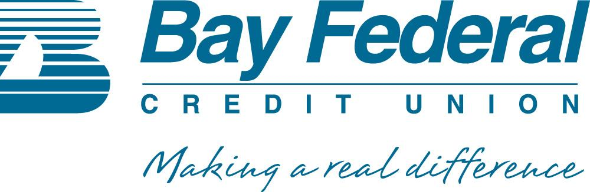
Tuesday Next Talks
● ● ● ● ● ● ● ● ● ● ● ● ● ● ● ● ● ● ● ● ● ● ● ●

Slide 2
INTELLECTUAL PROPERTY BOOT CAMP
Presented by:
Michael Mount, Esq.
Patrick Reilly, Esq.

Slide 3
Why Are There IP Rights?
© Copyright 2009-2019, Patrick Reilly, Michael Mount, All Rights Reserved

Slide 4
IP Rights Are a Social Contract
“To promote the progress of science and useful arts, by securing for limited times to authors and inventors the exclusive right to their respective writings and discoveries”;
        US Constitution, Article 1, Section 8

Slide 5
Species of Intellectual Property
Copyright
Trademark
  Trade Dress
Trade Secrets
Patents

Slide 6
COPYRIGHT

Slide 7
COPYRIGHT BY LAW
1710 Statute of Queen Anne
1790 First US Copyright Act
1909 Copyright Act
1974 Copyright Act
1998 Digital Millennium Copyright Act (DMCA)
2018 Music Modernization Act

Slide 8
Subject Matter of Copyright
(a) Copyright protection subsists…in original works of authorship fixed in any tangible medium of expression, now known or later developed, from which they can be perceived, reproduced, or otherwise communicated, either directly or with the aid of a machine or device.
(b) In no case does copyright protection for an original work of authorship extend to any idea, procedure, process, system, method of operation, concept, principle, or discovery, regardless of the form in which it is described, explained, illustrated, or embodied in such work.

Slide 9
Works of authorship include the following categories:
(1) Literary works (computer code);
(2) Musical works, including any accompanying words;
(3) Dramatic works, including any accompanying music;
(4) Pantomimes and choreographic works;
(5) Pictorial, graphic, and sculptural works;
(6) Motion pictures and other audiovisual works (digital games);
(7) Sound recordings; and
(8) Architectural works.

Slide 10
WHAT RIGHTS DOES COPYRIGHT PROTECT?
Bundle of Exclusive Rights:
  Reproduce
  Prepare derivative works
  Distribute Copies
  Perform publicly
  Display

Slide 11
WHEN DOES A COPYRIGHT COME INTO EXISTENCE?
Moment it is fixed in a tangible medium of expression.
HOW LONG DOES A COPYRIGHT LAST?
Published: Life of the author plus 70 years.
Unpublished: Life of the author plus 70 years.
Works Made for Hire: 95 years from publication
  OR 120 years from date of creation
Public Domain- 1923 and before

Slide 12
COPYRIGHT NOTICES:
Formal Requirements no longer required since 1976.
Do they still serve a purpose?
      Public Notice of Ownership
      Use requires permission
      REMOVING A COPYRIGHT NOTICE IS A FEDERAL CRIME.

Slide 13
TRANSFER OF RIGHTS
ASSIGNMENT: Transfers Ownership
Must be in writing
Number One Mistake of Start Ups
Getting Copyrights assigned into company In Writing
Founders, employees, contractors/consultants, customers.
      Funding: Investors, banks, sale of assets
      Registration: Due Diligence

Slide 14
LICENSES:
Exclusive vs Non-Exclusive Licenses
  Exclusive: In Writing = Ownership Rights
  Non-Exclusive: Verbal or In Writing
Division of Rights: Territory, fields of use, time period
Pre-Existing, Commissioned, Concurrent

Slide 15
ANCILLARY RIGHTS
Digital Games:
  Play Stations
  Downloads
  Mobile
  Merchandise *
  Film/TV/Plays/Musicals
  Translations
  Territory

Slide 16
INFRINGEMENT
Copying the expression of a work.
SIMILAR GAMES CONCEPTS:
  IDEA VS EXPRESSION

Slide 17

Substantially Similar
Bonnie Schiffman v. Rod Stewart

Slide 18


Slide 19
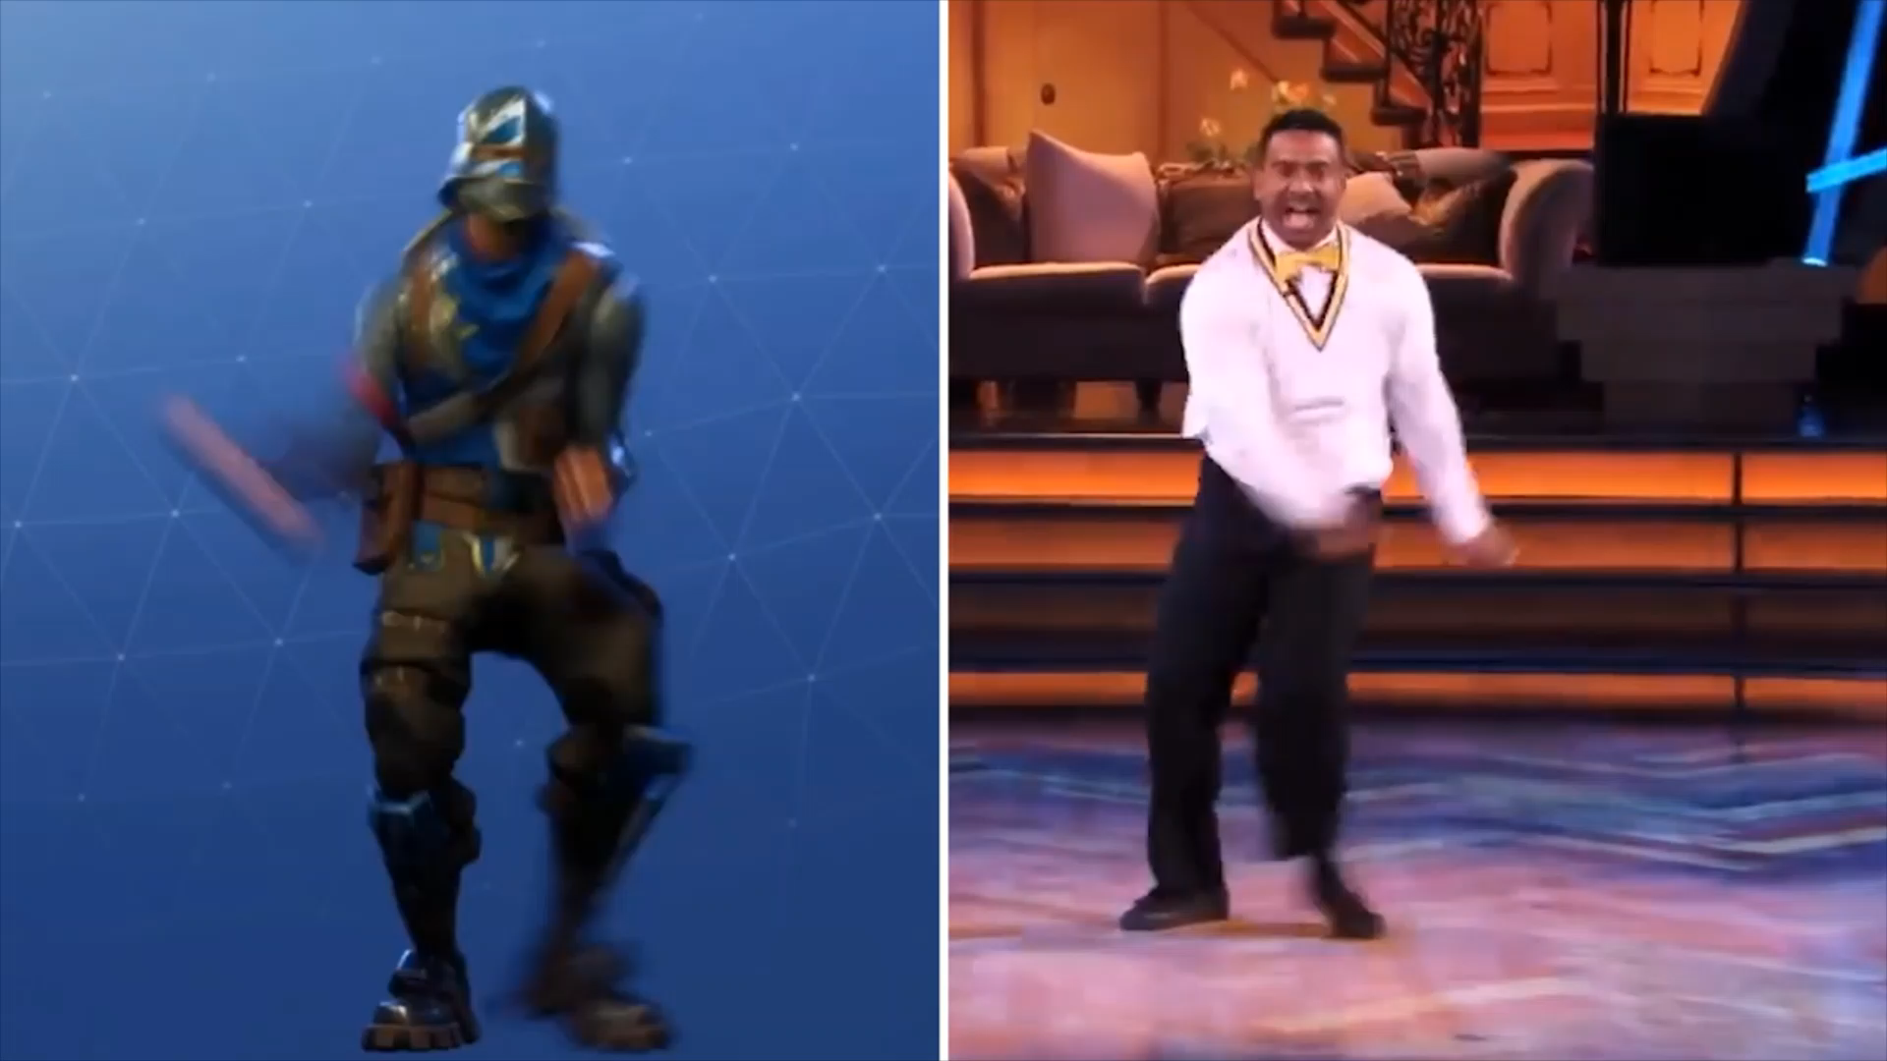
FORTNITE DANCE VIDEO

Slide 20
EASILY INFRINGED AREAS
SETS
CHARACTERS
STORY LINES
SCENES A FAIRE: Not Protected
RIGHT OF PUBLICITY: Sports or Entertainment Stars (Parody Defense)
Ask permission – don’t wait to apologize
Attribution doesn’t get you off the hook.

Slide 21
COPYRIGHT REGISTRATION
Benefits: Assets, Notice, Sue for infringement, Statutory Damages
Deposit Materials
Blacking out Trade Secrets
Access to your Deposit Materials
Effect as of day of submission
Expedited Registration – Reasons
Litigation
Funding
Websites: Code & Embedded Graphics
Costs

Slide 22
COPYRIGHT ENFORCEMENT
Registration Required to Bring Litigation
Statutory Damages vs. Actual Damages
$150,000 per infringement (innocent vs. willful)

Slide 23
FAIR USE: Misunderstood Doctrine
WHAT IS IT?
Fair use is a legal doctrine that permits limited use of copyrighted material without acquiring permission from the rights holders.
COURT TEST:
          Purpose and Character of use (Educational)
            “Transformative”
          Nature of Work
          Amount and Substantiality (heart of the work)
          Effect on potential Market or Value
            (making money on your schoolwork game may impact your fair use protection)
DON’T REMOVE ANY COPYRIGHT NOTICE!

Slide 24
Demonstrating Your Game Outside of Class
NOTICE: The following digital game contains copyrighted materials used under the Multimedia Guidelines and Fair Use exemptions of U.S. Copyright law. Further use is prohibited.

Slide 25
“TRANSFORMATIVE” Use:
Transformative uses take the original copyrighted work and transform its appearance or nature to such a high degree that the use no longer qualifies as infringing.

Slide 26

Cariou v. Prince: 35 photo images into collages

Slide 27
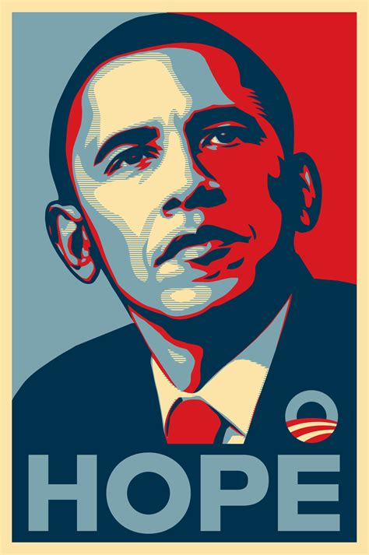

Slide 28
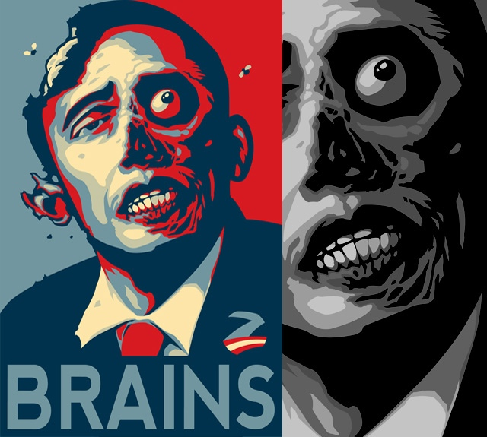
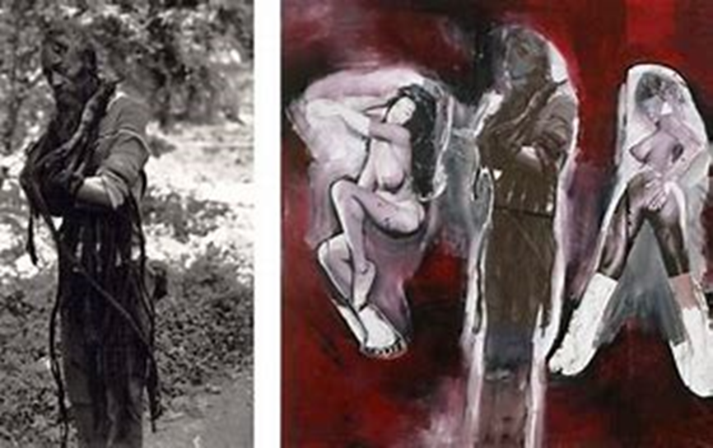

Slide 29
“WORK MADE FOR HIRE”
Another Misunderstood Doctrine - Only Two Categories
(1) a work prepared by an employee within the scope of his or her employment; or
(2) a work specially ordered or commissioned for use if the parties expressly agree in a written instrument signed by them that the work shall be considered a work made for hire – before the work is performed.

Slide 30
ENUMERATED TYPES OF WORKS MADE FOR HIRE
1. a contribution to a collective work,
2. a part of a motion picture or other audiovisual work,
3. a translation,
4. a supplementary work, (forward, afterwards, maps, tables, musical arrangements)
5. a compilation,
6. an instructional text,
7. a test,
8. answer material for a test, or
9. an atlas

Slide 31
OPEN SOURCE
Licenses: Good vs Bad
Expedite Development
Obligation to make public
Definitions differ from Copyright Law
-What constitutes “Distribution”?

Slide 32
DIGITAL MILLENNIUM COPYRIGHT ACT (DMCA)
Primarily Addresses Internet & Computer Program Issues
Criminalizes: Products & Services designed to circumvent access control measures (Digital Rts. Mng.)
Limits liability for Online Service Providers (ISPs) for the actions of their users
Take Down Notices
Registration of Agents for Receipt of Notice of Copyright Infringement
Duty to promptly investigate

Slide 33
VISUAL ARTS
Pictorial, graphic, and Sculptural Work
-Photographs, Jewelry
Rights to Attribution and Integrity

Slide 34
MUSIC
Sheet Music
Recordings
Performances
  Rights Holders
Composer
Lyricist
Orchestration
Recording
-Not Performance – Recording

Slide 35
MUSIC (cont’d)
Sampling
Acuff-Rose vs. 2 Live Crew
“Oh, Pretty Woman”
Fair Use
Transformative
            Parody
Obtaining Clearances
ASCAP, BMI, SESAC
Blanket Licenses
    Sampling Clearances
    Song Owner & Recording Owner

Slide 36
MUSIC MODERIZATION ACT
It would set up a non-profit governing agency that would create a database related to the owners of the mechanical license of sound recordings - the copyright that covers the composition and lyrics of a song. Blanket royalty rates used to pay the composers and songwriters when used by streaming services.
Compulsory License Streaming services would still be able to negotiate other royalty rates directly with the mechanical license owner if they so chose.
It assures that songwriters are paid a portion of mechanical license royalties for either physical or digital reproduction of a song with their lyrics, at a rate set by contract.
It revamps the rate court process; the bill would assign a random judge to oversee these cases.
Title II: CLASSICS Act
The Compensating Legacy Artists for their Songs, Service, and Important Contributions. Recordings between 1923 and 1956 to be phased into the public domain over the next few decades.
Title III: Allocation for Music Producers Act
The bill designates that SoundExchange to also distribute royalties to "a producer, mixer, or sound engineer who was part of the creative process that created [the] sound recording".

Slide 37
TRADEMARK & TRADE DRESS
    Trademark
      “ALMOST ANYTHING AT ALL THAT IS CAPABLE OF CARRYING MEANING”
    Trade Dress
      “ESSENTIALLY TOTAL IMAGE AND OVERALL APPEARANCE”
      “FEATURES SUCH AS SIZE, SHAPE, COLOR OR COLOR COMBINATIONS, TEXTURE, GRAPHICS, OR EVEN PARTICULAR
      SALES TECHNIQUES”
© Copyright 2006, Patrick Reilly, All Rights Reserved

Slide 38
DOLBY LABS

Slide 39
TRADEMARK
> to aid the consumer in differentiating among competing products and second; and
> to protect the producer's investment in reputation.

Slide 40
TRADEMARK
"[T]rademark law, by preventing others from copying a source-identifying mark, 'reduce[s] the customer's cost's of shopping and making purchasing decisions,' for it quickly and easily assures a potential customer that … the item with this mark … is made by the same producer as other similarly marked items that he or she liked (or disliked) in the past. At the same time, the law helps assure a producer that it (and not an imitating competitor) will reap the financial, reputation related rewards associated with a desirable product.”
US Supreme Court Qualitex Co. v. Jacobson Products Co:

Slide 41
TRADEMARK
A trademark includes any word, name, symbol, or device or any combination used or intended to be used in commerce to identify and distinguish the goods of one manufacturer or seller from goods manufactured or sold by others and to indicate the source of the goods.

Slide 42
TRADEMARK
> No time limit, but renewals required
> Actual use in commerce required to maintain
> Subjective test of infringement :
“Likelihood of confusion by the consumer”

Slide 43
SERVICE MARK
A service mark is any word, name, symbol, or device or any combination used or intended to be used in commerce to identify and distinguish the services of one provider from services provided by others and to indicate the source of the services.

Slide 44
CERTIFICATION MARK
A certification mark is any word, name, symbol, or device or any combination used or intended to be used in commerce with the owner’s permission by someone other than its owner to certify regional or other geographic origin, material, mode of manufacture, quality, accuracy, or other characteristics of someone’s goods or services or that the work or labor on the goods or services was performed by members of a union or other organization.

Slide 45
COLLECTIVE MARK
A collective mark is a trademark or service mark used or intended to be used in commerce by the members of a cooperative, an association, or other collective group or organization, including a mark which indicates membership in a union, an association, or other organization.

Slide 46
ADVANTAGES OF
US FEDERAL REGISTRTATION
Federal registration has several advantages including notice to the public of the registrant’s claim of ownership of the mark, a legal presumption of ownership nationwide, and the exclusive right to use the mark on or in connection with the goods or services set forth in the registration.

Slide 47
FURTHER ADVANTAGES OF
US FEDERAL REGISTRATATION
> Constructive notice nationwide of the trademark owner’s claim.
> Evidence of ownership of the trademark.
> Jurisdiction of federal courts may be invoked.
> Registration can be used as a basis for obtaining registration in foreign countries.
> Registration may be filed with U.S. Customs Service to prevent importation of infringing foreign goods.

Slide 48
TRADE SECRETS

Slide 49
SOMETIMES A COMPANY’S MOST VALUABLE ASSET
Coca Cola formula
Google search algorithm

Slide 50
WHAT IS A TRADE SECRET?
Not generally known to the public (secret)
Attains its commercial value because it is NOT known to the general public
Is the subject of reasonable measures by the information owner to maintain its confidentiality
Something used in business for competitive advantage
EXAMPLES OF TRADE SECRETS:
Customer lists, pricing, proprietary software, process, technique, a device, design, model, formula, idea, recipe, business method or plan, data.

Slide 51
DURATION OF A TRADE SECRET
As long as it remains secret
If made public through misappropriation - protection ends

Slide 52
HOW TO PROTECT TRADE SECRETS?
Non-Disclosure Agreements
Confidentiality Agreements or Provisions
Redaction in Copyright Registration
Internal limitations on the distribution of and access to the secret information
Limit the number of copies
Limit access
Stamp “Confidential and Proprietary”
Company Policy – written guidelines

Slide 53
HOW ARE TRADE SECRETS DIFFERENT FROM PATENTS OR COPYRIGHTS?
Patents and Copyrights are made public
through registration or publication
Redaction of Trade Secrets in Copyright Registration
Patents protect against independent discovery

Slide 54
US PATENT LAW v.
INTERNATIONAL IP RIGHTS
US PATENT RIGHTS
PATENT COOPERATION TREATY
EU INDUSTRIAL DESIGN RIGHT
© Copyright 2006 Patrick Reilly, All Rights Reserved

Slide 55
US PATENTS: UTILITY & DESIGN
FUNCTIONAL v. ORNAMENTAL
20 YEAR TERM v. 14 YEAR TERM

Slide 56
PATENT RIGHTS OF EXCLUSION
MAKE
USE
SELL
OFFER FOR SALE

Slide 57
Patentability Requirements
    Patentable Subject Matter
    Inventorship
    Novelty
    Non-obviousness

Slide 58
PATENTABLE SUBJECT MATTER
ARTICLE OF MANUFACTURE
MACHINE
COMPOSITION OF MATTER
METHOD

Slide 59
IT-ENABLED INVENTION
    Particular Machine
    Transformation of Matter

Slide 60
Structure of a Patent
    Abstract
    Specification
    Claims

Slide 61
US PATENT 4,575,330
March 11, 1986
Apparatus for production of three-dimensional objects by stereolithography
A system for producing a three-dimensional object from a fluid medium capable of solidification when subjected to prescribed synergistic stimulation, said system comprising:
  means for drawing upon and forming successive cross-sectional laminae of said object at a two-dimensional interface; and
  means for moving said cross-sections as they are formed and building up said object in step wise fashion, whereby a three-dimensional object is extracted from a substantially two-dimensional surface.

Slide 62
US PATENT 4,863,538
September 5, 1989
Method and apparatus for producing parts by selective sintering
A method of producing a part comprising the steps of:
depositing a first portion of powder onto a target surface;
scanning the aim of a directed energy beam over the target surface; sintering a first layer of the first powder portion corresponding to a first cross-sectional region of the part by operating the beam when the aim of the beam is within boundaries defined by said first cross-sectional region;
depositing a second portion of powder onto the first sintered layer;
scanning the aim of a directed energy beam over the first sintered layer;
sintering a second layer of the second powder portion corresponding to a second cross-sectional region of the part by operating the beam when the aim of the beam is within boundaries defined by said second cross-sectional region, including the substep of–joining the first and second layers during the sintering of the second layer; and
depositing successive portions of powder onto the previous sintered layers and sintering each successive portion to produce successive sintered layers joined to a previous sintered layer and a part comprising a plurality of sintered layers.

Slide 63
US Patent 6,610,429
August 26, 2003
Three dimensional printing material system and method
A product of a reaction of a mixture comprising:
a particulate material including plaster;
an aqueous fluid;
an at least partially water-soluble adhesive; and
an accelerator, wherein only a portion of said plaster is reacted with at least a portion of said aqueous fluid to form an essentially solid prototype article
including hydrated plaster, said article including a plurality of essentially
evenly distributed layers of said reaction product.

Slide 64
Responsibilities
    Duty of Candor
    No Duty of Discovery
    Naming Actual Inventors

Slide 65
PCT Patent Timeline Estimation
T=14 Office Action
& Amendment $
T=18 months
Publication
Initial US
Patent Application
T=12 months
$
US Patent Issues
(hopefully)
T=0 months
$
$
Patent Cooperation Treaty (PCT)
T=30 months
$
Can be a Provisional
Patent Application or
Utility Patent Application
$
File In Foreign Countries
T=18 months
Publication
Foreign Prosecution
Foreign
Patents
Issue
(hopefully)

Slide 66
EU INDUSTRIAL DESIGN RIGHT
Applicable to a design defined as “the appearance of the whole or a part of a product resulting from the features of, in particular, the lines, contours, colours, shape, texture and/or materials of the product itself and/or its ornamentation”.

Slide 67
EU INDUSTRIAL DESIGN RIGHT
25 Year term, renewable every 5 years;
Novelty test:
    the "informed user" would find the overall impression different from other designs which are available to the public.
67

Slide 68
EU INDUSTRIAL DESIGN RIGHT
When a design forms part of a more complex product, the novelty and individual character of the design are judged on the part of the design which is visible during normal use;
No protection when appearance is wholly determined by technical function or interconnection requirements; and
Modular systems may be eligible.
68

Slide 69
Michael Mount 382 Granite Creek Road | Patrick Reilly 101 Cooper Street
Santa Cruz, CA 95065 831.566.7721 | Santa Cruz, CA 95060 831.332.7127
mmount@pacbell.net | preilly@ipsociety.net

