Slide 1
Small Business Brown Bag Series
2018

Slide 2
Get Found on Google Search and Maps
Notes:
Welcome! [Introduce yourself and give brief overview of your qualifications.]
It’s important that a business’s information appears—and appears correctly— when people search online.
Research shows that 80% of consumers used a search engine when looking for information about local businesses.¹
And, businesses that are online grow 40% faster and are twice as likely to create jobs.²
This workshop will explain how to create or claim your local business listing using Google My Business.
Once this verification process is complete, you can manage your information as it appears across Google Search and Maps, and help potential customers find important information, including phone numbers, hours of operation, and driving directions.
Let’s get started.
***
The Consumer Barometer Survey, 2014/2015.
Source: BCG Report, The Connected World: The $4.2 Trillion Opportunity, March 2012

Slide 3
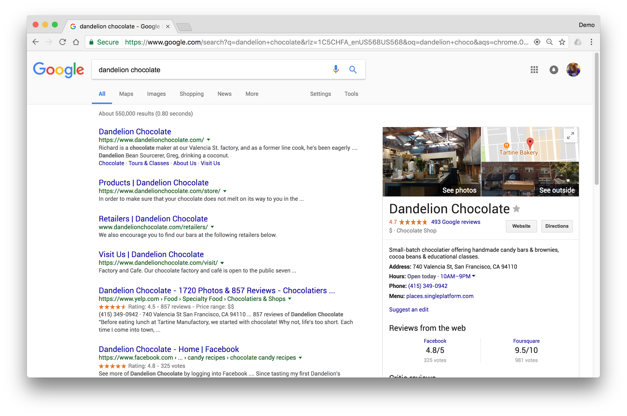
Connect with customers when they search Google
GET FOUND ON GOOGLE SEARCH AND MAPS
Notes:
Take a look at this example, “Dandelion Chocolate” in San Francisco, California.
You can see how their business details appear on this search engine results page.
Creating a business listing helps you control the details Google displays, so they’re up-to-date and consistent across Search and Maps.
It won’t guarantee that your business will appear in the search results, but it can help.
Google My Business doesn’t replace a business website, but it can help your listing stand out in the search results and on the Map, and send potential customers to your site.

Slide 4
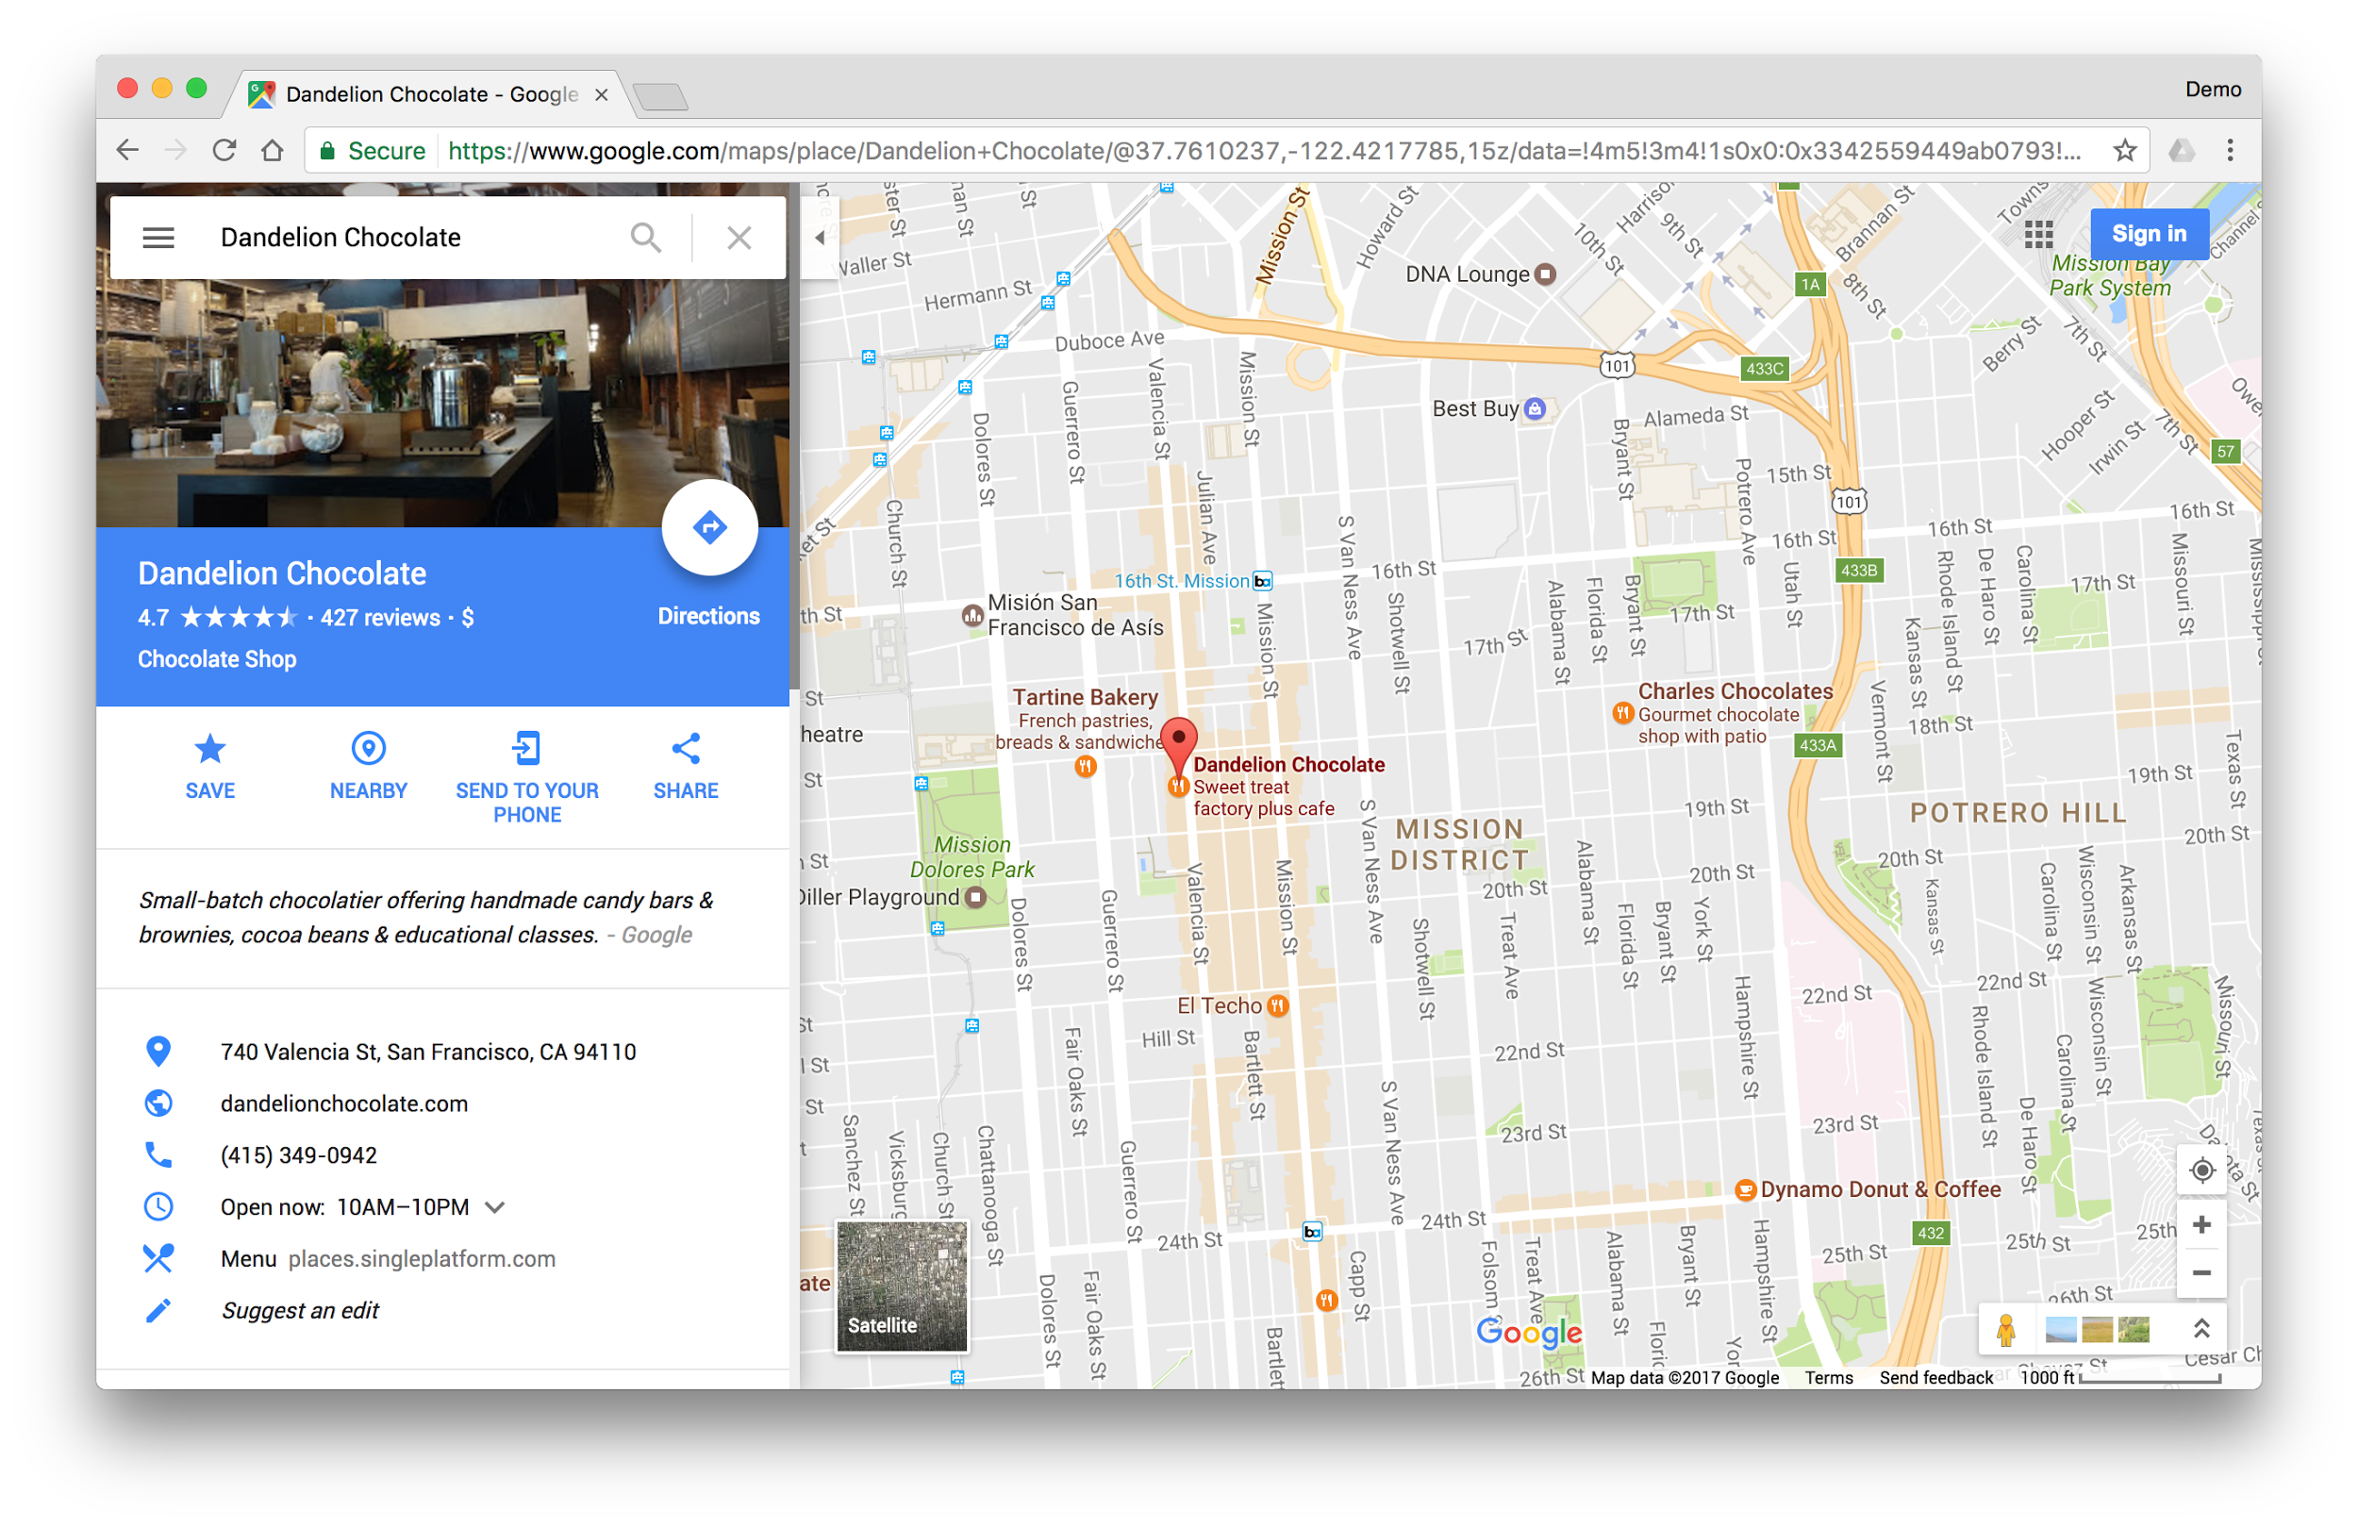
Connect on Google Maps
GET FOUND ON GOOGLE SEARCH AND MAPS
Notes:
People visit 1.5 billion destinations every month related to their Google Searches. Source: Google Data, Mar. 2016.
People are searching locally: there are billions of local searches made monthly, and more than 30% of all mobile searches are related to location (1) SOURCE: Google internal data, Jan 2017
Businesses with storefronts open to customers—and those that meet with customers in local service areas—can appear on Google Maps.
These listings help searchers find businesses nearby.
Google Maps also considers other factors, like relevancy, distance, and prominence.
Relevancy is how well a business listing matches a search. If your listing is detailed and up-to-date, Google is more likely to show it for relevant searches.
Distance is just like it sounds: how close is the business to the searcher, or the area specified?
And, prominence is gauged by how well-known the business is, based on information Google can find across the web.

Slide 5
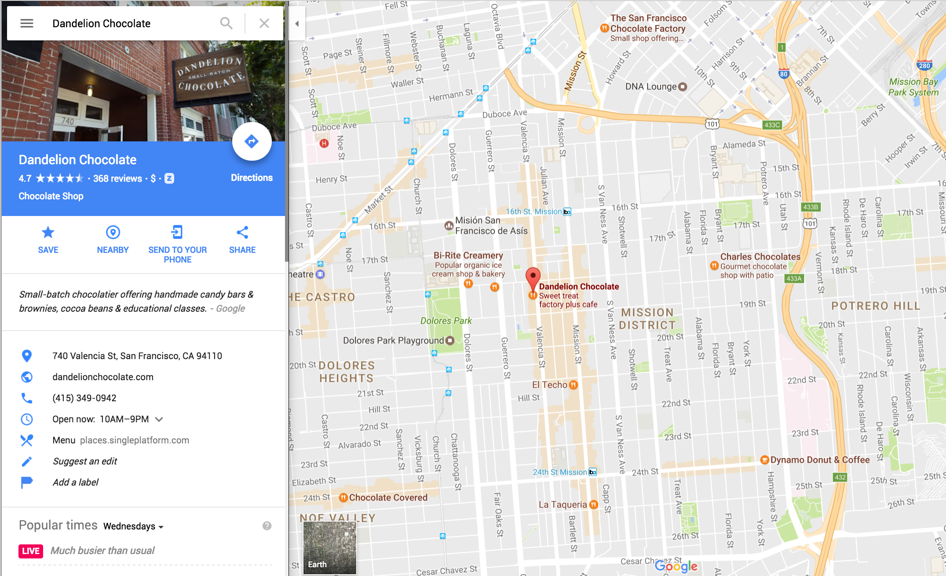
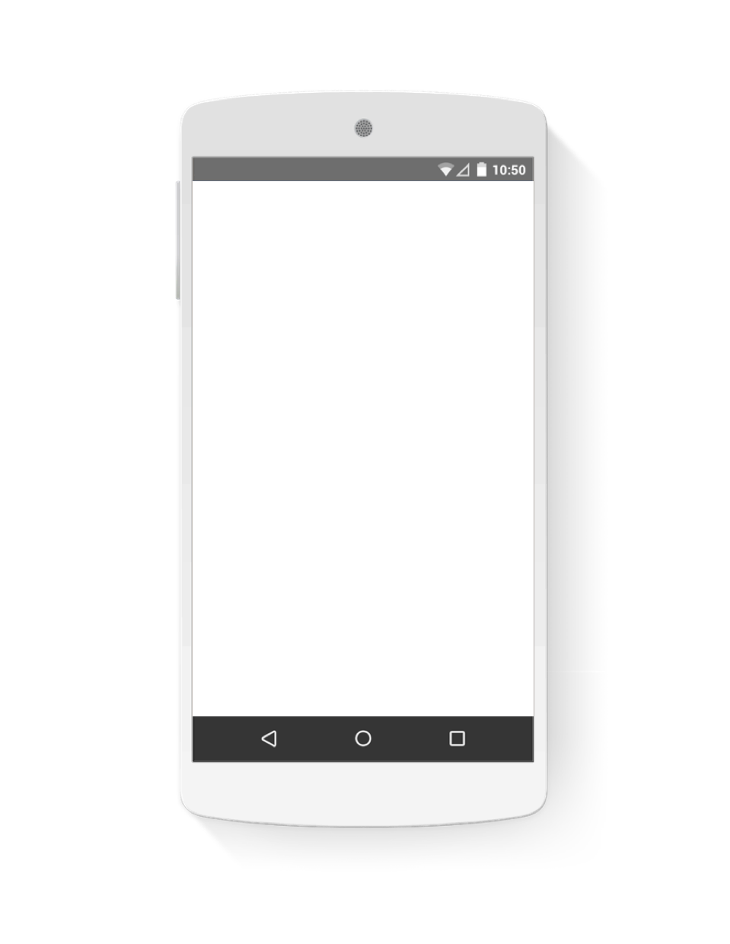
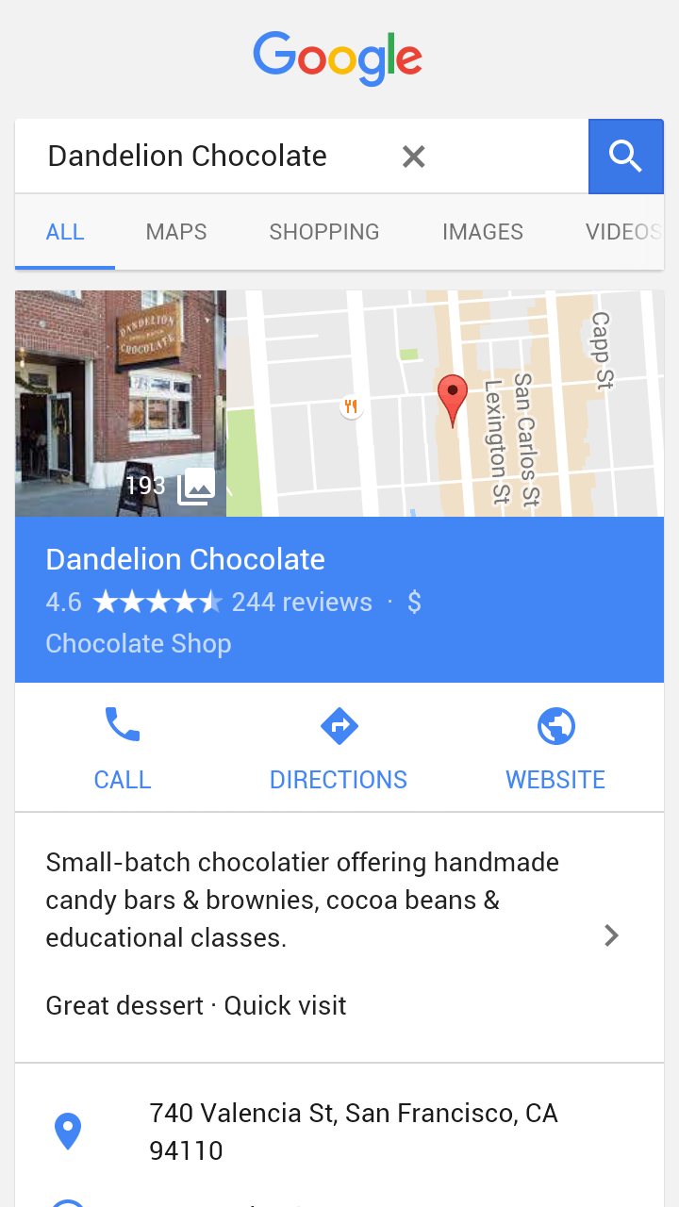
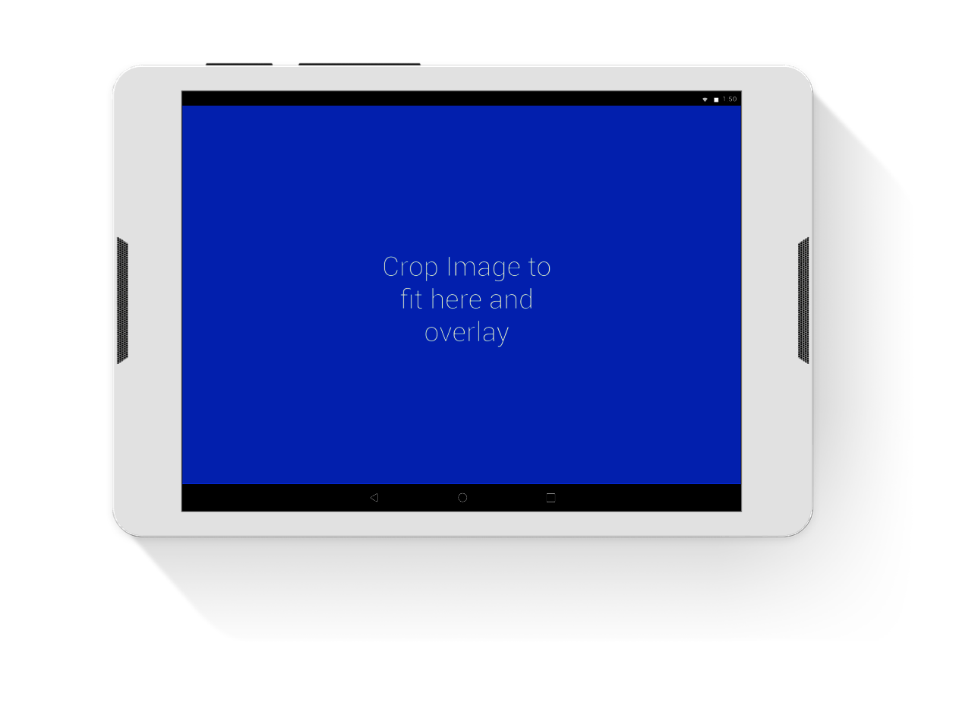
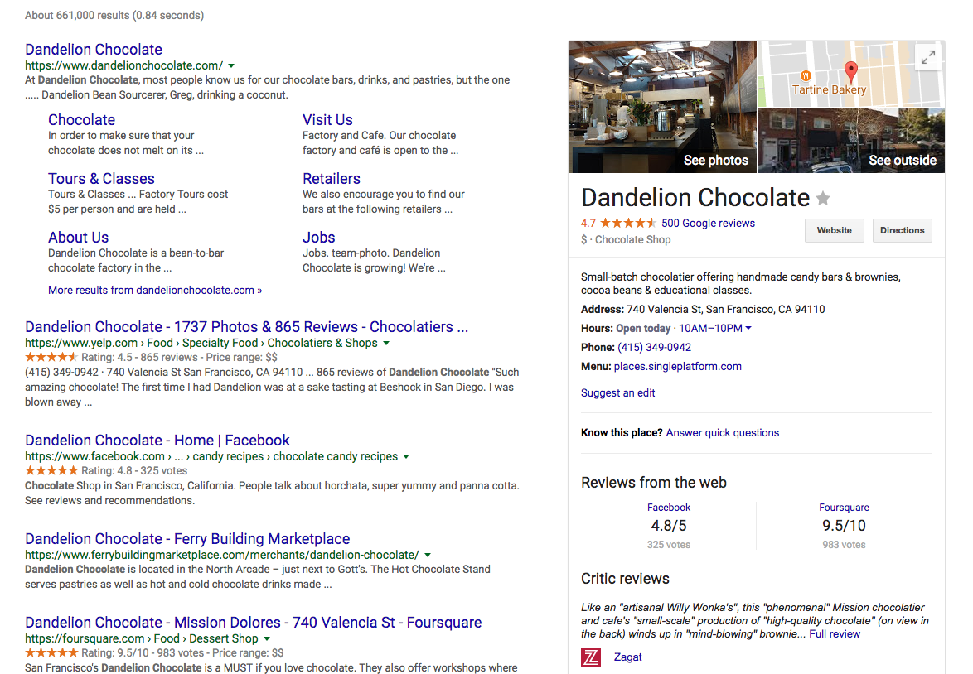
Connect across devices
GET FOUND ON GOOGLE SEARCH AND MAPS
Google My Business works on desktops, laptops, tablets, and mobile phones.
Notes:
It’s critically important that a business appears—on any device—when consumers want to know, go, do, or buy.
Every day, consumers turn to whatever device is handy to act on their needs.
Smartphones have become indispensable shopping tools, and many people rely on them to do research and make purchases.
It’s a significant trend: shopping-related searches on mobile devices have grown more than 120% year-over-year. (Source: Google Global search data, September 2014 to September 2015, as defined by searches that trigger Shopping ads.)
And, it’s no longer true that people "look on mobile but buy on their computers."
30% of all online purchases now happen directly on smartphones. (Source: Google Analytics Data, September 2014 v. September 2015, U.S)
And, being found online supports in-store sales. 6 in 10 internet users check whether a product is available in a local store before visiting a store. Source: Google/Ipsos Connect, GPS Omnibus, n=2,013 U.S. online respondents ages 18+, Mar. 2016.
Google My Business makes it easy for your listing to appear on all devices.
It works on computers, laptops, tablets and smartphones, so potential customers can find you, no matter how they get online.
***
Google Global search data, September 2014 to September 2015, as defined by searches that trigger Shopping ads.
Google Analytics Data, September 2014 v. September 2015, U.S.

Slide 6
Notes:
Let’s take a look at this short video that introduces Google My Business.
Link to video file: https://drive.google.com/open?id=1HxtDxgbfmmR7PKTCkxu48HKHn8pn6Cmn

Slide 7
Get your business on Google for free
Notes:
To qualify for a business listing, a businesses must meet with customers face-to-face, at a store or within a specified local service area.
Businesses must have a location that receives mail (in other words, not a general vicinity, or a parking lot). However, the address is not required to be public, as in the case of a service provider who has an office in a residential home who works with customers at their locations.
Here are a few examples of ineligible businesses:
Online or telemarketing businesses
Events held at a temporary location
Businesses that operate sporadically or at temporary locations, like most farmers’ markets
Displays of products within a store
Vacation homes, rental properties, or properties for sale
Businesses that haven’t yet opened (Prematurely verifying a business may result in its removal. Do not verify a business unless it is fully open and operational, even if they are taking future reservations or hiring staff.)
Brand pages are for businesses and entities that aren’t “local” - like online-only companies, artists, and organizations.
Brand listings can appear on Google Search, but won’t appear on Google Maps.
This workshop focuses on setting up a Google My Business listing, for businesses with storefronts or service areas.
NOTES FOR SPEAKER:
For verifications on site, you must only verify the business where you are physically present.
For verifications at events, you can verify up to 10 listings per owner/person provided that they bring the required documents for each one of those businesses.
For Bulk Verification: send them to Help Center: support.google.com/business/answer/4490296

Slide 8
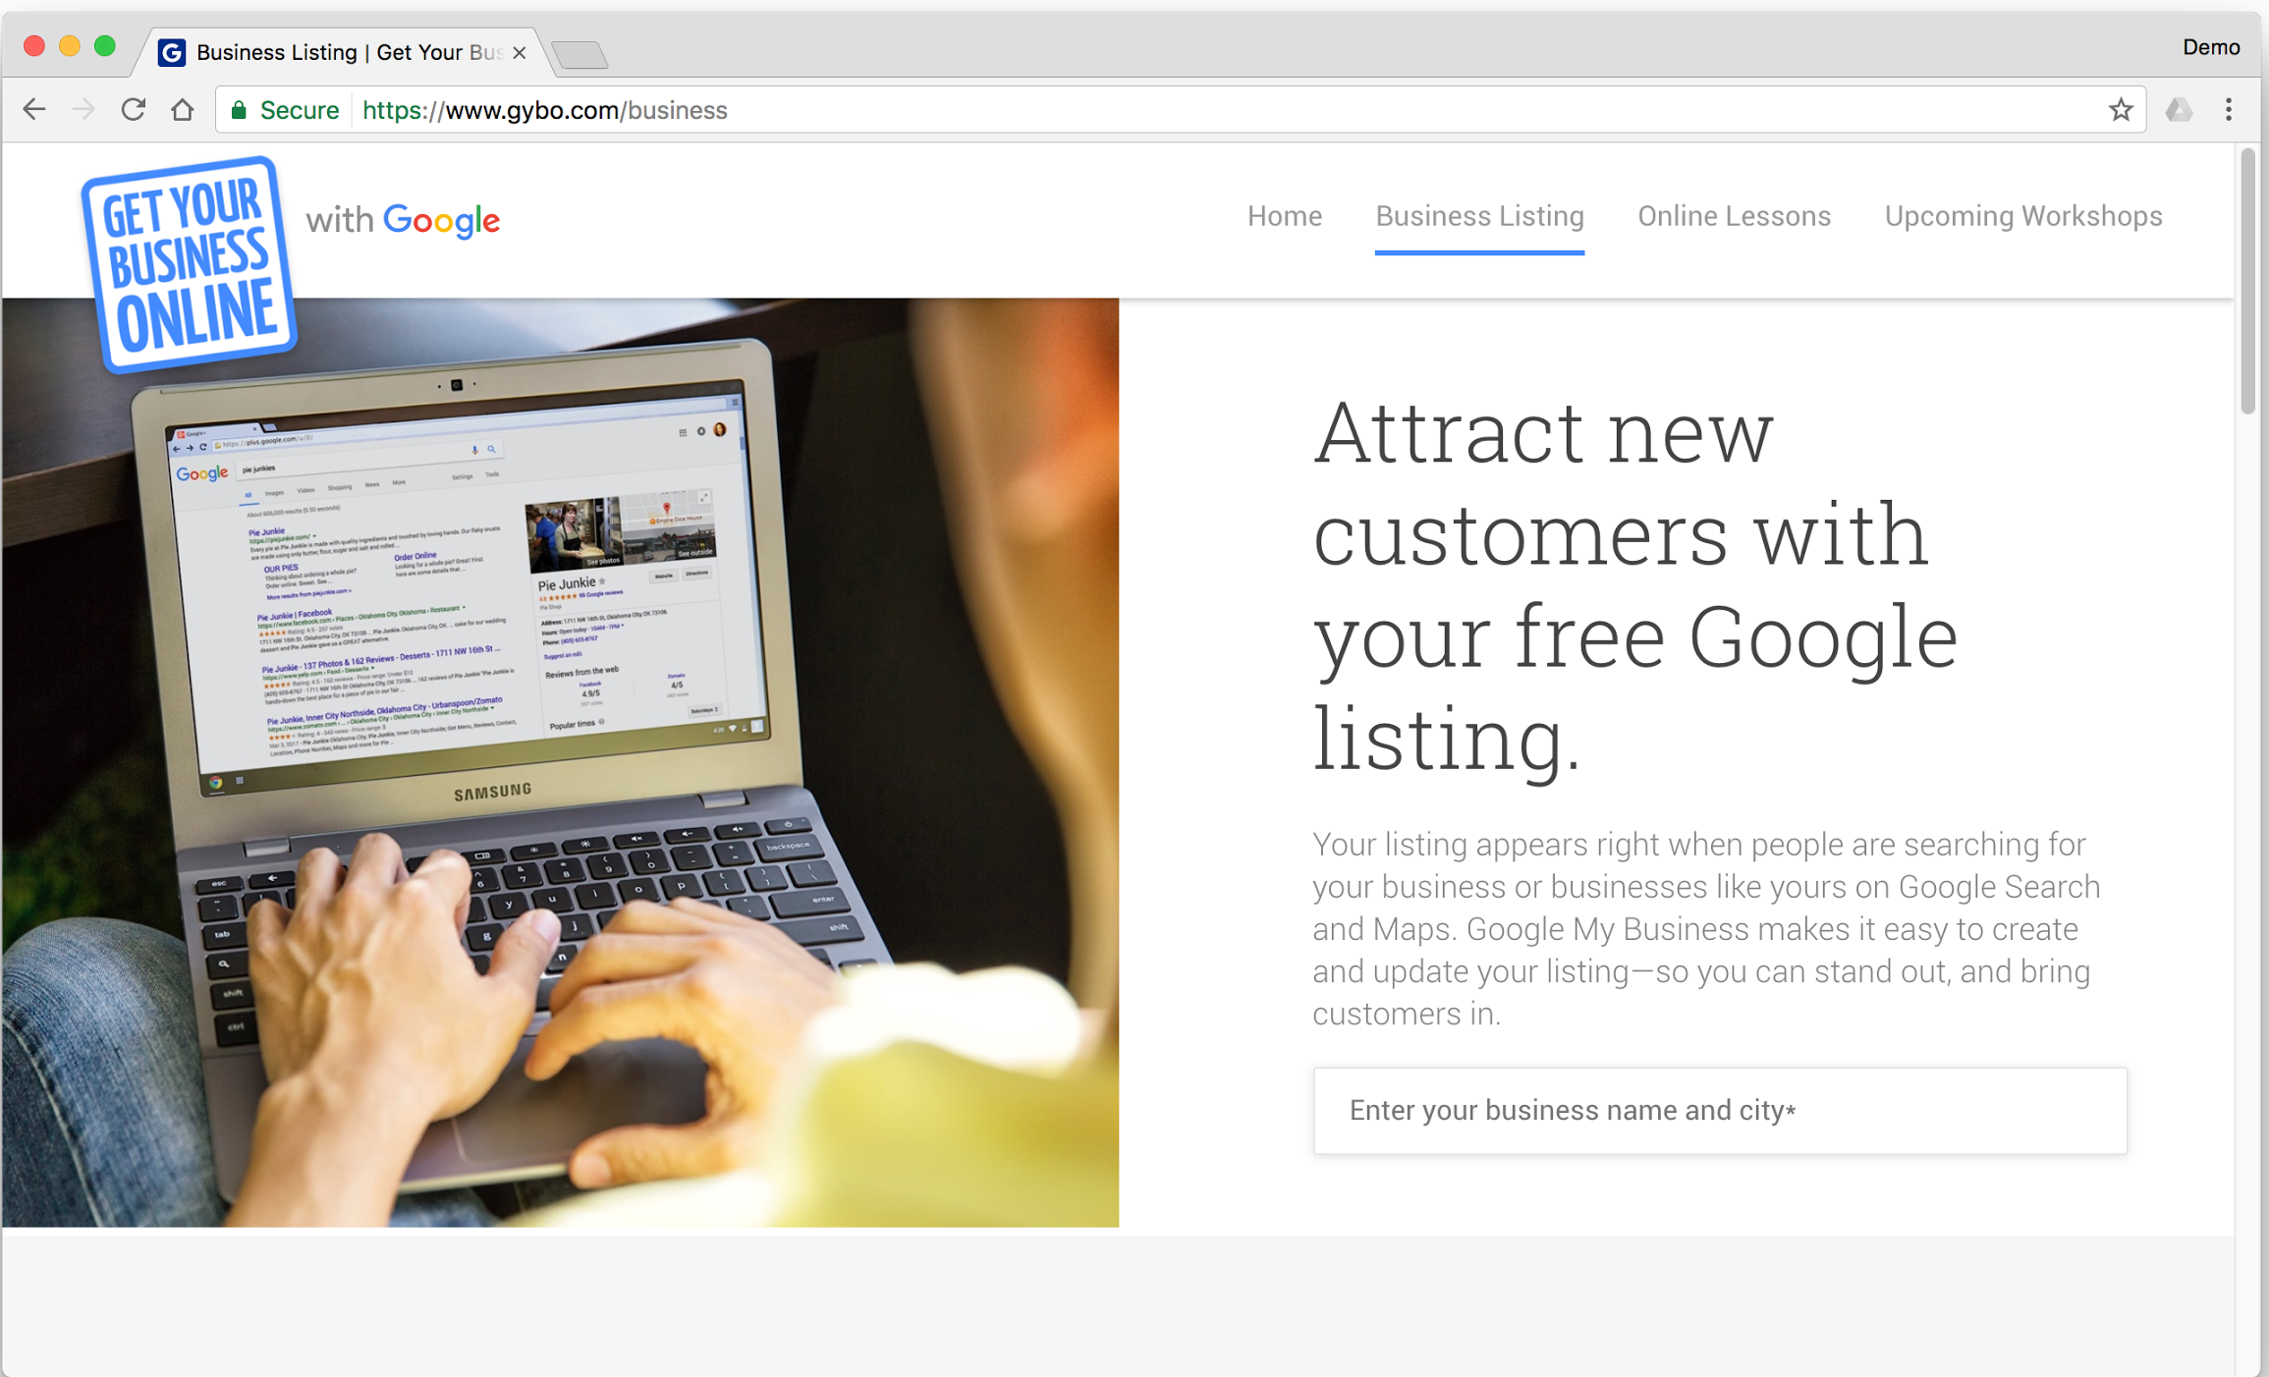
Step 1: Search for your business
GET YOUR BUSINESS ON GOOGLE FOR FREE
Enter your business name and city to see if your business appears on Google Search and Maps
gybo.com/business
Notes:
Let’s start by seeing if—or how— the business appears across Google.
Open a web browser like Google Chrome and visit: www.gybo.com/business
Click the button labeled “View my listing.”
Type in the name of the business; it may appear below as you type it in.
If you see the business in the list, click on it.
Otherwise, type in the complete business name and click “Not showing up? Add your business info.”

Slide 9
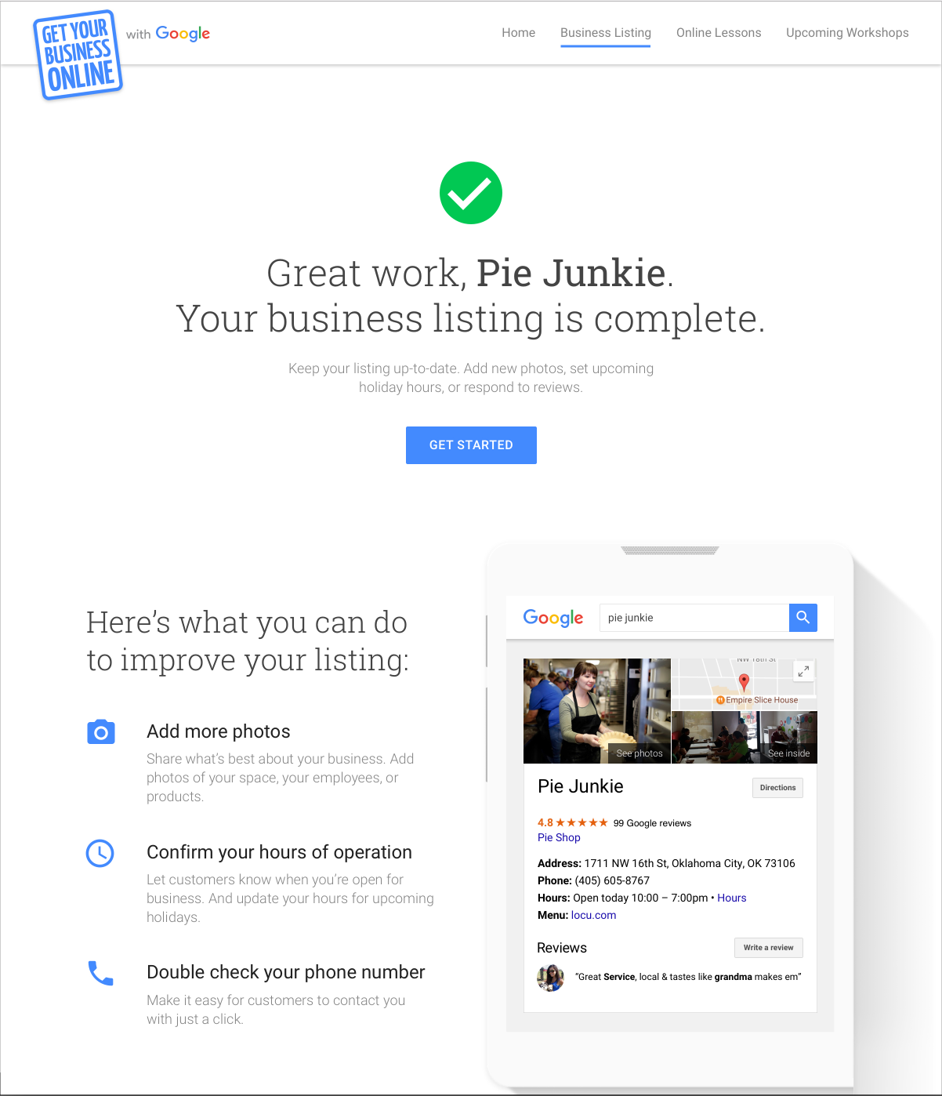
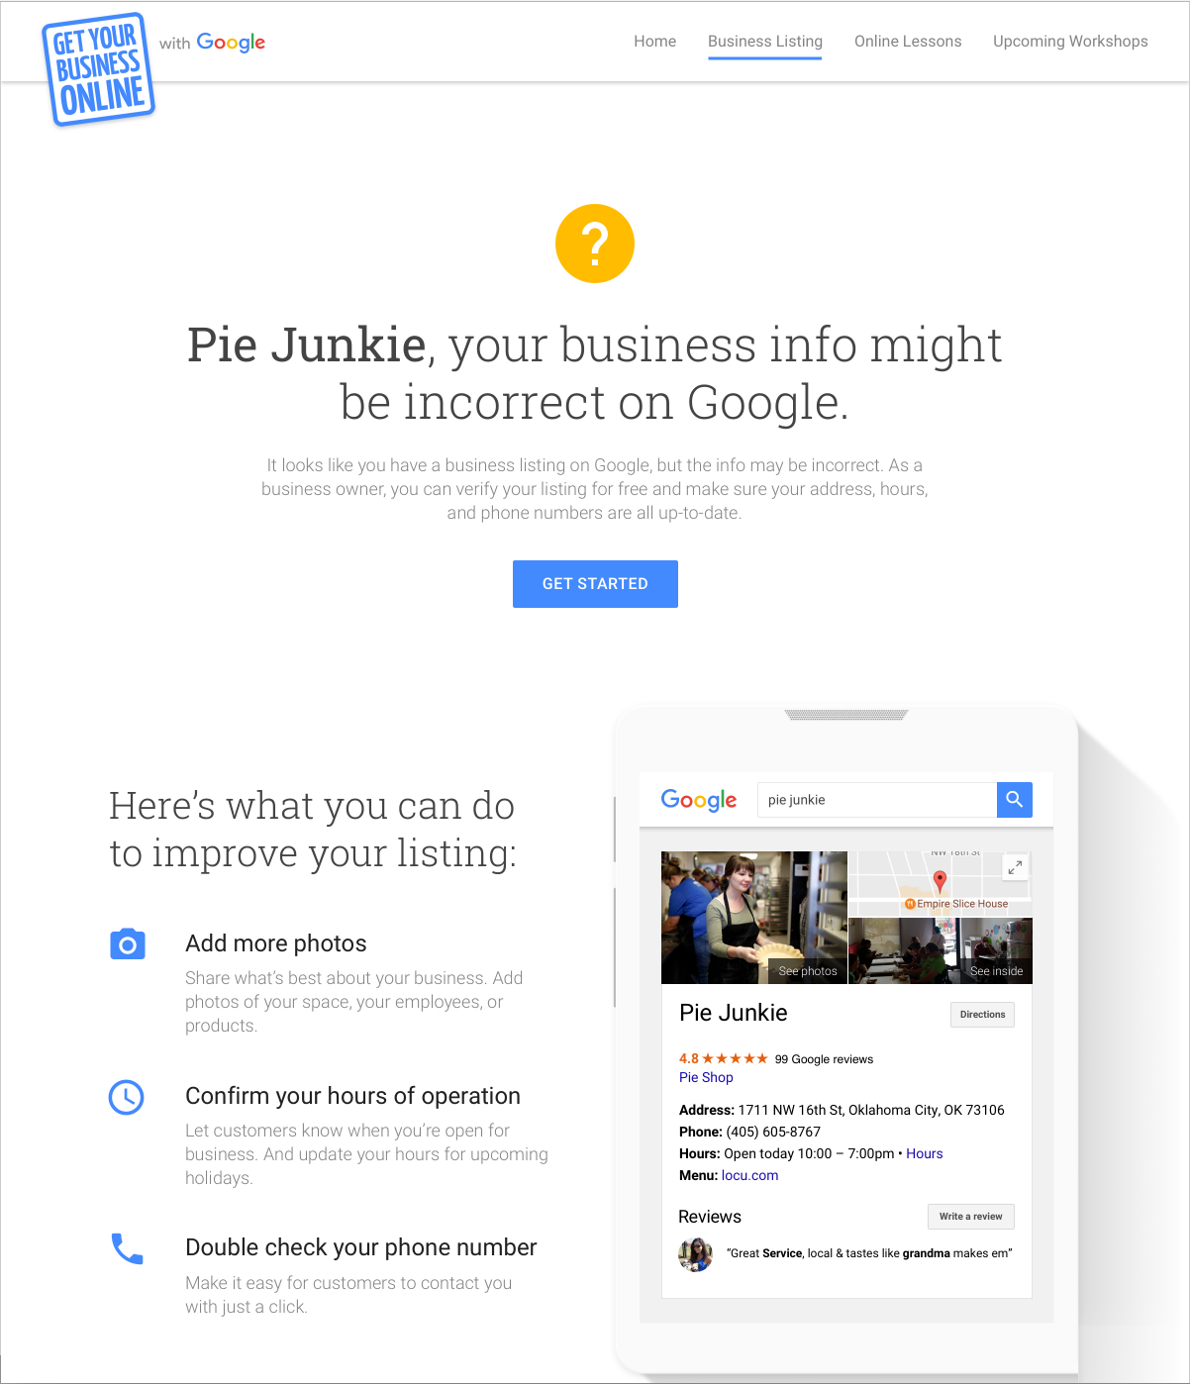
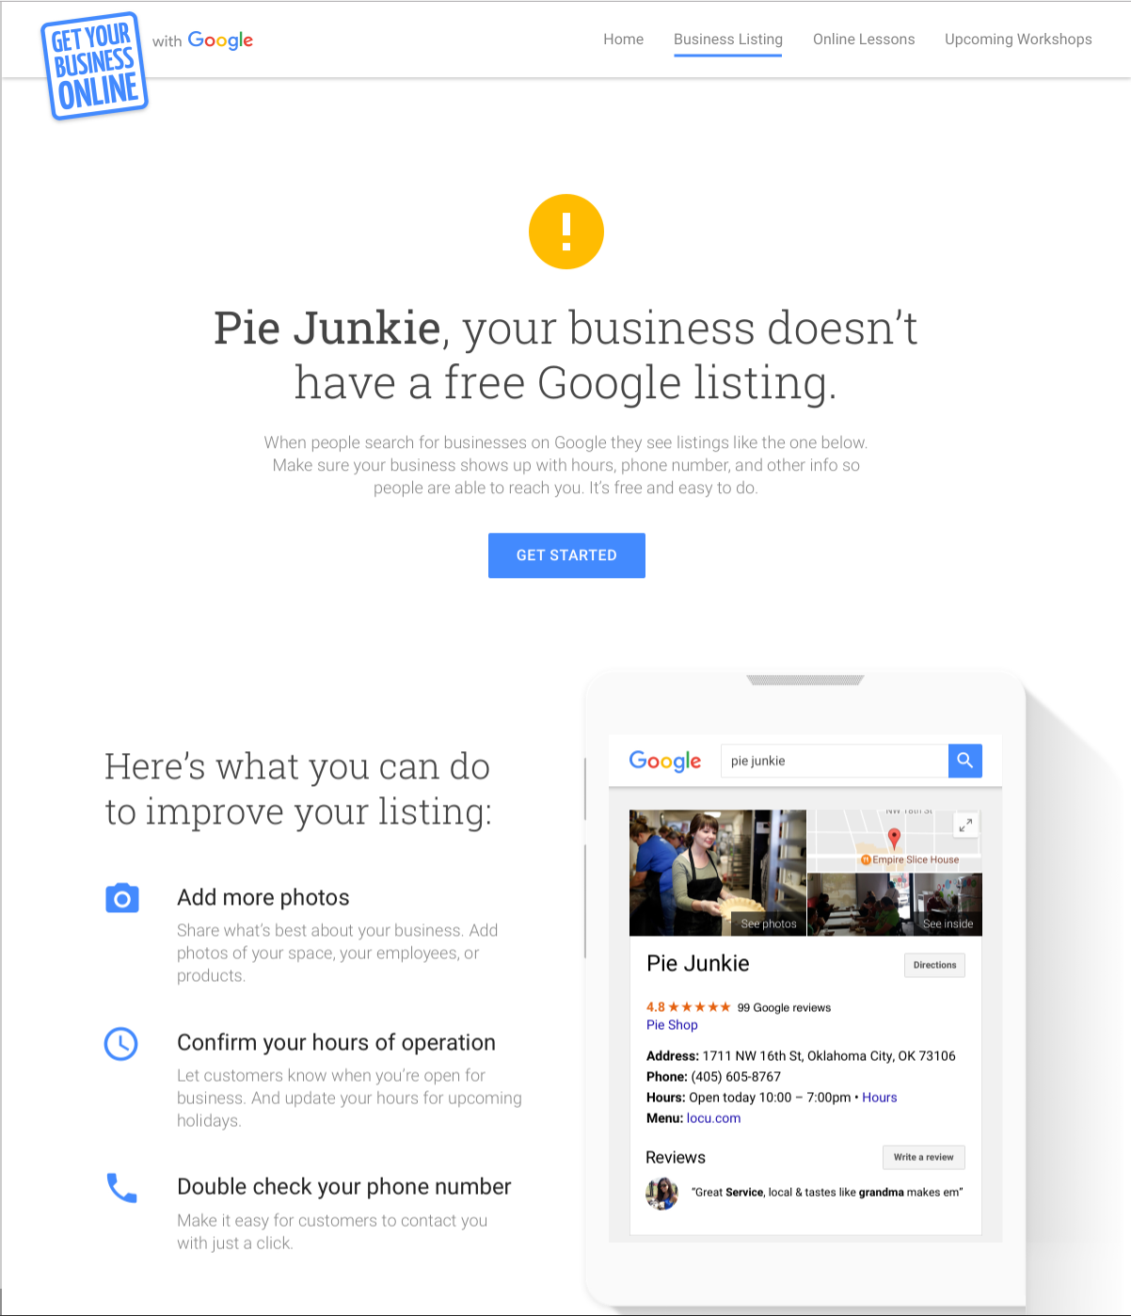
Is your business info complete?
GET YOUR BUSINESS ON GOOGLE FOR FREE
Update info
Verify info
Create listing
Notes:
This triggers a diagnostic tool that tells you whether or not the business can be found on Google. There are three possible outcomes.
The first: “Great work. Your business listing is complete.”
This means the business is verified, that is, the business owner— or someone authorized to manage the business— can sign in and make updates that can appear on Search and Maps.
You can see suggestions for keeping the business information accurate and up-to-date, plus a preview of the listing as it could appear on Google. If sections are missing information they are highlighted for your attention.
To access Google My Business from the diagnostic tool, click the “Get started” button.
You will need to sign in to Google My Business with the Google username and password associated with the listing.
The second outcome: “Your business info might be incorrect on Google.”
This means your business information may appear on Google, but the location is unconfirmed and the listing hasn’t been claimed, or verified.
If this is your business, you can verify it to confirm the location by clicking the button labeled “Get Started.”
This starts the verification process. I’ll explain how that works in a few minutes.
The third outcome: the diagnostic tool can’t find any information about the business and you see: “Your business doesn’t have a free Google listing.”
Click “Get started” to create a listing.
NOTE FOR SPEAKER, IF IT COMES UP: What to do if there’s already a verified page for the business, but the owner cannot access
Step one: sign in to any other Google accounts you can access and see if you can find the verified listing. If you find it, you can manage it there or transfer ownership to a different account.
Step two: if you can’t locate the listing in an existing Google account, start the process of creating a new listing. You should see your existing listing appear in a list of results. Select your business. Then, you will see the option to request admin rights from the current owner. Don’t try to create and verify a duplicate listing; the system will detect and disable it.
Step three: If there is no response from the owner, the process to let you claim the listing will continue. Remember to check your email.
Need help? Contact Google My Business support or the friendly Get Your Business Online with Google team.

Slide 10
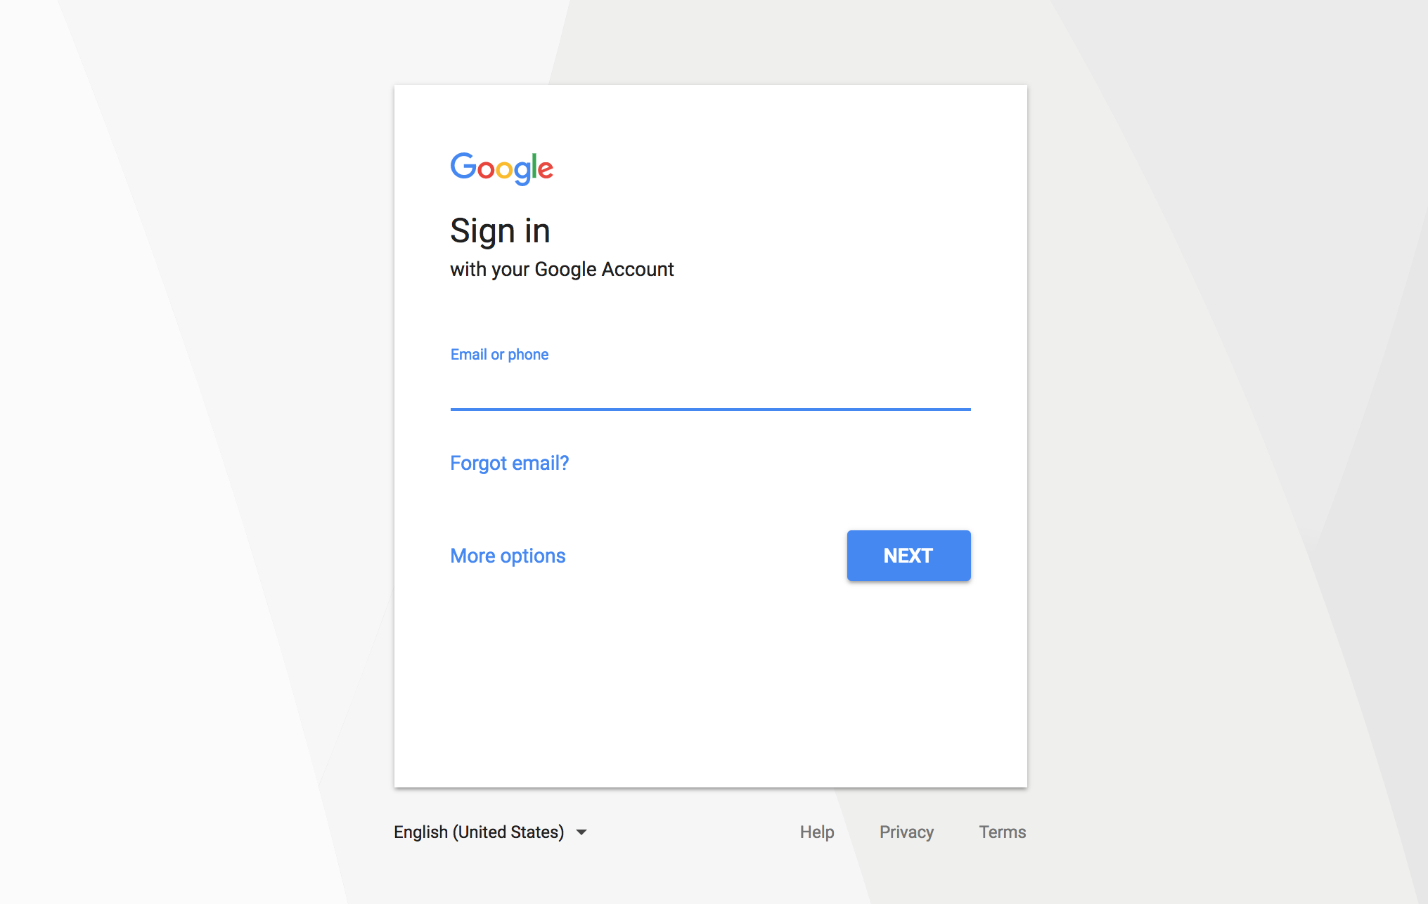
Sign into your Google Account
GET YOUR BUSINESS ON GOOGLE FOR FREE
If you don’t have a Google Account, click “More options” to get started
Sign into the Google Account you use for your business
google.com/accounts
Notes:
Before using many of Google’s products, you need to set up a free Google account.
This provides a single sign in (username and password) that lets you access all the connected Google products.
For example, if you sign into Gmail (which is automatically a Google account), you do not need to sign in again to access your calendar and docs - they are all connected.
If you don’t use Gmail, you can register another email address as a Google account by visiting www.google.com/accounts.

Slide 11
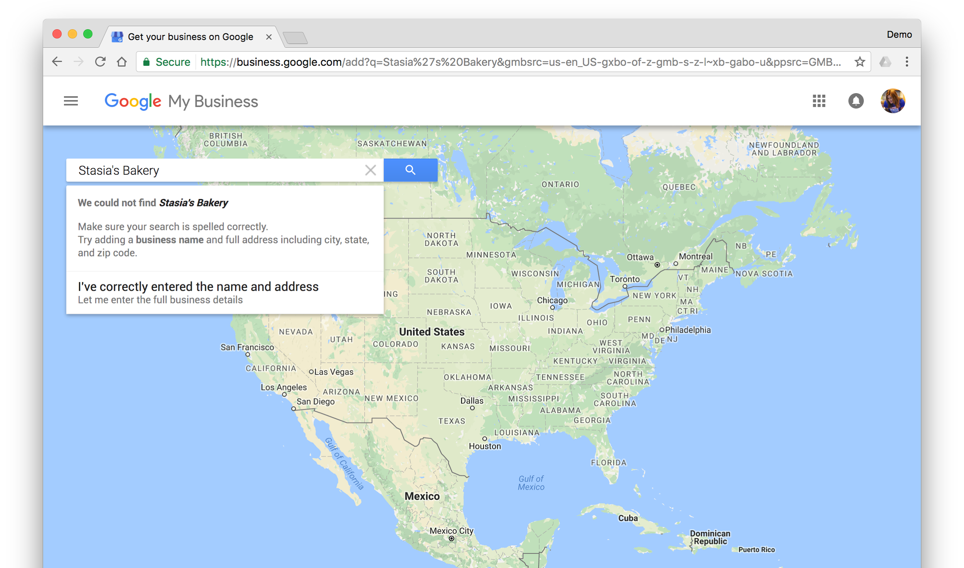
Step 2: Select your business or add it
GET YOUR BUSINESS ON GOOGLE FOR FREE
See your business in the list? Click it to continue. Don’t see your business? Click “Let me enter the full business details.”
Notes:
If you see a list of businesses, scan the results to see if yours appears.
If it does, click on it. This skips you ahead one step.
You won’t enter business details you’ll immediately be asked to “Confirm your business.”
Don’t worry if you want to make changes to your information - I’ll show you how to do that within Google My Business after you’ve confirmed the listing.
If the business doesn’t appear in the list— or you don’t see any options listed— click the link labeled “Let me enter the full business details.”

Slide 12
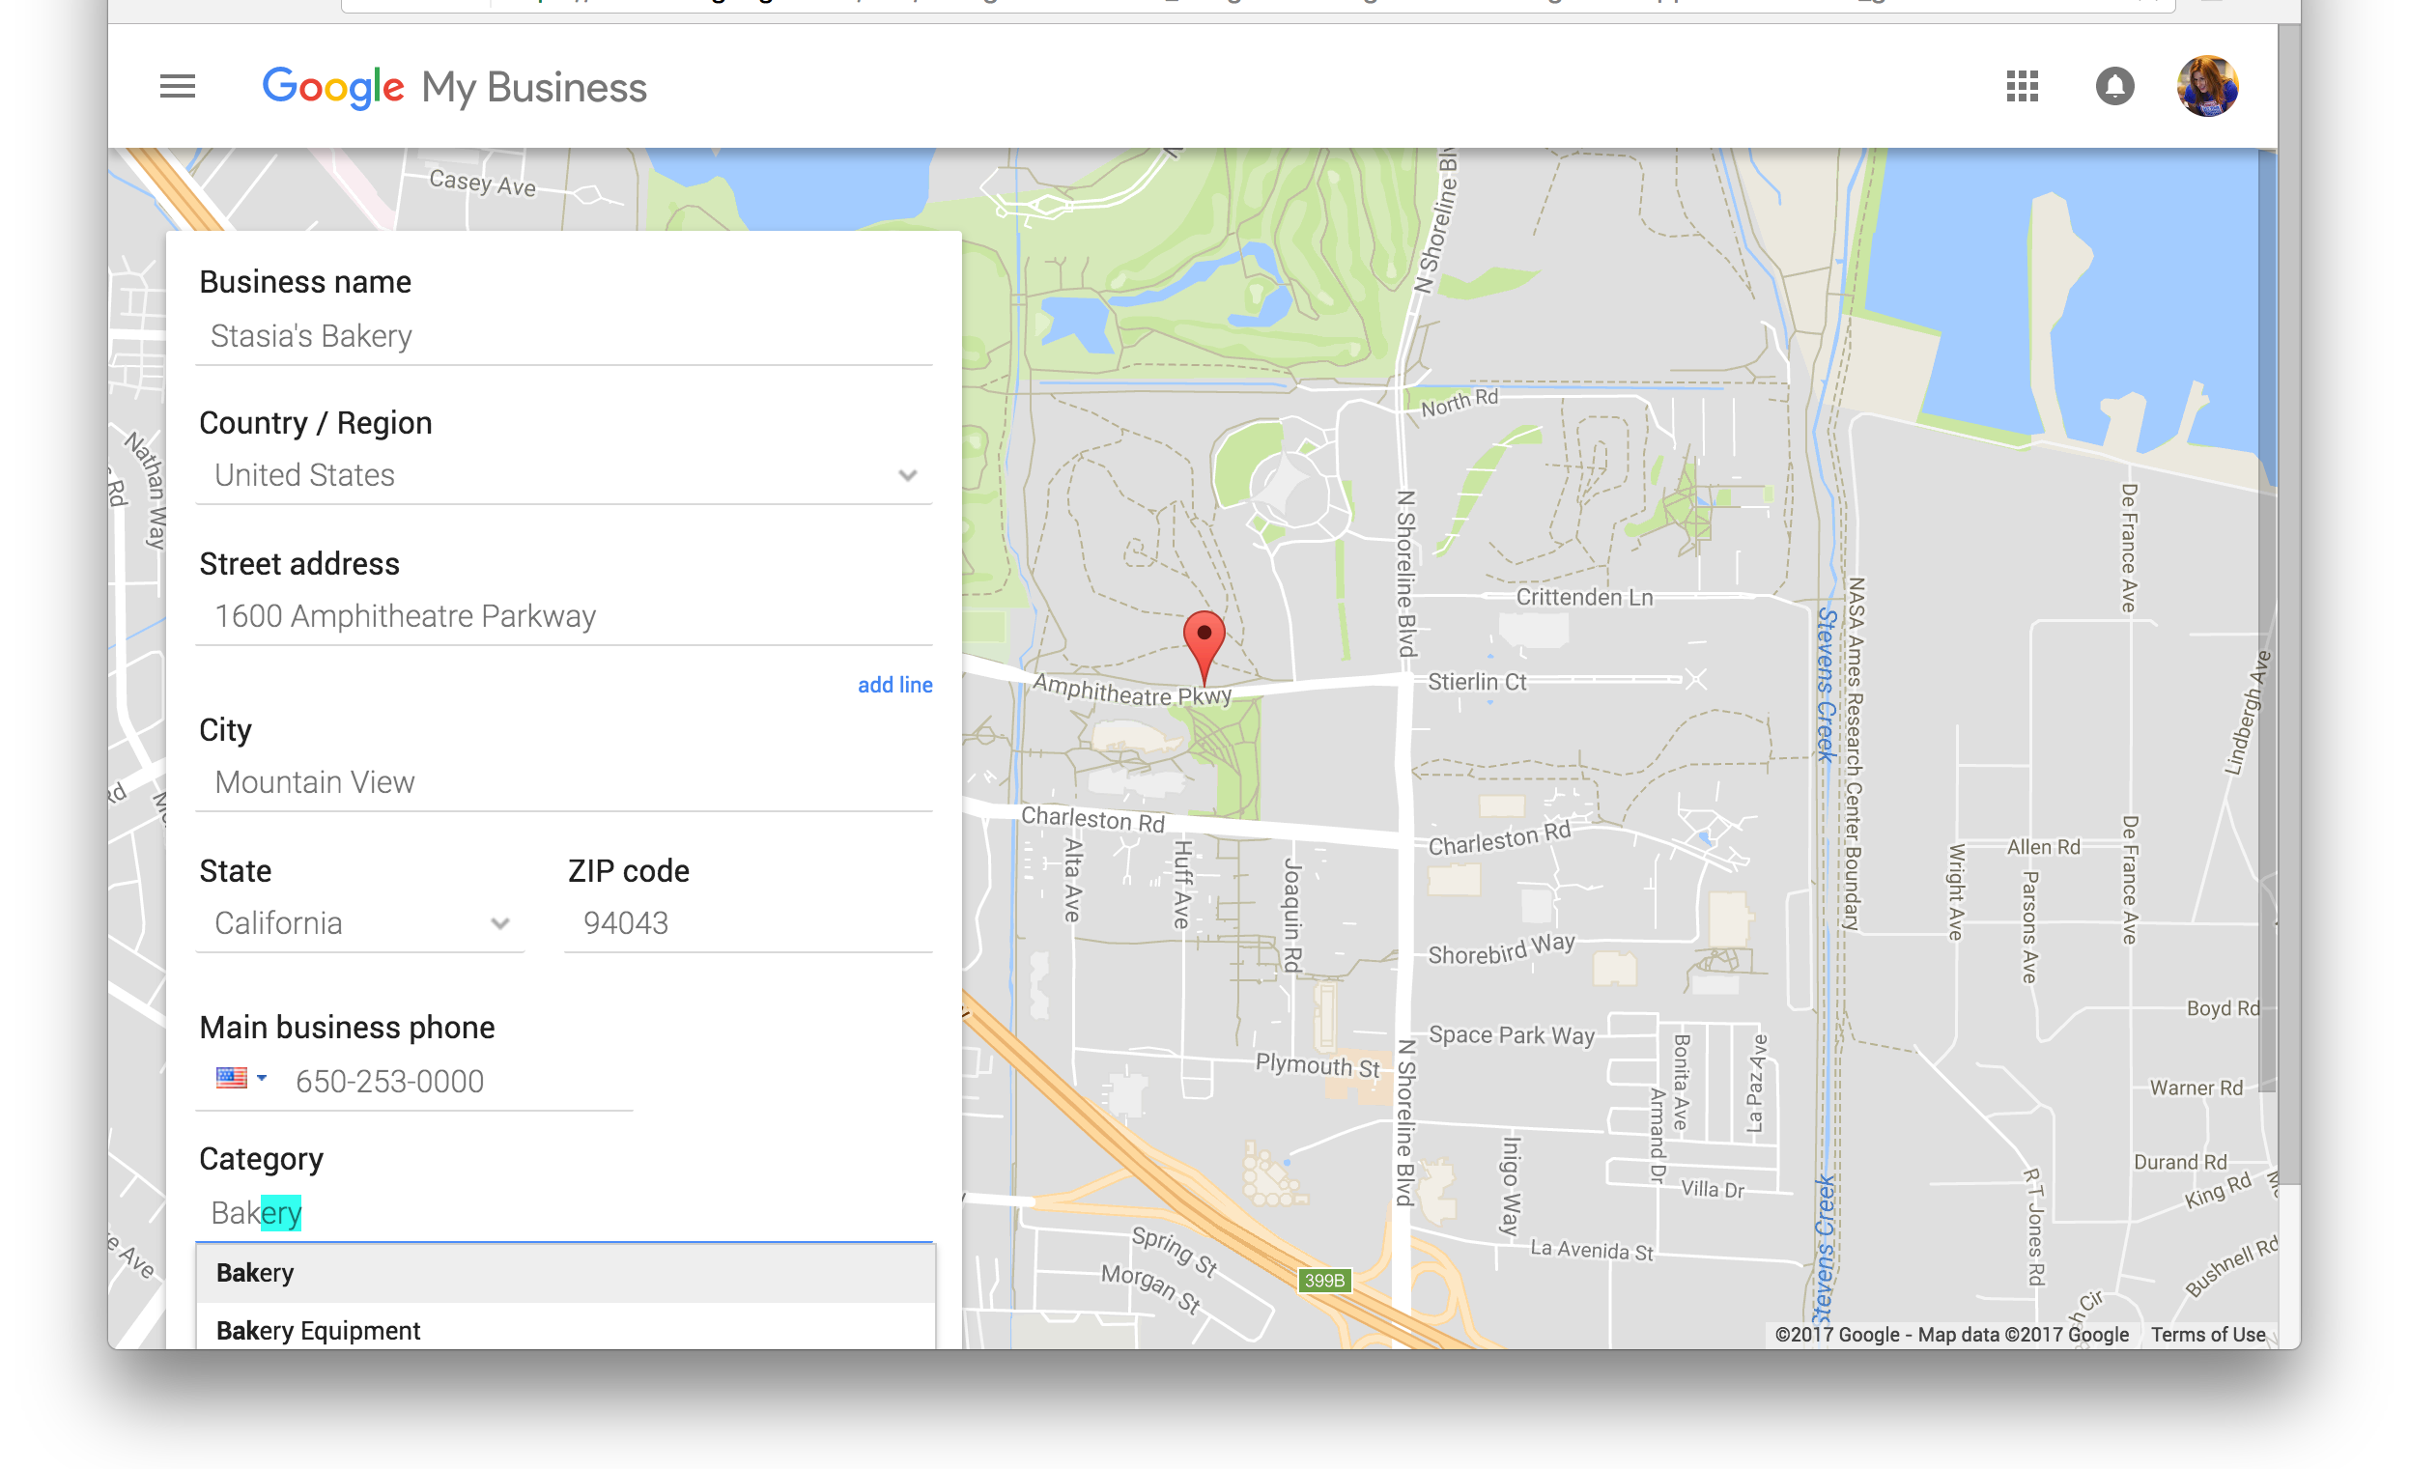
Step 3: Enter your business details
GET YOUR BUSINESS ON GOOGLE FOR FREE
If you can’t find the perfect category choose something close
Notes:
If you you clicked “Let me enter the full business details” you will see this page that asks you to enter your business information.
Now you’ll enter information about the business.
Pay attention to spelling and capitalization - this is what potential customers could see across Google.
Here are a few guidelines:
The business name must match the legal name. Nicknames, slogans, geographical landmarks, cross streets (etc.) should not be included. If a business has multiple locations, do not add location differentiators unless they’re part of the legal name. Do not enter the name in all capital letters unless that's the official business name.
Enter the complete, official street address for the business.
Please don’t include extra details, like cross-streets or nearby landmarks.
You can add suite or office numbers on the separate address line.
PO Boxes are not allowed.
You also need to select a category for the business.
Start by thinking of a category you’d like to use, then type in a few letters to see what options appear below.
You must choose an existing category - you can’t edit or create them.
It’s OK if you can’t find the perfect category, just choose something close.
NOTES FOR PRESENTER:
Businesses that use PO boxes and cannot receive mail at their physical address cannot be verified via the Trusted Verifier App. Instead, submit verification requests at: www.gybo.com/verifymybusiness. These listings must be manually approved by Google.

Slide 13
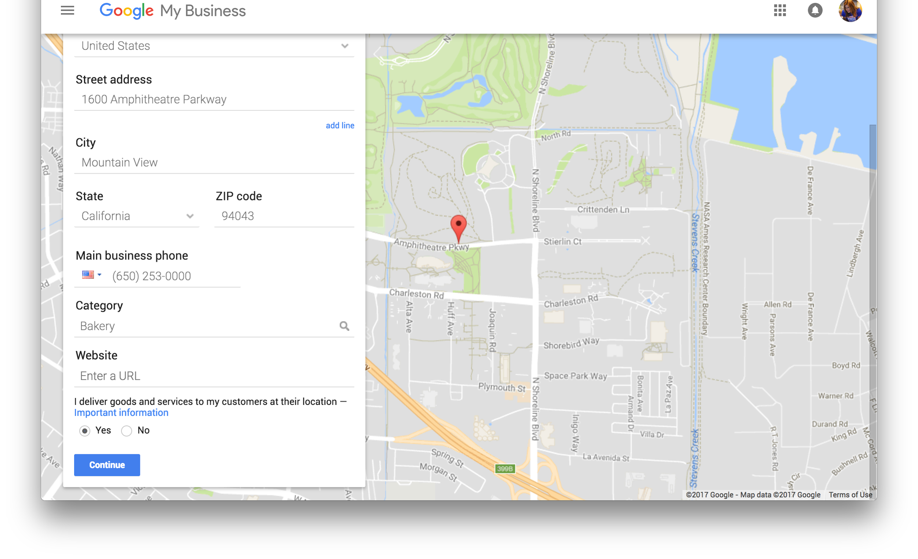
Do you work from home?
GET YOUR BUSINESS ON GOOGLE FOR FREE
Keep your residential address private.
Select “Yes” if your business serves customers at their locations. Then, click “Continue” to set up a service area.
Notes:
Many local service-area businesses operate out of private homes.
These businesses can still appear on Google Maps without displaying the address or driving directions.
Here’s how you do it.
At the bottom of the page, look for the section labeled, “I deliver goods and services to my customers at their location.”
Check the radio button labeled “Yes.”
Now you’ll set a service area.
You can define the service area by adding cities and ZIP codes, or specifying a radius.
Keep in mind that the service area is intended for a local presence on Google Maps.
It’s not a way to advertise the business nationwide or worldwide.
Even if the business ships products or offers services anywhere, the radius should reflect a local area.
Google does not have an official recommendation for the size of a service area—it depends.
For example, in a densely populated area, like NYC, the radius might be 5 miles.
In a rural area, the radius might be 100 miles.
Choose a distance that makes sense for your business.
If the business has a service area and a storefront open to customers, check the box labeled “I also serve customers at my business address.”
This allows the address and the service area to appear on Google Maps.
When you’re done, click “Continue” to go to the next step.

Slide 14
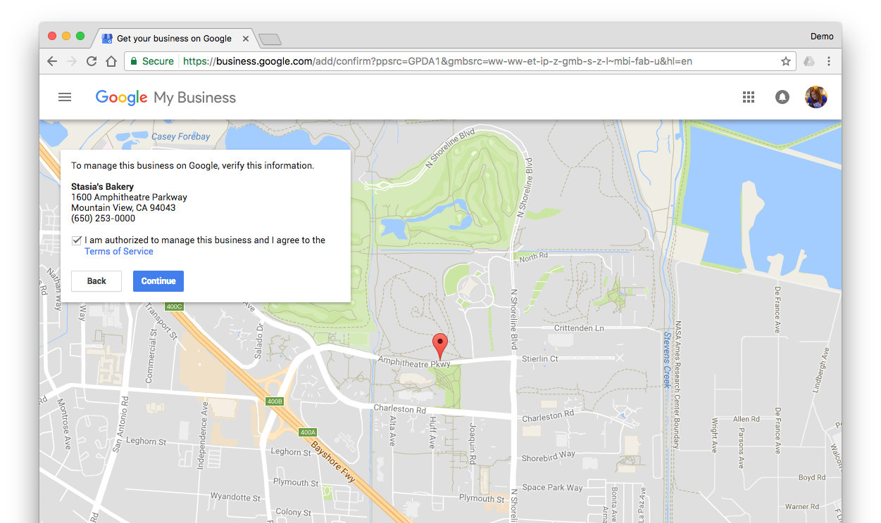
Step 4: Confirm your business
GET YOUR BUSINESS ON GOOGLE FOR FREE
Agree to the
Terms of Service and click “Continue”
Notes:
Now, review the information carefully.
Click the back button to make any corrections.
Review Google’s Terms of Service by clicking on the hyperlink
If everything looks good, check the box to indicate that you are authorized to manage the business information and agree to Google’s Terms of Service.
Then, click “Continue.”

Slide 15
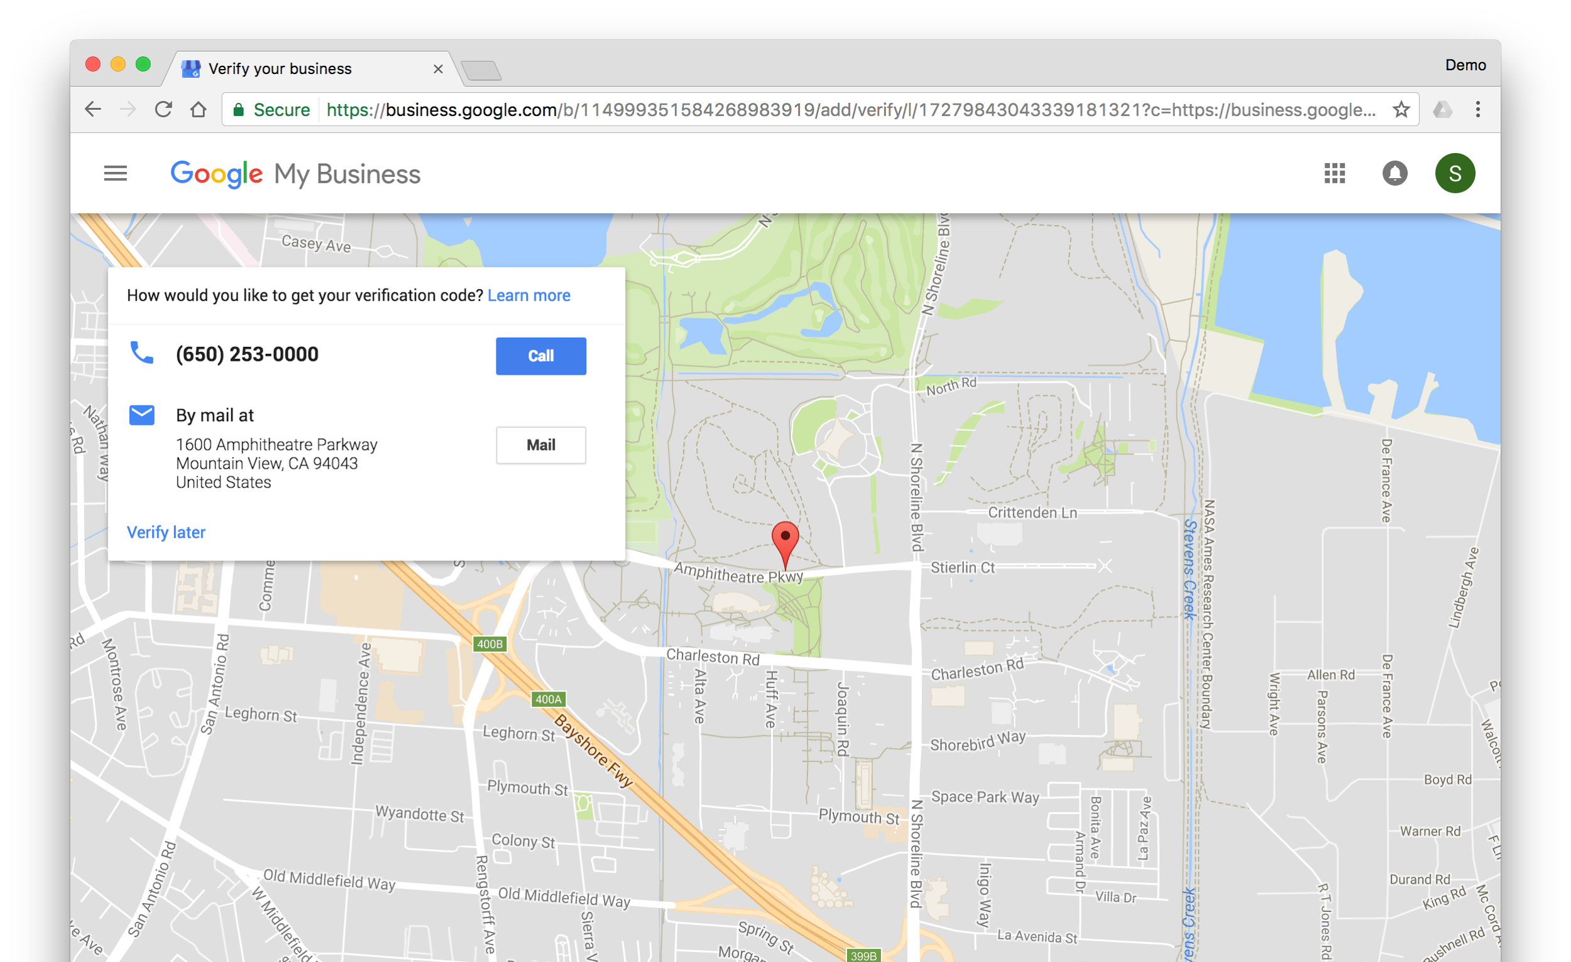
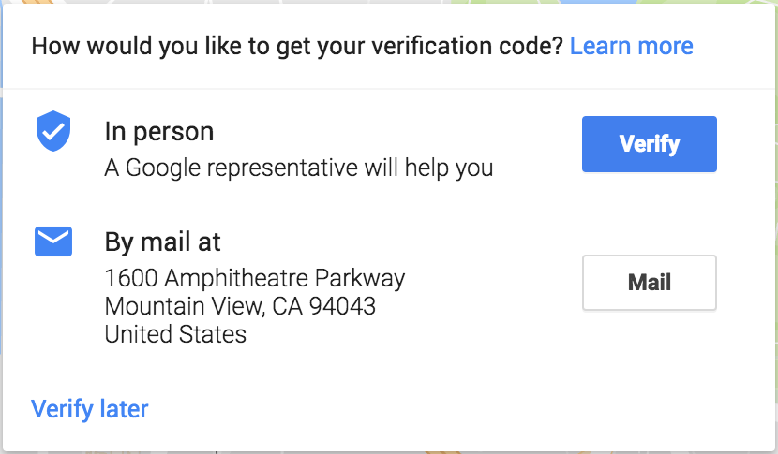
GET YOUR BUSINESS ON GOOGLE FOR FREE
Step 5: Verify your business
Double-click here to access in person verification
Click “Verify” to see your QR code. Don’t have your documentation with you? No worries! Click “Verify later.”
Notes:
Step 5: This starts the verification process, to confirm the business location and your authorization to manage the listing.
Verification options will appear.
IF PRESENTER HAS ACCESS TO TRUSTED VERIFIER APP:
Attending this workshop provides an option available exclusively through Google’s Trusted Verifier program.
If you have access to the “In Person” verification option; AND you have one or more of the following original documents you are eligible:
Utility bill(s)
Tax letter(s)
Business registration certificate(s)
The documents must show the business name and address.
If you have one of these documents in-hand, doubleclick the sentence that says “How would you like to get your verification code?”
A dialog box will appear with an “In person” option. Click the button labeled “Verify” next to the “In person” option.
IF PRESENTER DOES NOT HAVE ACCESS TO TRUSTED VERIFIER APP:
Attending this workshop provides an option available exclusively through Google’s Official City Partners Program.
You do NOT need to request a postcard, because we will verify you another way.
Click the link labeled “Verify later.”
NOTES FOR TRUSTED VERIFIER/ SPEAKER:
Some businesses may not qualify for Instant Verification and the “In person” option will be unavailable. In this case, you can offer access to the Expedited Verification option, which is covered in an upcoming slide in this presentation.
Trusted Verifier MUST be familiar with the acceptable types of documents.
Copies are NOT acceptable, all documents must be original.
Business cards are NOT sufficient for verification with the Trusted Verifier app.
In the absence of required documentation, you should not verify the business using Trusted Verifier. However, the business owner can request verification from the other available methods when applicable: postcard mail verification, phone verification, and Google Search Console verification.

Slide 16
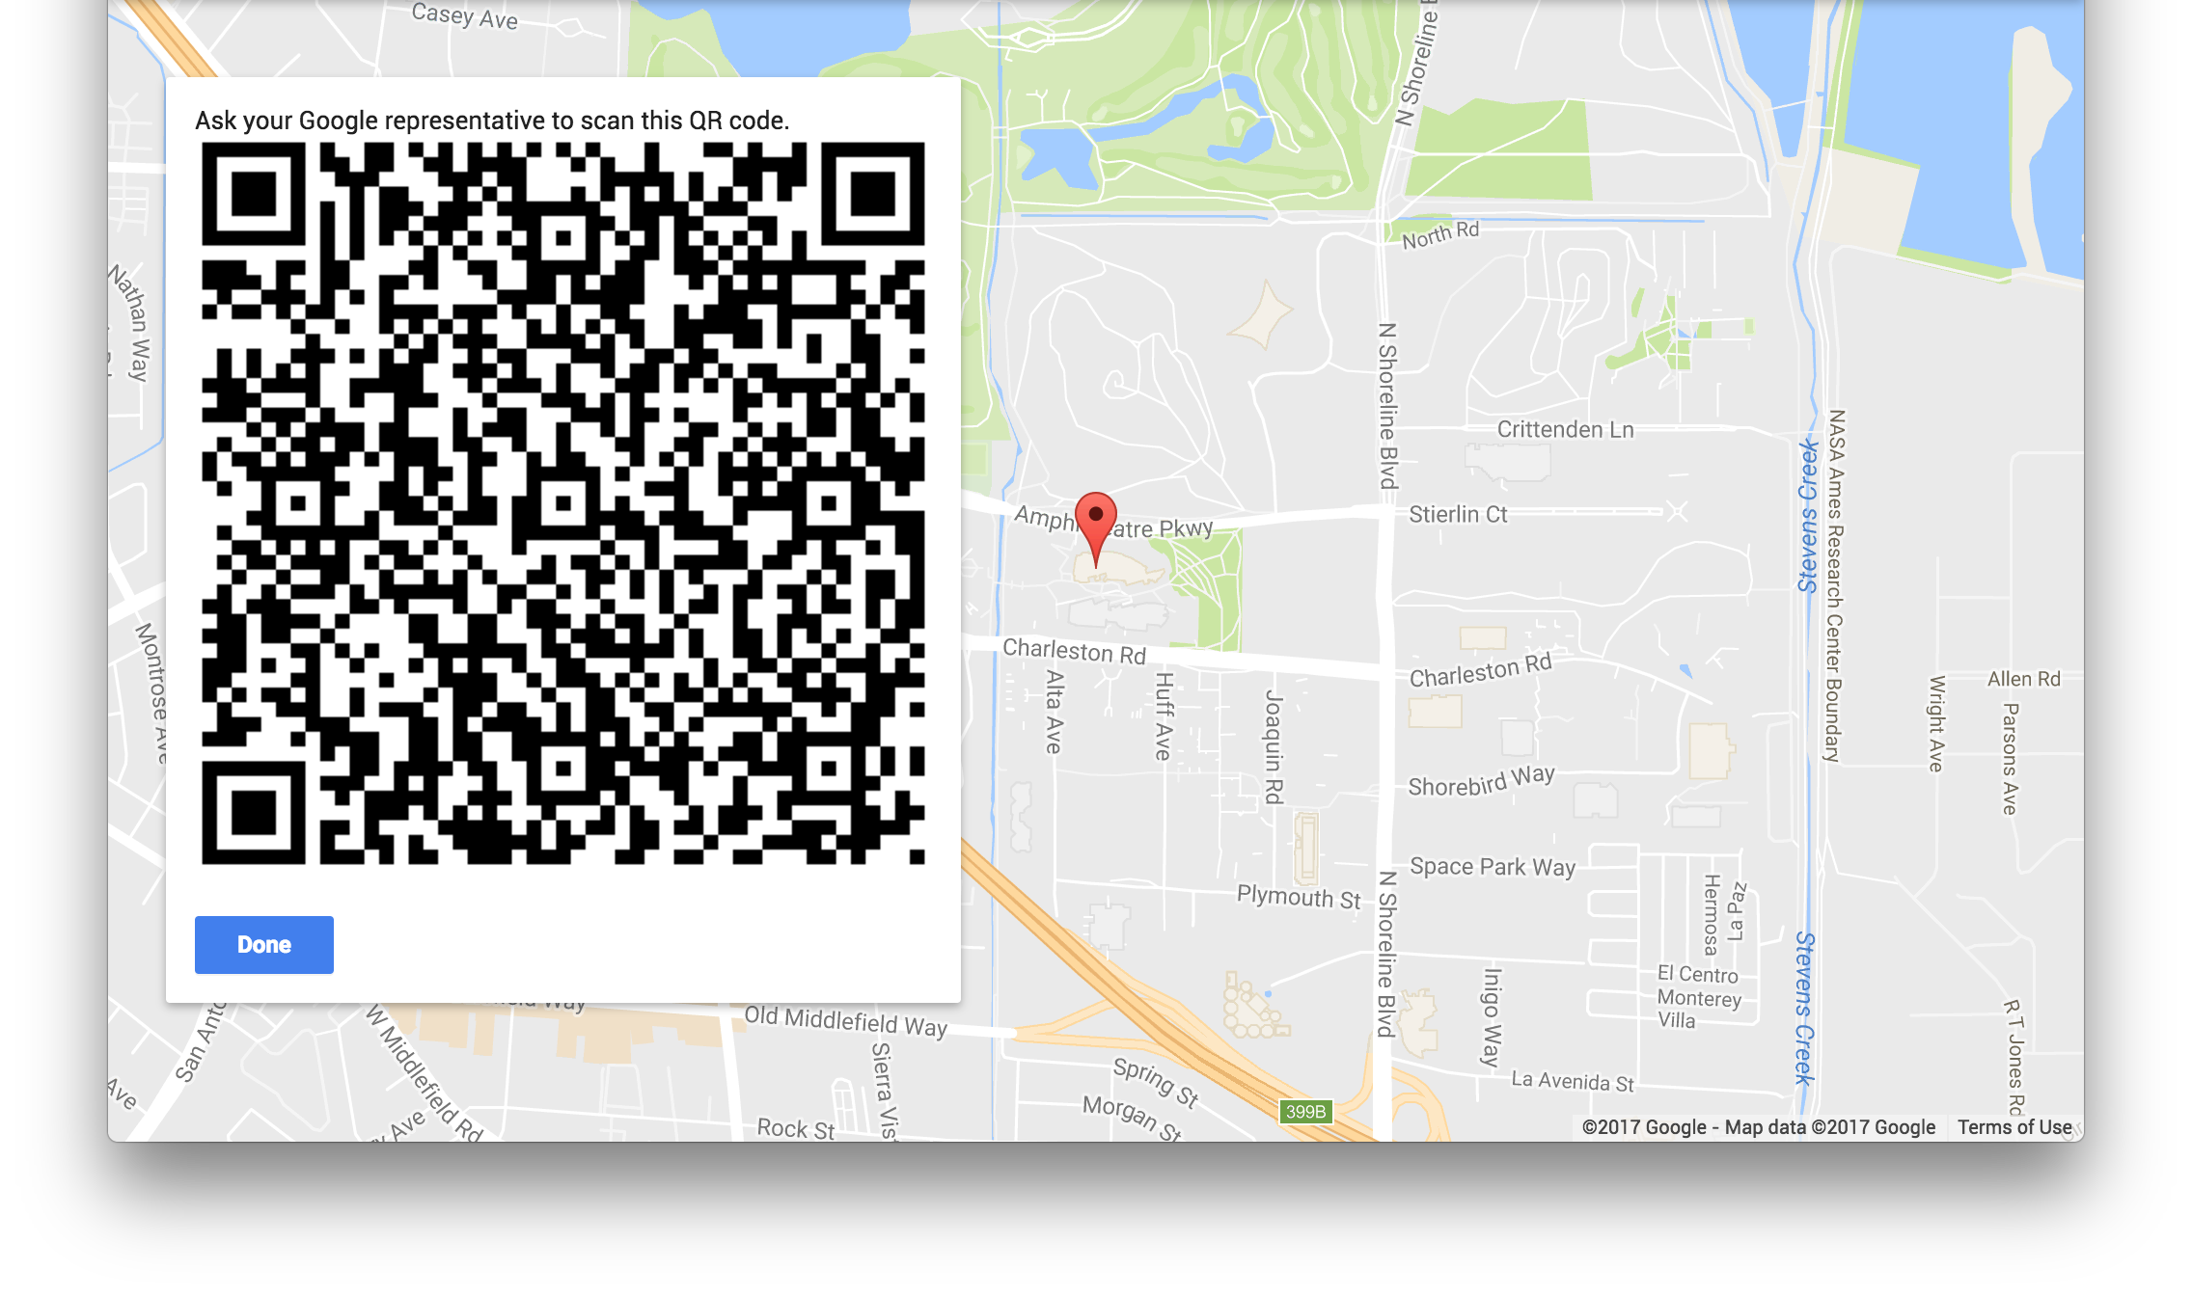
We need to scan your code
GET YOUR BUSINESS ON GOOGLE FOR FREE
After your info is confirmed and the code is scanned, click “Done”
Notes:
IF PRESENTER HAS ACCESS TO TRUSTED VERIFIER APP:
After clicking “Verify” you should see a QR code.
Please stay on this screen until an Official City Partner with the Trusted Verifier app comes around scan your barcode.
The Trusted Verifier needs to review the documents you brought to the session to confirm your business name, location, and your authorization to manage it.
If you don’t have one of these documents with you today, again, no worries. We can still help you verify your business another way.
Let’s assume you have the required documentation and everything looks good.
Once the Trusted Verifier scans your barcode, click “Done.”
NOTES FOR SPEAKER:
Once the QR code is read and the verification has completed (Verified icon), or is in progress (clock icon), the user will click on the “Done” button in the window displaying the QR code. In the next window, the user will click on Continue.
If the listing has been successfully verified and has the Verified icon in the Trusted Verifier application, the user can go to their Google My Business page and confirm it displays the business as verified.

Slide 17
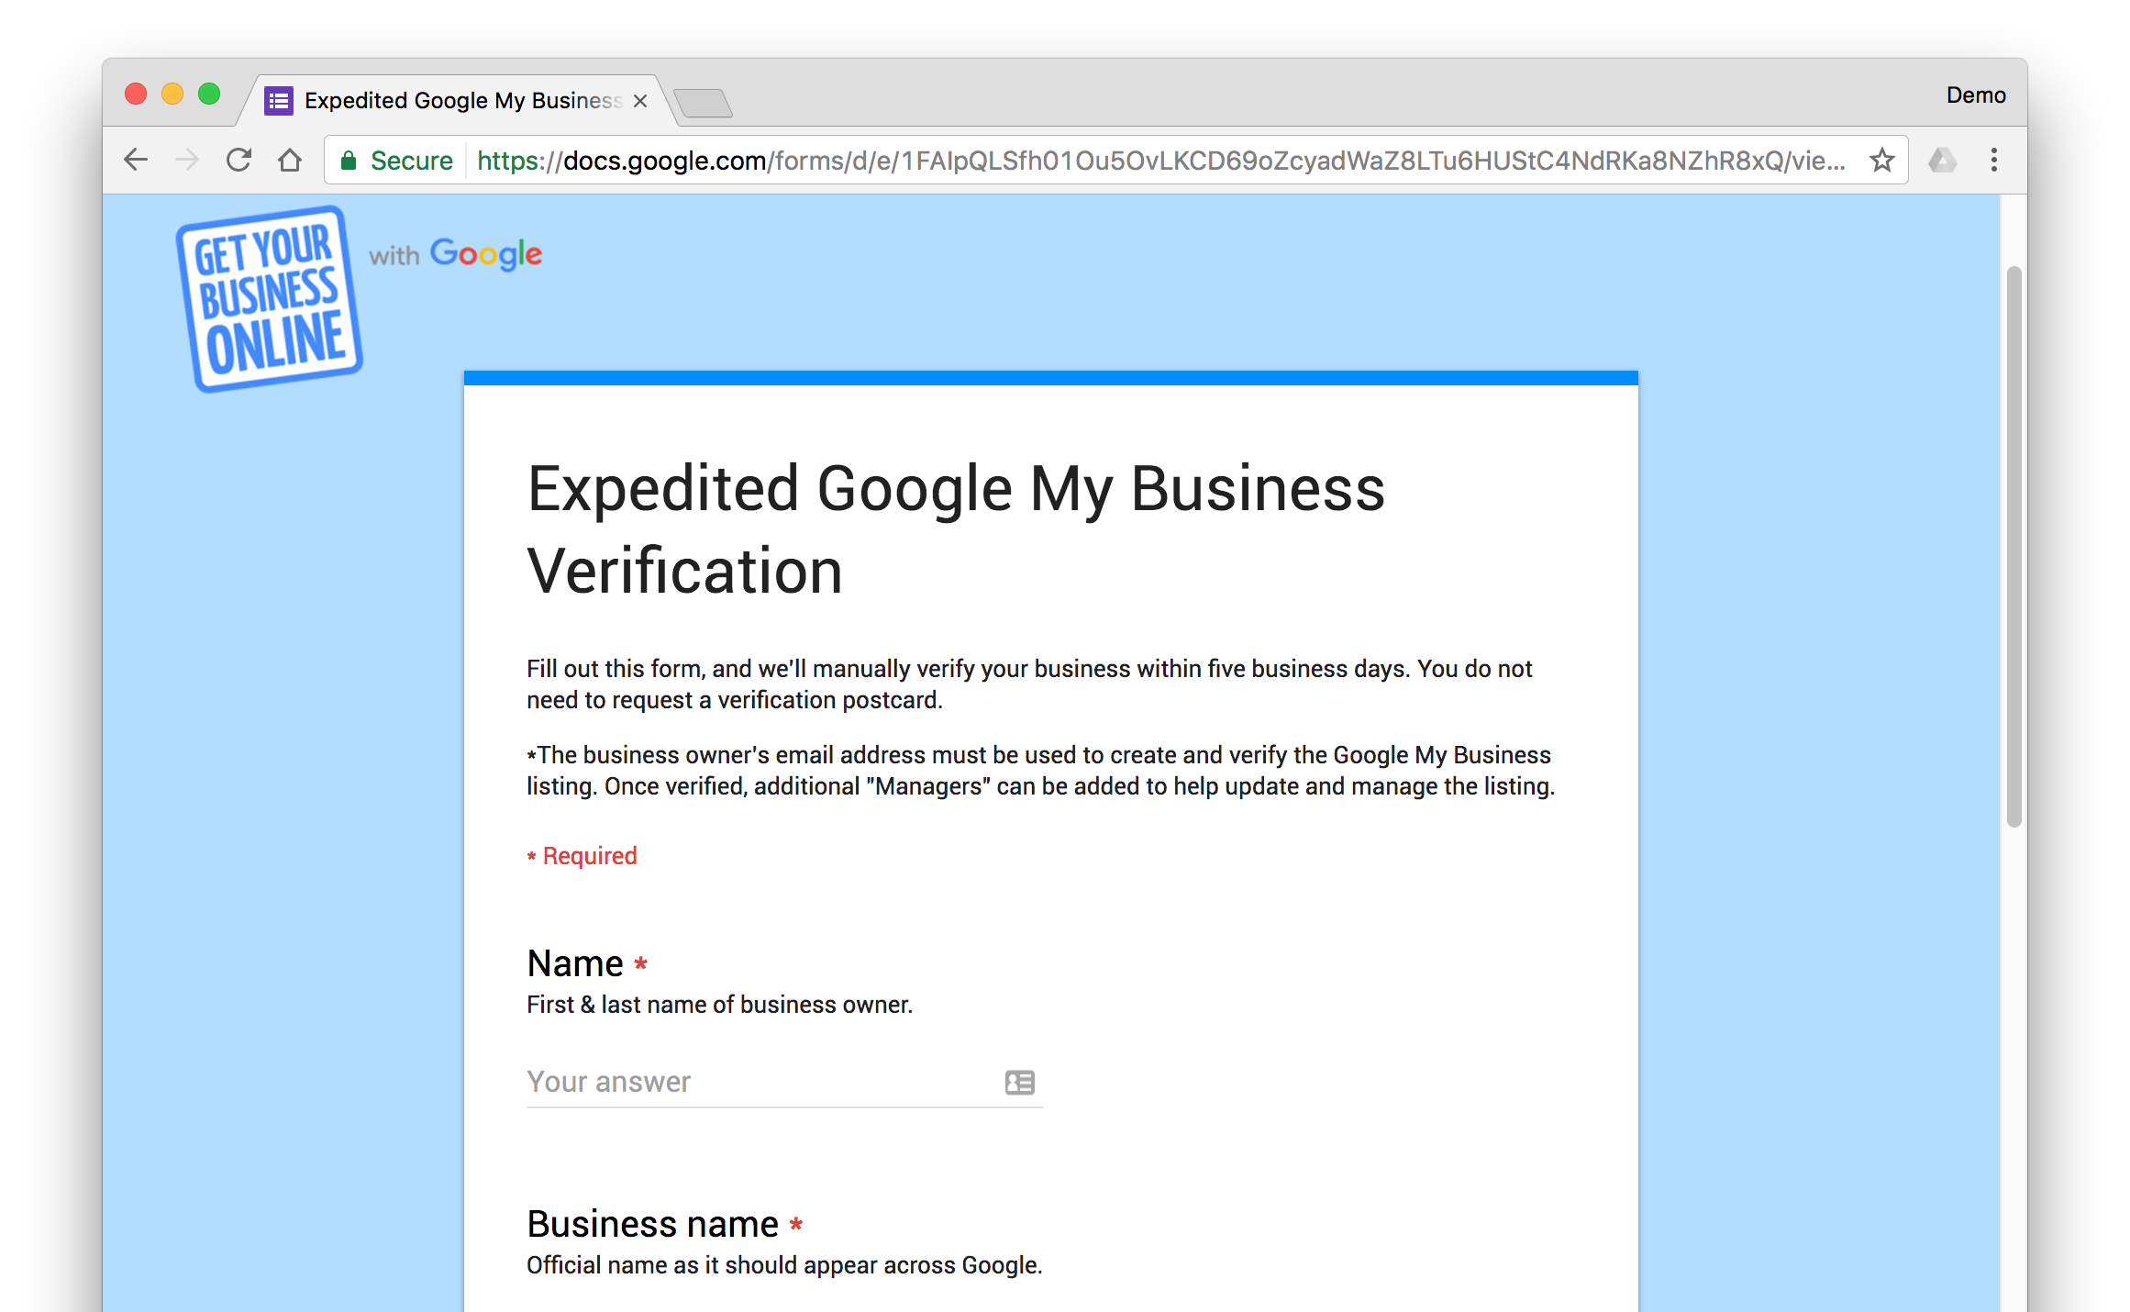
Alternatively: expedited verification
GET YOUR BUSINESS ON GOOGLE FOR FREE
Google username: the complete email address associated with the listing.
gybo.com/onthemap
Notes:
If you do not have verification document with you, here’s another way to verify your business: the expedited form
You can access the form at gybo.com/onthemap
Make sure that the Google username is the same email address you signed in with to create the listing. You must enter the complete email address.
*

Slide 18
Take a tour of Google My Business
Notes:
Let’s take a look inside Google My Business to see what you can do.

Slide 19
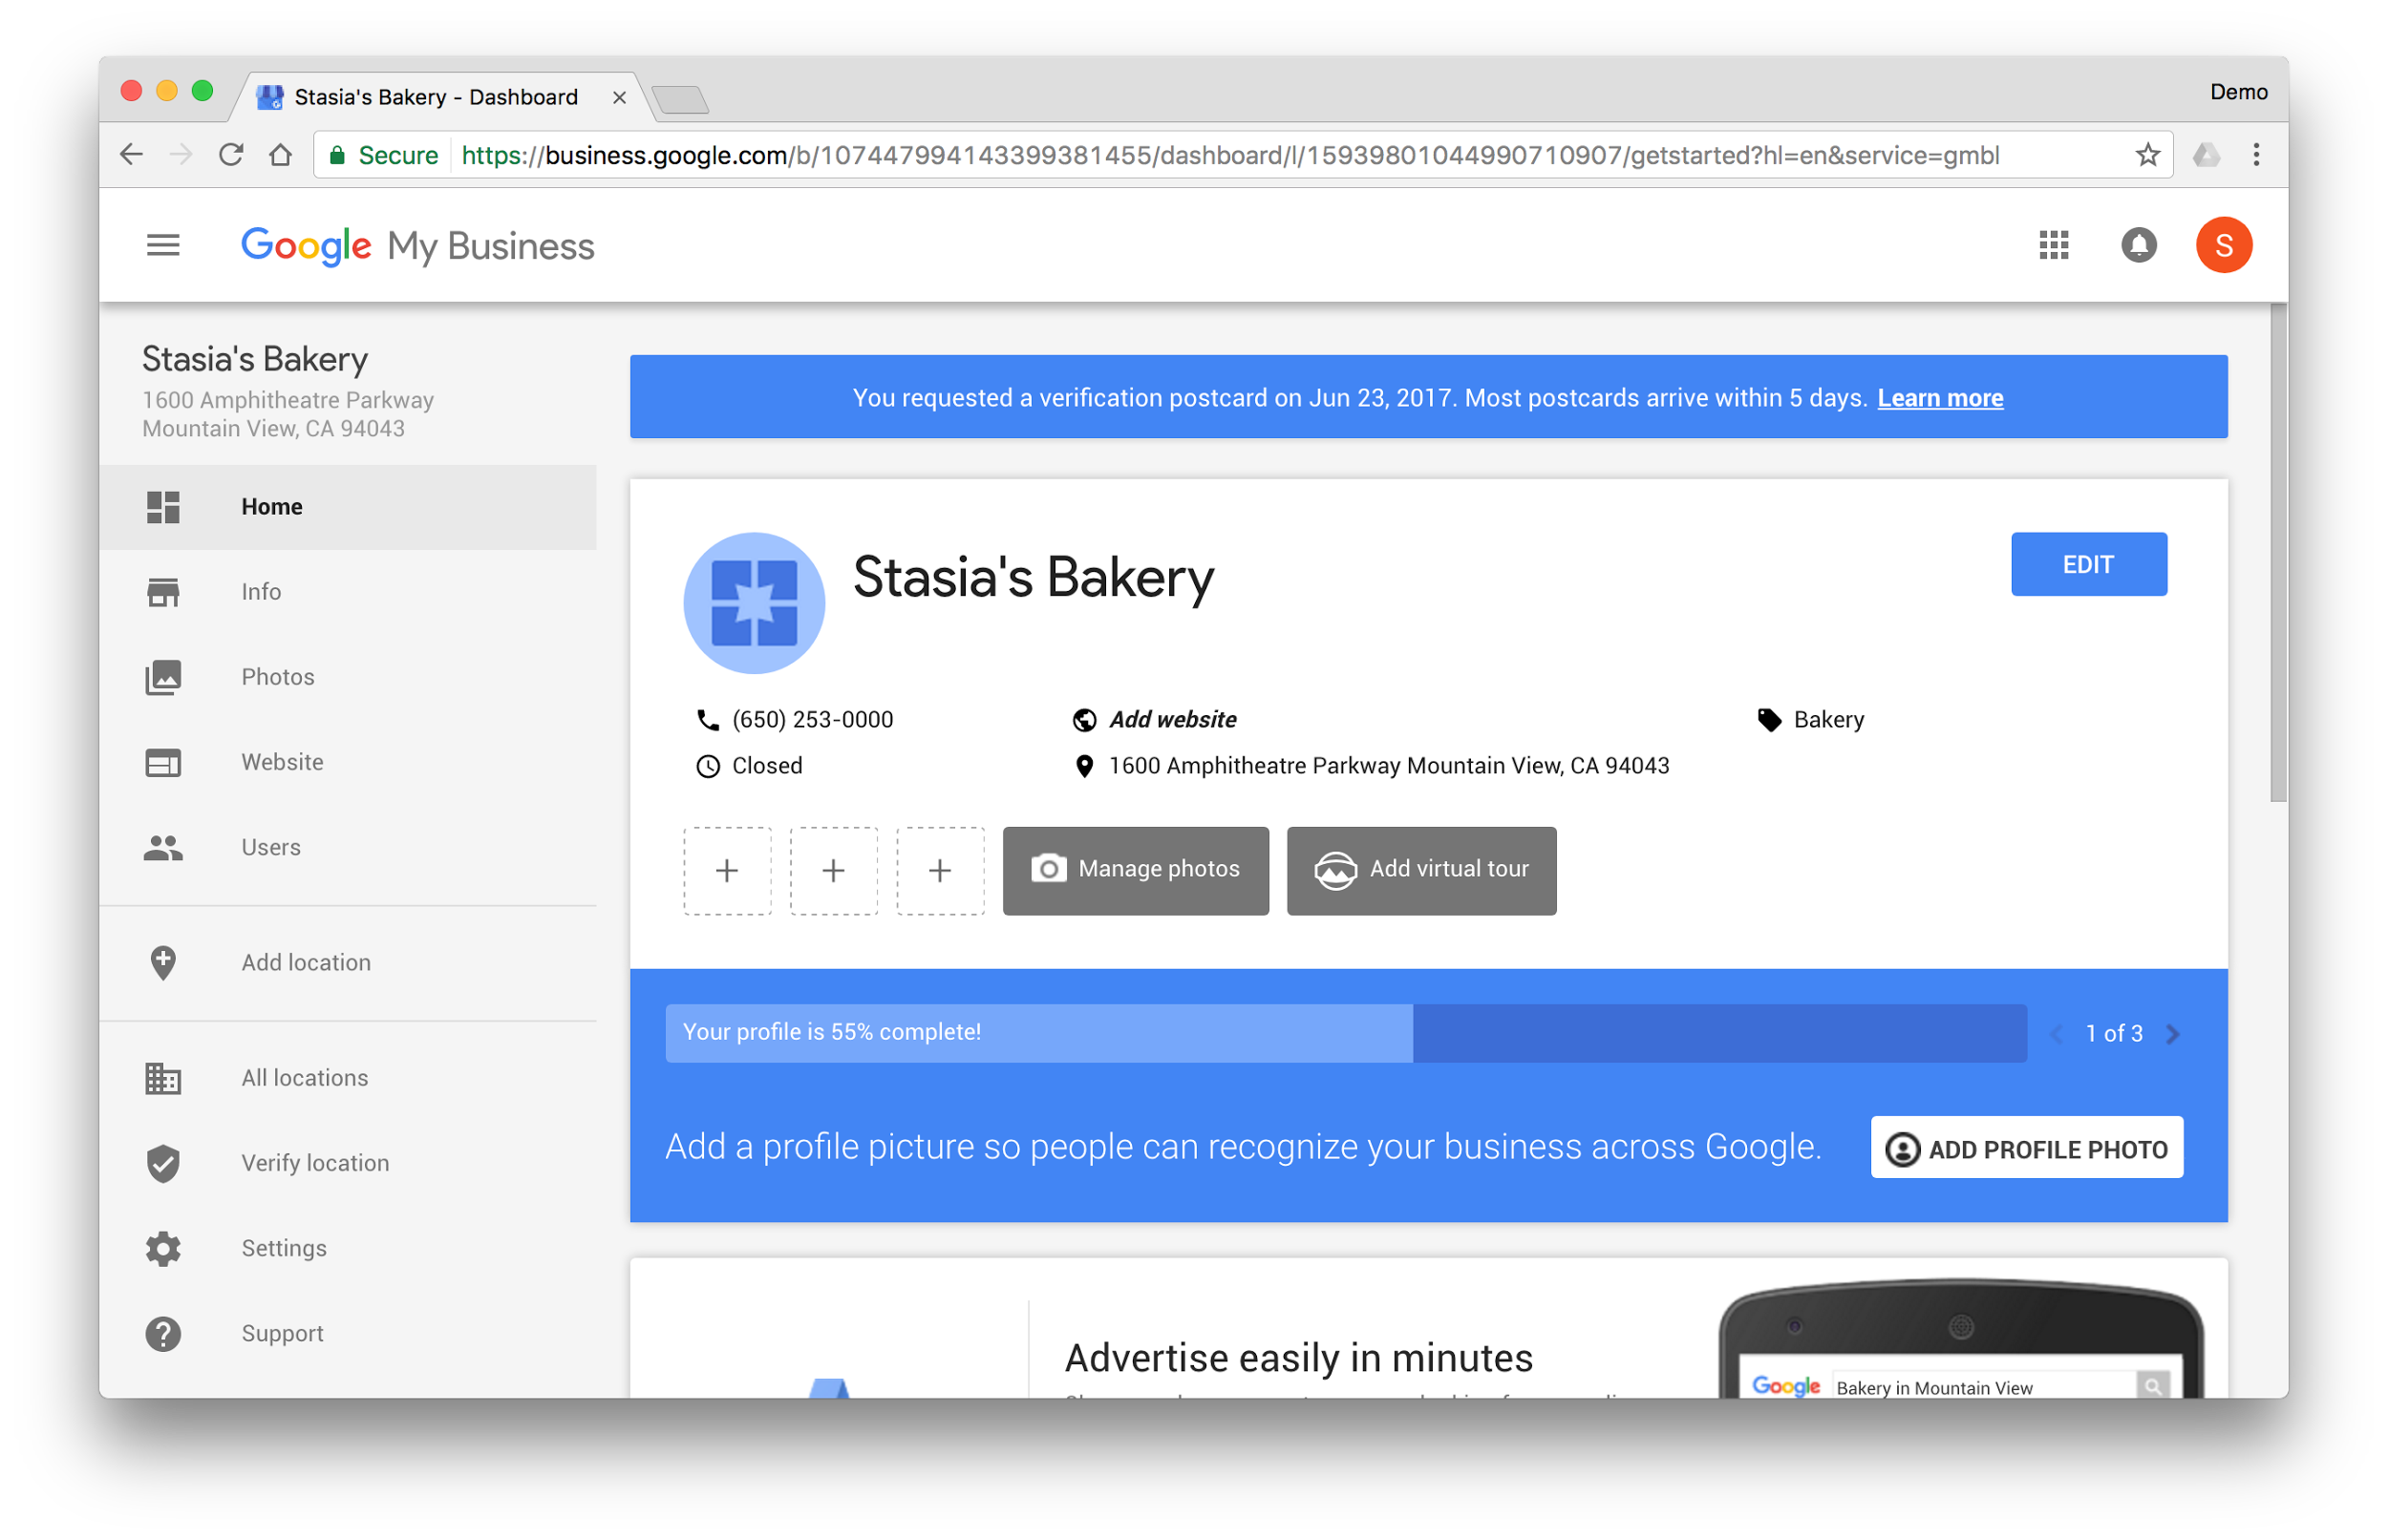
TAKE A TOUR OF GOOGLE MY BUSINESS
Make updates from the dashboard
Up-to-date listings are:
2X more likely to be considered reputable.¹
38% more likely to have searchers visit the location.²
29% more likely to have searchers consider purchasing from them.²
^{1.} Google/Oxera, The Benefits of Complete Business Listings, Dec 2014
^{2.} Ipsos MORI, Impact of Search Listings for Local Businesses, Aug 2014
Notes:
This is the Google My Business dashboard, where you can review and manage your business info.
It’s critical to keep your address, hours, and other business information accurate and up-to-date because people look to Google to 2x find that info.
Keep your listing well-maintained by adding all the business info you can, including hours of operations and photos. Encourage happy customers to leave reviews, and respond to them via Google My Business.
Some business categories offer the option to add additional information, like links to restaurant menus and the option to make reservations. Check your listing to see what’s available.
In the center area you can see the information you entered when you created the listing a few moments ago.
To make changes, click the “Edit” button or “Info” link in the side navigation.
***
Google/Oxera, The Benefits of Complete Business Listings, Dec 2014
Ipsos MORI, Impact of Search Listings for Local Businesses, Aug 2014

Slide 20
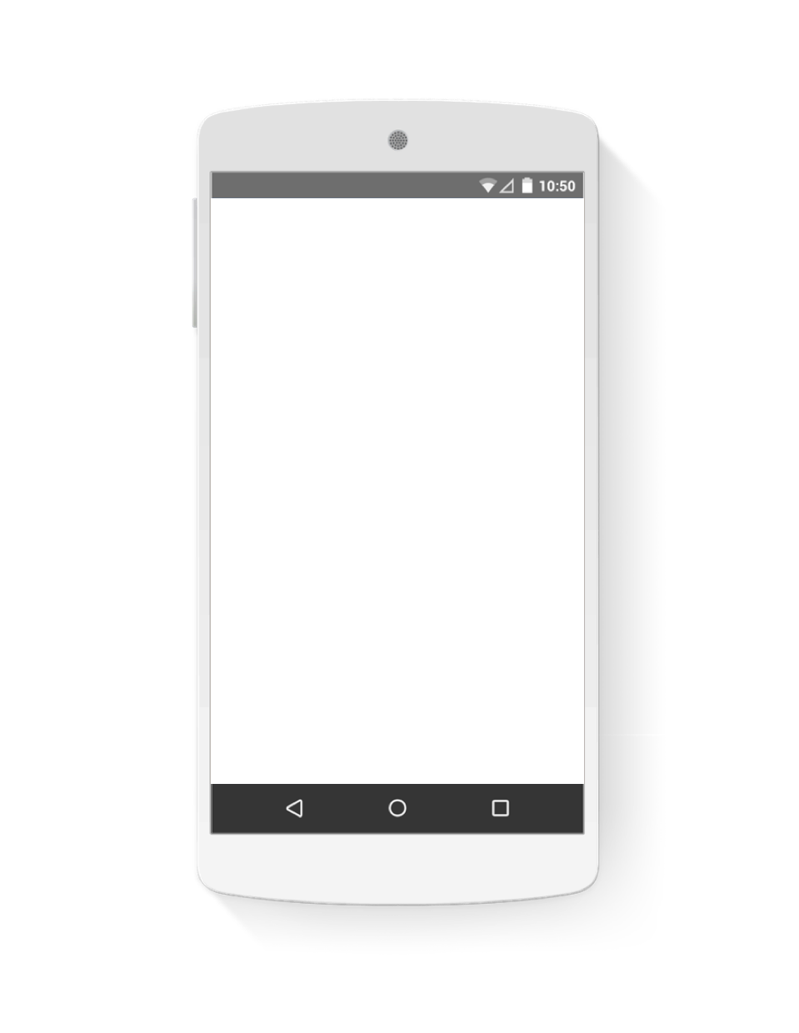
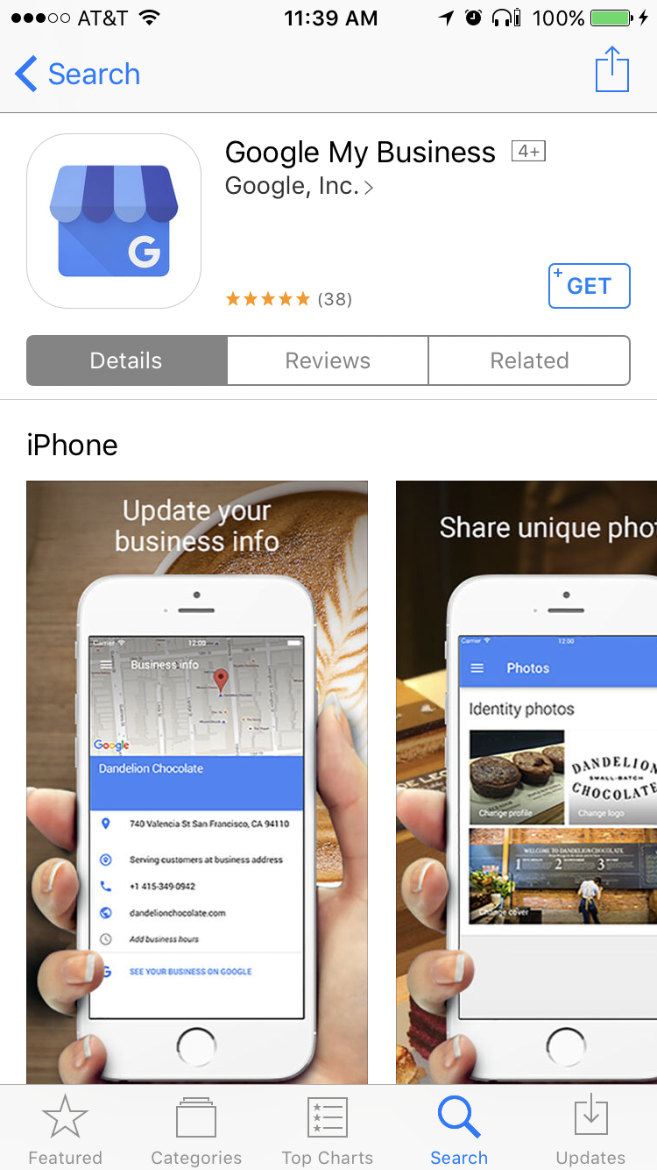
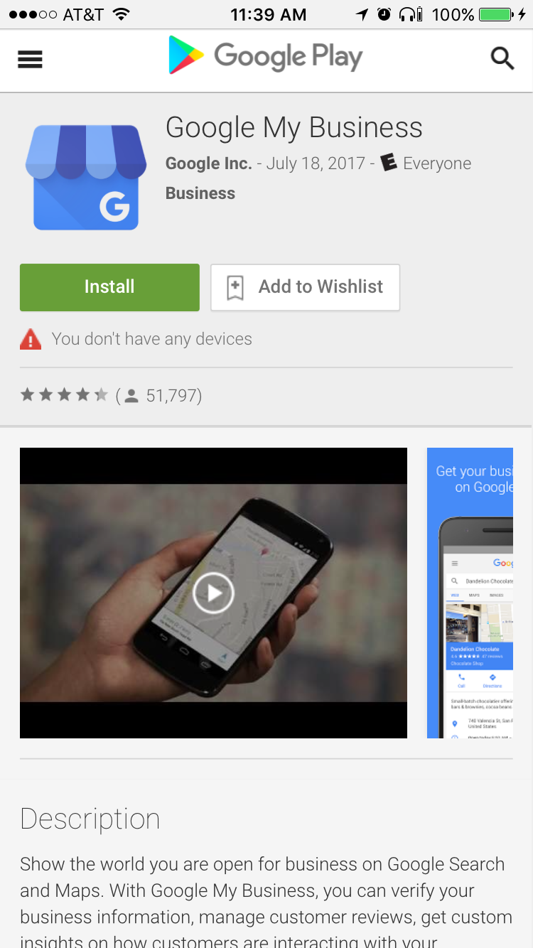
Make updates with the mobile app
TAKE A TOUR OF GOOGLE MY BUSINESS
Download the free app for Android or iOS.
Notes:
If you prefer to use your smartphone, you can also make updates with the free Google My Business, app available for Android and Apple devices.
You can download the app at Google Play (play.google.com) or the iTunes Store (apple.com/itunes)
*

Slide 21
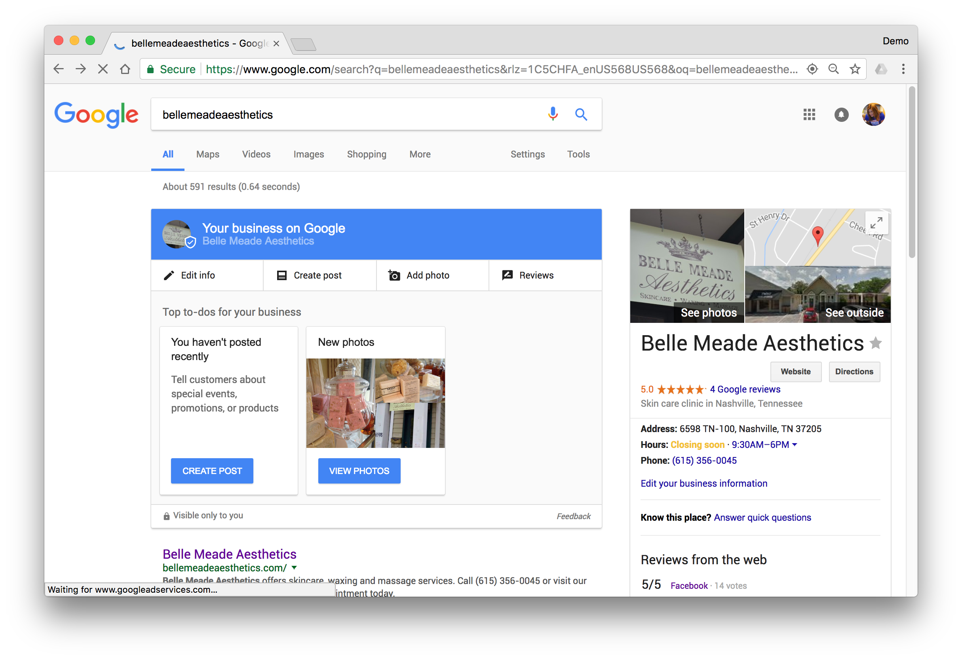
Make updates from search results
TAKE A TOUR OF GOOGLE MY BUSINESS
This option is visible only to managers of verified businesses.
Edit business info
Create posts
Add photos
Manage reviews

Slide 22
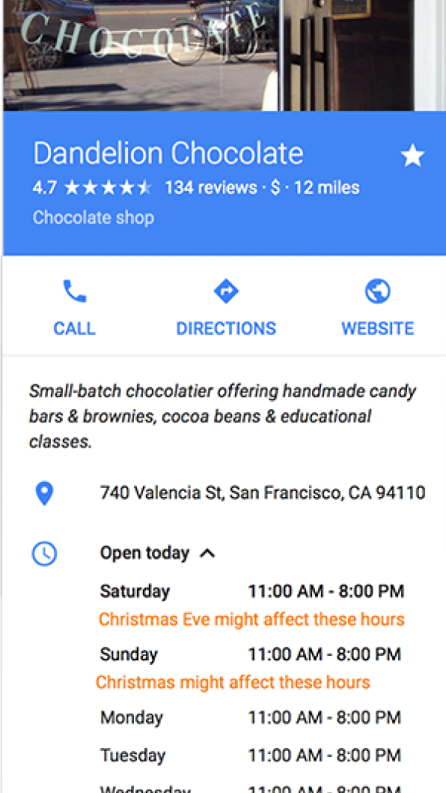
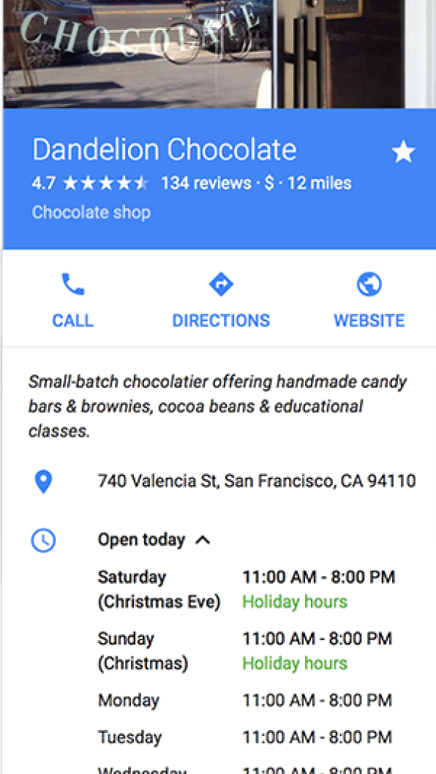
Show your holiday hours on Google
TAKE A TOUR OF GOOGLE MY BUSINESS
40% of local business searchers want to find hours of operation.¹
Confirmed
Unconfirmed
^{1.} Google Consumer Barometer, April 2017
Notes:
I’ve already mentioned adding business operating hours.
You can edit them within the Google My Business dashboard.
It’s important because 40% of local business searchers want to find hours of operation. Source: Google Consumer Barometer, April 2017
And, if your businesses has special hours throughout the year (like for holidays when you’re closed, or extending hours), you can also specify particular dates and help shoppers know when you’re open for business.

Slide 23
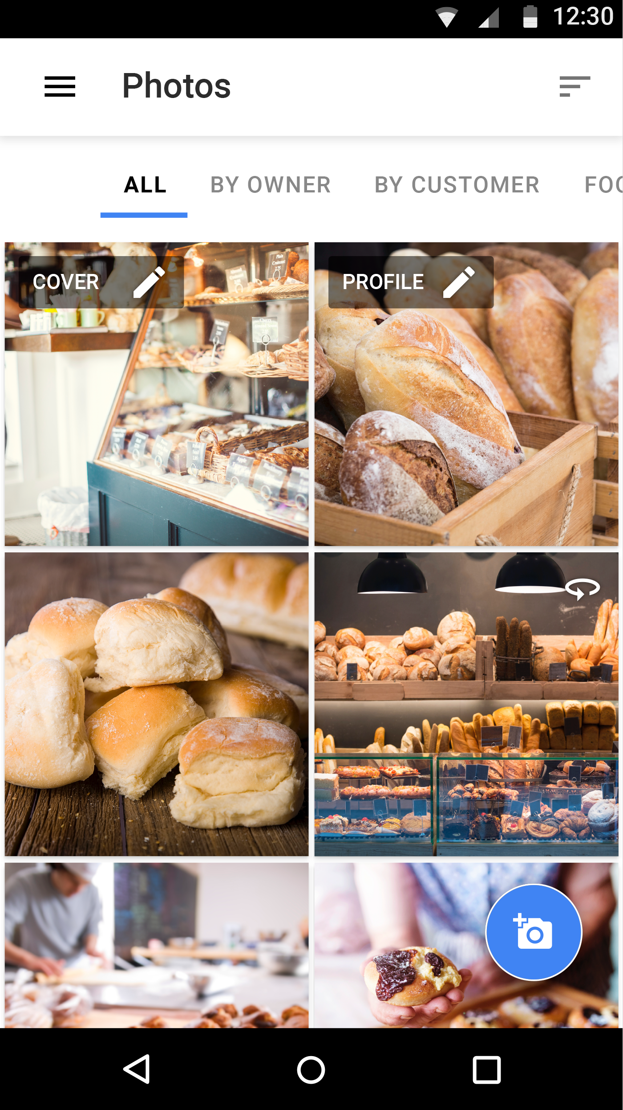
Add business photos
TAKE A TOUR OF GOOGLE MY BUSINESS
42%
more requests for directions¹
Click to manage photos
^{1.} Google/Oxera, The Benefits of Complete Business Listings, Dec 2014
Notes:
Adding business photo can help your business listing stand out on Google.
Please note that photos can be added by both the business and customers. The photos you add in Google My Business will be eligible to show on Google after the business is verified.
And, for businesses who want to show off their storefront, there is an option to “Add virtual tour.” This connects you to a site with information about hiring a Google Trusted Photographer to take a 3D tour of your business location and add to your listing.
Best practices for photos:
Format: JPG/JPEG, PNG
Image File Size: 10KB - 5MB
Recommended minimum dimensions: 720px wide by 720 pixels high
Quality: The photo should be in-focus, well-lit, have no photoshop alterations, and no excessive use of filters. The image should represent reality.

Slide 24
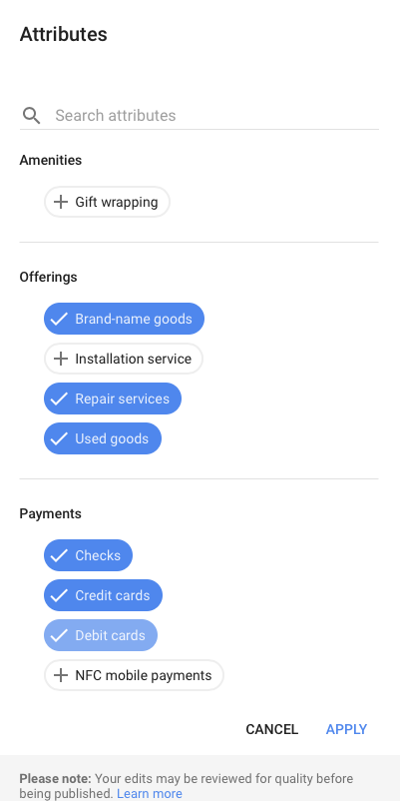
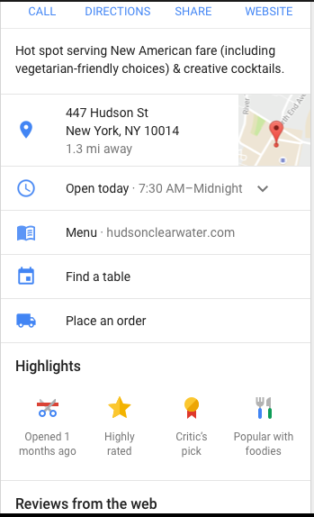
Add details with attributes
TAKE A TOUR OF GOOGLE MY BUSINESS
Optional attributes help searchers learn more about your business.
Can appear as highlights to help your business stand out in search results.
Notes:
Another way to help your listing stand out: adding “attributes,” optional details about your business.
To access attributes, click “Info” on the side navigation or the “Edit Info” button on the dashboard.
Look for the section labeled “Attributes” and click to edit.
You can see which attributes are available to your business; add them if you wish.
There is a wide range of attributes: some examples are: what payment types are accepted, whether gift wrapping is available, whether the location is wheelchair accessible, if the business identifies as LGBTQ-friendly, what type of ambience people can expect, etc..
The attributes you select may be visually highlighted in search results, helping your business info stand out even more.
Check back regularly to see if additional attributes are available for your listing.

Slide 25
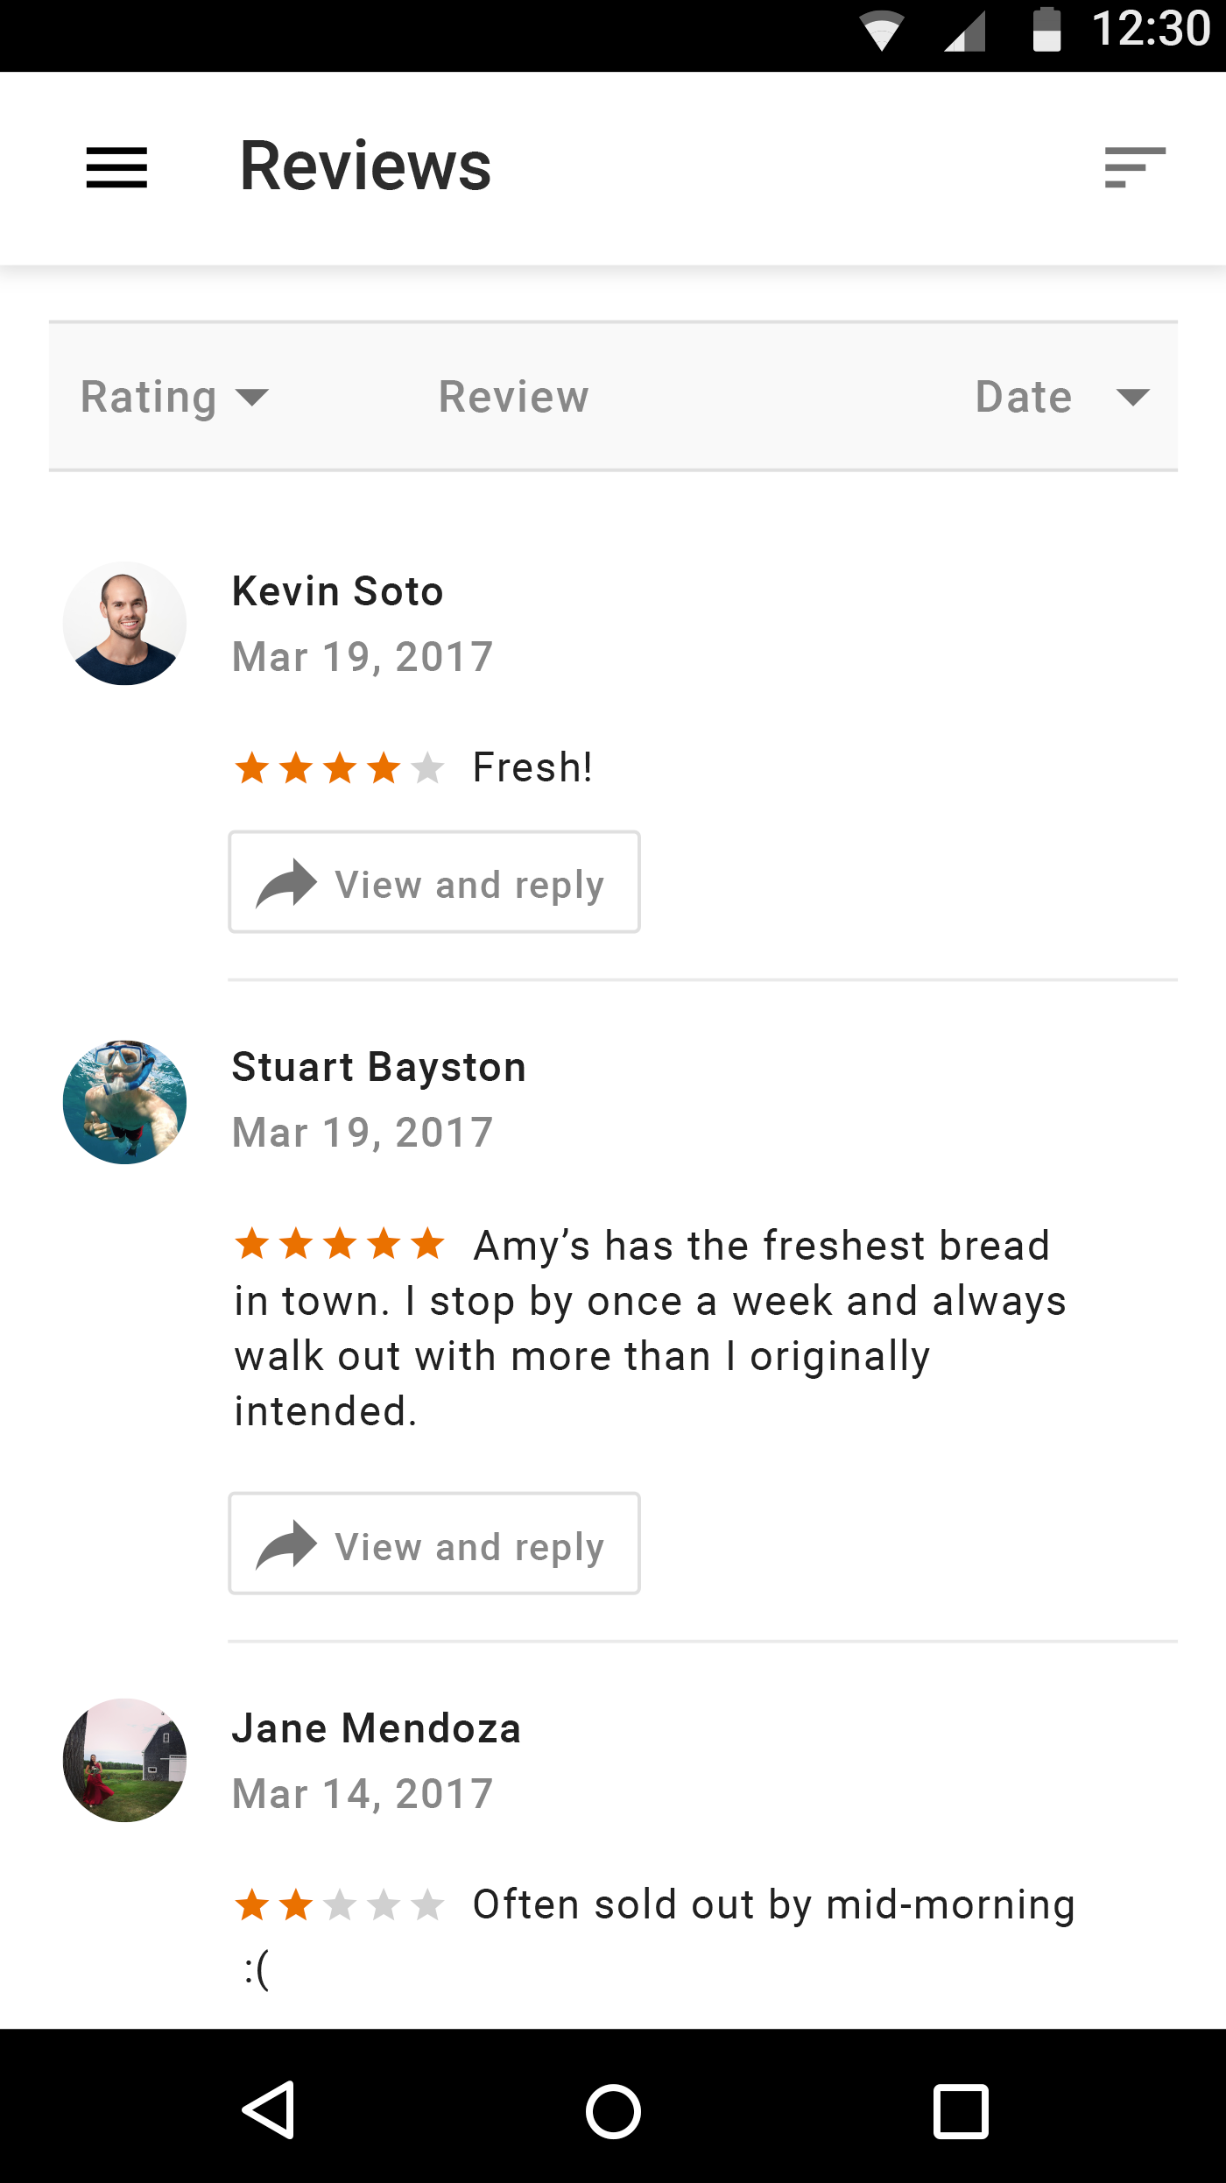
Read and respond to reviews
TAKE A TOUR OF GOOGLE MY BUSINESS
Be notified when customers write reviews about your business.
Build brand loyalty by responding.
Reply with your point-of-view, solutions, answers, or thanks.
Notes:
One your Google My Business listing is verified, you have the option to read and respond to reviews about your business published on Google.
Business owners often ask for advice about negative reviews —usually, “How can I remove them?”
Google won’t remove a review unless it violates a content policy.
Instead, Google encourages business owners to respond.
Responses might explain a company policy, or thank happy customers for positive feedback.
The timeliness and professionalism of responses demonstrates the business listens to customer feedback, and can positively influence potential customers.

Slide 26
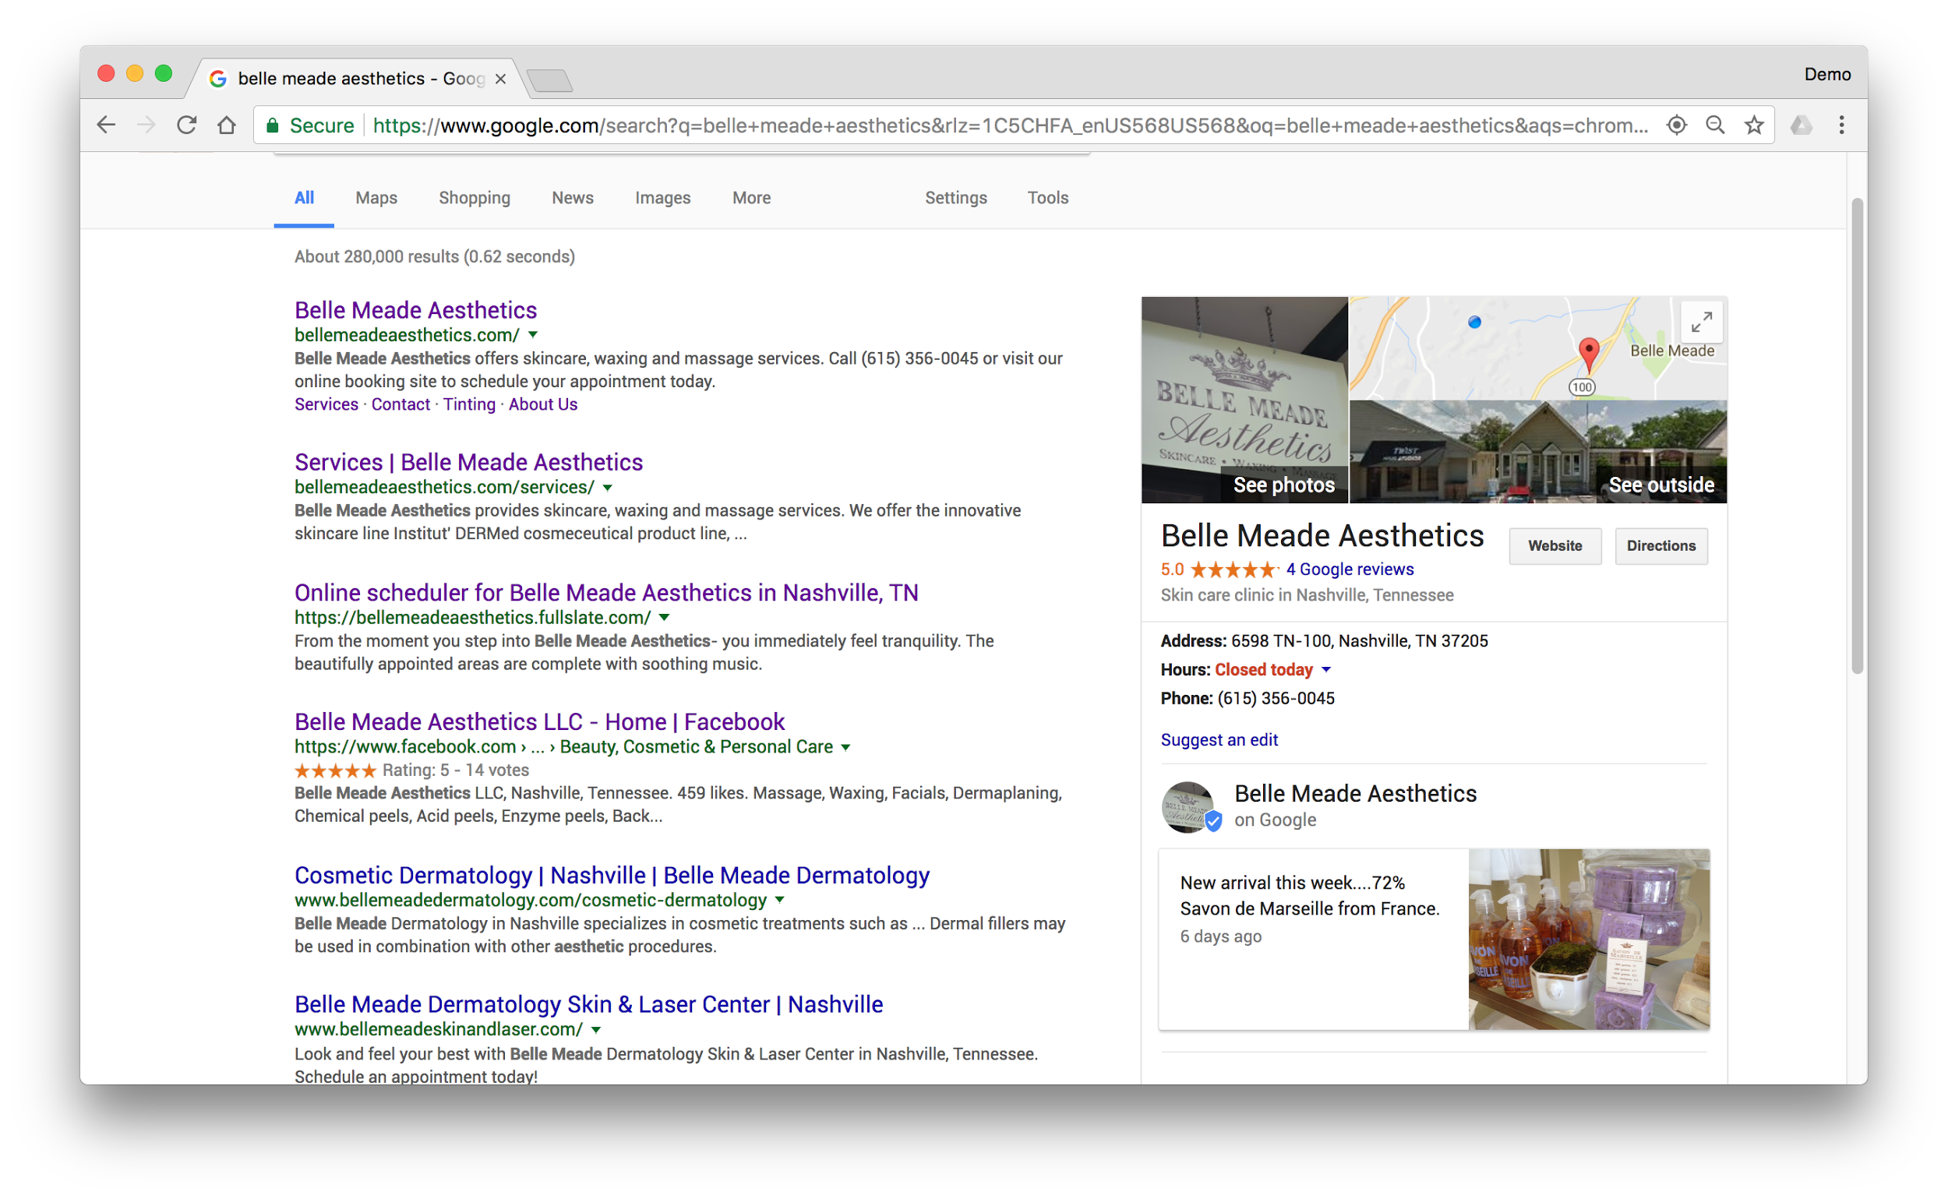
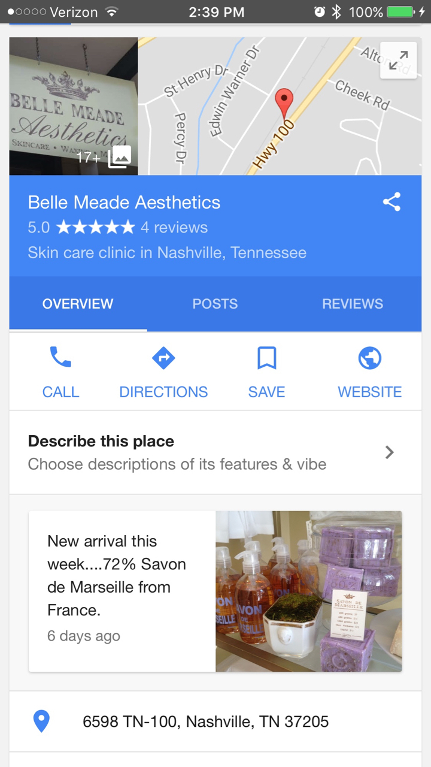
Share updates with posts
TAKE A TOUR OF GOOGLE MY BUSINESS
Post live updates directly on your Google business listing.
Notes:
Posts is a new feature of Google My Business that allows merchants to post live updates directly on their Google business listing. Posts allow you to communicate in new ways with potential customers, to share info, encourage reservations, promote an email newsletter, buy products, etc.
Posts appear in your Google listing on Search and Maps
Create posts from the Google My Business app or the web dashboard.
You can also see how posts are influencing potential customers by reviewing their activity from the Google My Business dashboard.

Slide 27
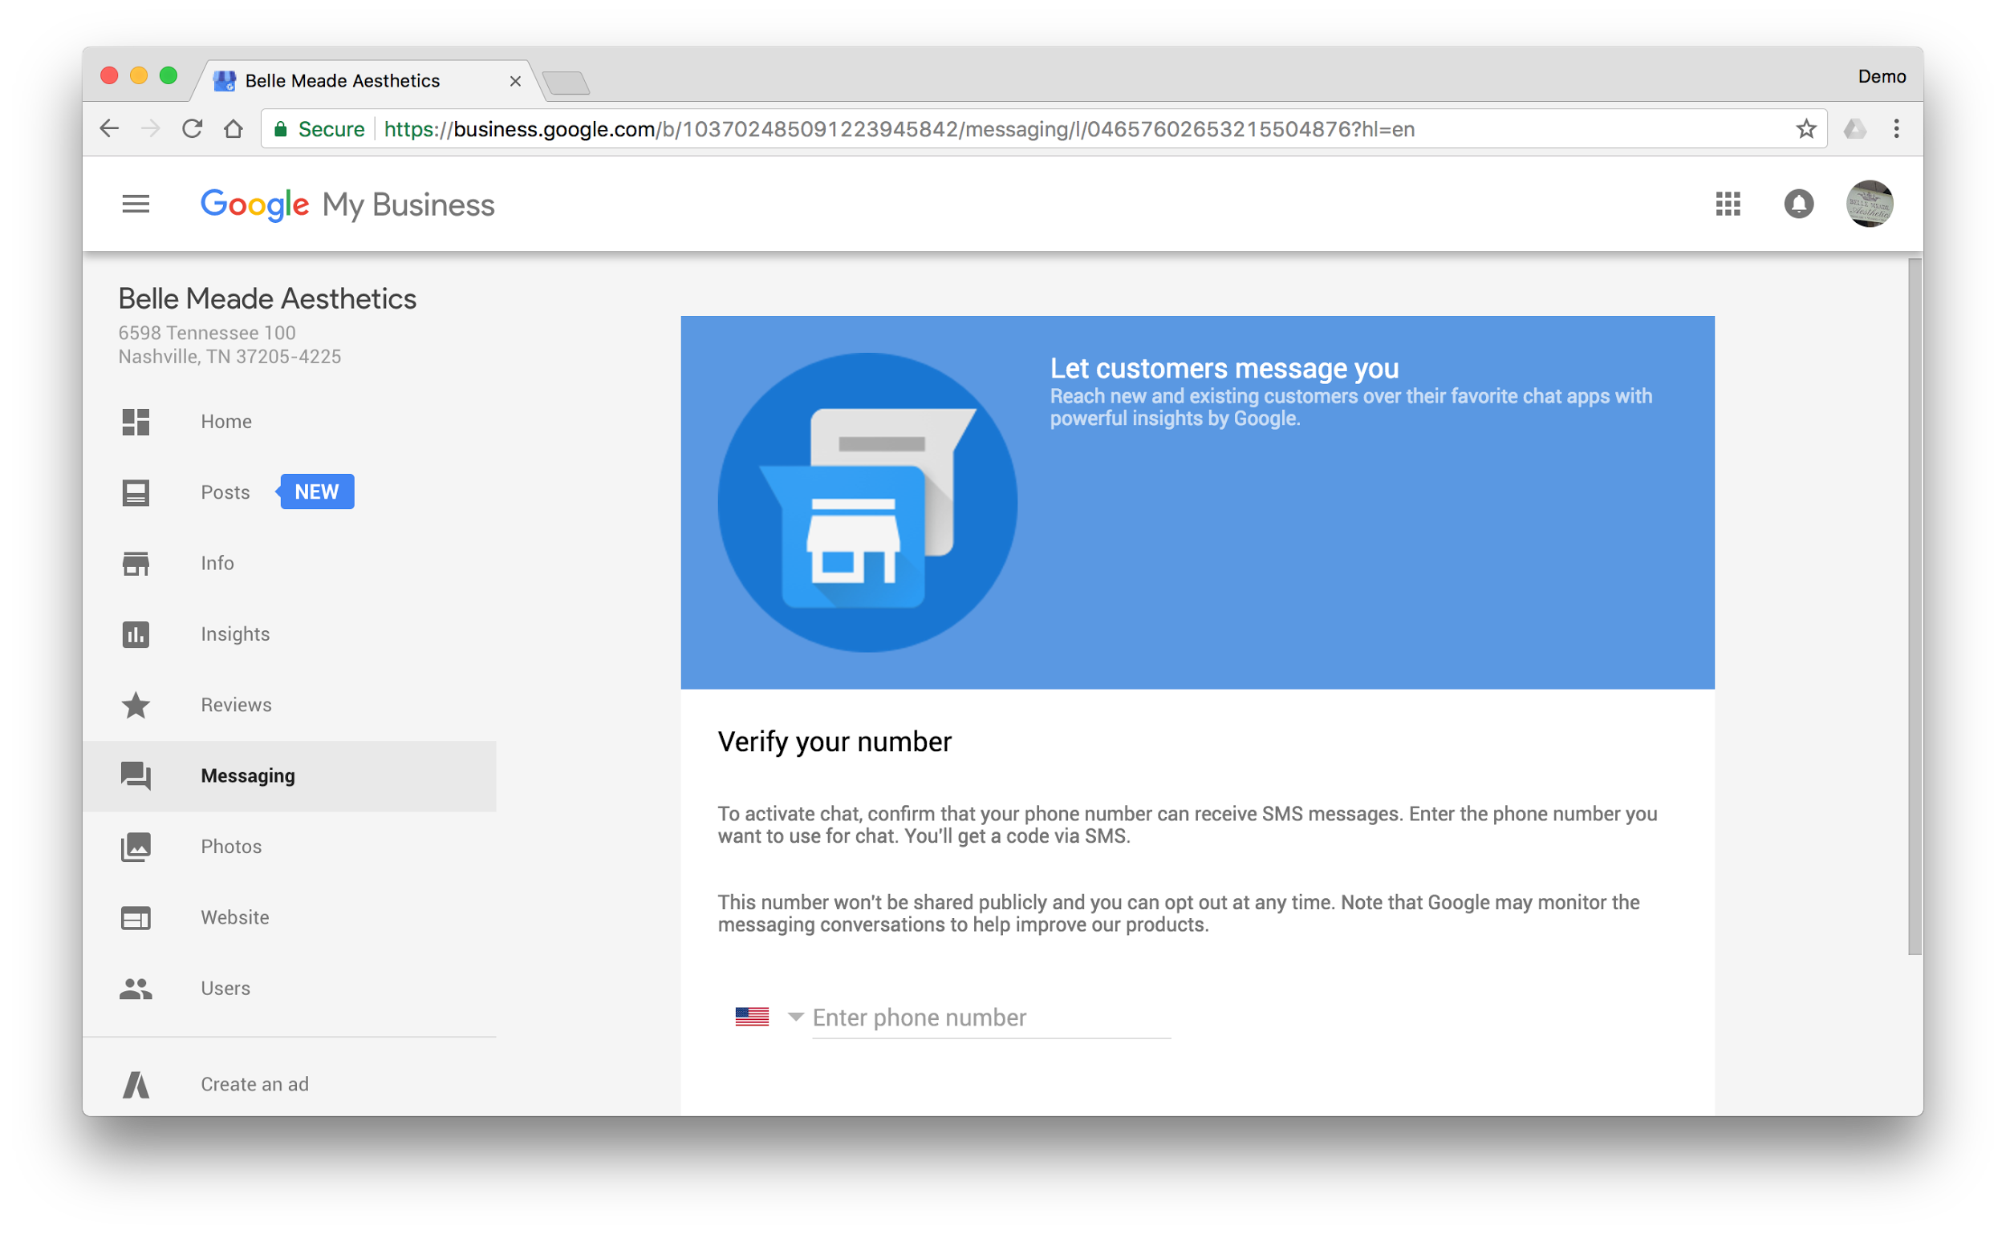
Use messaging to communicate...
TAKE A TOUR OF GOOGLE MY BUSINESS
First, set up “Messaging”
Notes:
Google My Business allows you to chat directly with customers who find your business listing on Google Search.
Responding to customers can help you answer their questions, tell your business’s story, and attract more people to your location.
To turn on messaging with customers, sign in to Google My Business and look for the "Messaging" card in the Home menu.

Slide 28
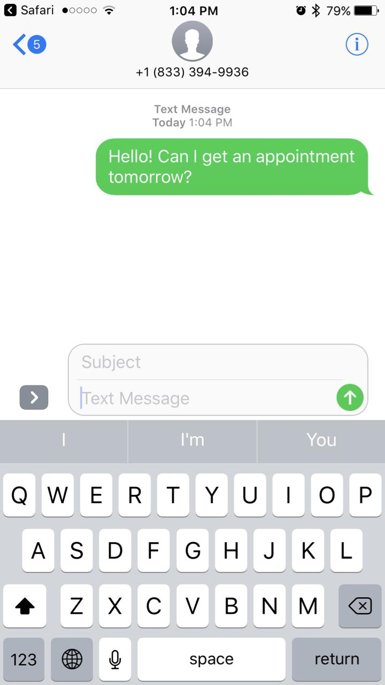
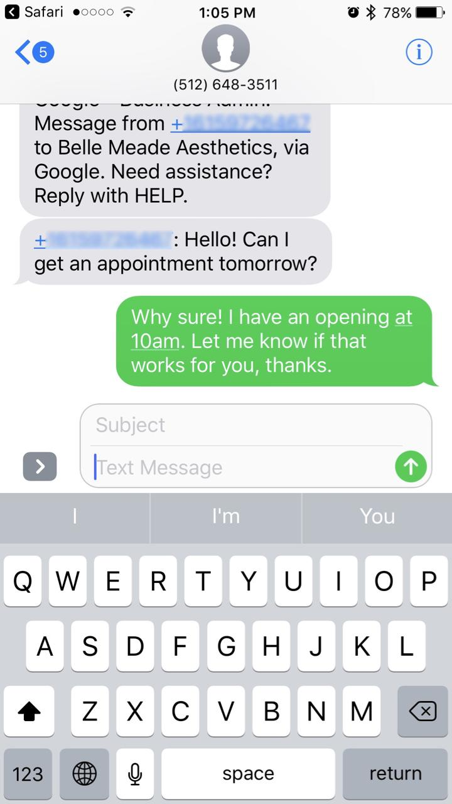
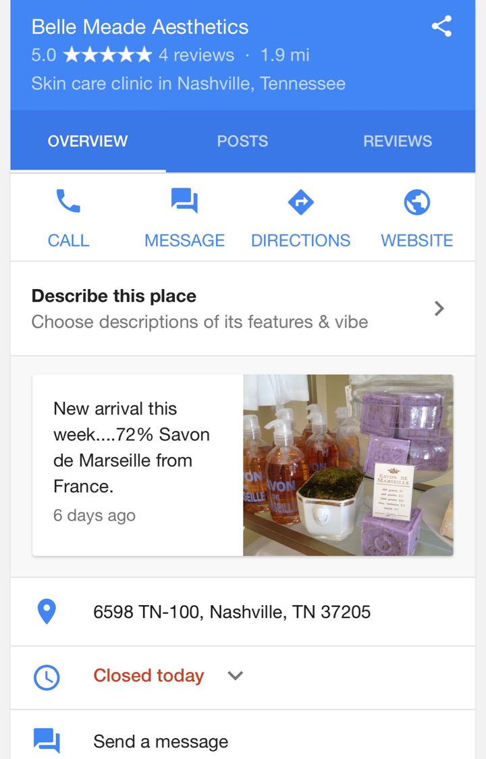
...via text message
TAKE A TOUR OF GOOGLE MY BUSINESS
Customers can send messages from search results.
Then, customers can send messages
Notes:
Make sure that you provide a phone number that can receive SMS messages and will be readily accessible for responding to customers.
You can also use Google Allo, rather than SMS, to respond to messages. To start using Allo:
Download Google Allo from the Android Play Store or iOS App Store.
Register Allo with the same number you used to sign up for messaging on Google My Business.
Messages will start to appear on Google Allo instead of SMS.
Things to keep in mind:
When customers message you, they’ll see your average response time. (You can see this time on the “Messaging” card in the Home menu.)
Avoid sensitive content. Make sure that you don’t provide or request sensitive information during a chat with customers.
Sensitive information includes, but is not limited to:
Credit card numbers
Social Security or other government identification numbers
Login credentials, like passwords
When using SMB messaging, standard message and data rates may apply.
You can turn messaging on and off at any time.

Slide 29
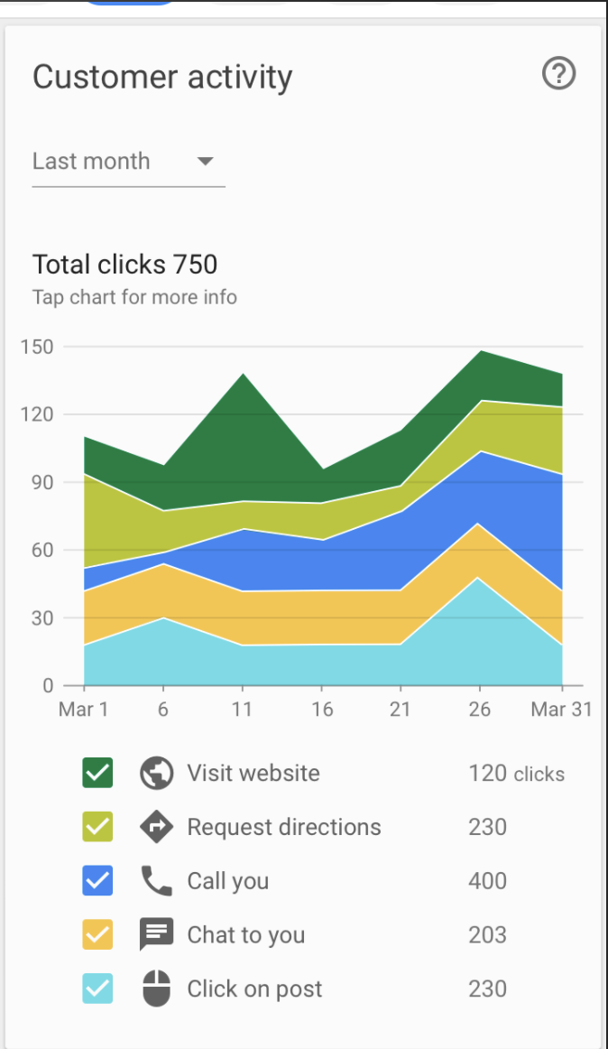
See what’s working with insights
TAKE A TOUR OF GOOGLE MY BUSINESS
How do searchers find you?
How do they interact with the listing?
Do they call, request directions, and visit your website?
Where do customers come from?
What days have the most activity?
Notes:
Another feature available for verified listings: Insights reports.
Insights shows you how people found your business listing on the web.
The reports focus on how customers use Search and Maps to find your listing, and what they do once they find it.
Insights consists of six sections, each of which gives you a different way to understand how customers interact with your listing:
How customers found your listing: it shows how many customers found you in a “Direct” search (in other words, they searched for your business name or address) versus a “Discovery” search (they searched for a category, product, or service, and your listing appeared).
Where customers found you on Google: Google Search or Google Maps.
Actions: what searchers did once they found your listing on Google. The actions include: Visiting your website; Requesting directions; Calling you; Viewing photos
Where on the map people request driving directions to your business. You’ll see your location pinned on the map, and a heat map that shows the most popular places from which people ask Google Maps for driving directions to your address.
When and how often searchers called your business via your Google business listing on Google. You can view trends by “Day of week” or “Time of day.”
The number of photos associated with your listing, and how often they’re viewed compared to photos of businesses similar to yours.

Slide 30
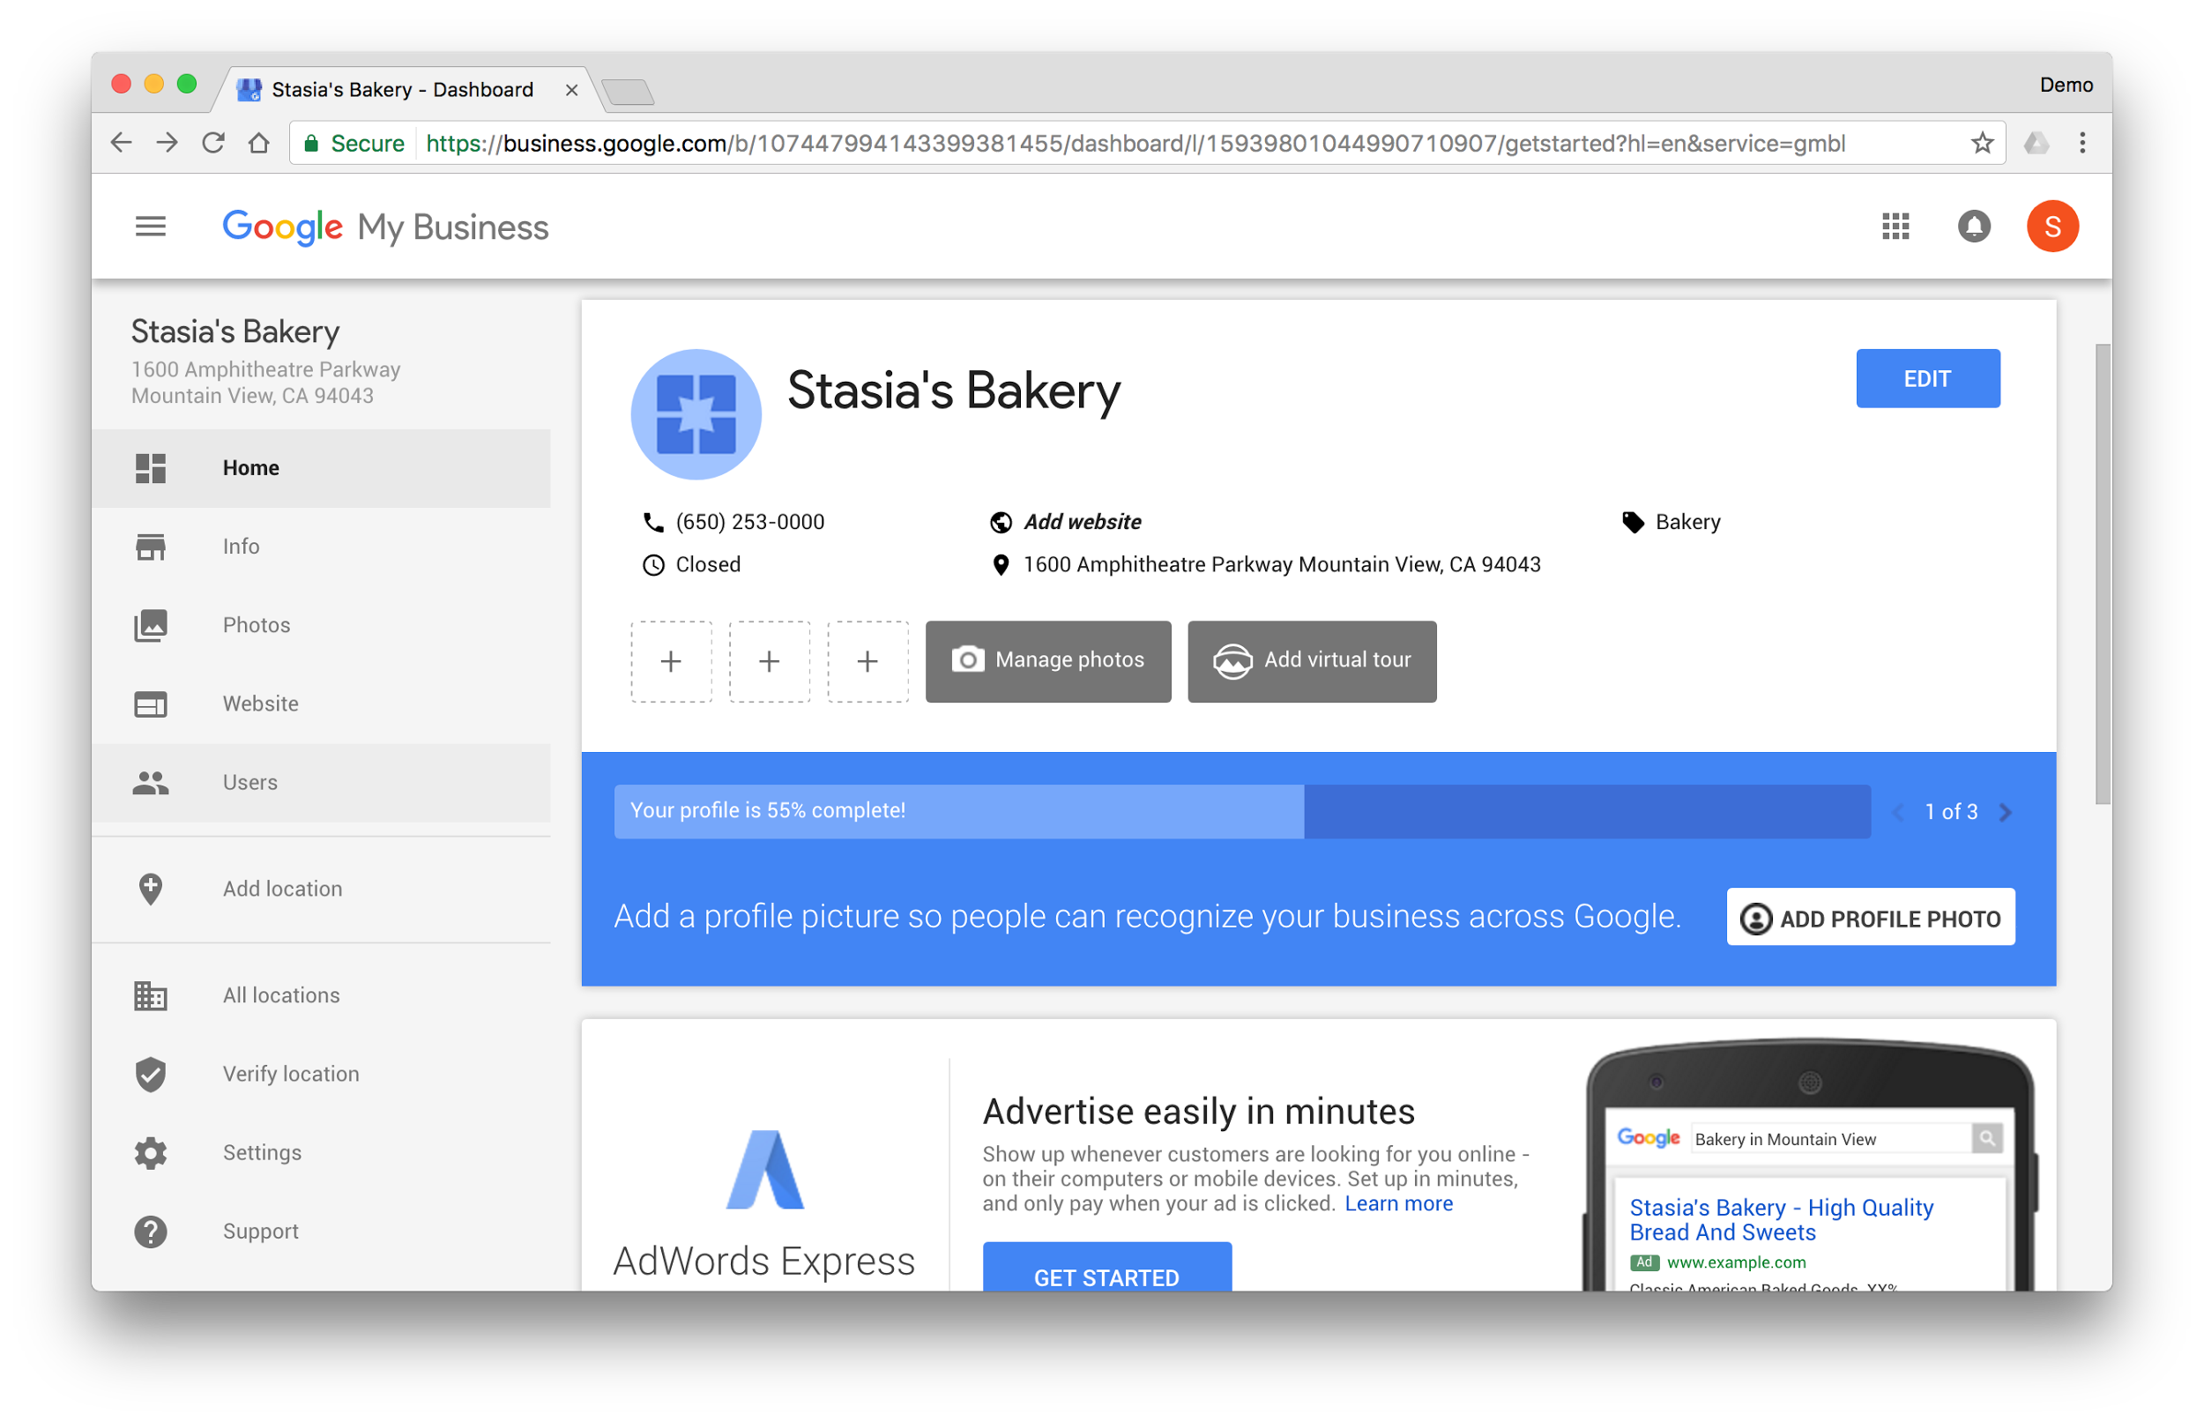
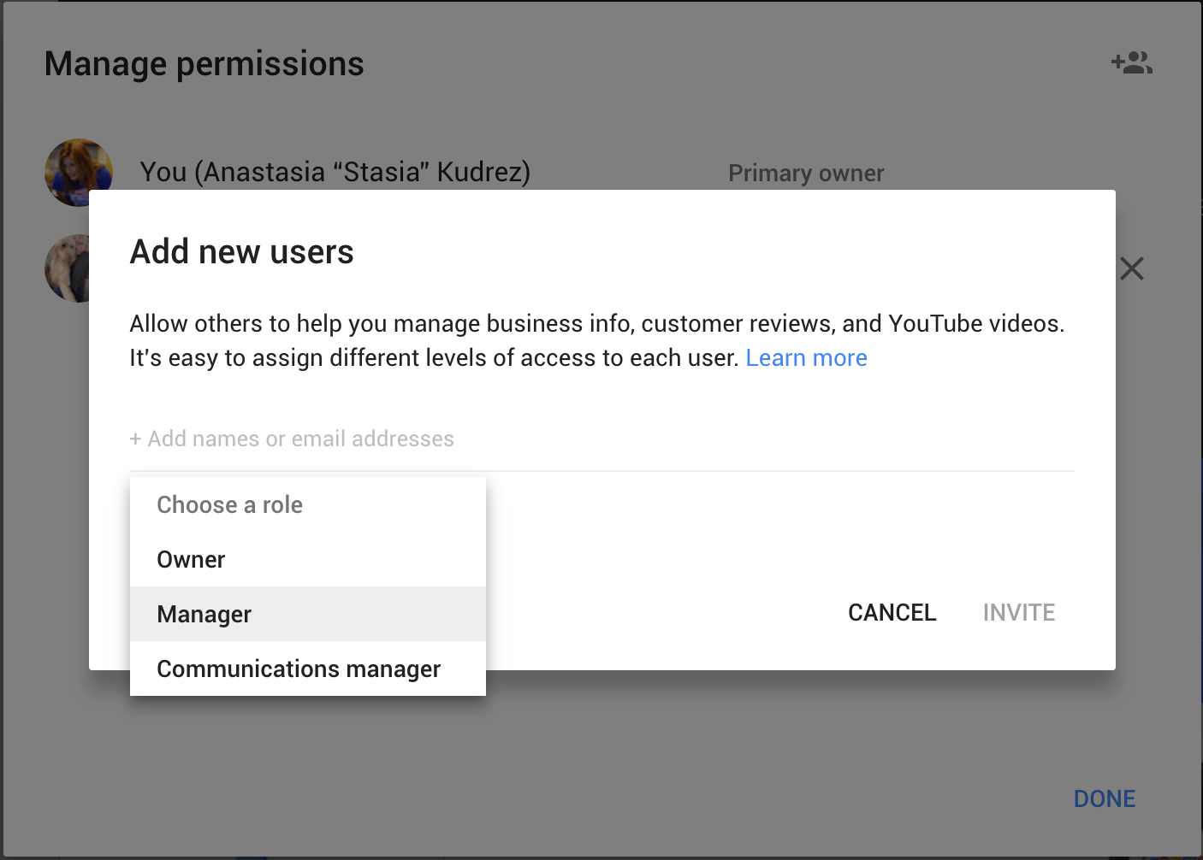
Add managers to help
TAKE A TOUR OF GOOGLE MY BUSINESS
First, click “Users”
Next, invite managers by adding their email addresses
Choose their access level
Notes:
The owner of the business listing can invite other people to manage the information.
Incidentally, inviting another person gives them access to this Google My Business listing, but not any other Google products you might use, like Gmail. In other words, they can’t read your email.
To add a manager, click “Users” from the left side navigation.
Click the icon of the people at the top right corner.
Now, add the email addresses of the managers you’d like to invite.
There are four access levels: Owner (that’s you, unless your transfer ownership); Co-owners, Managers (they can do almost everything owners can do, except delete the listing or transfer ownership); and Communications Managers (they have more limited access to the business listing).
When you’re done, click “Invite” to send an email to the new page managers. Once they open the email and accept the invitation, you will see them listed as authorized managers.
As the owner, can you revoke access to the business listing or transfer ownership.

Slide 31
How to create a website, step by step
Notes:
Google My Business includes the option to create a free, simple website, generated with the info from the business listing.
It’s a great starting point to being online, perfect for small businesses who do not yet have a web presence.
Creating a website with Google My Business takes about five minutes.
There are three steps to creating a website with Google My Business.
Click “website” in the left side navigation and the info from the business listing will be used to generate the website.
You have the option to customize some elements of the site, including the theme, text, and photos.
When you’re ready to go live, click the Publish button.
Let’s take a look.

Slide 32
Choose “website” from navigation
HOW TO CREATE A WEBSITE, STEP-BY-STEP
Click “website” to get started
Notes:
Step #1: click “Website” in the left side navigation.
Business info is used to create the site.

Slide 33
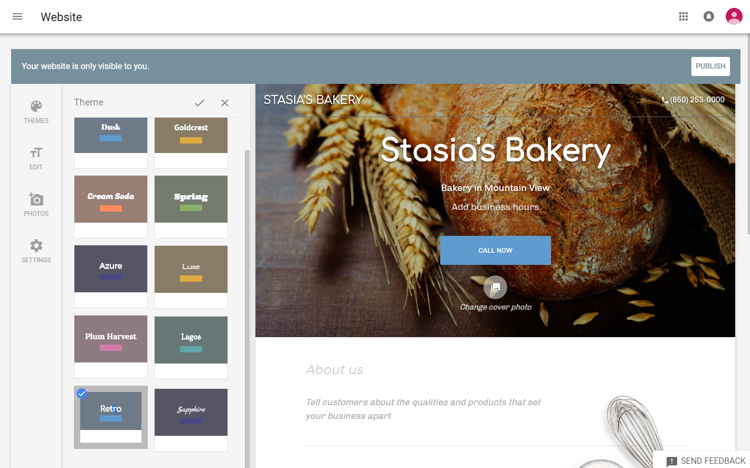
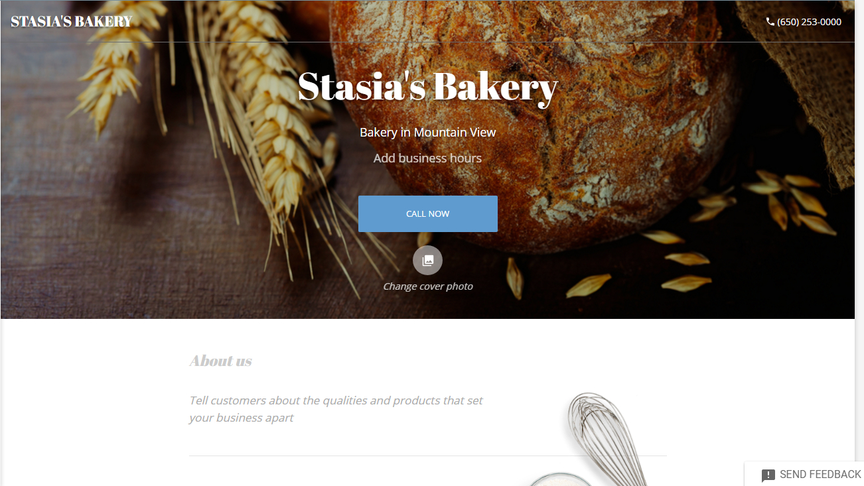
Edit your website
HOW TO CREATE A WEBSITE, STEP-BY-STEP
Select “Themes” to change the site design
Select “Edit” to add text to your website
Select “Photos” to add images to your website
Notes:
You will see a preview of your website.
To make edits, click the items in the left menu.
The first option is to edit the “theme” of the website.
Themes change the color palette and fonts for your site.
Choose the theme that best matches the personality of your business.
When you’re done, click the checkmark icon at the top to save your selection.
To edit the text on your site, click “Edit” in the left side navigation.
You can customize four sections.
Headline: the main title of the website
Description: the text that appears directly beneath the headline, perfect for a tagline.
Summary header: appearing further down this page, this is the title that appears above the main content on the web page.
Summary body: where you can enter the text for your website, like a welcome message, a description of your products and services, and any other relevant information for potential customers.
When you’re done, click the checkmark icon at the top to save your work.
If your Google My Business listing includes photos, they will automatically appear as a gallery on your website.
You can add additional images by choosing “Photos” from the left side navigation and uploading them to your website.
On a related note: you may have noticed a link labeled “Change Cover Photo” beneath the title of your website.
If you click that link, you can change the image that appears as the background at the top of your site, by uploading your own.
The default images are based on your business category.

Slide 34
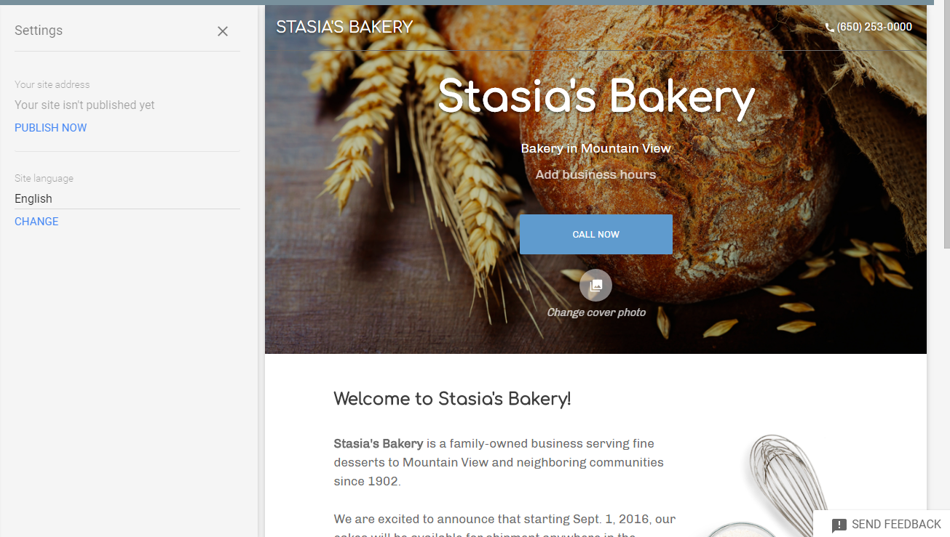
Manage settings and publish
HOW TO CREATE A WEBSITE, STEP-BY-STEP
Select “Settings” to publish or unpublish your site, change the domain name, or change default language.
Or, click the “Publish” button
Notes:
The Settings option allows you to Publish (or then unpublish) your website.
You also have the option to change the default language for the website. This updates any text that appears as part of the site template. It does not translate any custom text you enter.
Once you’re are happy with the your website, send it live by clicking “Publish” in the “Settings” section.
You can also do this by clicking the “Publish” button at the top right corner.
You also have the option to “unpublish” your site from within the Settings section.

Slide 35
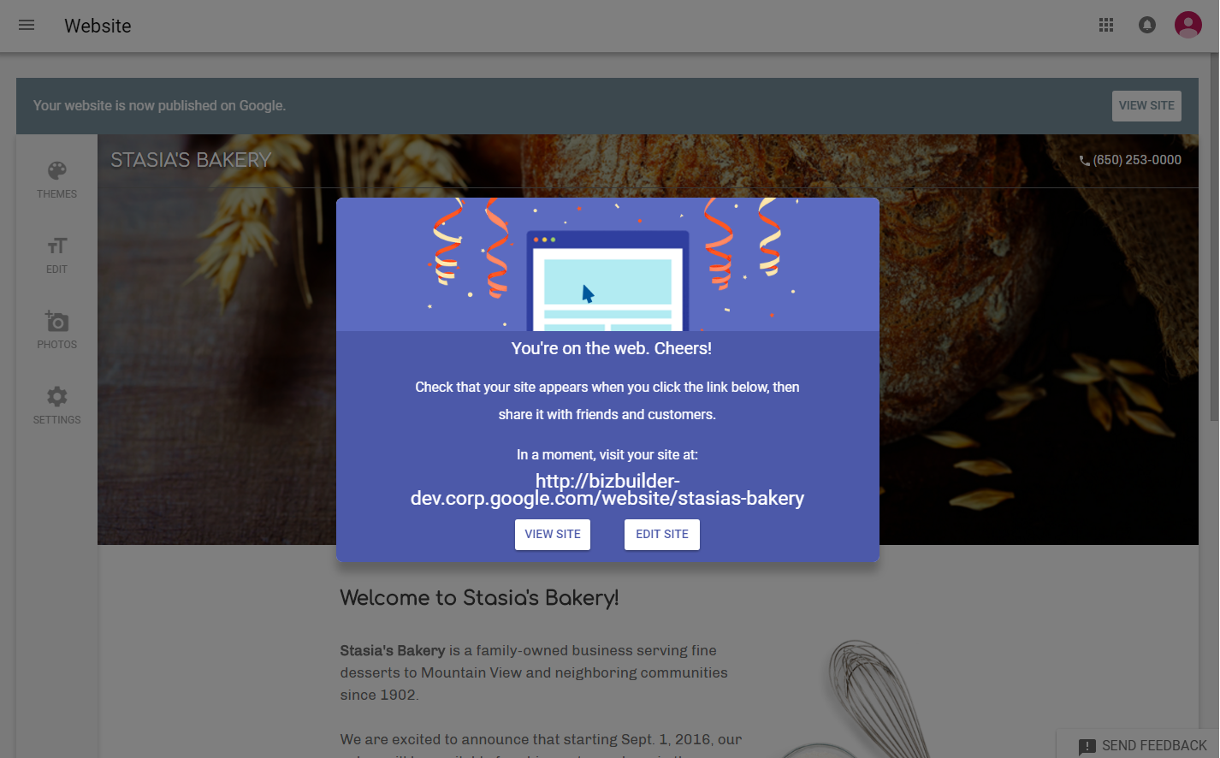
Choose a website address
HOW TO CREATE A WEBSITE, STEP-BY-STEP
You have two options:
[your business name].business.site
Use a custom domain name
Notes:
Next, you will create an address for your business.
The first option is free. You can customize your website address by entering the first part of the domain name. It will automatically be followed by dot business dot site.
So, if you entered the name “stasiasbakery” your website address would be: stasiasbakery.business.site
Alternatively, you can register your own domain name. This option is not free; you will need to register the domain through Google Domains.
If you already registered a domain name—even with a registrar other than Google—you can use it for your new Google site.
To do so, you’ll need to either login to your hosting company account and choose a “Redirect” option or similar, or contact your hosting company and tell them to redirect your existing domain to your new Google site.
Once you find a redirect option, point your domain to the URL for your new site provided during the Google My Business site creation process.
To find your new site’s URL, return to Google My Business, select Website from the menu, and then click Settings in the toolbar on the left side. At the top of the panel that appears, you’ll see your site address.

Slide 36
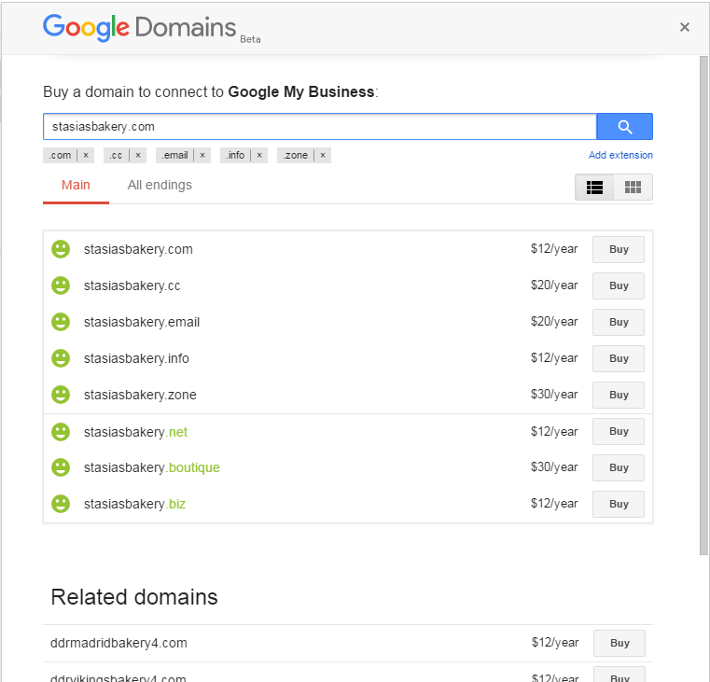
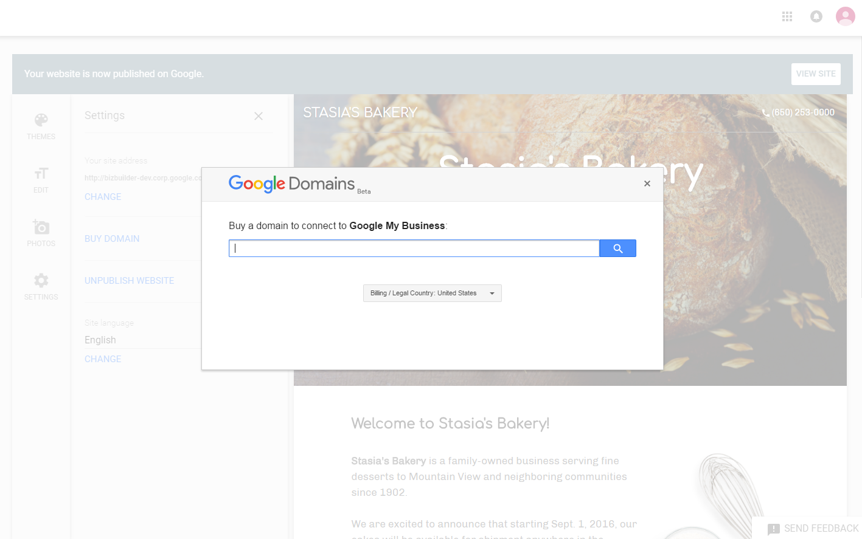
You can register a domain with Google Domains
HOW TO CREATE A WEBSITE, STEP-BY-STEP
Search for a domain name
Choose a domain for your site
Notes:
If you choose the option to register your own domain name, you will see a search box.
Enter a domain name you’d like to use for your website.
For example, this business, Stasia’s Bakery, might search for “stasiasbakery.com.”
You will see a list of available domain names.
If the domain you wanted is available, it will appear in the list.
You will also see other variations of the domain you searched for.
The cost you see is for a year (please note: the renewal price may be different.)
Prices also vary by the domain name extension (e.g., .com, .net, .org, etc.).
If you see a domain name you’d like to use, click the “Buy” button next to it.
To complete the domain name registration, enter your billing details.
Once submitted, your domain name will be registered and automatically connected to your Google My Business website.

Slide 37
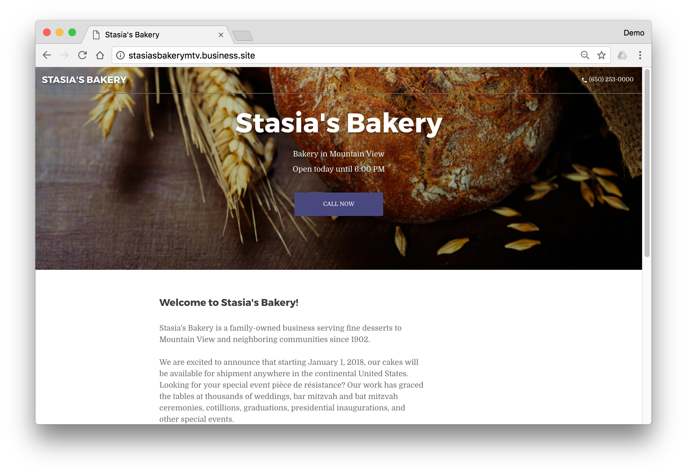
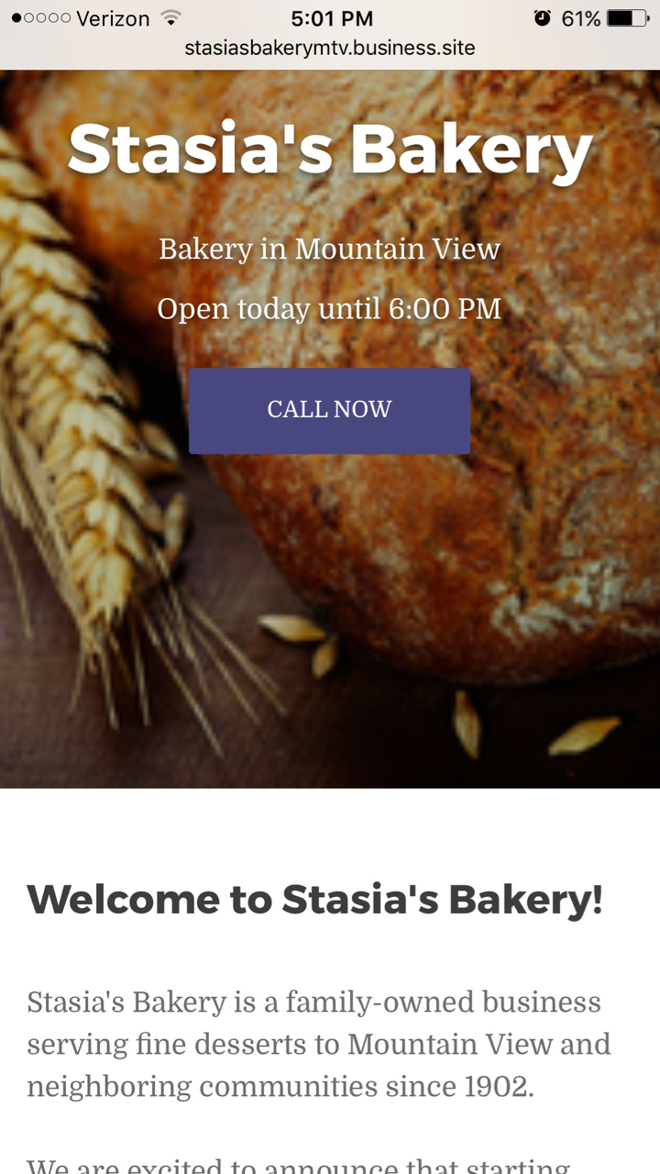
Congrats, you’re on the web!
HOW TO CREATE A WEBSITE, STEP-BY-STEP
Notes:
And that’s it!
You can sign into your Google My Business account at any time to access, edit, publish or unpublish your website.

Slide 38
Thank you
After today, sign in at google.com/business
Notes:
Congratulations, you’re ready to set up Google My Business!
You can access and edit business information anytime via the Google My Business dashboard.
To return, visit: www.google.com/business and sign in.
Thank you so much for attending today’s session.
If you have any more questions, we’ll be here for the remainder of the session to help.

Slide 39
Workshop Time
GET FOUND ON GOOGLE SEARCH AND MAPS
1
Visit gybo.com/business
2
Search for your business. Claim or complete the listing.
3
If you have documents for Instant Verification, raise your hand. We’ll scan your QR code.
4
If not:
Do NOT request a postcard. Click “Verify later.”
Visit gybo.com/verifymybusiness
Fill out form using complete email address associated with the listing.
Look for a confirmation email (give us a few days).
Need Help? Raise your hand.

Slide 40
Please fill out our survey
GET FOUND ON GOOGLE SEARCH AND MAPS
gybo.com/survey
Notes:
*

Slide 41
Thank you to our Sponsors! Please complete an evaluation form

Slide 42
Thank you to our Sponsors! Please complete an evaluation form

Slide 43
This presentation can be found at
https://www.santacruzpl.org/brownbags/

