Slide 1
Integrating libraries into
mixed-use structures
Notes:
Libraries are being integrated into many mixed-use projects! The proposed mixed-use structure is not an anomaly to Santa Cruz -- it is part of a growing movement to use libraries to anchor buildings in a mutually beneficial way. Although the libraries tend to be on the first floor in these structures, they are not “buried” or feel like they are in a “basement.” They are generally beautiful, high-ceilinged, welcoming spaces, filled with natural light and great ventilation. The following examples range from small neighborhood branch libraries to the main libraries of large cities, and may not be appropriate for the character of our Santa Cruz downtown. However, they all show how mixed-use structures that contain libraries can keep both neighborhoods vibrant and libraries viable in the 21st century.

Slide 2
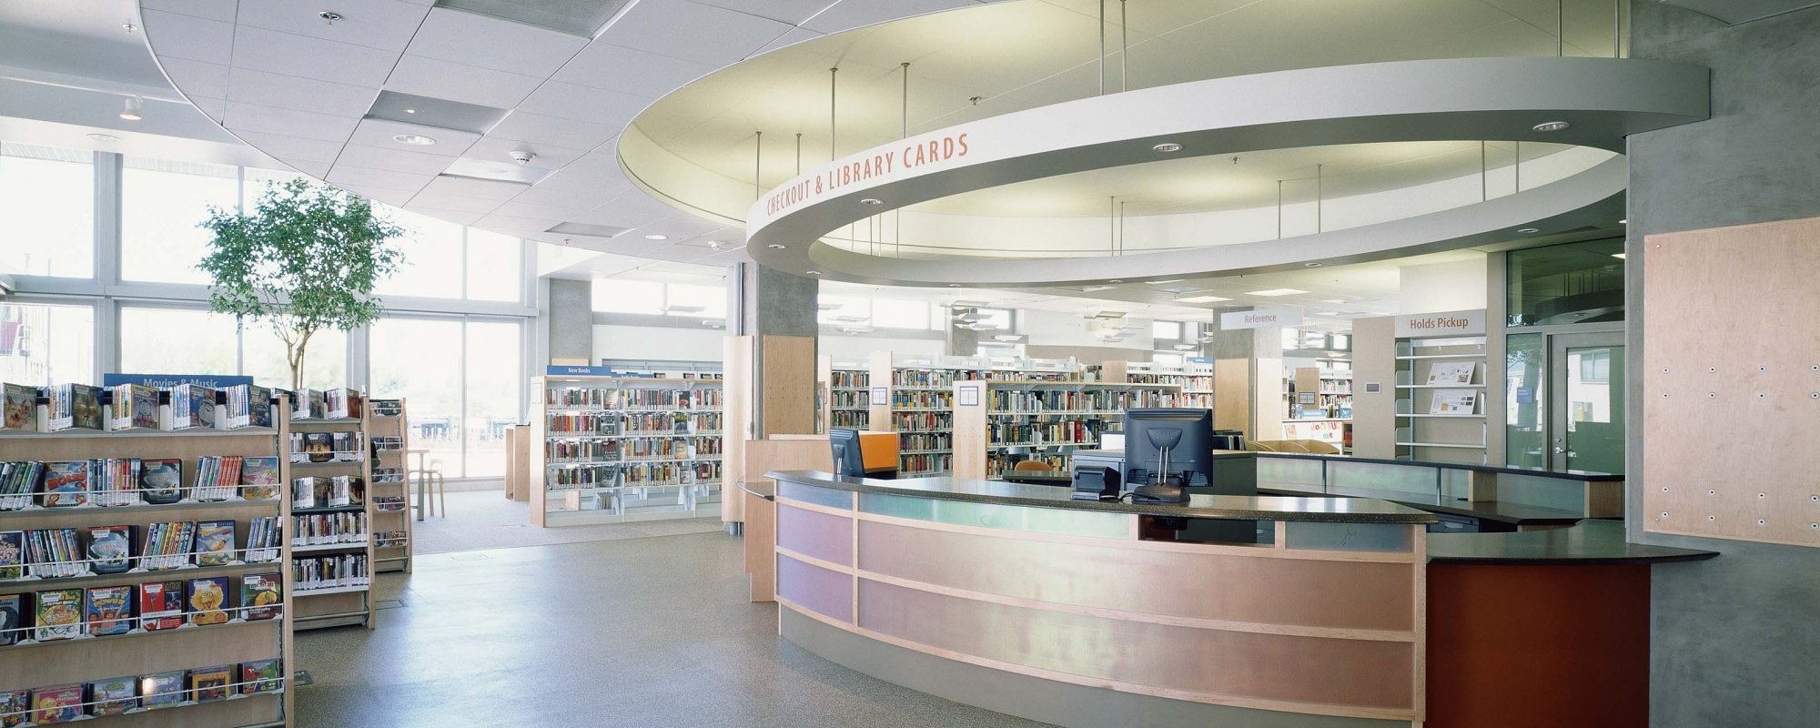
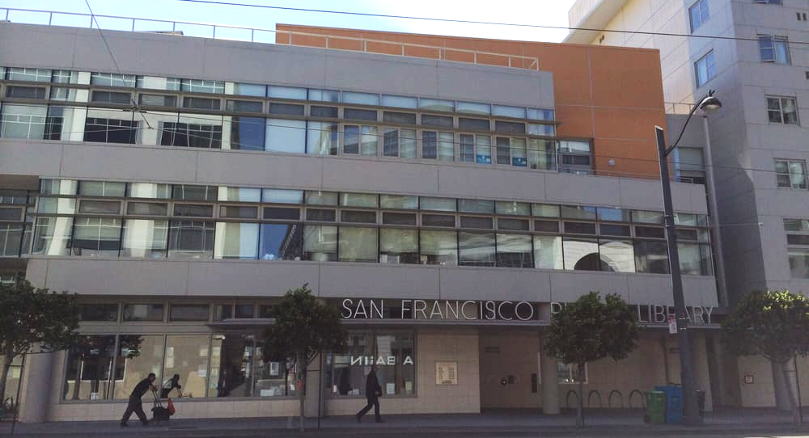
Mission Bay in SF, with Housing & Adult Day Center
Notes:
This is a tiny 7,500-square-foot library located on the ground floor of a multi-use facility in San Francisco. (By comparison, our library is 44,000 square feet.) In addition to the library, the building houses an adult day health center, affordable senior housing, retail space and a large community meeting room. The inside is bright and airy, and filled with natural light. In fact, many of the yelp reviews talk about how much they love the natural light in this library. (Bottom photo courtesy of Yelp.)

Slide 3
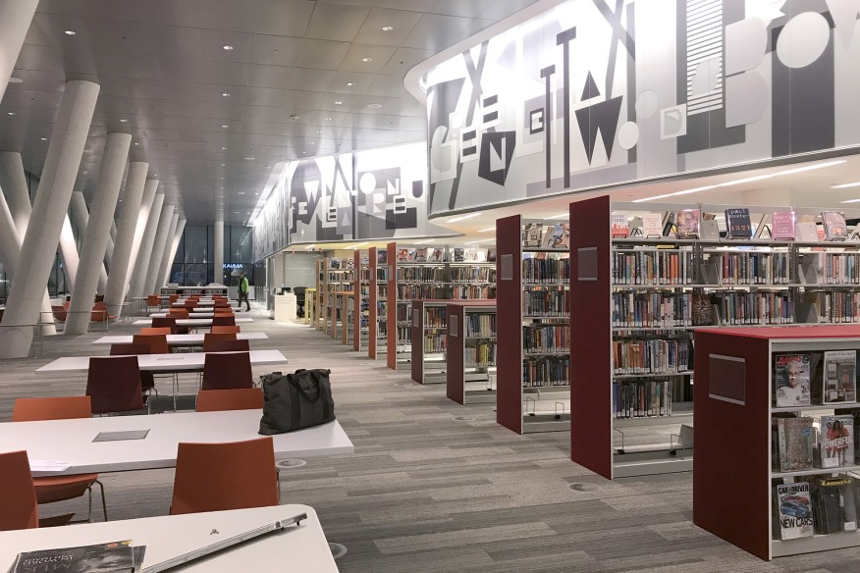
West End Library, Condos, and Apartments in DC
Notes:
This library in Washington, DC is on the ground floor of a nine-story building that contains a “tower of rental units.” However, you wouldn’t know it from the inside -- it feels airy and spacious. This neighborhood branch library is about half the size of ours, at 21,000 square feet. The second floor of the multi-use structure has meeting rooms and staff offices. The rest of the building contains condos and many rental units.

Slide 4
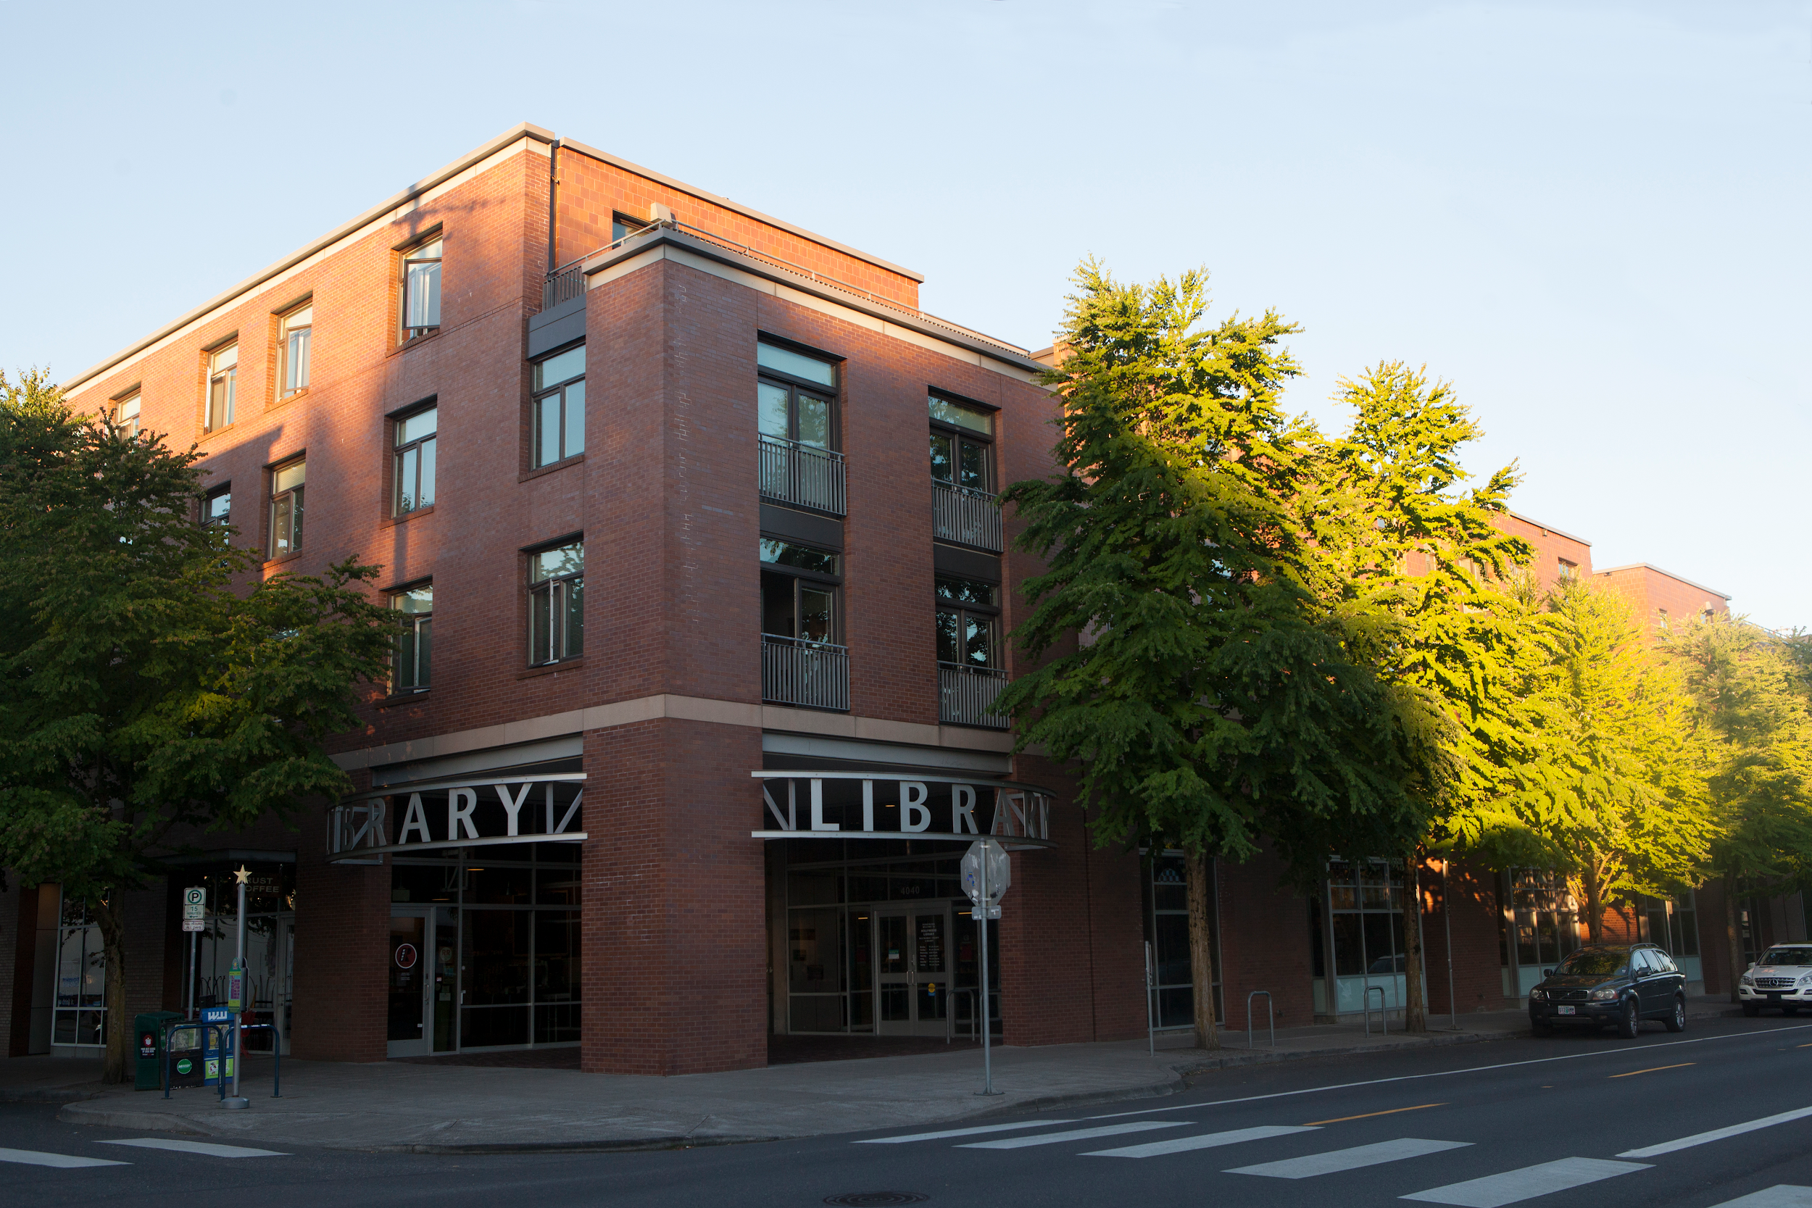
Hollywood Library and Apartments in Portland, OR
Notes:
This is a small neighborhood branch library of 13,000 square feet, with 47 mixed-income apartments above, with a total of four floors.

Slide 5
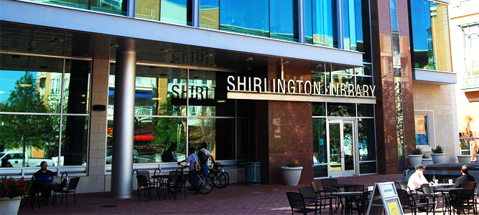
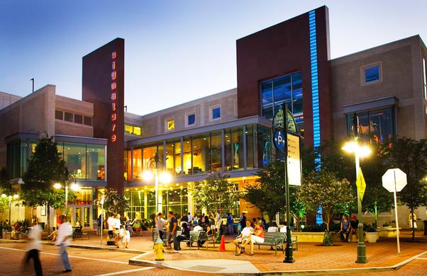
Shirlington Library, Theater, and Parking Garage
Notes:
This is an example of a library becoming an integral part of an economic and cultural anchor building in Arlington County, Virginia. This is a public-private partnership. In the four-story building, a branch of the county library occupies the first floor, and the theater (for plays) is on the second, third and fourth floors, and is adjacent to a 750-space parking garage. The vibrant and art-filled courtyard unites the entrances. Although it is underneath a theater, this branch has a reputation as a great place for concentrated studying. The branch manager confirmed that they have never received a complaint about noise from the theater or parking garage.

Slide 6
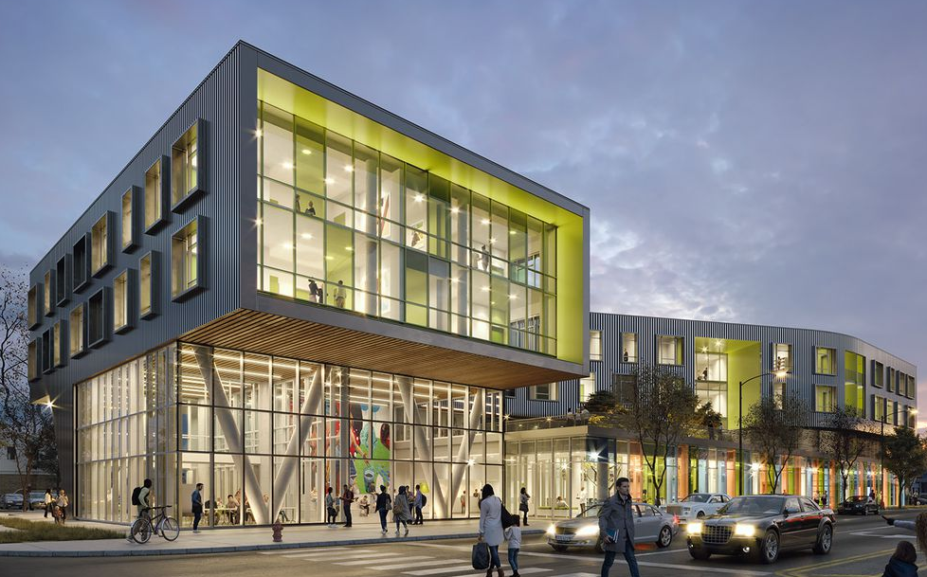
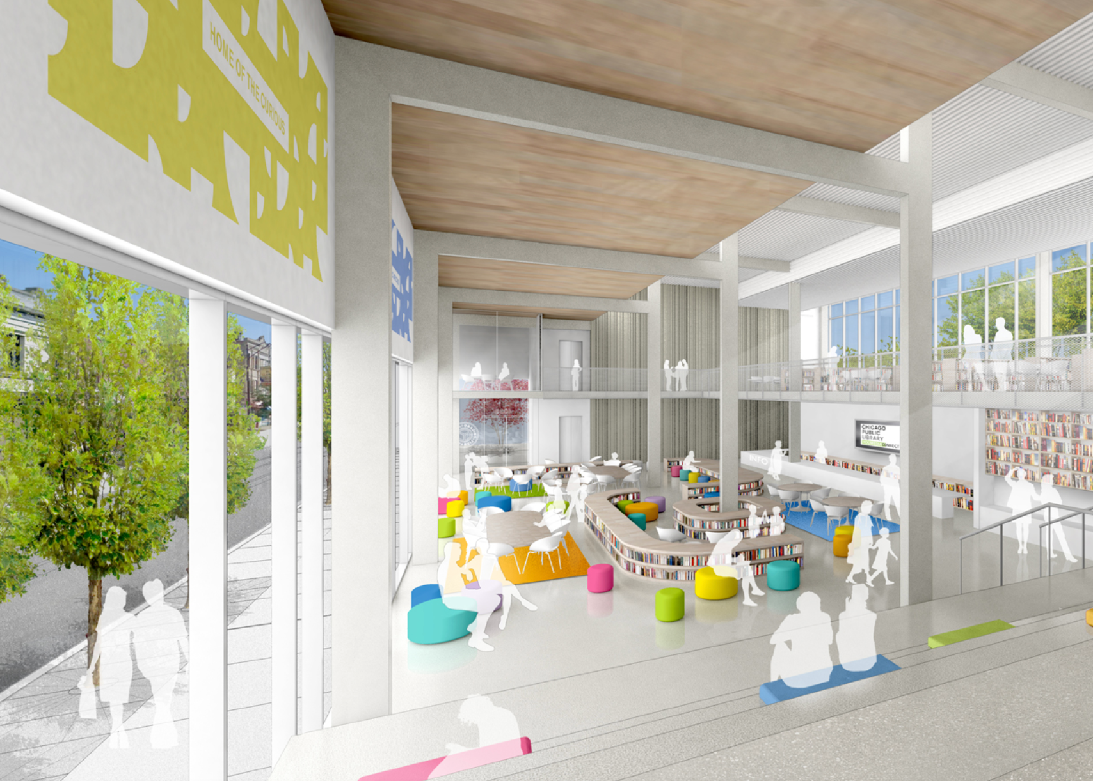
Chicago Branch Libraries with Affordable Housing
Notes:
Chicago is in the process of rebuilding many branch libraries in mixed-use structures with housing. For example, the West Ridge Branch project in the left photo will soon feature a glassy, 16,000-square-foot ground-floor library space topped by 44 senior housing units. The right photo is of their Independence Branch, currently under construction. Although it will be on the bottom two levels of a six story building, the library will be flooded with natural light and high ceilings. From inside the library, the design ensures that one would never feel like four stories of housing are above. The four upper levels will contain 44 apartments comprising of 30 public housing units and 14 affordable-rate units.

Slide 7
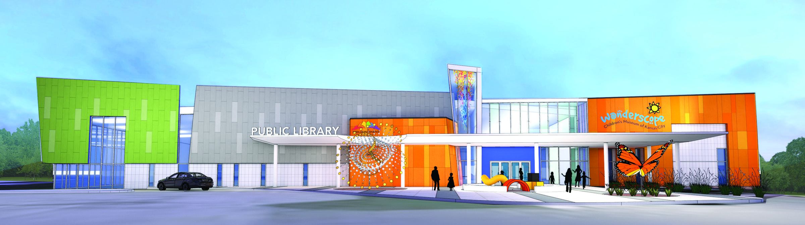
Kansas City Proposed Library & Children’s Museum
Notes:
A children’s museum in Kansas City is currently raising funds to build a joint structure with a branch library, and hope to have the building open within two years.

Slide 8
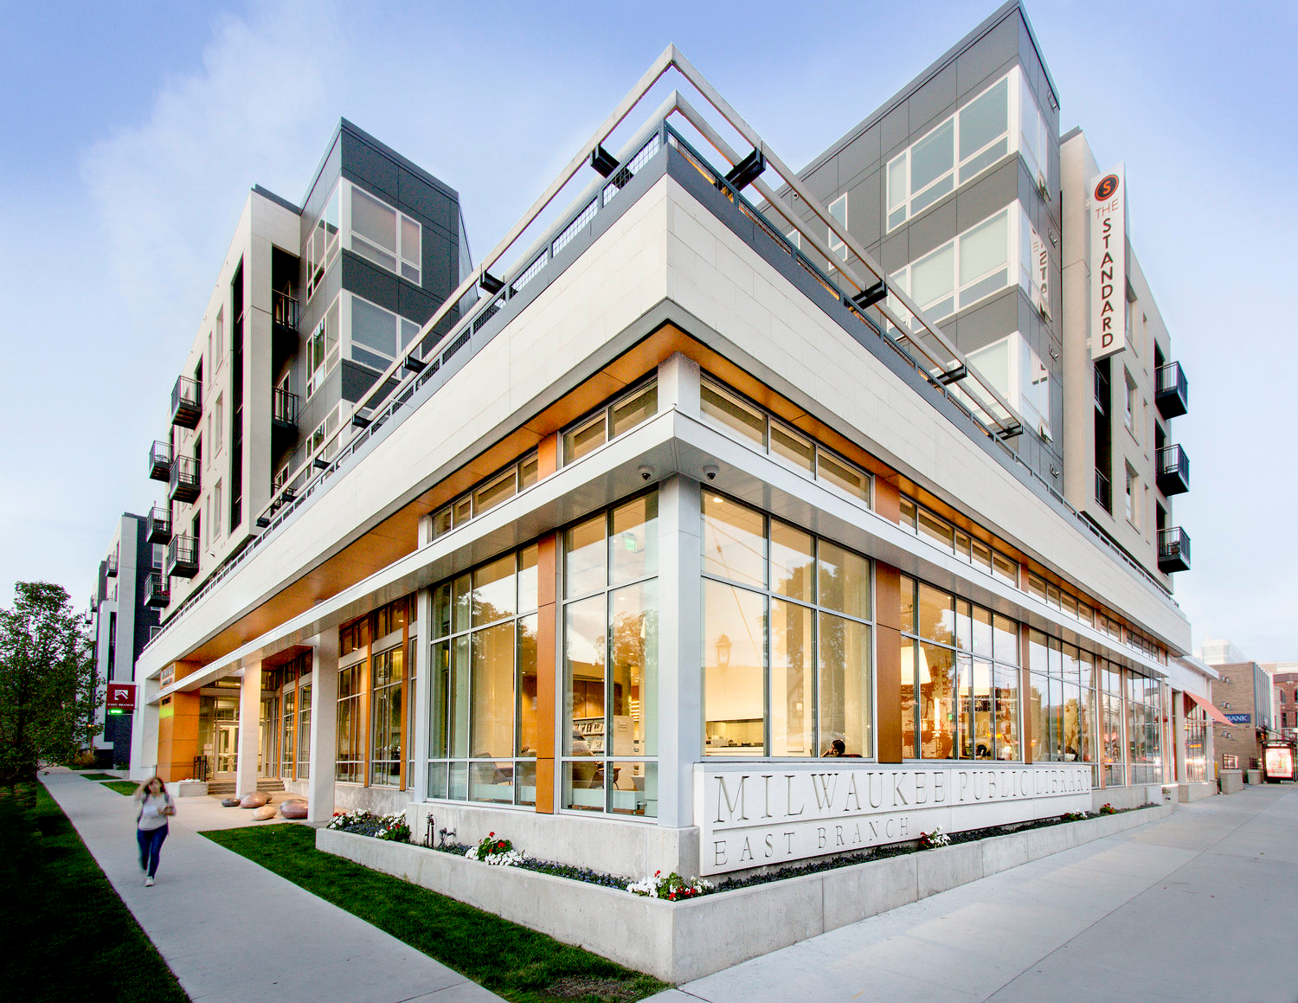
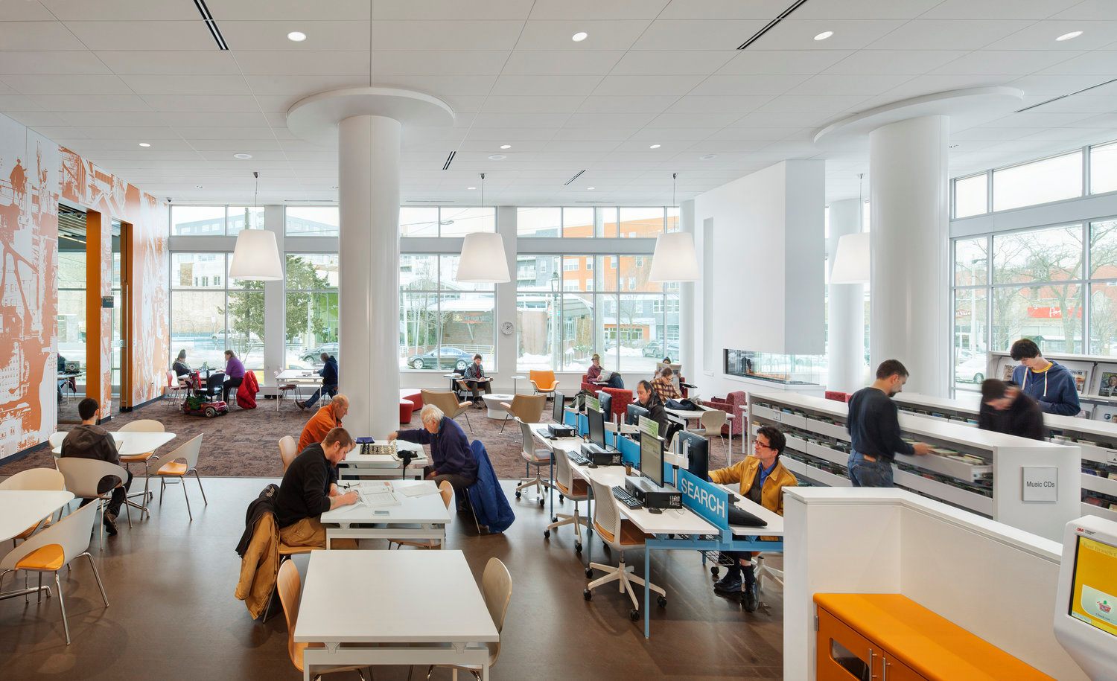
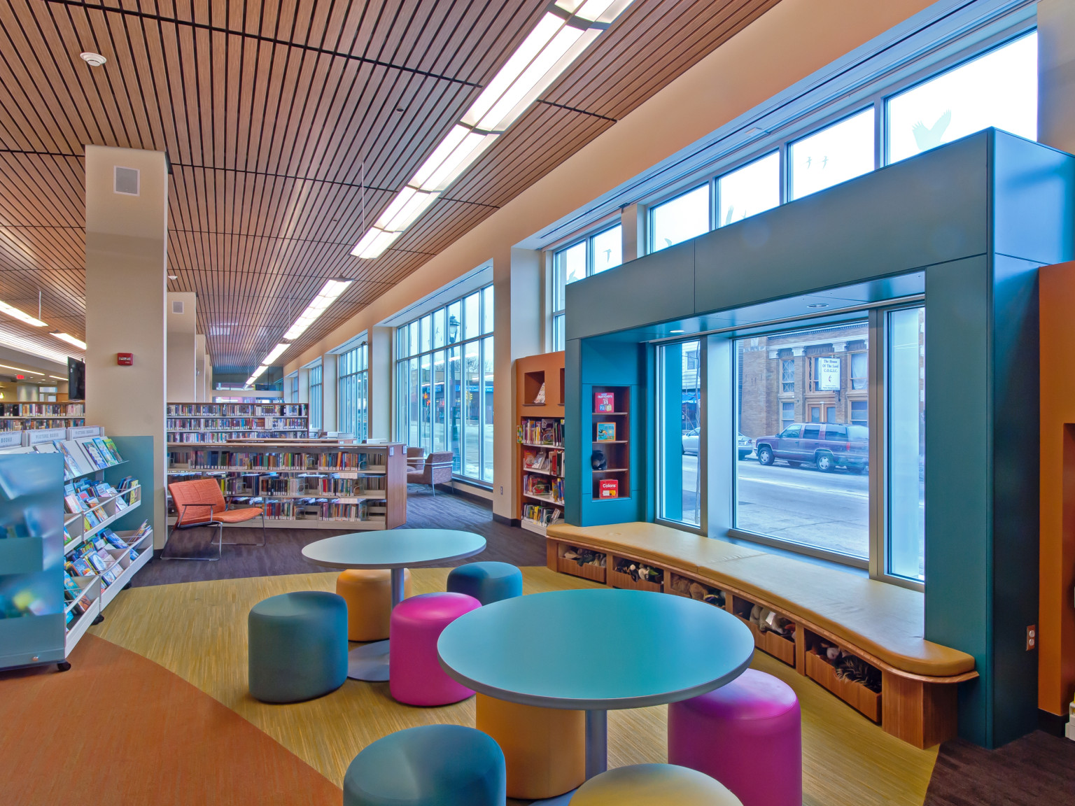
Milwaukee Libraries with Housing and Parking
Notes:
The Milwaukee Library System is currently converting many of their branches to mixed-use structures. The large picture and the one in the right corner are the East Branch library, a 16,000 square foot library in 5-story building with 99 apartments, parking, and retail space. The Milwaukee Public Library Villard Square Branch, pictured in the bottom corner, is in a mixed-use development that includes the library on the first floor, with 47 apartment homes on three stories above for families where grandparents are the primary caregivers for their grandchildren. Both feature high ceilings, many windows, and a welcoming design.

Slide 9
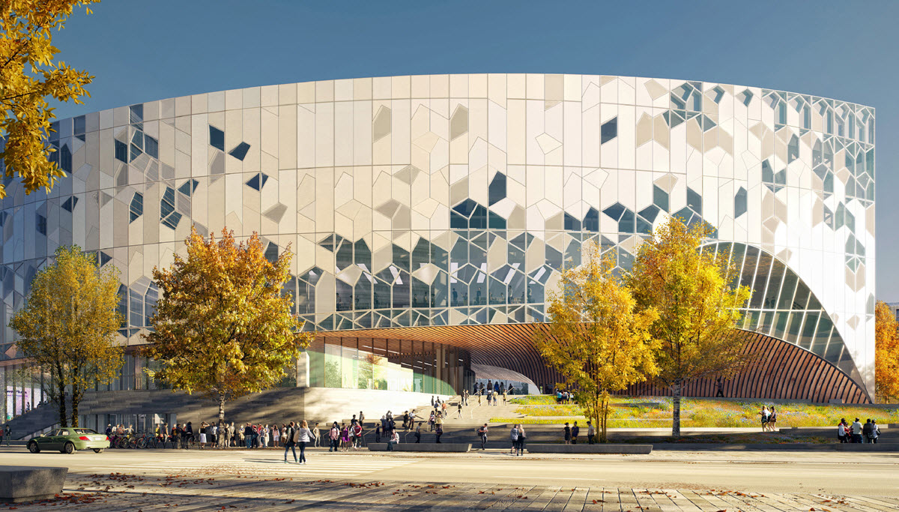
Calgary Library over Light Rail Transit
Notes:
This is a project which dwarfs the scope of anything Santa Cruz would consider, but it shows how a library and transportation can coexist. In Calgary, Canada, a 240,000 square foot, five-story building is slated to open this November. Underneath the building is an active LRT (light rail transit) line. They encapsulated the rail lines and used that as a foundation for the building above, while insulating the building from noise and fumes.

