Slide 1
Spotlight on Collections
At Santa Cruz Public Libraries
www.santacruzpl.org connect | inspire | inform

Slide 2
Santa Cruz Public Libraries
Total physical items in collection: 484,175
Adult materials: 276,304
Teen materials: 15,278
Kids materials: 129,933
www.santacruzpl.org connect | inspire | inform

Slide 3
eResources
Ebooks, eAudiobooks, Movies/TV, Music, and Magazines
www.santacruzpl.org connect | inspire | inform

Slide 4
eResources
Reference Databases and eResearch
Value Line
Newspapers.com World Collection
Consumer Reports
Ancestry Library Edition
Morningstar
BookBrowse
America’s News
EBSCOhost Masterfile
Gale General Onefile
HeritageQuest
www.santacruzpl.org connect | inspire | inform

Slide 5
Types of Collections at SCPL
www.santacruzpl.org connect | inspire | inform

Slide 6
Who decides what is in the collection?
A team of selectors with assigned categories: audiobooks, adult fiction, adult nonfiction, youth materials, Spanish materials, DVDs and CDs, periodicals, and databases.
www.santacruzpl.org connect | inspire | inform

Slide 7
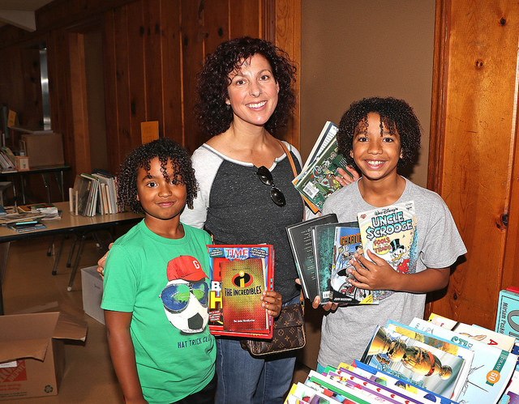
How do we decide what goes in to the collection?
Patron demand
www.santacruzpl.org connect | inspire | inform

Slide 8
Review journals
KIRKUS
New York Times Book Review
www.santacruzpl.org connect | inspire | inform

Slide 9
Award winners
National Book Award
Newbery Medal
Man Booker Prize
Caldecott Medal
Beatty Award
Coretta Scott King Award
Pura Belpre Award
Geisel Medal
Michael L. Printz Award
Nobel Prize in Literature
Pulitzer Prize
www.santacruzpl.org connect | inspire | inform

Slide 10
Local buzz
Bookshop Santa Cruz event
Profile in a local newspaper
Local author
Partnership with local schools
www.santacruzpl.org connect | inspire | inform

Slide 11
Data
Polaris (ILS) reports
collectionHQ: a decision support tool, giving us the data we need to make our decisions
ESP: evidence-based selection planning
www.santacruzpl.org connect | inspire | inform

Slide 12
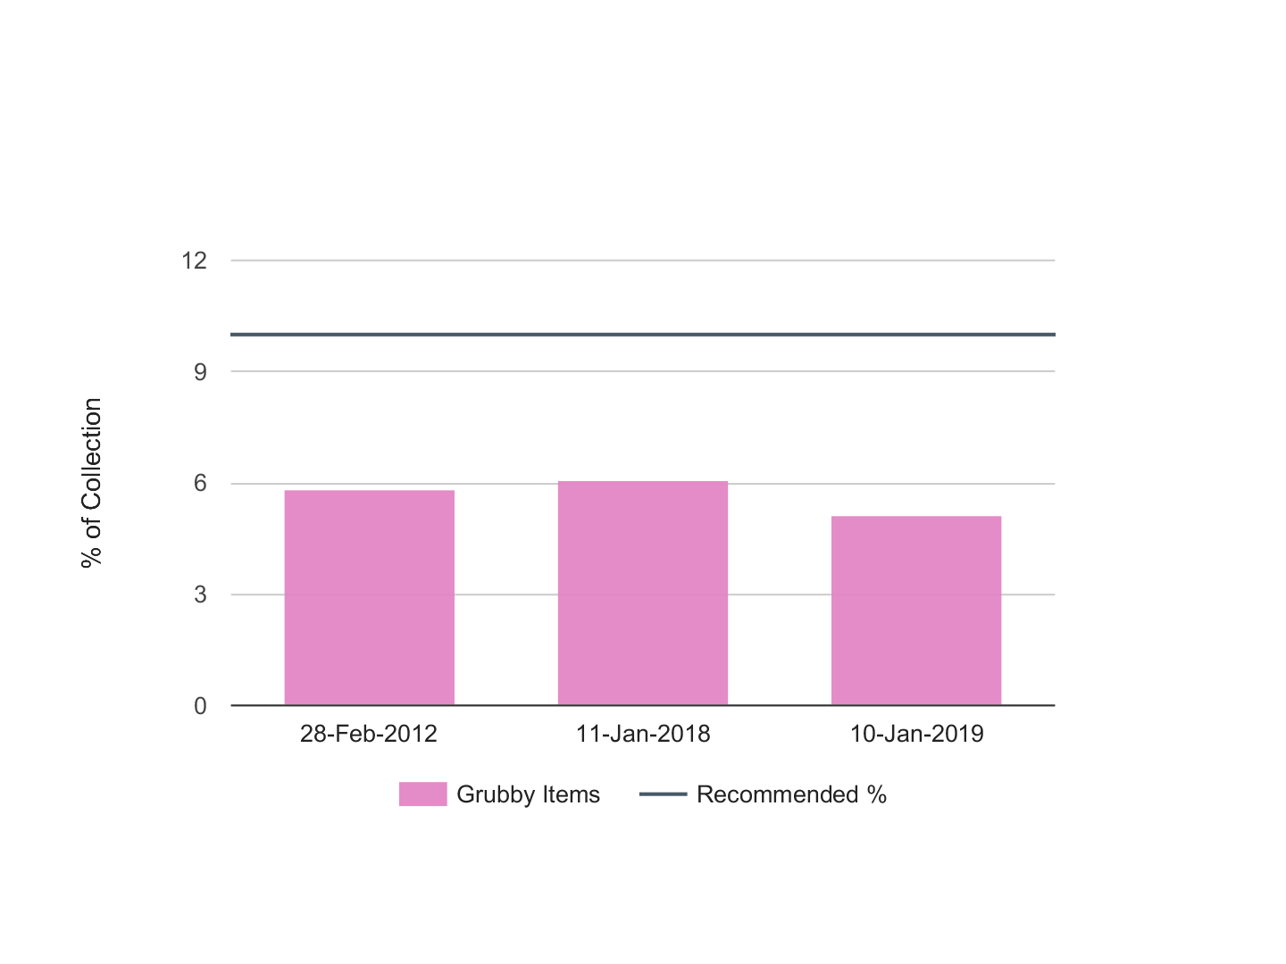
Grubby Items
Audience: All
Library Branch: All

Slide 13
Standing orders
www.santacruzpl.org connect | inspire | inform

Slide 14
Diversity and Inclusion
Image credit: We Need Diverse Books https://diversebooks.org/about-wndb/
www.santacruzpl.org connect | inspire | inform

Slide 15
Budget
www.santacruzpl.org connect | inspire | inform

Slide 16
www.santacruzpl.org connect | inspire | inform

Slide 17
www.santacruzpl.org connect | inspire | inform

Slide 18
Collection Maintenance (weeding)
Poor physical condition
Obsolete, dated, or incorrect information
Number of copies exceeds demand
Subject or title adequately provided by other materials in the collection
Providing out of date and incorrect information creates a barrier to knowledge.
www.santacruzpl.org connect | inspire | inform

Slide 19
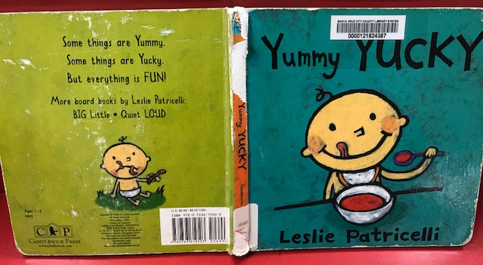
www.santacruzpl.org connect | inspire | inform

Slide 20
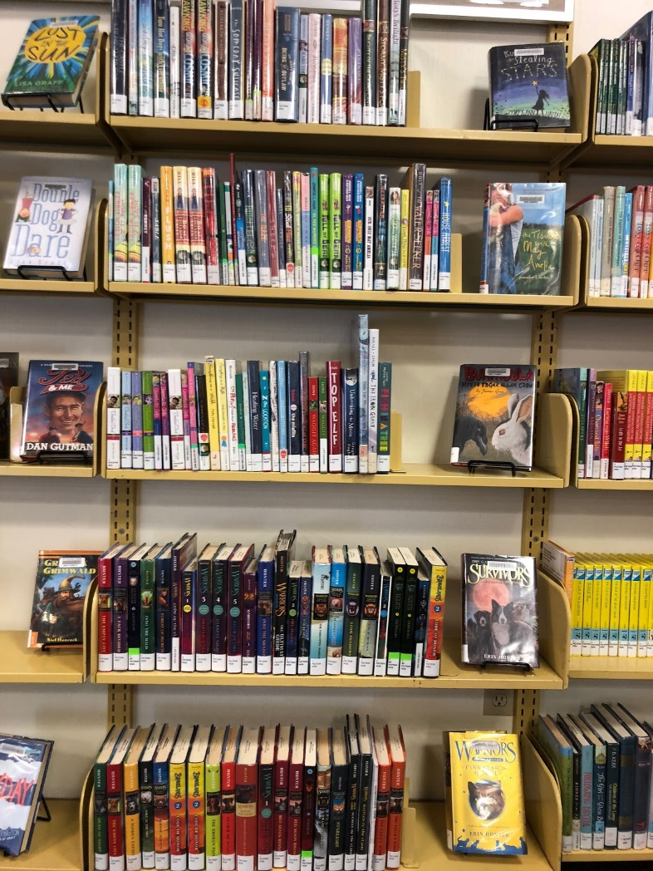
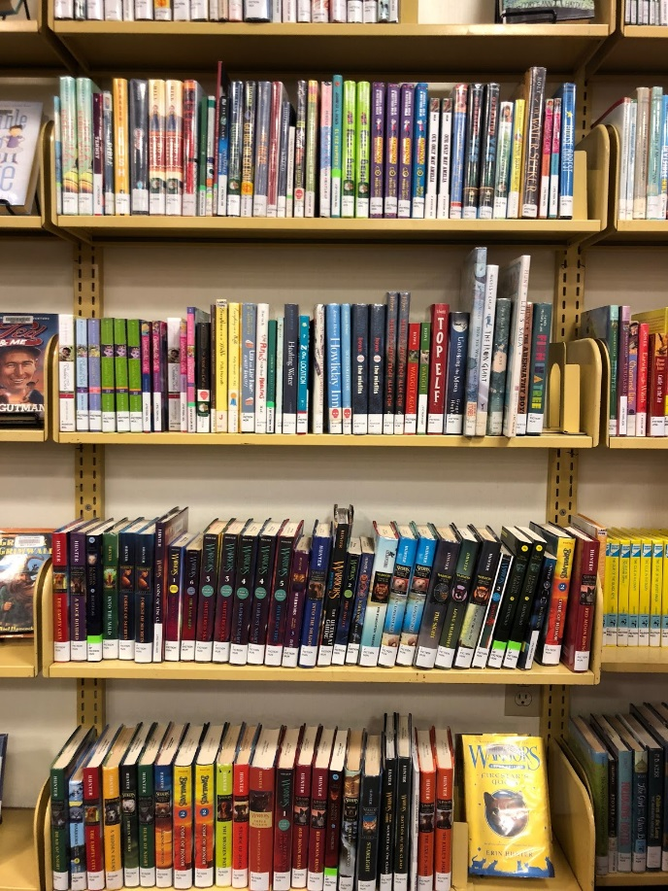
Before
After
www.santacruzpl.org connect | inspire | inform

Slide 21
Is this the end of the road?
Friends of the Santa Cruz Public Libraries sell materials in good condition at their book sales to benefit the library
Books that aren’t given to the Friends go to Better World Books, a nonprofit organization that champions literacy. Their partners include Books for Africa and Feed the Children.
Unfortunately, some items are too damaged for reuse and must be discarded.
www.santacruzpl.org connect | inspire | inform

Slide 22
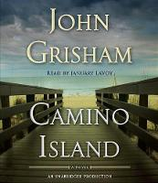
Top Circulating Titles 2018
Audience: All
Library Branch: All
1 2 3 4 5
6 7 8 9 10

Slide 23
Most requested items, January 2019
Becoming, by Michelle Obama
Book: 134
Large Print: 116
Audio CD: 67
eBook: 125
eAudio: 220
Educated, by Tara Westover
Book: 116
Large Print: 32
Audio CD: 25
eBook: 94
eAudio: 66
The Library Book, by Susan Orlean
Book: 94
Large Print: n/a
Audio CD: 16
eBook: 30
eAudio: 33
Crazy Rich Asians
DVD: 86
www.santacruzpl.org connect | inspire | inform

Slide 24
Most requested items, January 2019
Orion StarBlast Telescope
Telescope: 86
Blackkklansman
DVD: 75
Bohemian Rhapsody
DVD: 70
Old Man and the Gun
DVD: 69
www.santacruzpl.org connect | inspire | inform

Slide 25
Thank you!
www.santacruzpl.org connect | inspire | inform

