Slide 1
Providing Health Care and Housing Services During COVID-19 to People Experiencing Homelessness
County of Santa Cruz – Homeless Persons Health Project
Joseph Crottogini, MPH
Health Center Manager
Homeless Persons Health Project

Slide 2
Homeless Persons Health Project 115-A Coral St., Santa Cruz, CA 95060 831-454-2080; HPHPReferral@santacruzcounty.us
The mission of the Homeless Persons Health Project is to eliminate homelessness by providing comprehensive health care and housing for everyone.
Healthcare for the Homeless, Patient Centered Medical Home
Primary Care, integrated behavioral health, substance use disorder services including medication-assisted treatment & acupuncture

Slide 3
12 bed recuperative care center
On-site medication dispensary
Benefits advocacy and money management program
Permanent Supportive Housing Programs
Housing Navigation and Case Management
Outreach + Harm Reduction Services, Narcan distribution program
Project Connect – team for frequent users of the ER

Slide 4
Recuperative Care Center
Partnership with HPHP & Housing Matters
HPHP provides all medical services
Serves an average of 68 patients/year
Average length of stay is 50 days
Notes:
Services include access to 24-hour bed rest, showers, nutritious meals, safe storage of medications and medical supplies, pharmacy services and medication management support, transportation to medical appointments, care provided on site, primary medical services, integrated behavioral health and substance abuse care, establishment of a medical home as needed, self-care management of chronic conditions, eligibility assistance for health insurance, disability and other benefits, and housing case management.

Slide 5
Permanent Supportive Housing
HPHP currently supports 93 clients in permanent supportive housing
Current clients have been housed an average of 5.5 years
Total of 195 clients receive case management from HPHP staff
Working with Coordinated Entry System

Slide 6
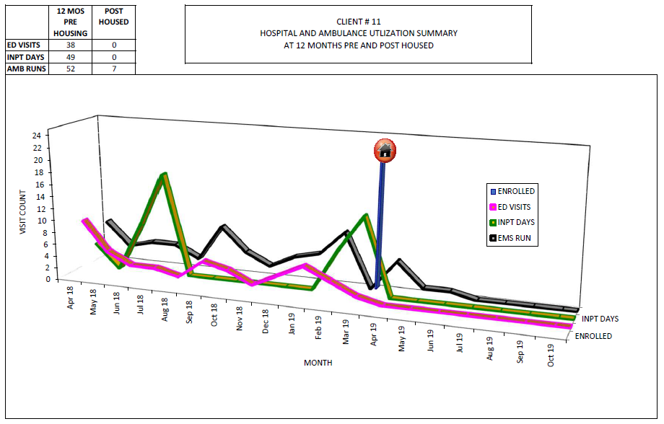
Housing Is Health

Slide 7
Homelessness & Risk for COVID-19
Medically Vulnerable
Congregate Settings
Advanced Age
Limited Ability to follow public health guidance
Stigma and discrimination

Slide 8
COVID-19 Recommendations for PEH
Establish isolation & quarantine (IQ) Space
Deliver services while in IQ
Assist shelters with screening and preparation
Provide services to encampments & other unsheltered
Expanded testing protocols
Coordinate PPE & supplies
Continued access to food programs
Source – National Health Care for the Homeless. (2020). Needed Actions from Public Health & Emergency Response Systems. Issue Brief April 2020.

Slide 9
Adapting to COVID-19
Social distancing measures, hand washing, disinfecting, PPE
Testing for COVID-19
Telehealth/Telemedicine Appointments
Supporting Shelter In Place for Individuals without Shelter
Non-COVID-19 Clinical Care
Notes:
On Testing - When testing followed identification of a cluster, public health teams found high proportions of residents and staff members also had positive test results: Seattle: 17% clients/17% staff, Boston: 36% clients/30% staff, and San Francisco: 66% clients/ 16% staff.
Tellingly, when testing was conducted in other Seattle shelters where only one previous case had been identified in each shelter, there was a low prevalence of infection (5% clients/ 1% staff). Similarly, when shelters in Atlanta conducted testing where no cases had been reported, a low prevalence of infection was also identified (4% clients/2% staff).

Slide 10
Coordinating Shelter In Place (SIP) & Isolation/Quarantine (IQ)
24/7 COVID-19 Nurse On-Call line
Nurse visits at IQ Motels
Site visits at expanded shelter sites
Coordinating prioritization of referrals for IQ

Slide 11
Barriers to Care
Homeless – no address
No phone
Transportation
Stigma in health care
Mental Illness, Substance Use, Trauma

Slide 12
Why Implement Outreach Teams?
Expand access to care – Reach most isolated, difficult to reach populations
Continuous Engagement
Preventative Medicine – Prevent outbreaks, decrease ER use
Low-cost to implement

Slide 13
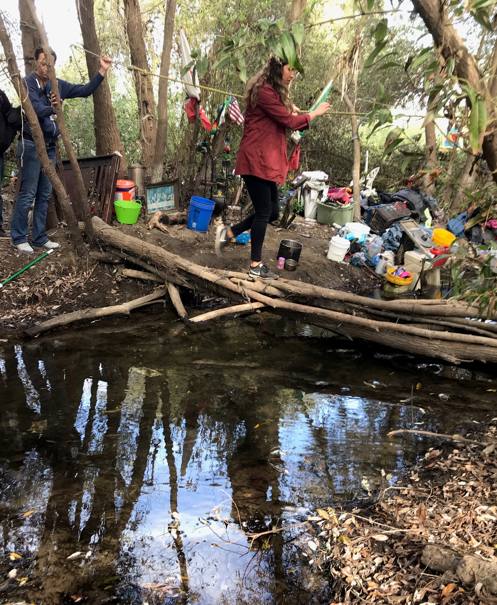
Effective Street Outreach
Street outreach staff receive regular training in evidence-based practices
Utilize harm reduction principles
Liaison to housing services
Coordinate with other agencies
Notes:
HOPES Team is one true MDT coordinating outreach efforts targeting individuals experiencing homelessness. The County of Santa Cruz hired the consultant firm Focus Strategies to assist community leadership and key stakeholders to evaluate, align, and improve the countywide response to homelessness. In one of their report, they found that while outreach does exist, it is not well coordinated between agencies, and recommended better coordination between other agencies to improve systematic response to homelessness that involves common goals, shared approach or protocols, understanding of geographic coverage, consistent data collection, and common outcomes. The Homeless Persons Health Project expects to take a leadership position in the efforts to coordinate outreach activities within the Health Services Agency, as well as throughout the community with other agencies involved.
Department of Housing & Urban Development, Department of Veteran Affairs, Department of Health & Human Services, and the National Alliance to End Family Homelessness produced several guidelines for effective outreach
Provide warm handoffs to coordinated entry or to shelter, housing, and service providers.

Slide 14
Street Medicine
Expanded outreach efforts, working with Homeless Outreach Service Sites (HOSS)
Provided ~300 sleeping bags, 75 tents, 100’s of blankets and tarps, rain gear, 1000’s of pairs of socks, 2000 Narcan kits, and hygiene supplies to homeless population throughout the year
Gateway for volunteers and interns to expand service capacity and opportunities for learning and recruitment
Notes:
Continued support of Syringe Services Program at Santa Cruz Health Center on Emeline Avenue
Expanded outreach efforts - Salvation Army shelter locations in Santa Cruz and Watsonville, downtown Santa Cruz, River Street Camp, Watsonville Levee, and other areas

Slide 15
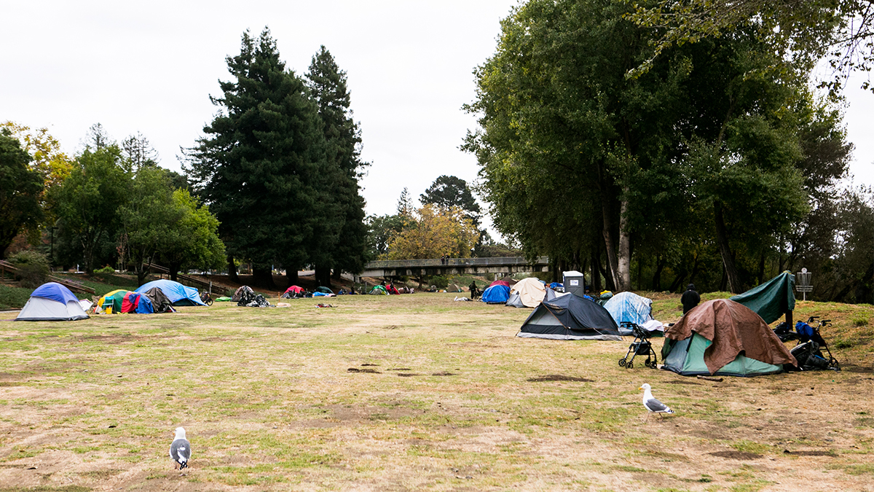
An Ecological Approach to Health Care – County of Santa Cruz Health Services Agency
Legal Assistance
Behavioral Health
Referrals
Primary Care
HIV/HCV Testing
MAT
HPHP Mobile Clinic – Street Medicine
Case Mgmt
SSP
Shelter
Wound Care
Naloxone
IOP + Inpatient SUD Programs
Coordinated Entry/Permanent Supportive Housing
Food
Image from Santa Cruz Good Times

Slide 16
Why Mobile Health Clinic?
2,000 mobile clinics located across the country.
Expanding access with 6.5 million visits annually.
Average return on Investment for mobile health is 12:1.
It is estimated that each mobile clinic results in 600 fewer Emergency Department visits every year.
Notes:
Average operational cost of a mobile program is $429k per year
On average each mobile health clinic saves 65 quality adjusted life years every year of operation. This means that each visit they save on average $1,600 due to this prevention

