Slide 1

Better iPhone Photography for Business
Jules Holdsworth Photographer
iPhone

Slide 2

Before we start
Kindly silence your phone.
I will be answering questions at the end.
If you must leave, please do so quietly.
Get out your phone.
Thank you
iPhone

Slide 3
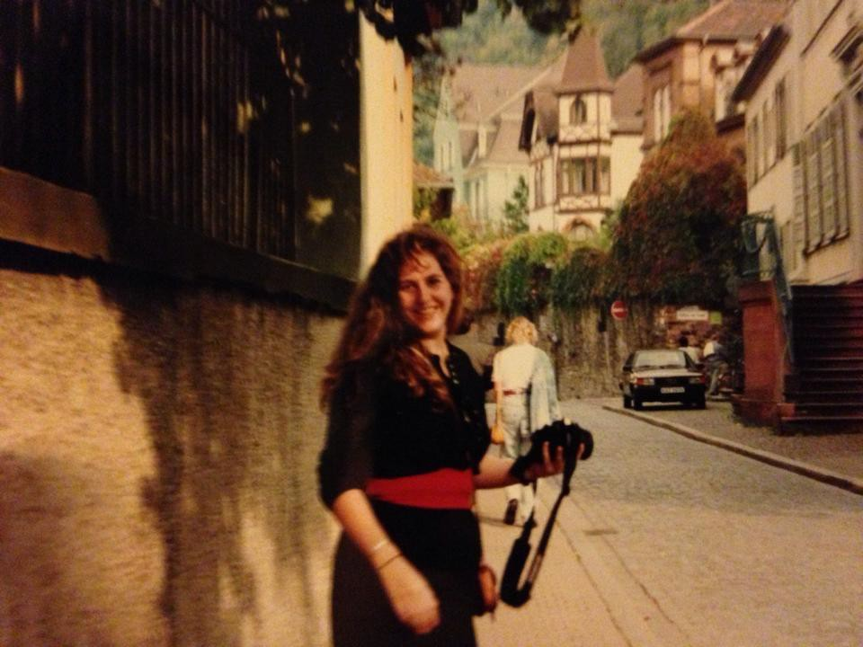
A little about me
First camera in 4th, Kodak Instamatic
First SLR in 8th grade
Every photography class in high school
Teacher’s Assistant First paying gig 1985
Jules in Germany, 1989
35 mm film

Slide 4
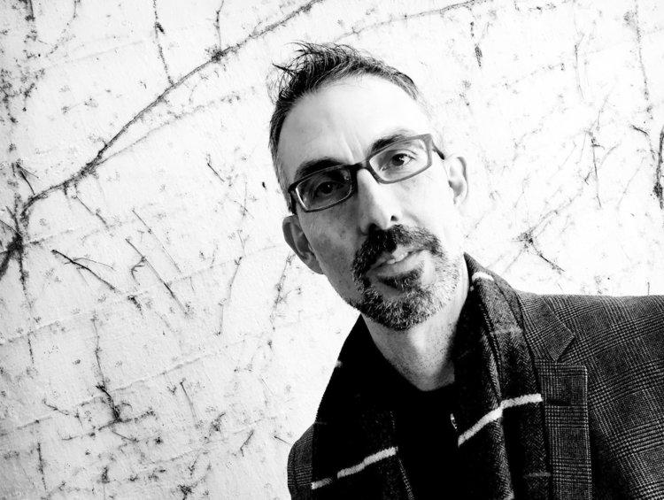
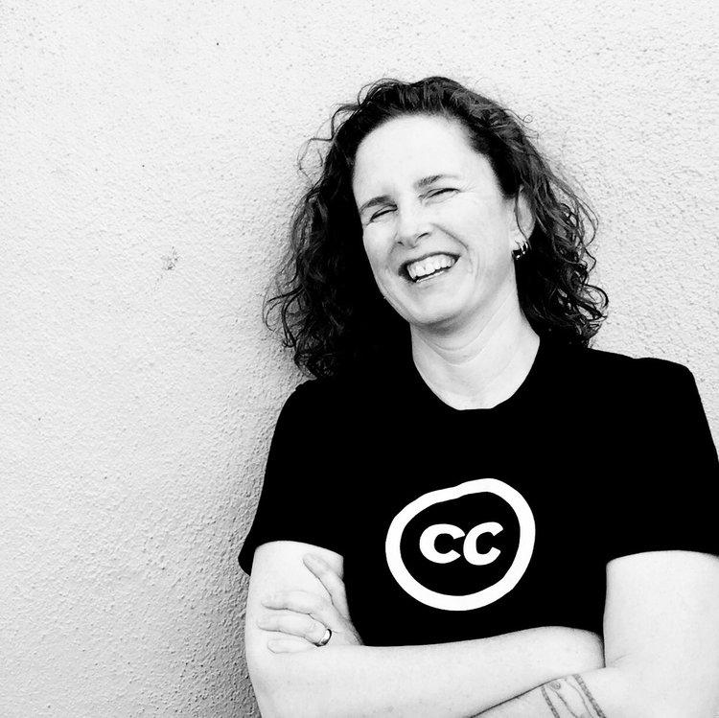
A little about me
iPhone
iPhone

Slide 5
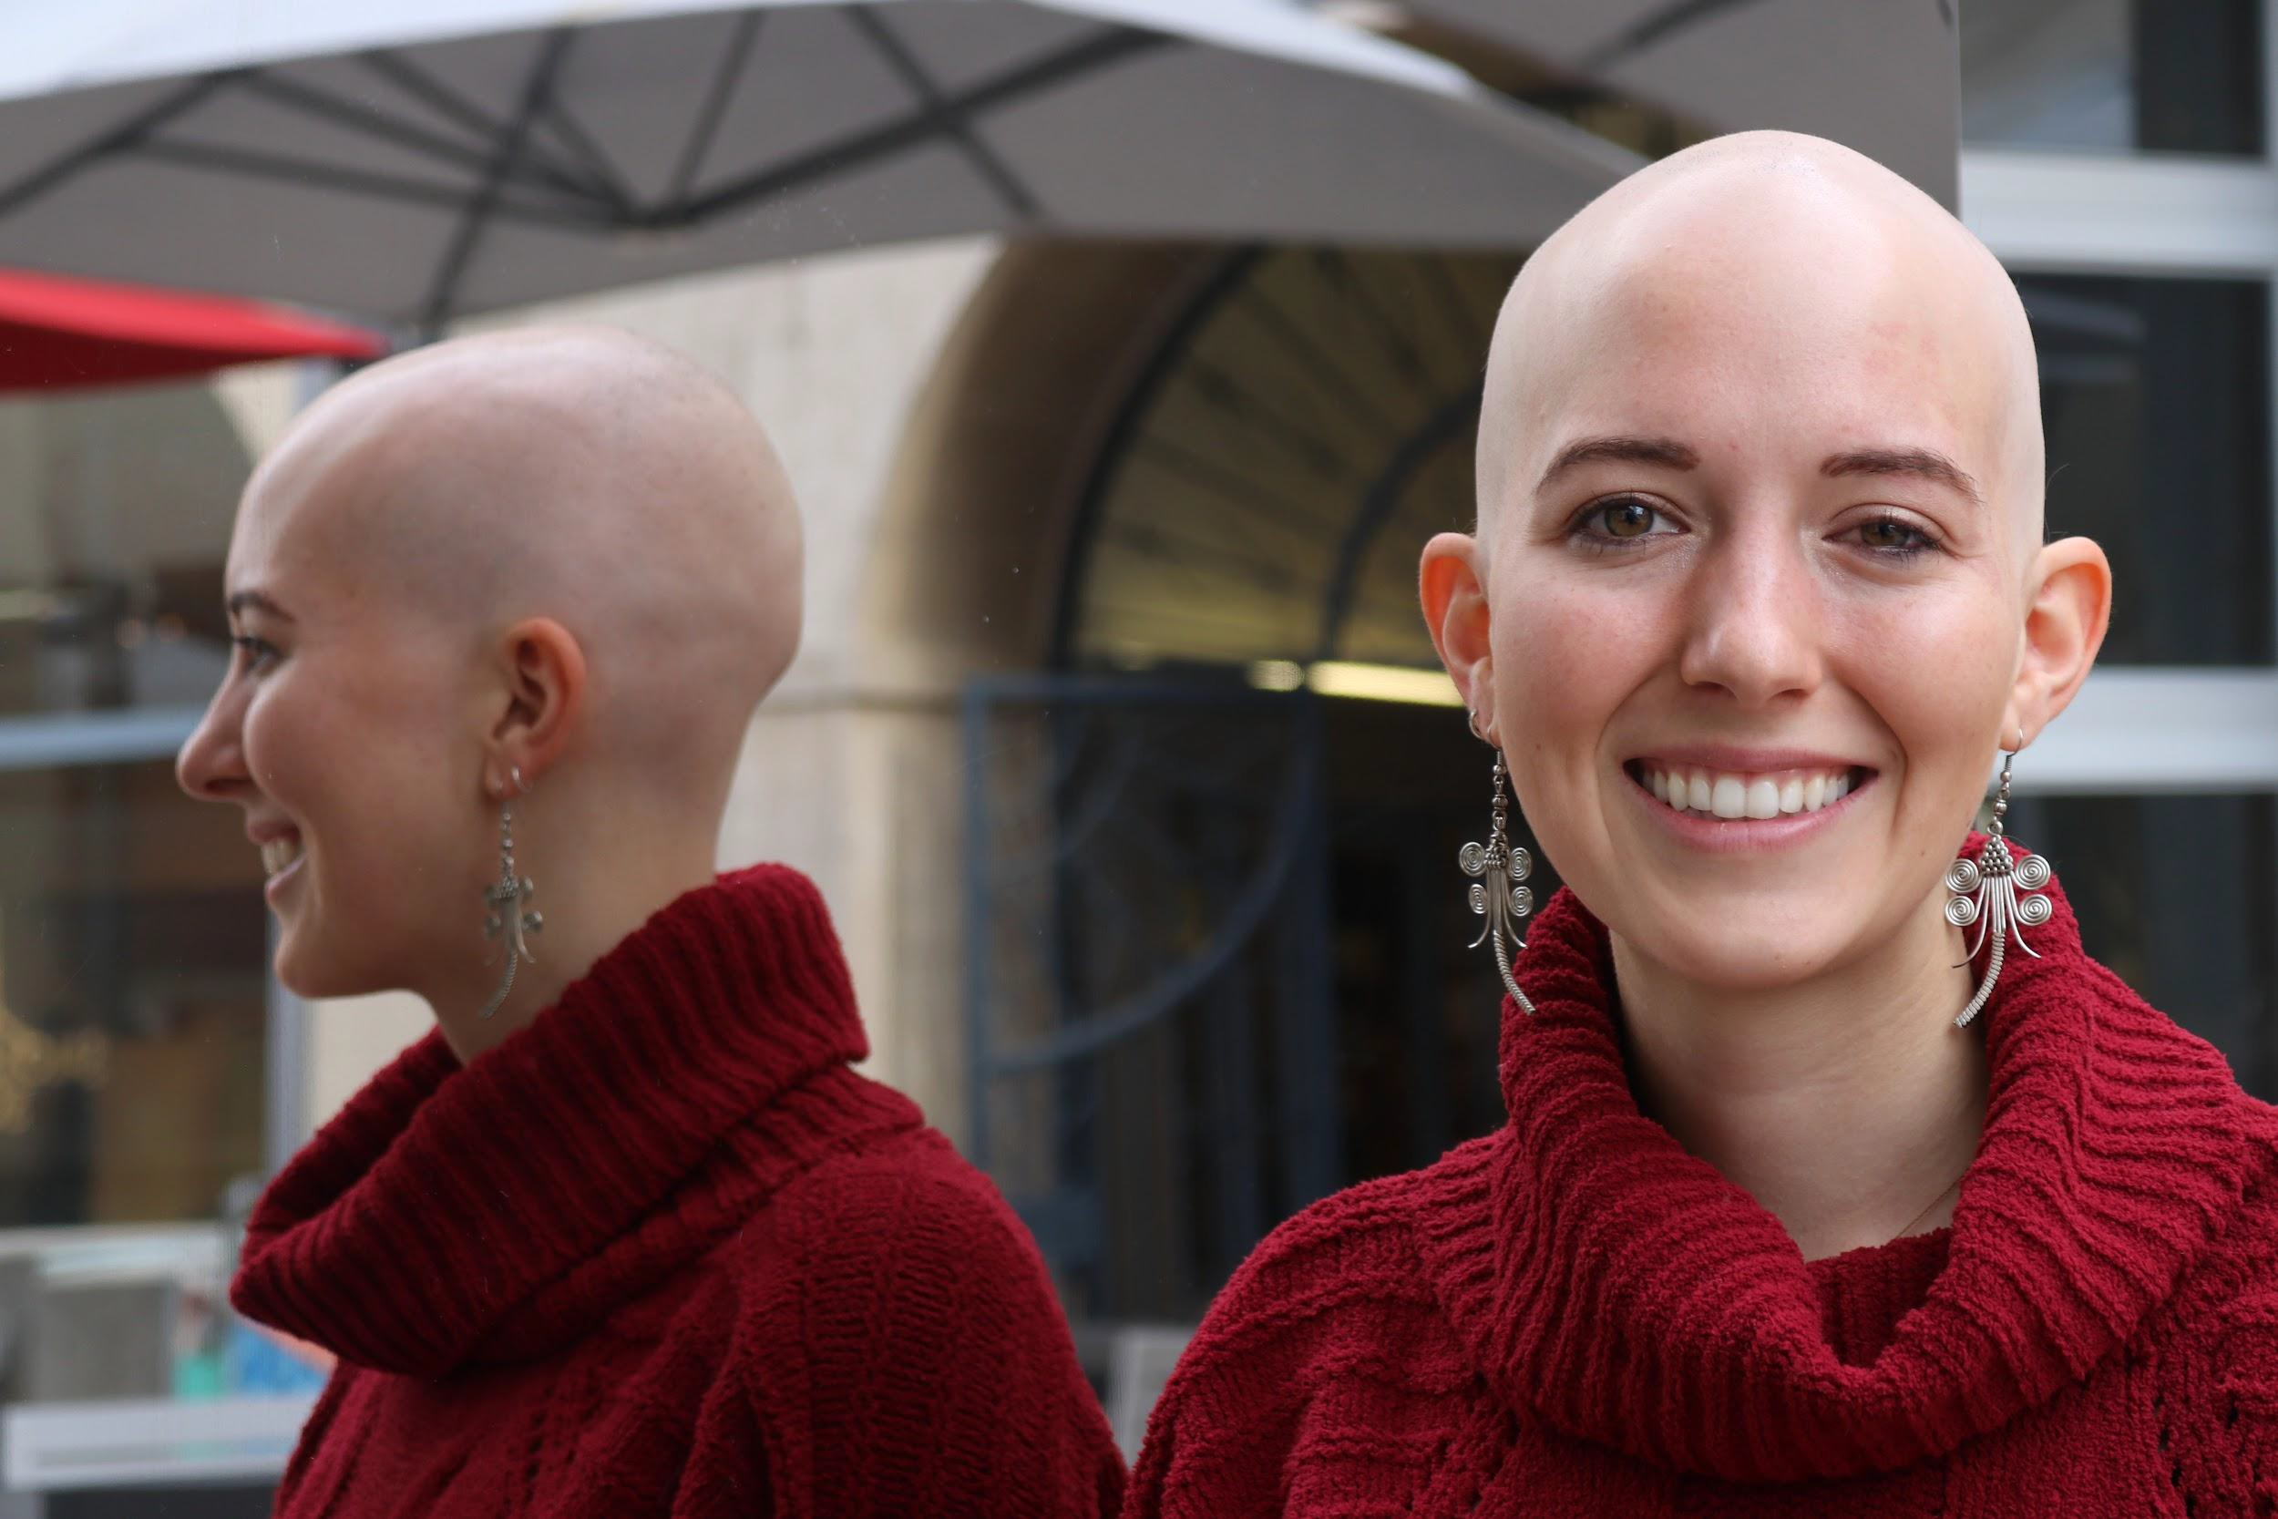


A little more about me
DSLR
See, Be Seen
Portrait Exhibit at the MAH May – September 2018

Slide 6

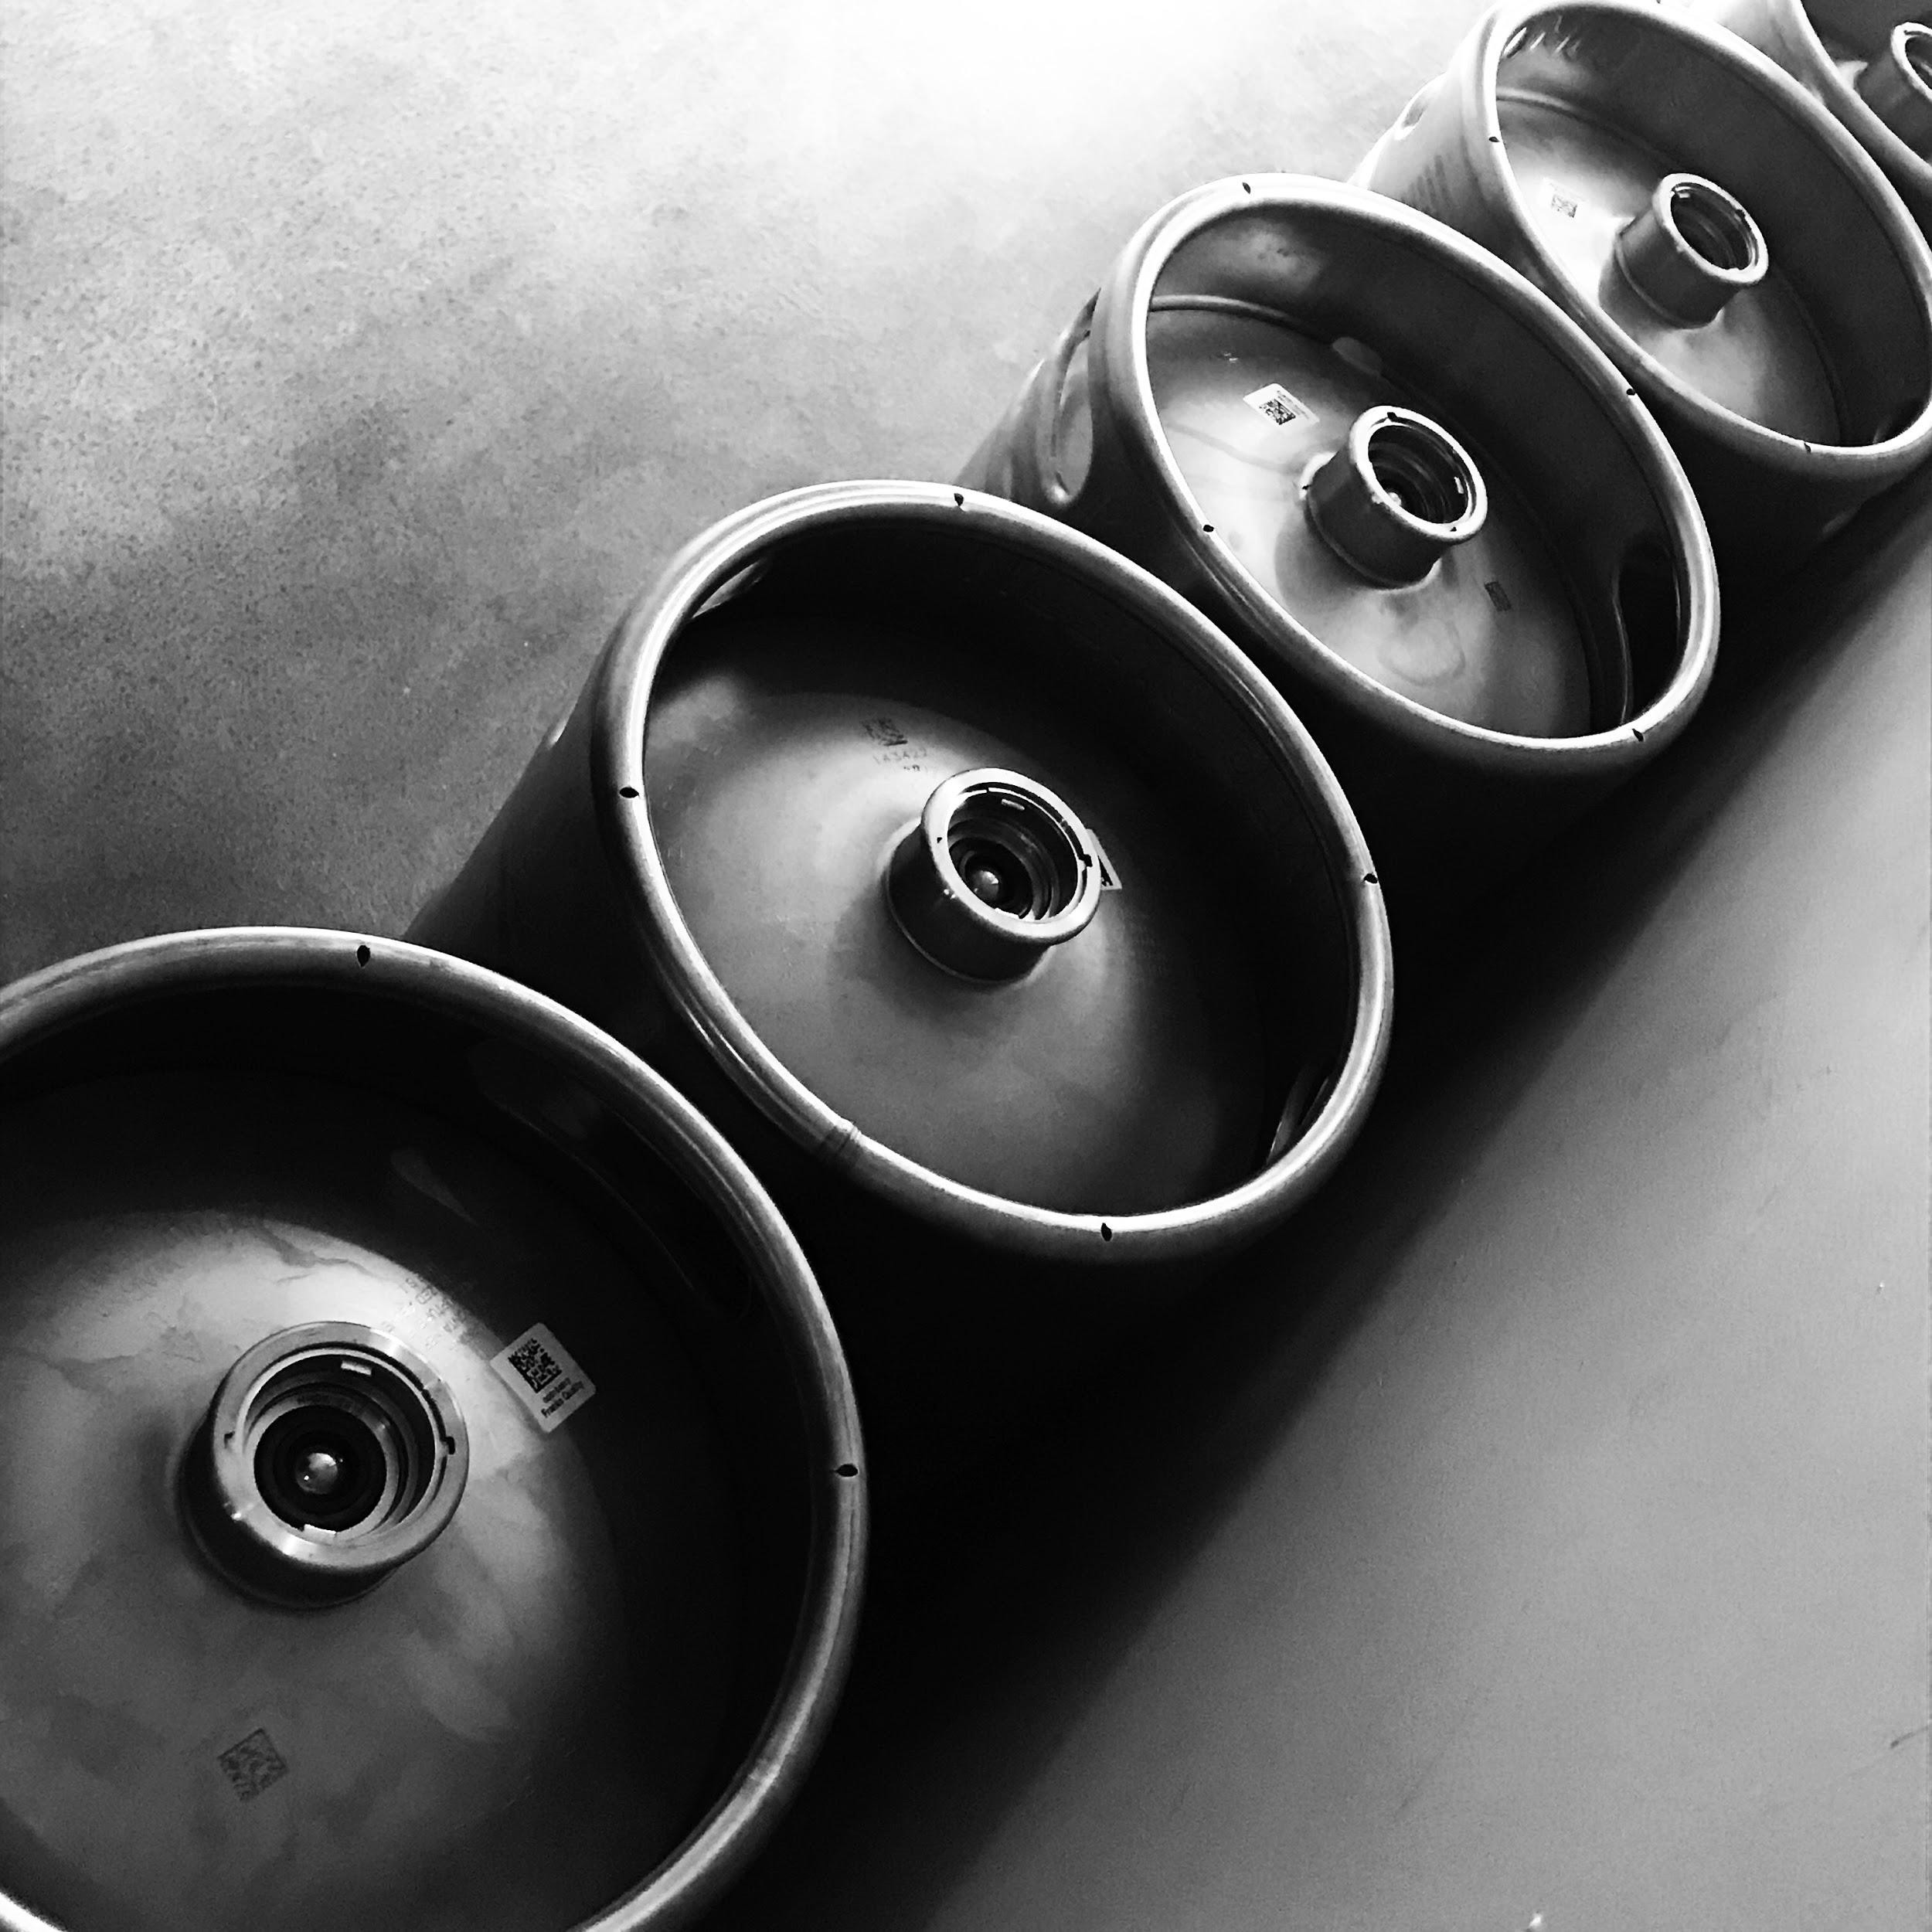
iPhone Photography
I want to help you take better photos with the camera you carry all the time.
Many of these tips will work with any phone or camera.
Know your iPhone settings.
iPhone

Slide 7
Five tips for better iPhone photography

Slide 8
Five tips for better iPhone photography:
1. Get to know your human subject a little before you begin photographing them.

Slide 9
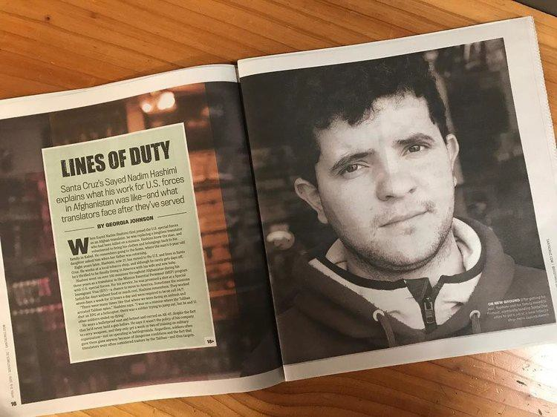
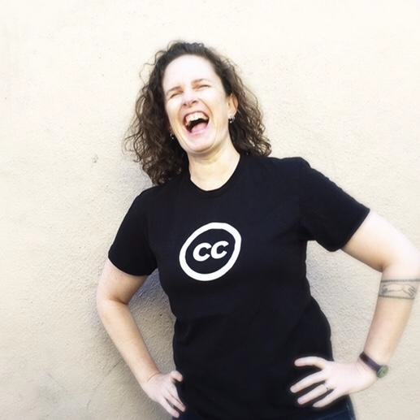
Get to know your subject
DSLR
iPhone

Slide 10
Five tips for better iPhone photography:
Get to know your human subject a little before you begin photographing them.
Hold the phone up high, down low or at an angle.

Slide 11

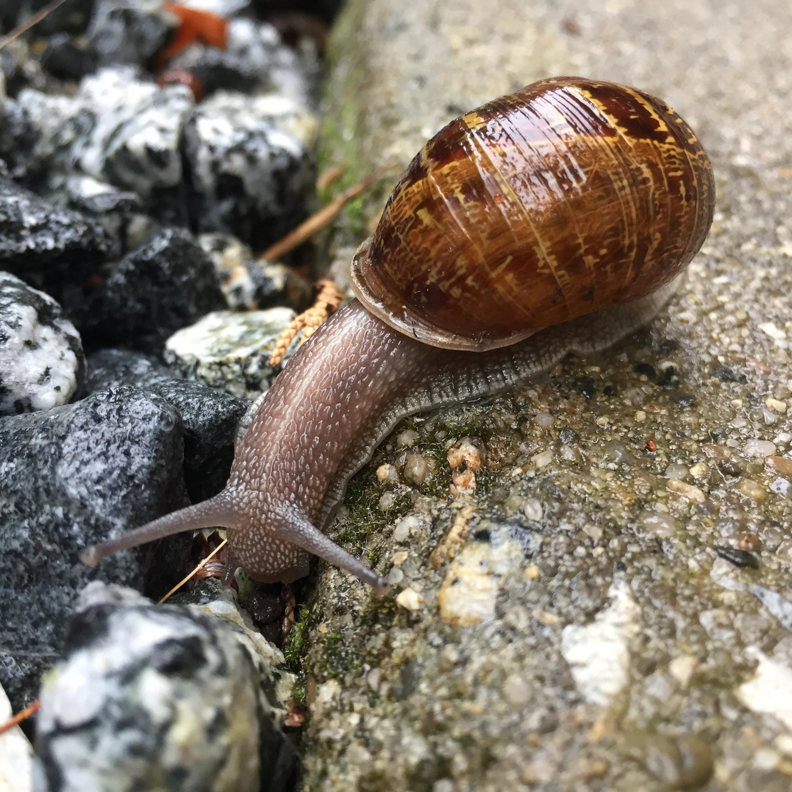
Shoot from different angles
iPhone
iPhone

Slide 12
Five tips for better iPhone photography:
Get to know your human subject a little before you begin photographing them.
Hold the phone up high, down low or at an angle.
Get closer to your subject.

Slide 13
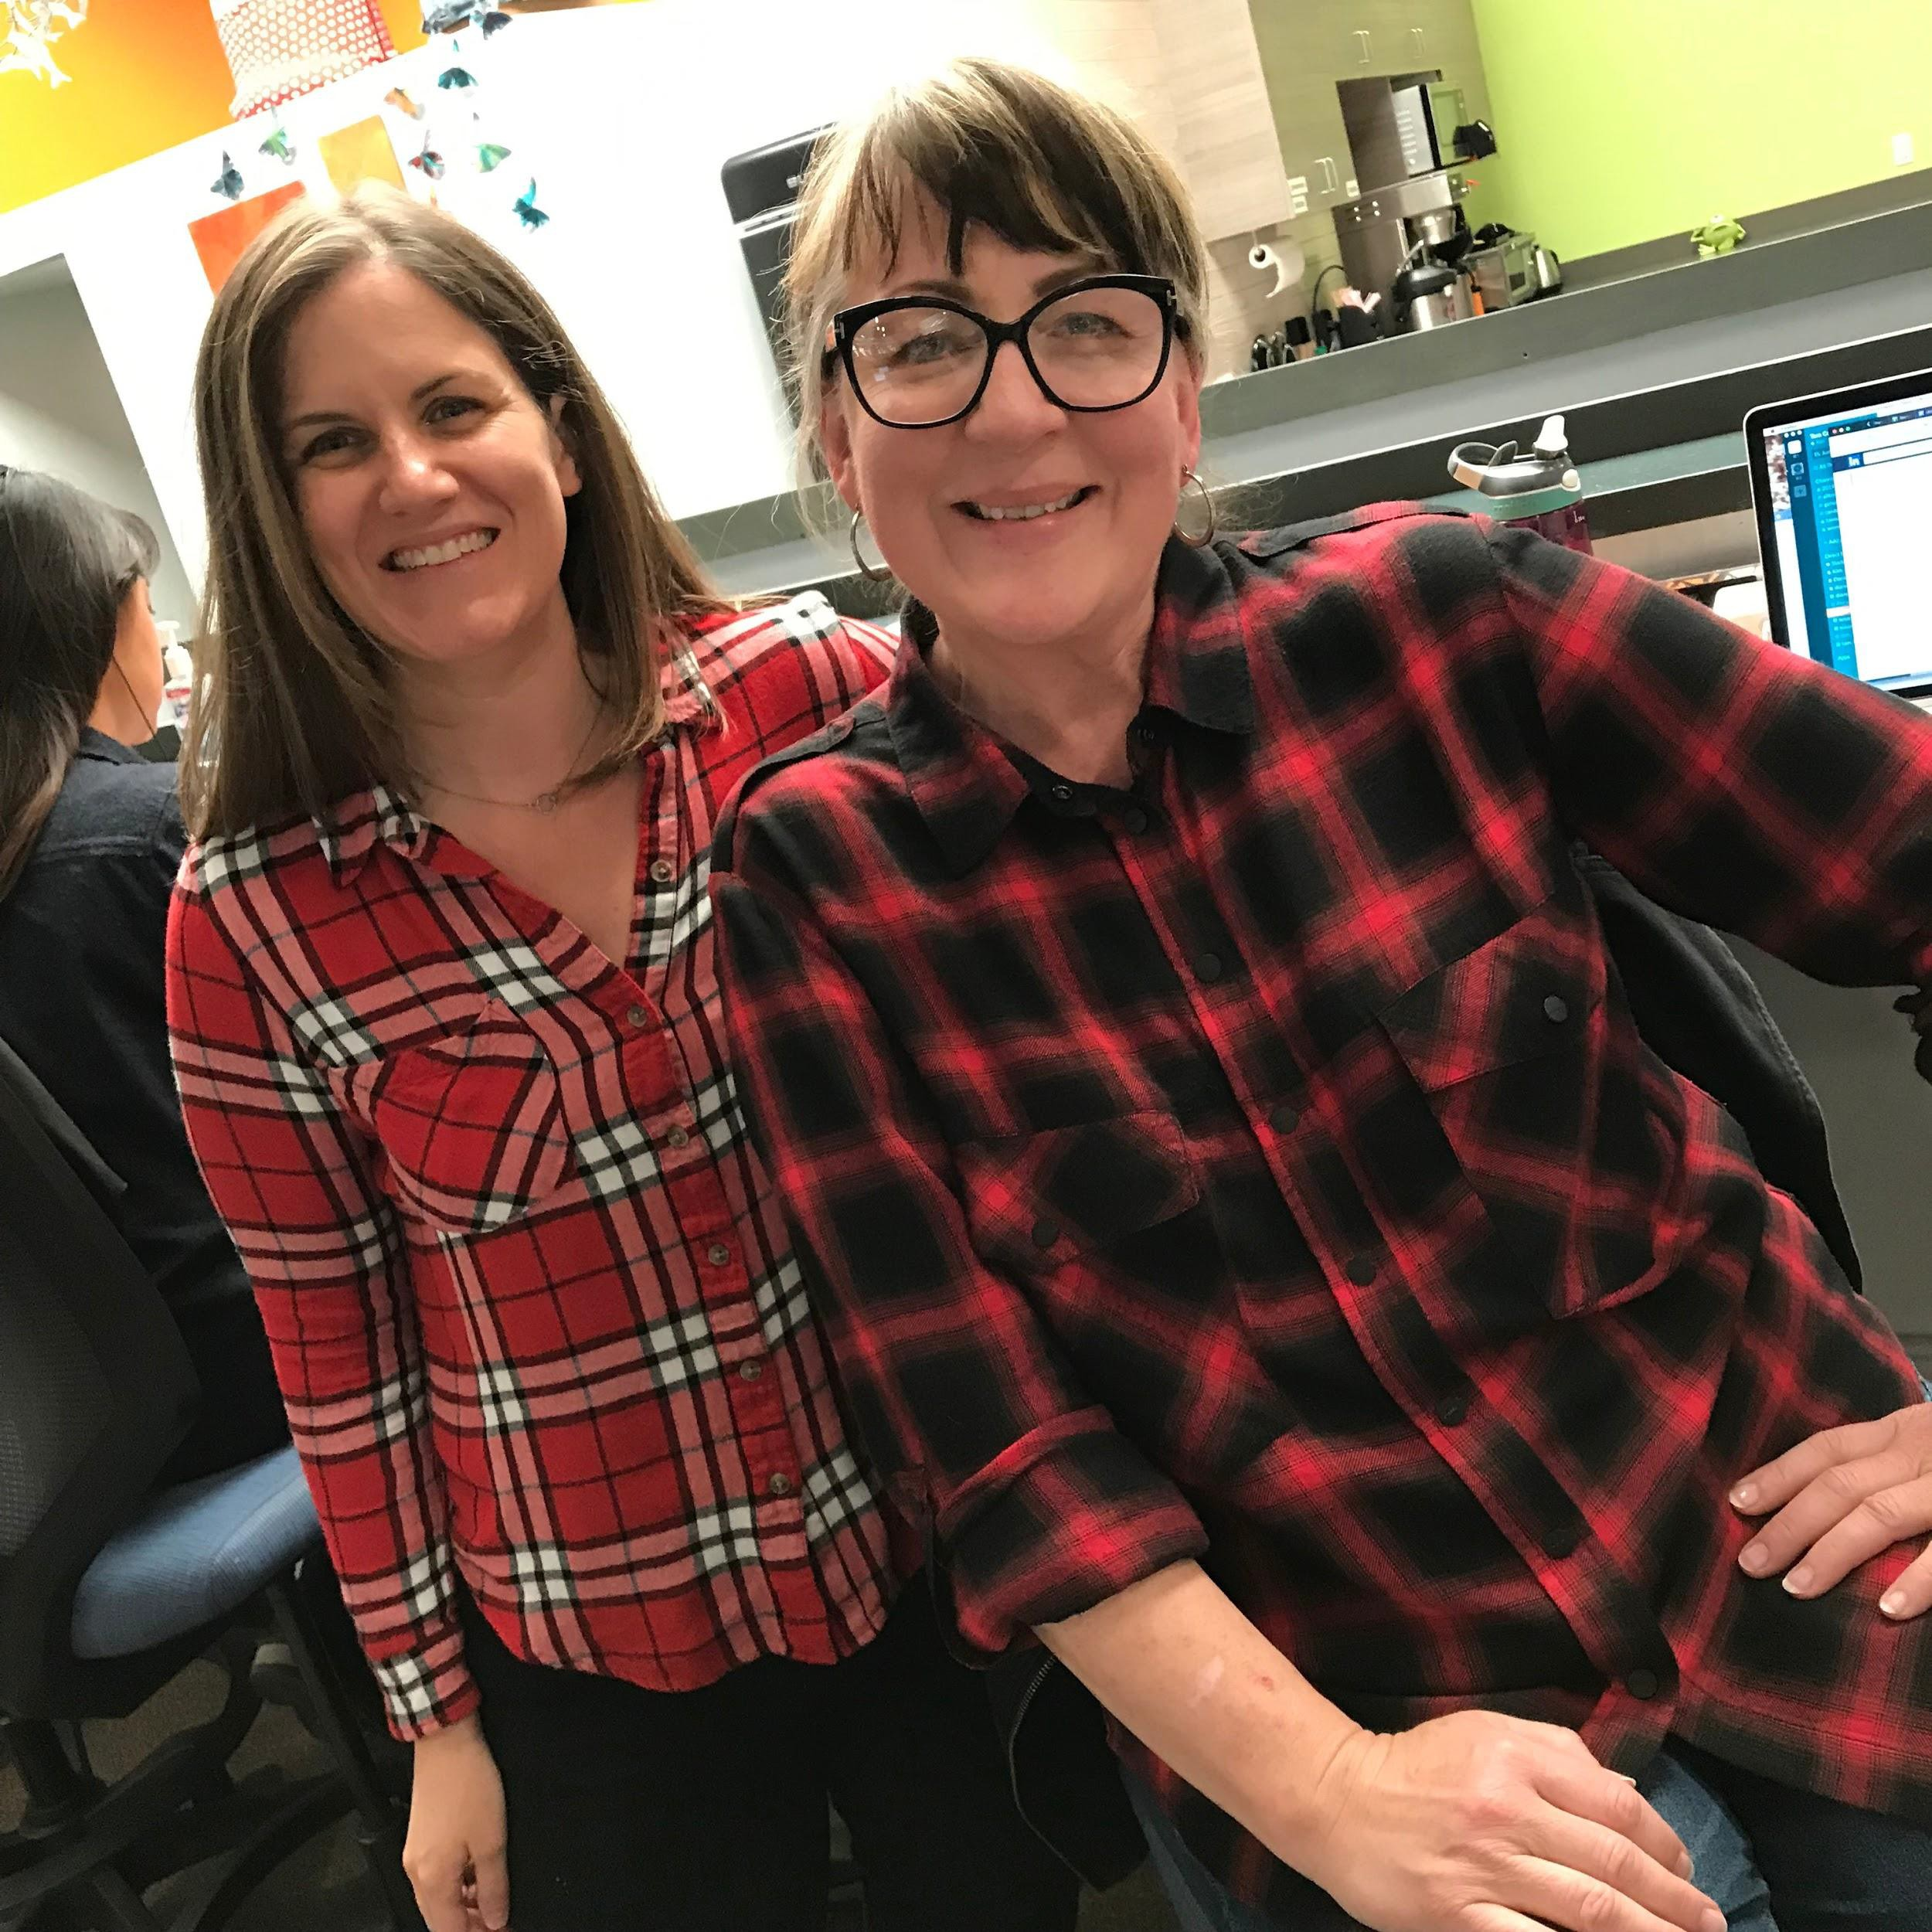
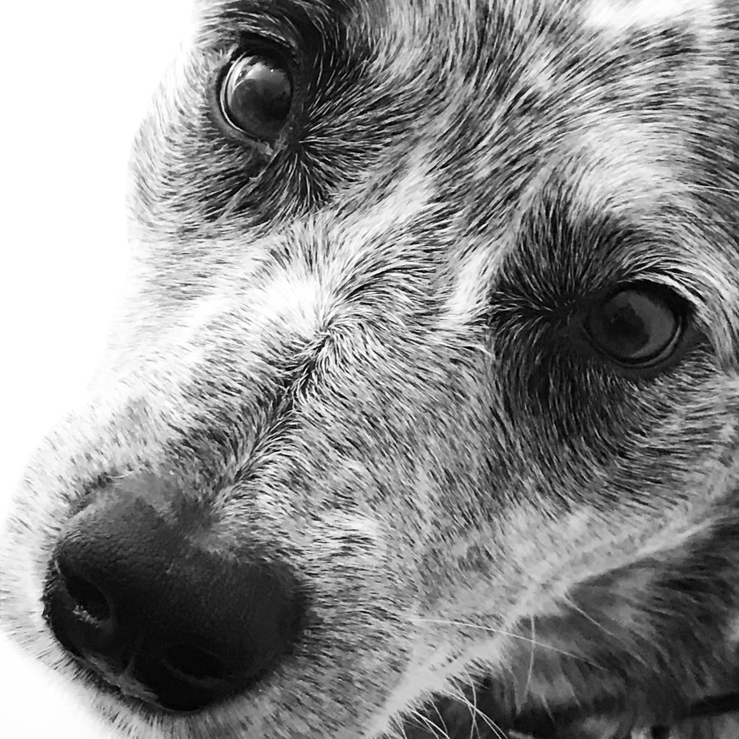
Get closer
iPhone
iPhone

Slide 14
Five tips for better iPhone photography:
Get to know your human subject a little before you begin photographing them.
Hold the phone up high, down low or at an angle.
Get closer to your subject.
Touch your screen to focus in different areas and/or to affect the lighting.

Slide 15
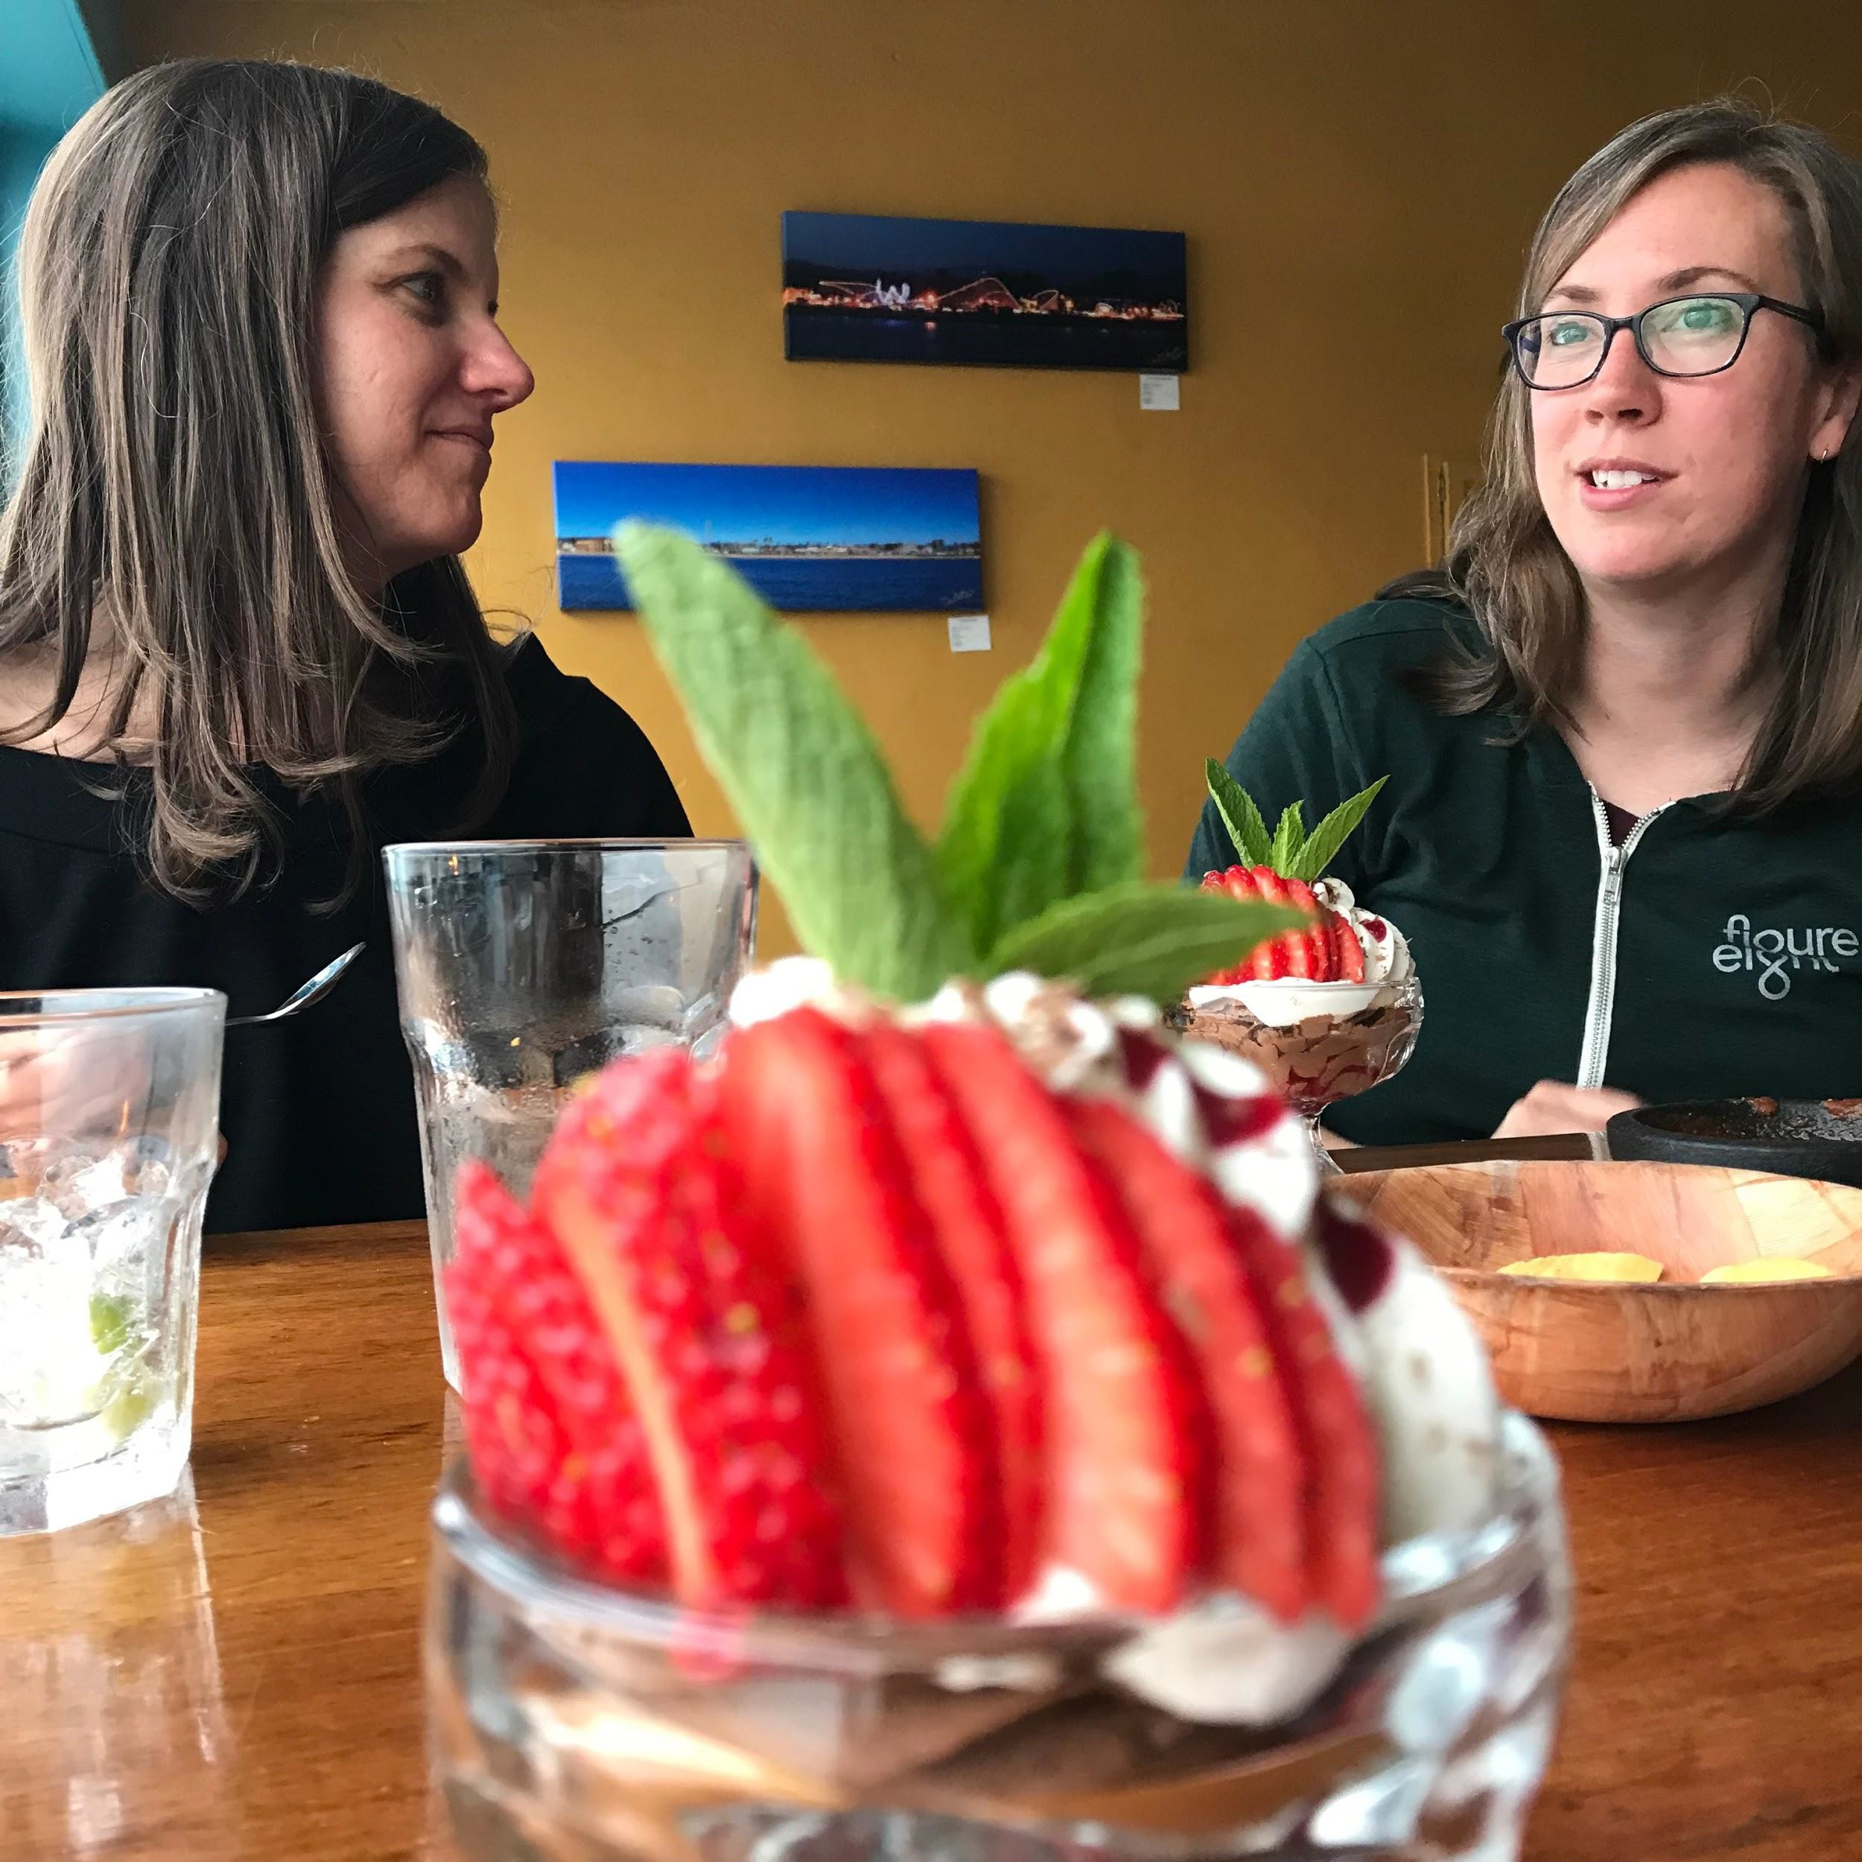
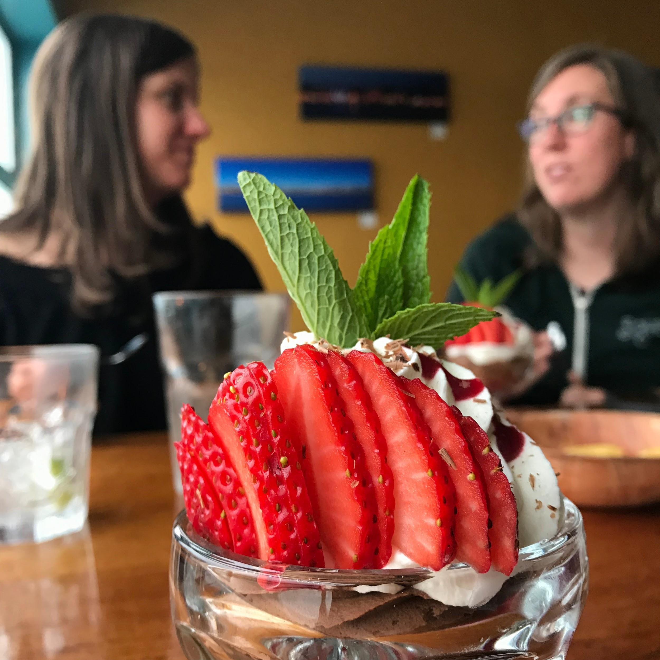
Touch the screen in different places
iPhone
iPhone

Slide 16

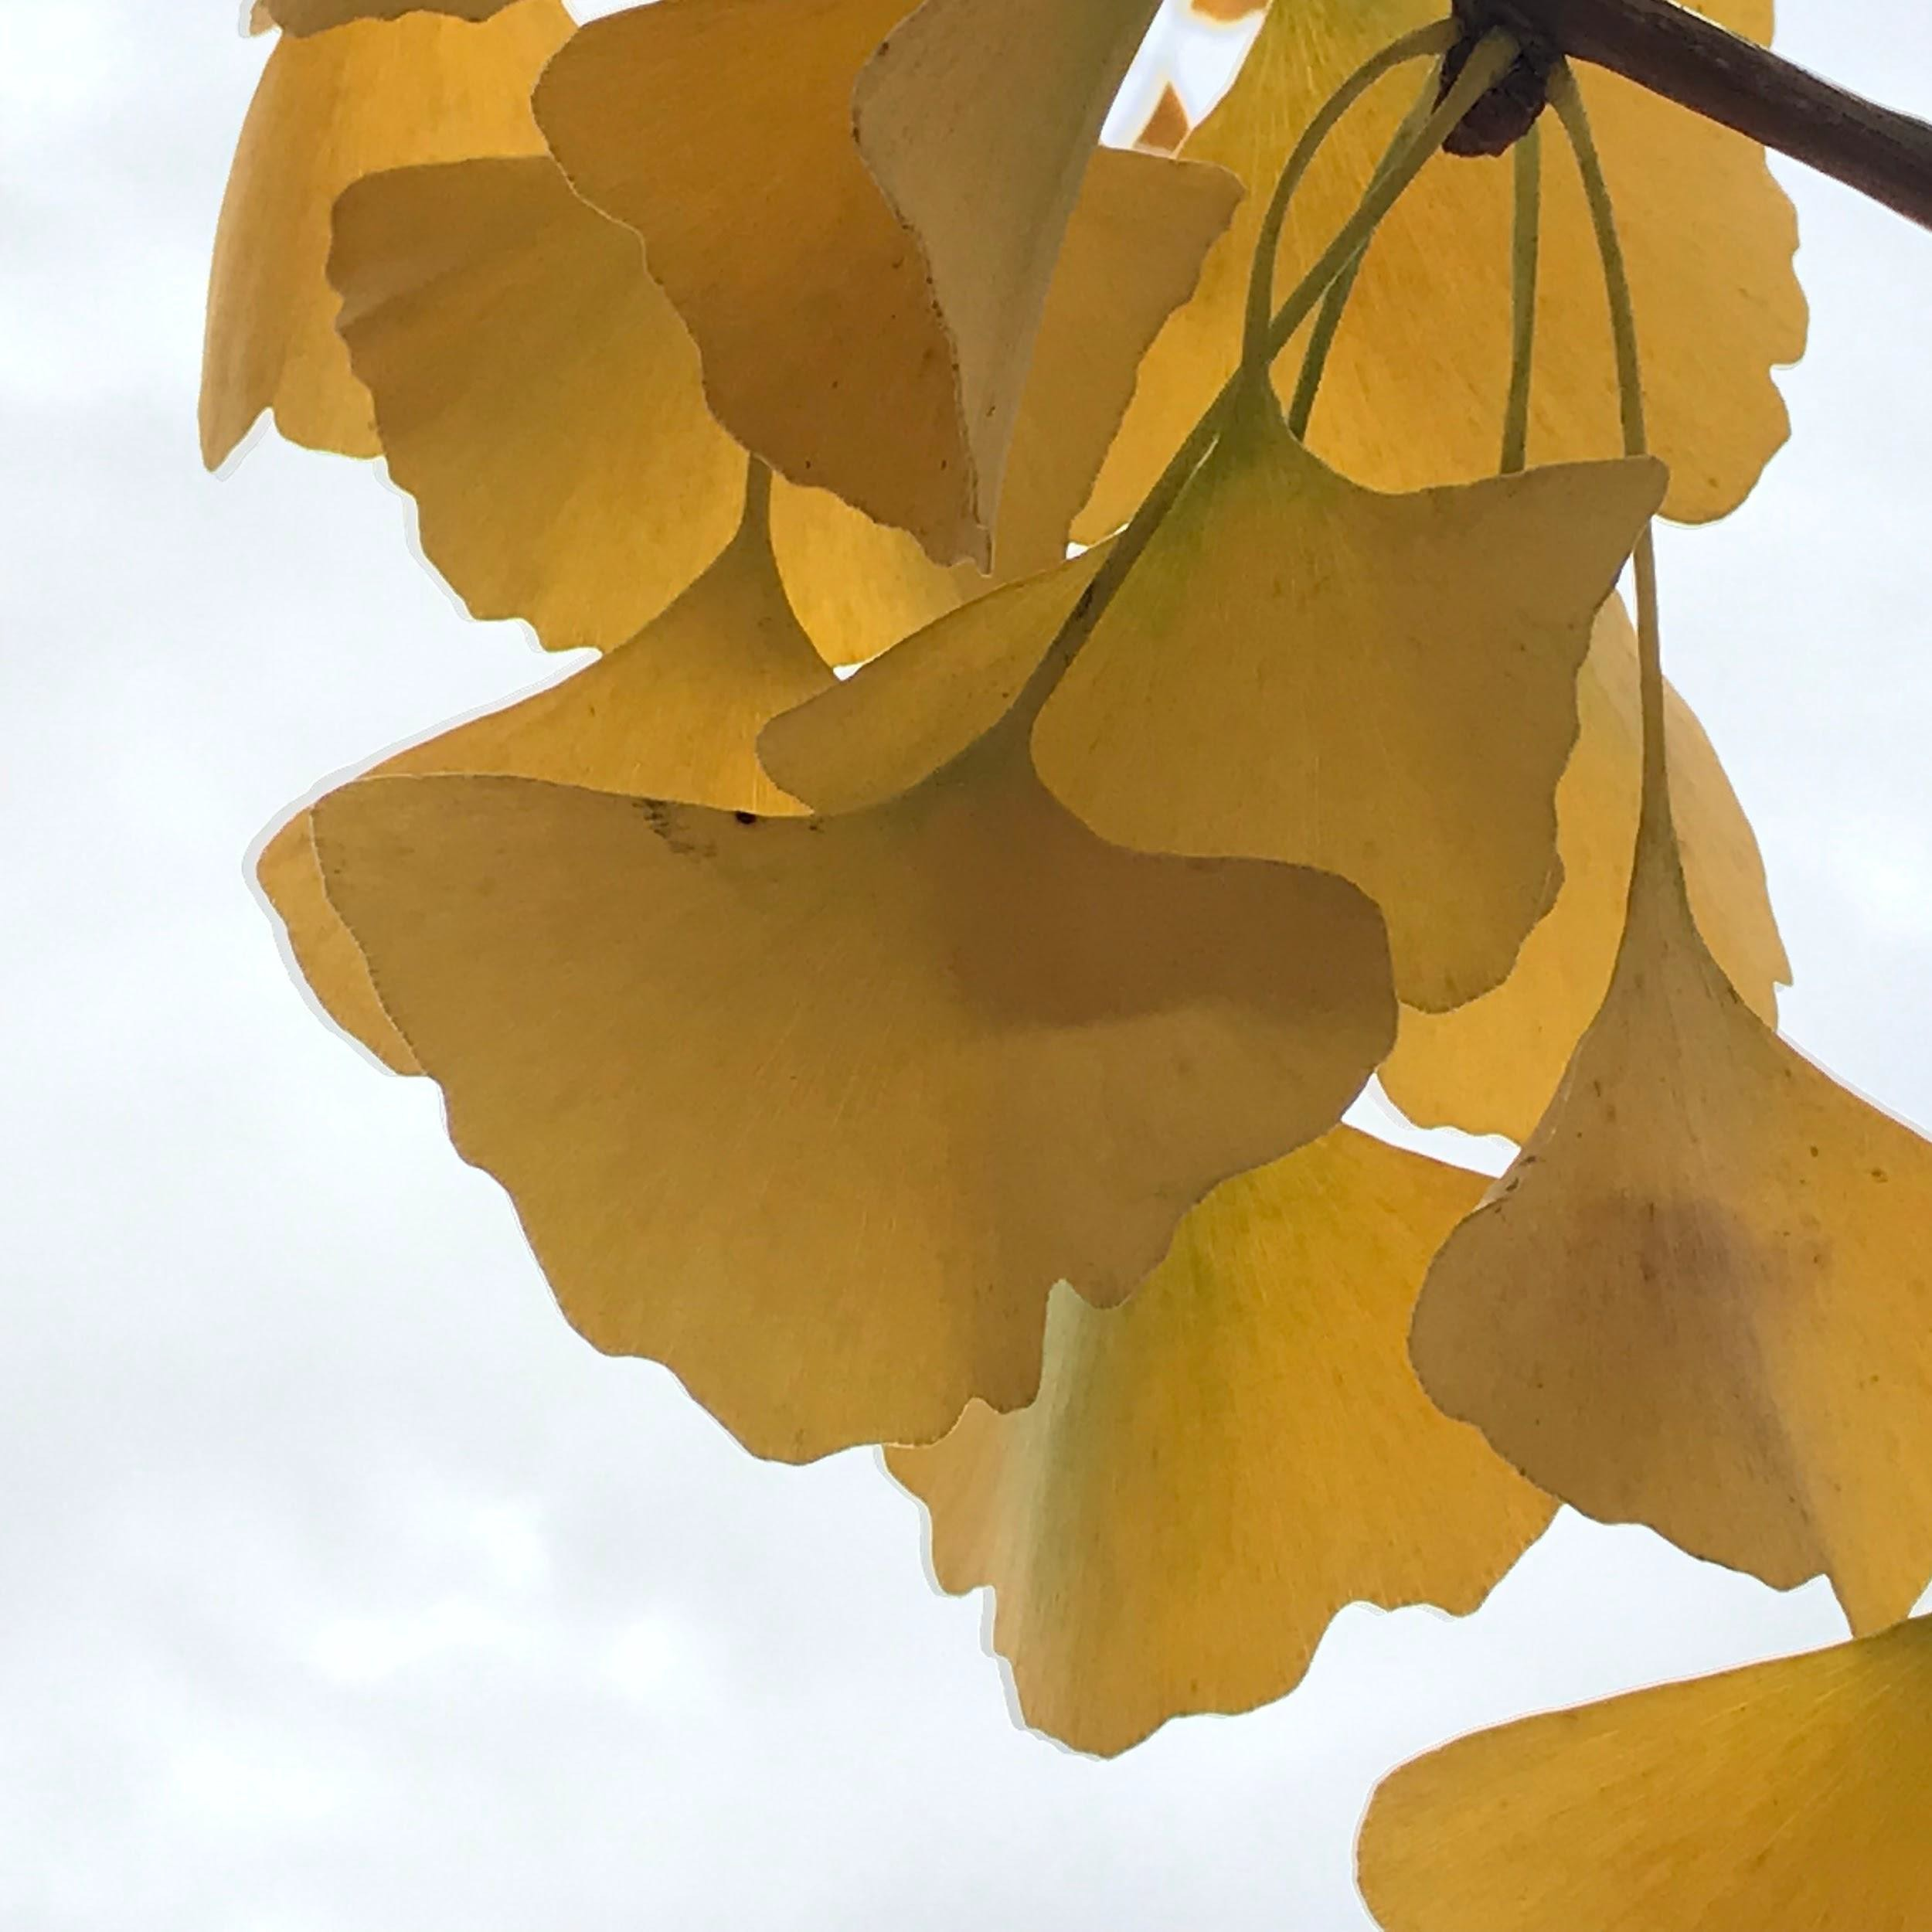
Touch the screen in different places
iPhone
iPhone

Slide 17
Five tips for better iPhone photography:
Get to know your human subject a little before you begin photographing them.
Hold the phone up high, down low or at an angle.
Get closer to your subject.
Touch your screen to focus in different areas and/or to affect the lighting.
Be aware of what’s around your subject.

Slide 18
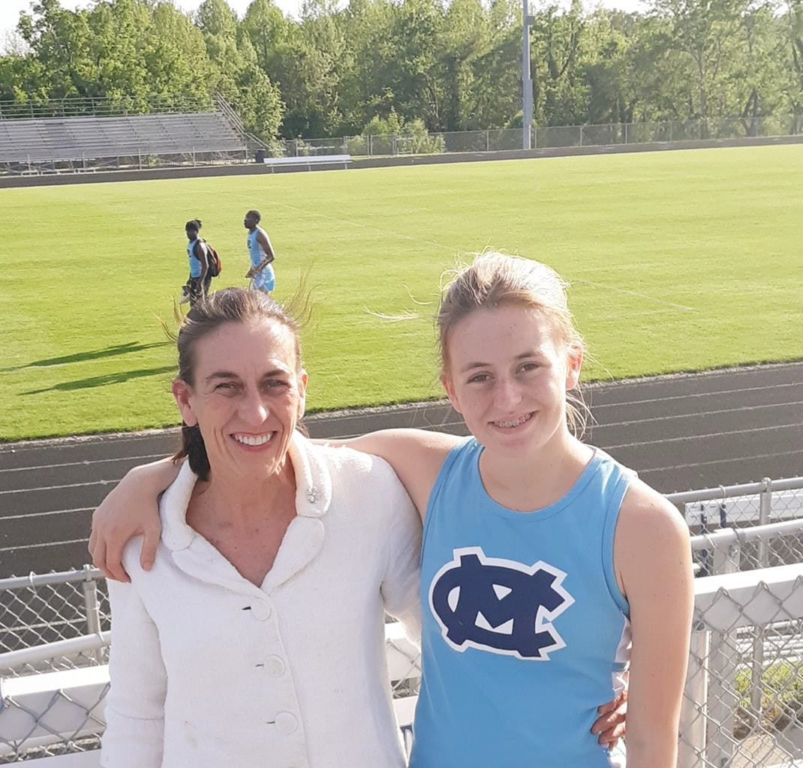
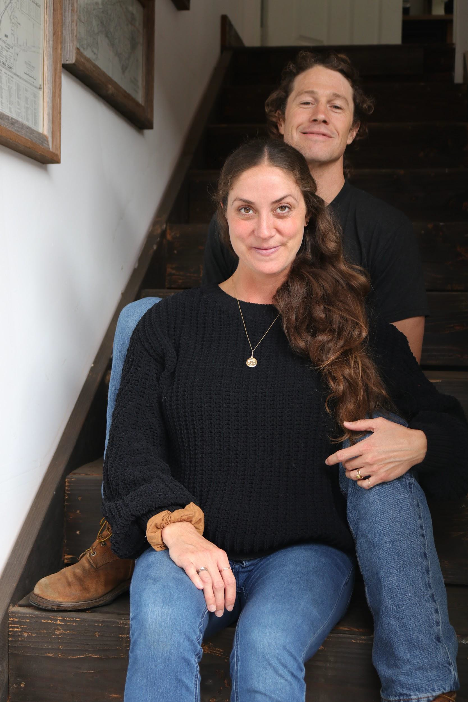
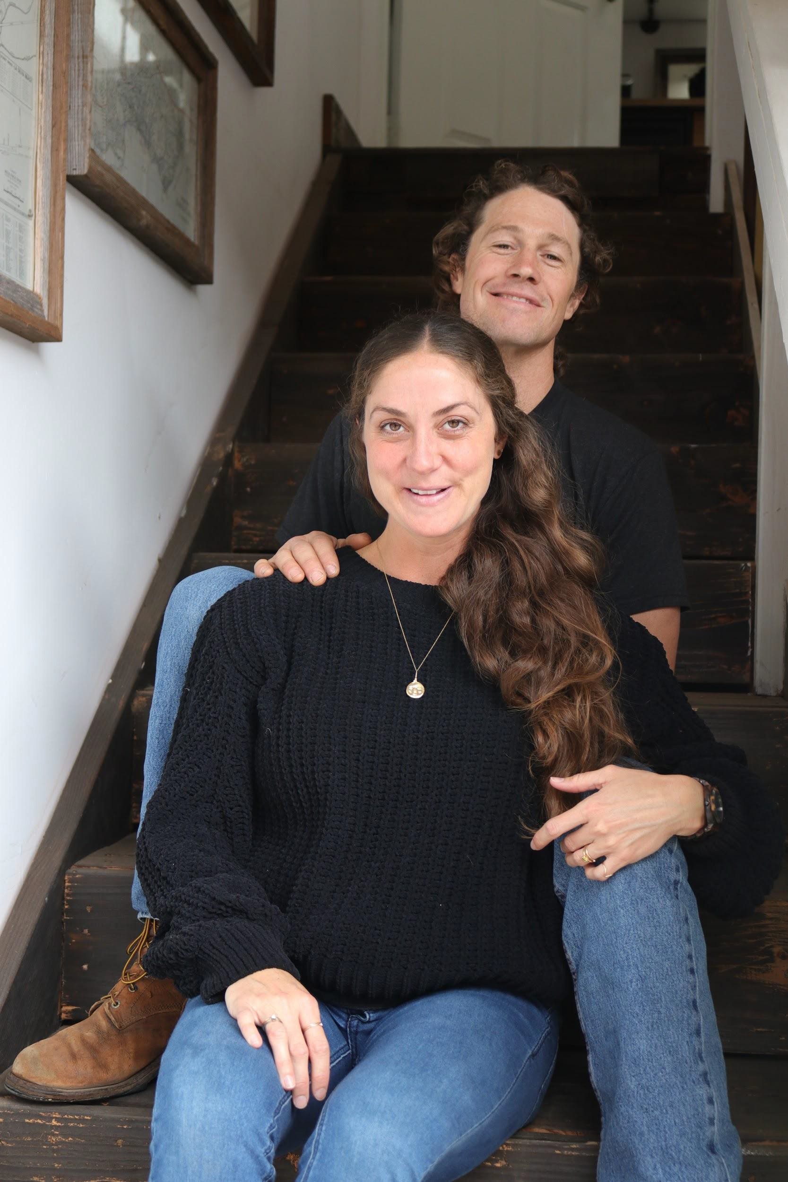
Isolate your subject and be aware
Not my photo
DSLR

Slide 19
Five tips for better iPhone photography:
Get to know your human subject a little before you begin photographing them.
Hold the phone up high, down low or at an angle.
Get closer to your subject.
Touch your screen to focus in different areas and/or to affect the lighting.
Be aware of what’s around your subject.

Slide 20
Five tips for better iPhone photography:
Get to know your human subject a little before you begin photographing them.
Hold the phone up high, down low or at an angle.
Get closer to your subject.
Touch your screen to focus in different areas and/or to affect the lighting.
Be aware of what’s around your subject.

Slide 21
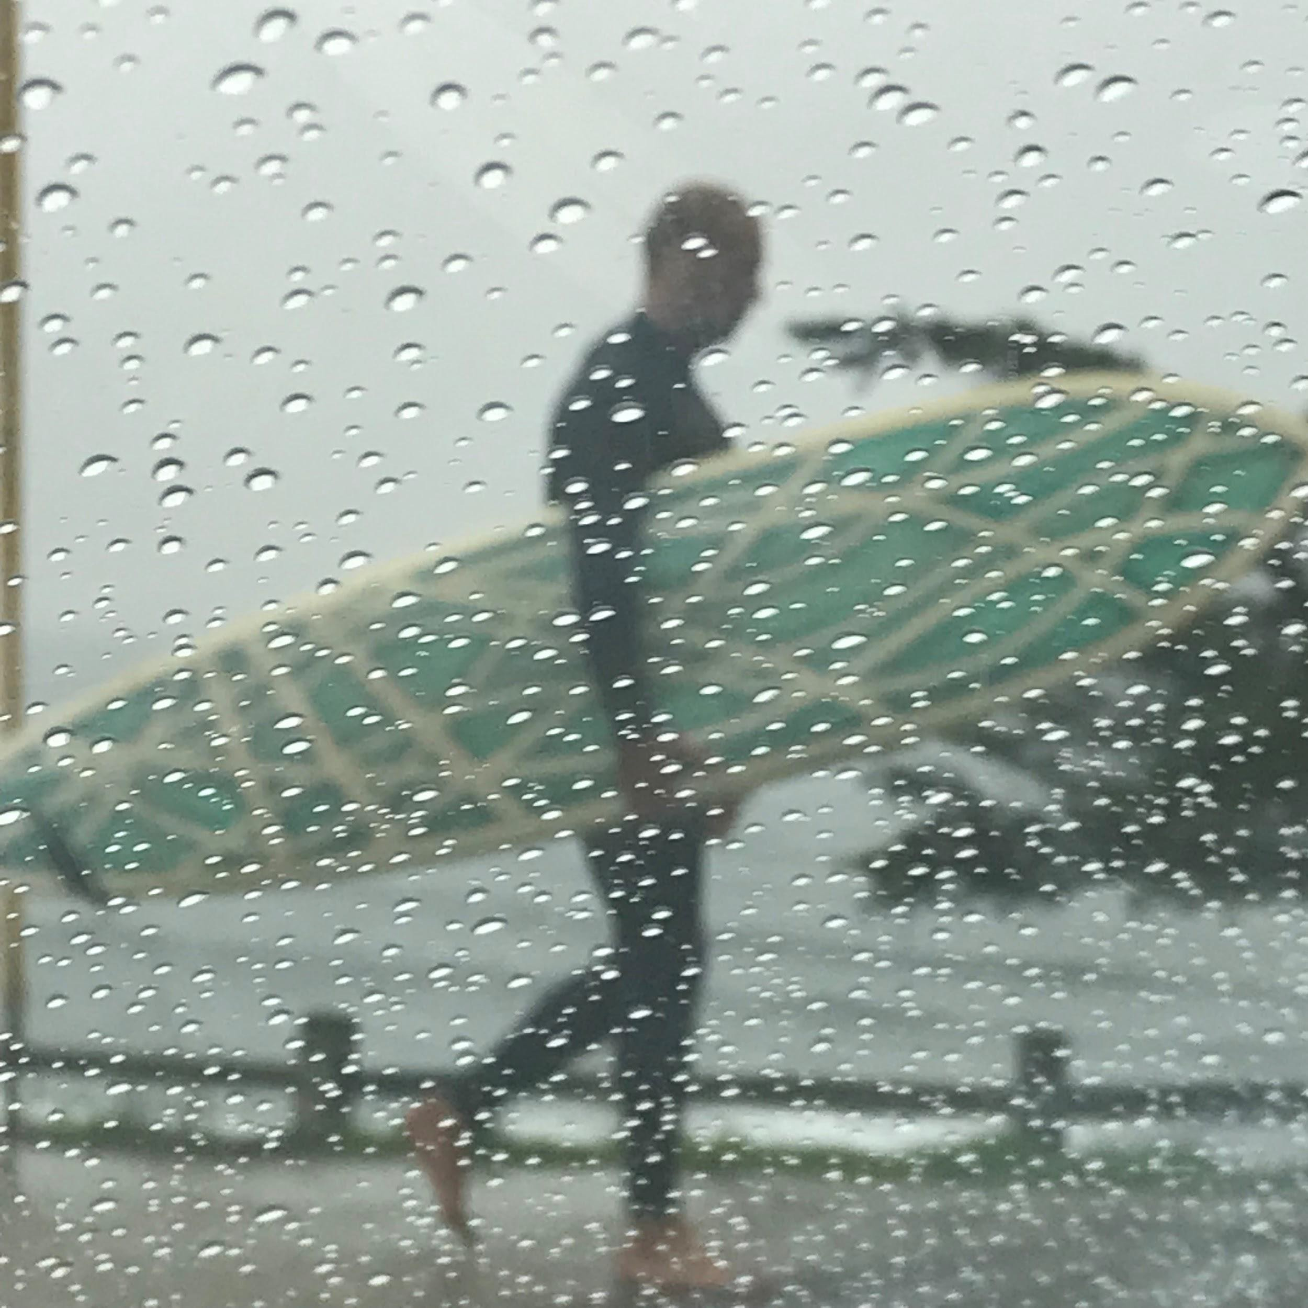
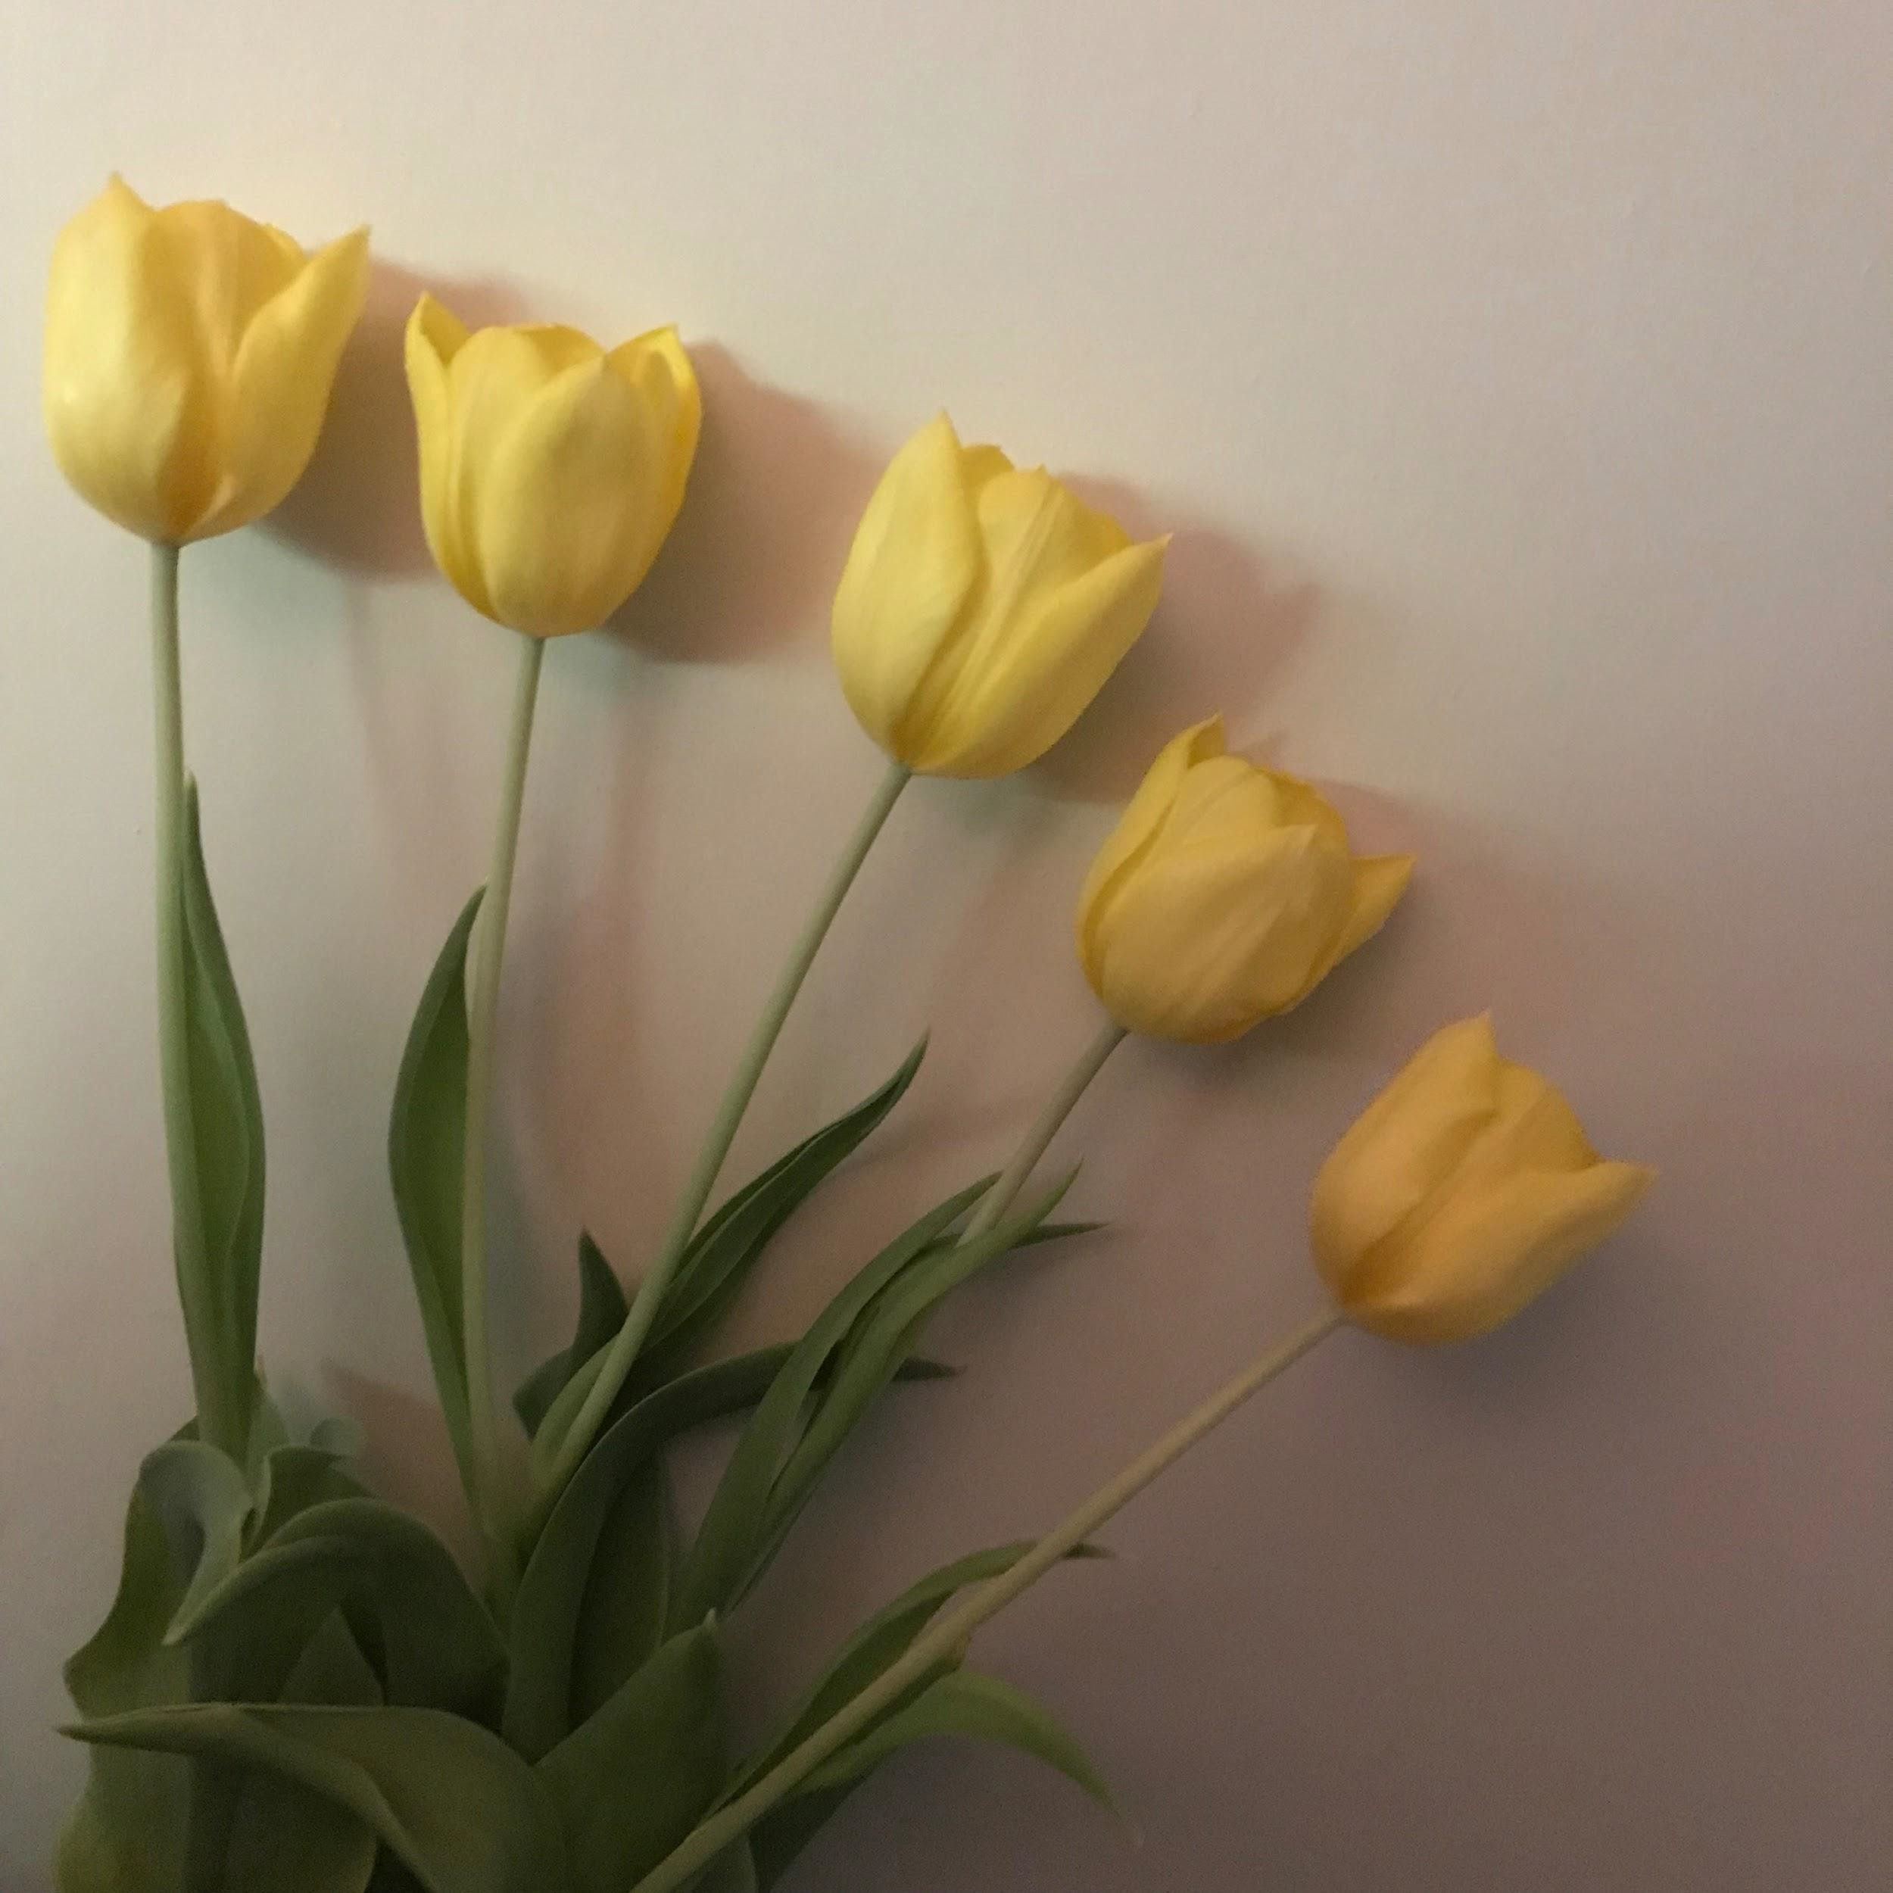
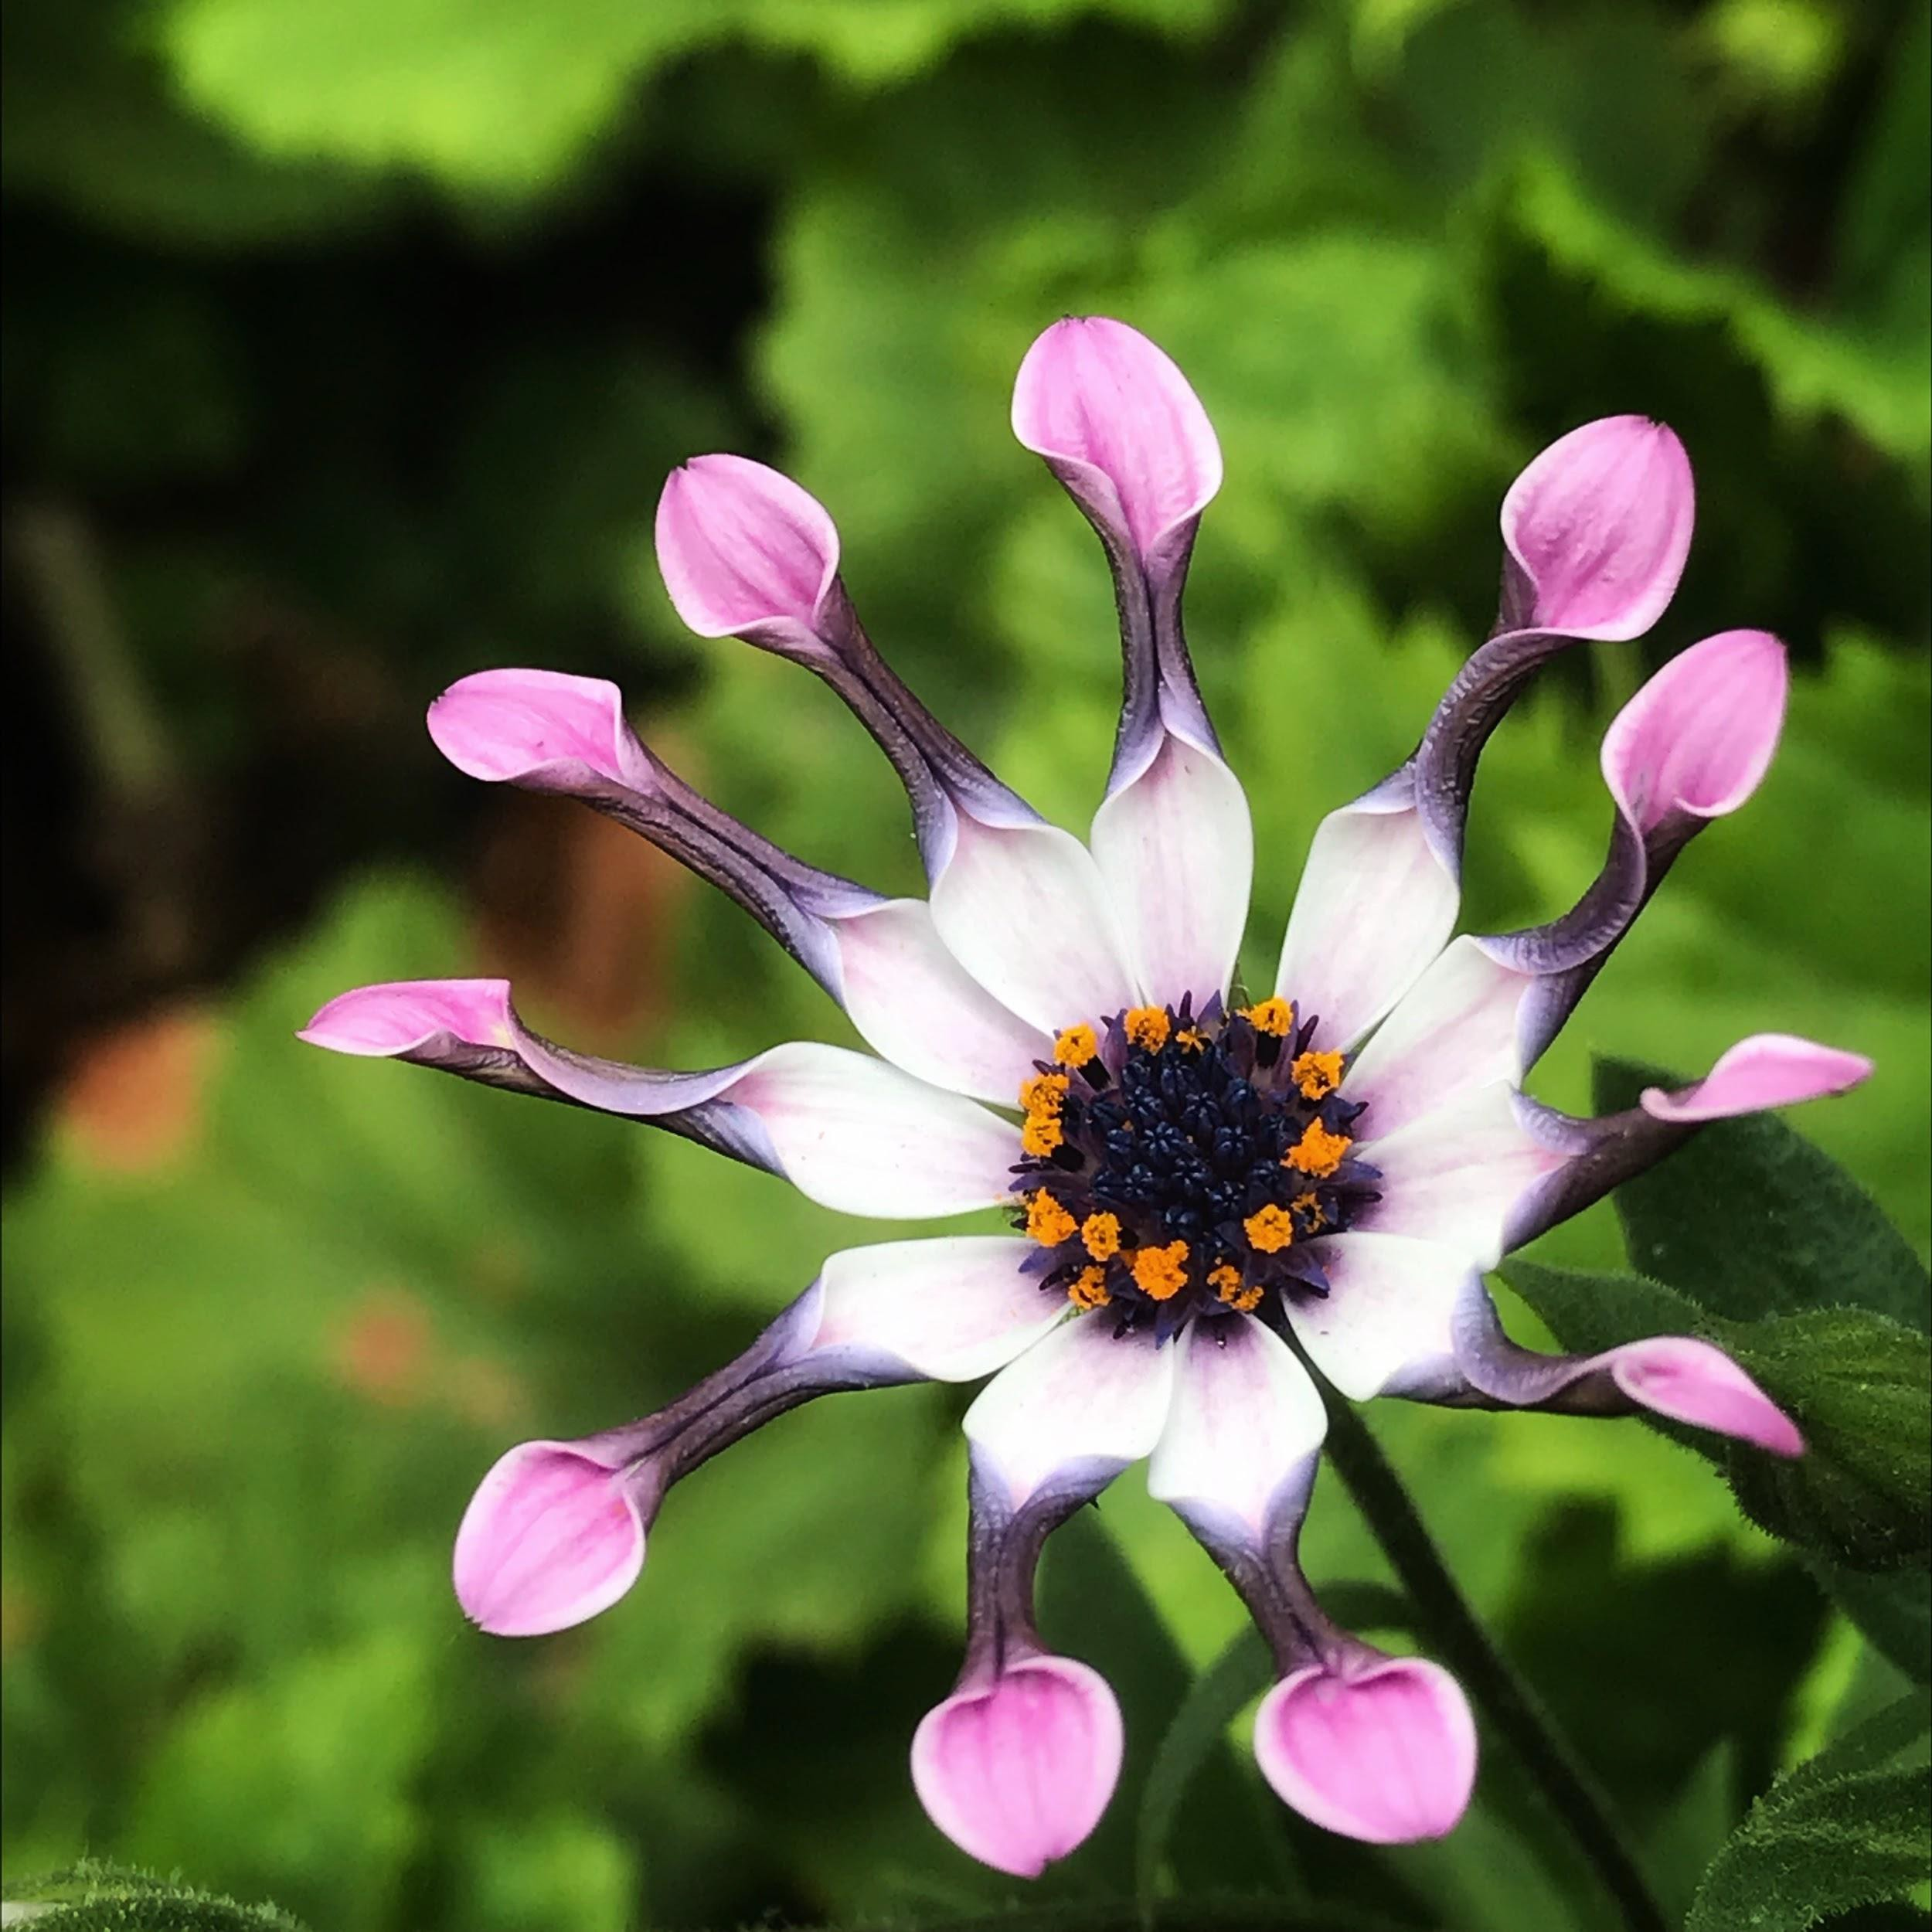
iPhone Samples
iPhone
iPhone
iPhone

Slide 22



iPhone Samples
iPhone
iPhone
iPhone

Slide 23
Photograph flowers
Everyone photograph a flower (10 minutes)
Get to know your flower a little before you begin photographing it. Observe it, look at it from different angles.
Hold the phone up high, down low or at an angle.
Get closer to your flower.
Touch your screen to focus in different areas and/or to affect the lighting.
Be aware of what’s around your flower.

Slide 24
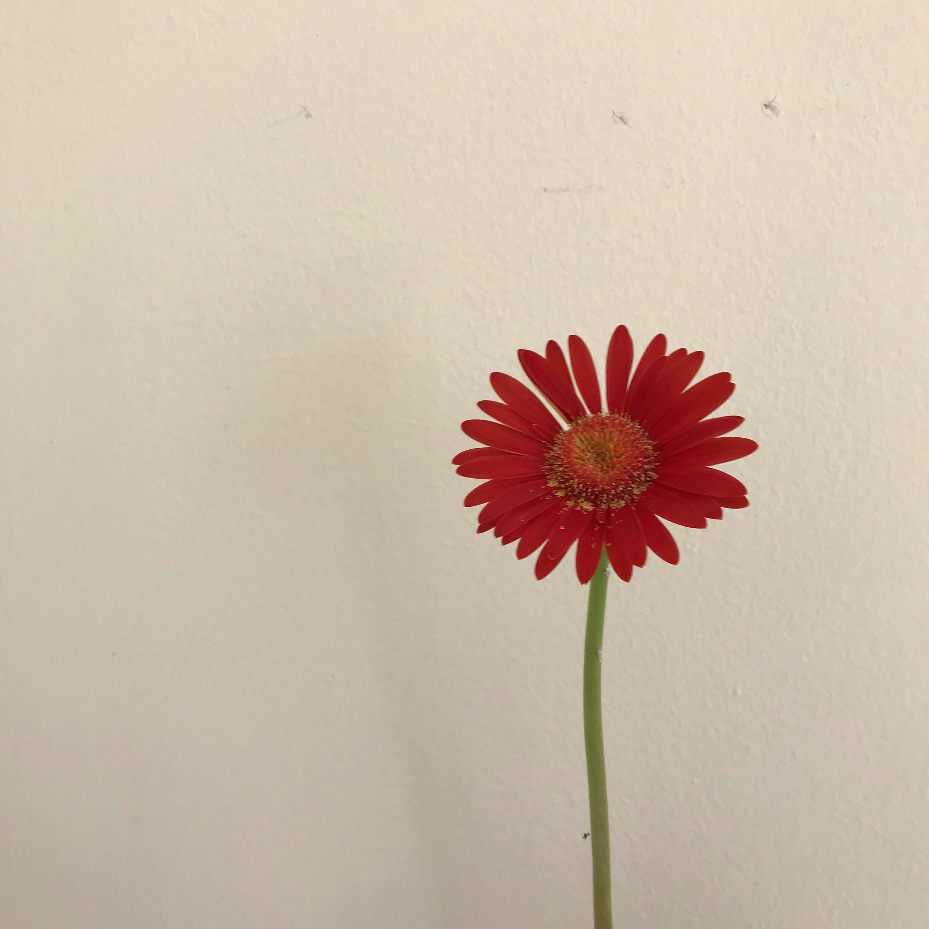
Time is up!
If you’d like to share your photograph, feel free to post on my Facebook page:
julesholdsworthphotography
iPhone

Slide 25
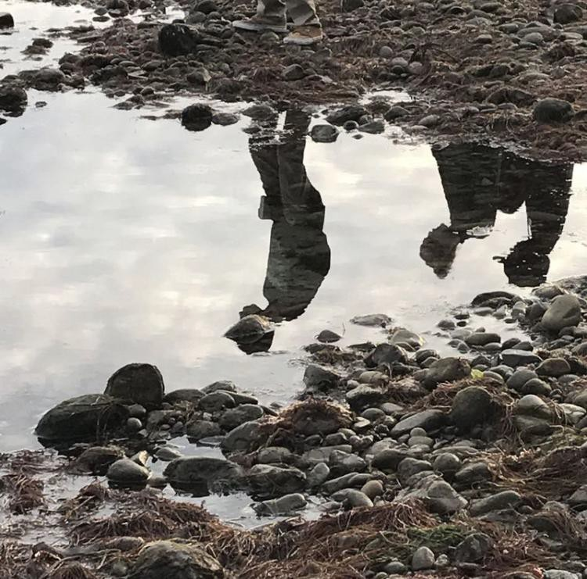
Bonus Tips
Have people say “yoga” instead of “cheese.” You will get a more natural smile and possible a laugh.
Clean the lens on your phone regularly.
Shoot every day!
iPhone

Slide 26
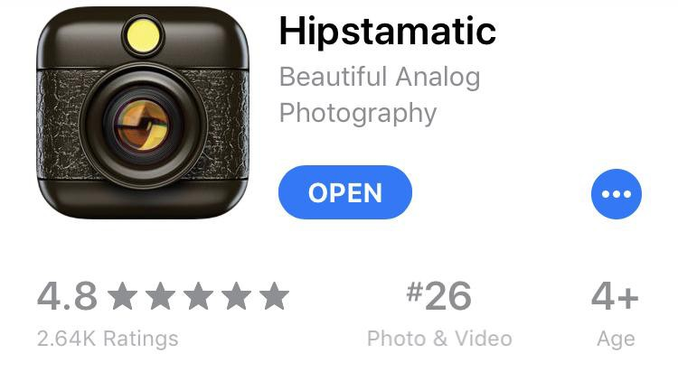
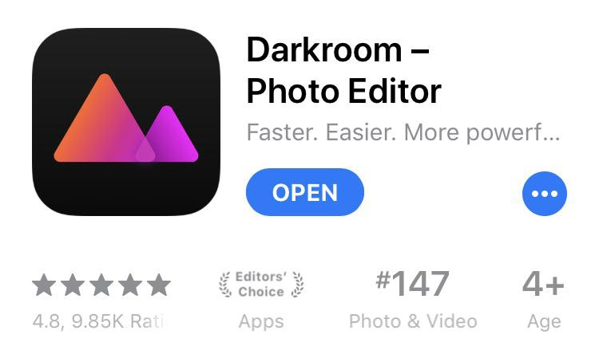
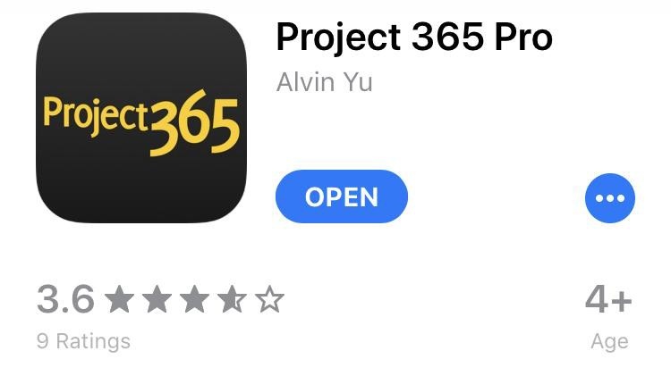

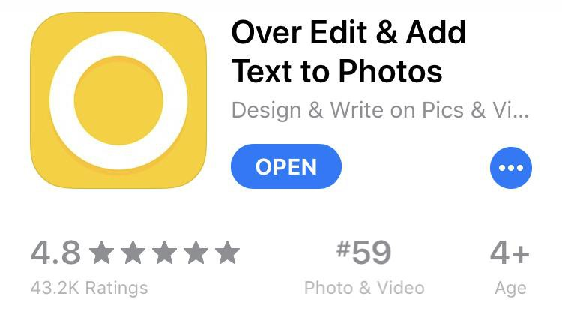
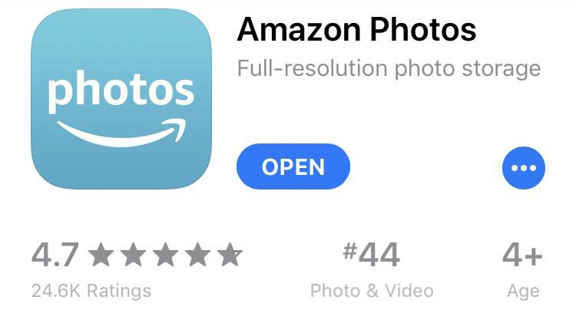
Better iPhone Photography for Business
Apps I recommend:
fun filter
photo
editing
journal
editing
storage
social
media

Slide 27
Follow me
See me
Join me
Instagram
@wavycreative
Facebook Page julesholdsworthphotography
Website www.julesholdsworth.com
GoodTimes
Edible Monterey Bay
Headshot Sessions
Family Portraits
Graduate Portraits
Business /Website Photography
Social media Photography
Photography Workshops (starting June 15)

Slide 28
For information about the Santa Cruz Small Business Development Center visit
www.santacruzsbdc.org
For this and other NextTalks visit
www.santacruzpl.org/brownbags

Slide 29

Jules Holdsworth
www.julesholdsworth.com
Thank you!

