Slide 1
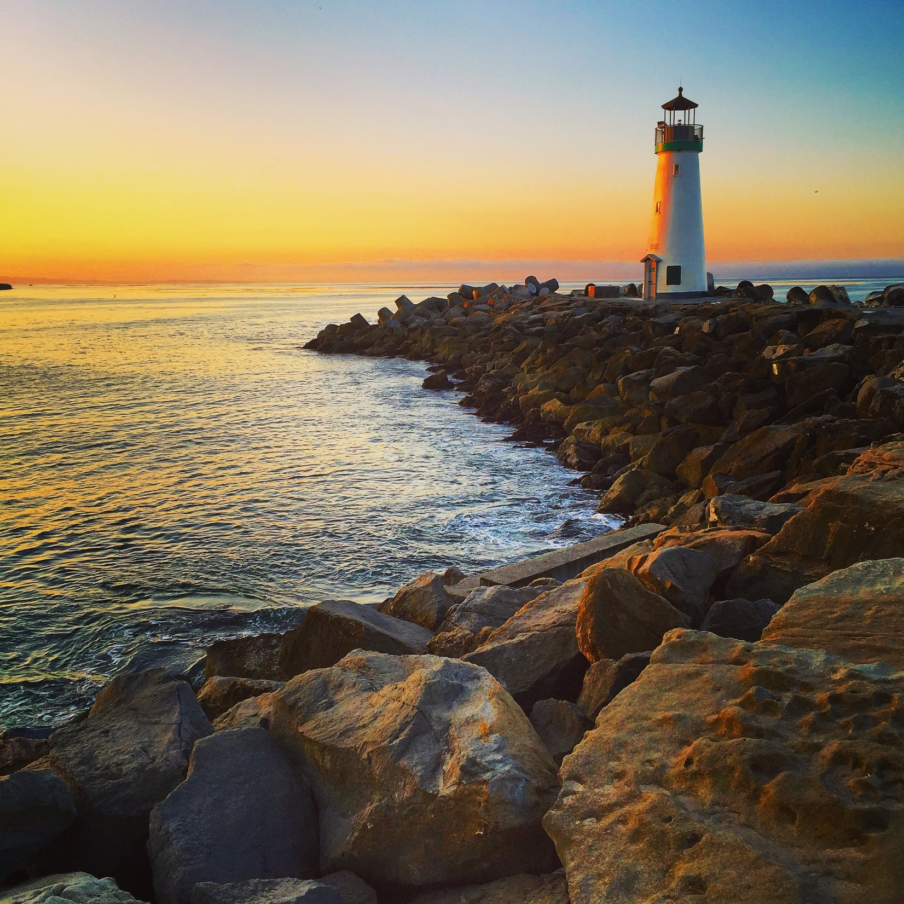
Santa Cruz Public Libraries
Overview
143-150
Page
Susan Nemitz,
Director

Slide 2
Accomplishments
Passed Measure S
Hired a Library Director
Developed a strategic plan
Reorganized the workforce
Worked with the Friends to build a strong infrastructure for fundraising.
Developed two-prong plan for working with homelessness
Adopted funding framework for strategic investments
Notes:
1000 people
Working with Friends to build a strong infrastructure so we can do capital campaign around construction projects – developing a City of Santa Cruz F of the L group
Homelessness
Worked with City on Consistent Expectations and Enforcement of Behavior Expectations – 201 incidents w/ 49 suspensions
Joined Downtown committees, began enhanced reporting
Property becoming official part of civic campus
Employees developed and Board passed new Code of Conduct/procedures
Doing environmental projects
Provided 340 hours of intensive mental health first aid training to staff
Worked with the Community on providing information services to individuals experiencing homelessness
Started Thursday Coffee Hour to listen, trained seven volunteers – averages 40
Identified Community Partners Homeless Person Health Project, Downtown Outreach Wroker, HSC Intake Coordinator
Developed Working Together program – assistance with info needs – averages 4-7
Received grant and opened Vets information center
Working on civic engagement series
Marcus assistance – analyzed the Library in January to strategically use one-time balances to make important investments in the library
15% reserve
2.4 million fund balance

Slide 3
2017-2018
Add 66 public open hours per week
4 at Branciforte
4 at Downtown
9 at Garfield
Replace and adding public computers
Add wireless printing
Invest $300k into the collection
Develop a plan for the Downtown Library
Begin building Capitola and Felton
Celebrating 150 years

Slide 4
Library Governance
Governance Changes
Joint Powers Board
Consists of 3 City Managers and the County Administrator
Library overhead charge paid to the City
Jurisdictions own the buildings
Notes:
Cities of Santa Cruz, Capitola, Scotts Valley and County/does not include Watsonville
Managers of each jurisdiction serve as representatives
Overhead is primarily financial and human resources – library employees are employees of the City
Measure S gives money to the jurisdictions, not the Library Joint Powers Board – each jurisdiction is responsible for building and remodeling facilities

Slide 5
Facilities Master Plan
2012 – Group 4
Goal - Create modern library facilities
1968 built Downtown
Recommendations:
Maintain $8.2 M
Gain $1.4 - $1.9 M
Attain $24.9 – $35.6 M
Notes:
Need $83 million for full attain plan
Downtown $565 to $890 per square foot

Slide 6
Measure S
Modernize, upgrade and repair local libraries
$67 M bond Issue
Passed June 2016
Must be used by 2025
Distribution:
County $26 M
City $25 M
Capitola $ 8 M
SV $ 3 M

Slide 7
2016 Feasibility Study
Explore multi-use facility
Completed study of Cedar Street with parking garage
$23-27 M
Requested advisory committee

Slide 8
Downtown Library Options
Remodel on site
Rebuild on site
Rebuild as part of parking garage on Cedar Street

