Slide 1
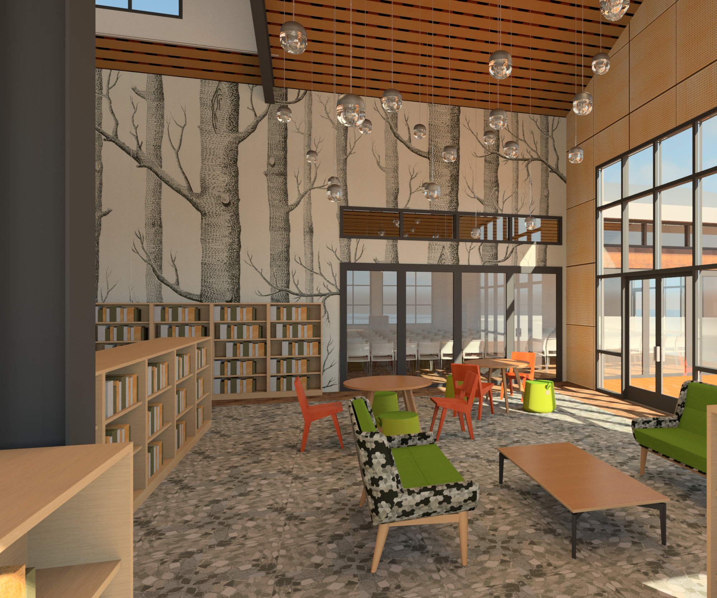
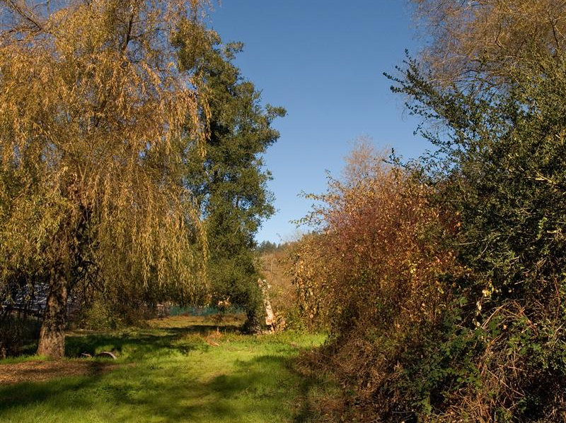
The Library…... A place to connect, inspire, and inform
The Park……. A place to explore, discover, and enjoy
Together, a unique pairing of community treasures
Notes:
Measure S passed in 2016 provides the funding for the library.The park concept that will complement library services, emerged in 2015 with the county’s acquisition of the land on the north side of Bull Creek.

Slide 2
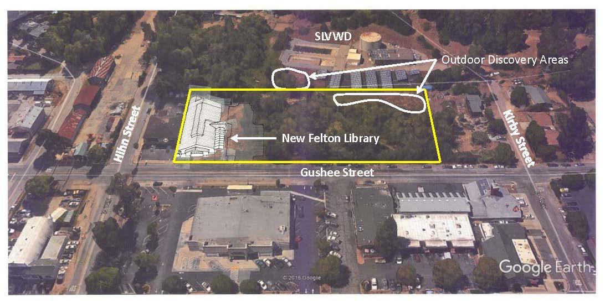
Library and Park located on 2.1 acre site in downtown Felton
Notes:
By now most of you are familiar with the site where construction began in late September. The San Lorenzo Valley water district offered to provide space for riparian mitigation requirements as well as land that is expanding the park.

Slide 3
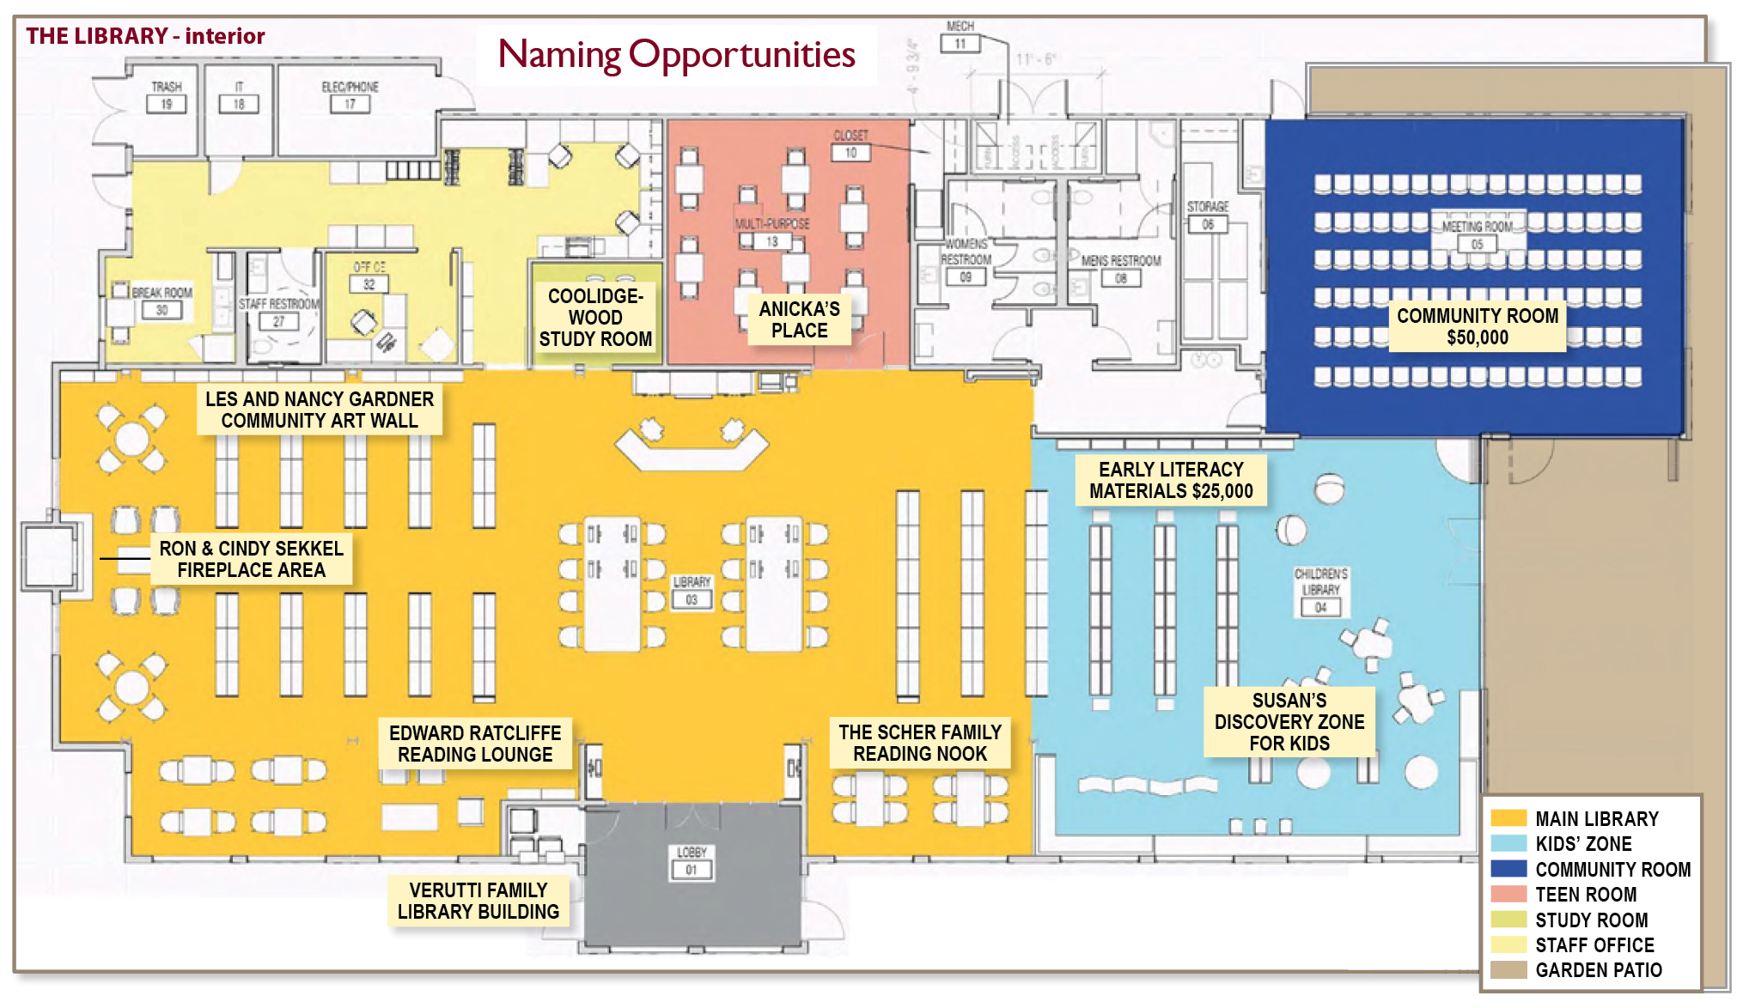
Notes:
The FLF capital campaign is grateful for Gifts from local families and organizations. These will provide enhancements for the library and park and to develop a programming fund. The community wide campaign will kick off this March.
Walk through pointing out uses for areas.
100 chairs for seated events and 60 for programs with tables etc.

Slide 4
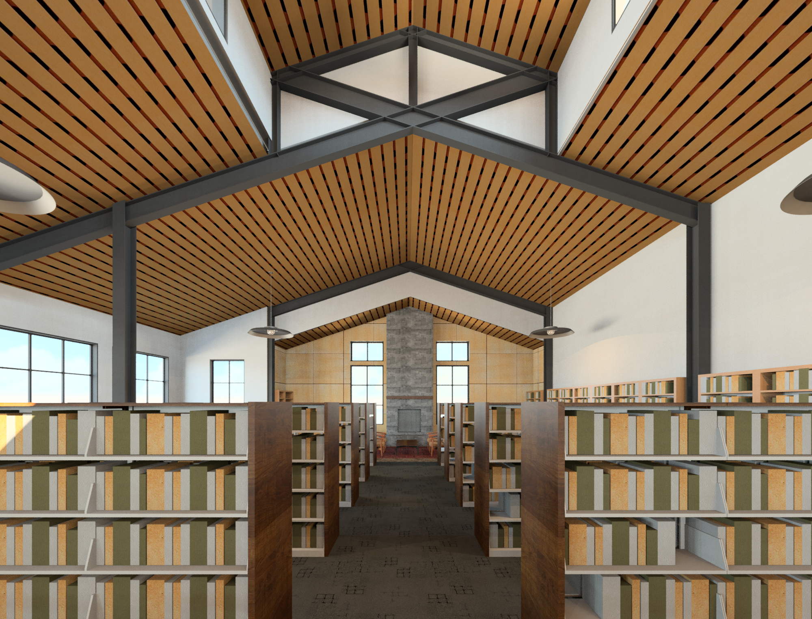
A place to learn, connect and relax.
Notes:
Local glass artist Lea DeWit is the public artist chosen. Blown glass butterflies will be suspended from the ceiling.

Slide 5
A place for children and families to create lasting memories.

Slide 6
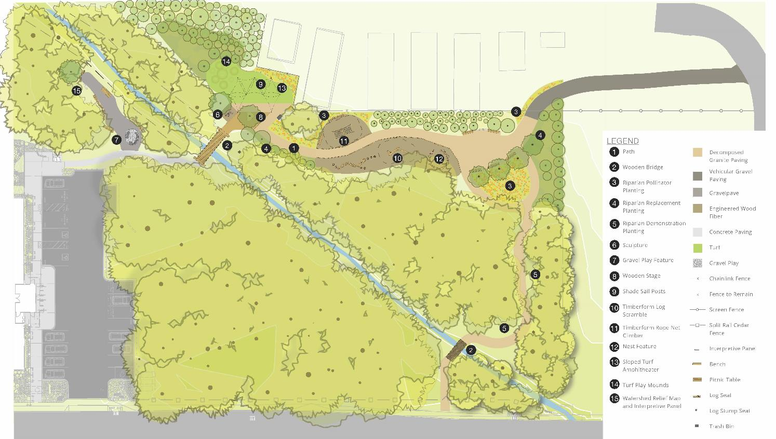
Nature Discovery Park
Notes:
Watershed learning area

Slide 7
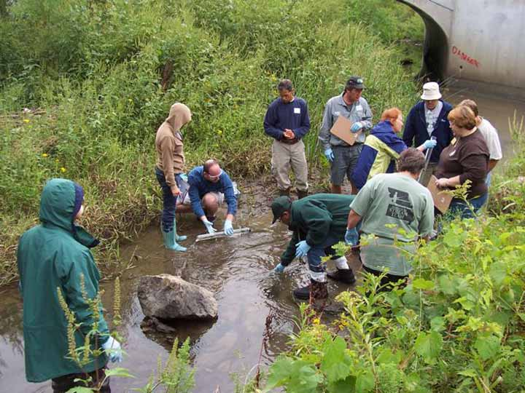
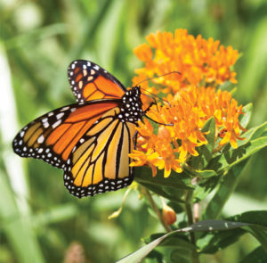
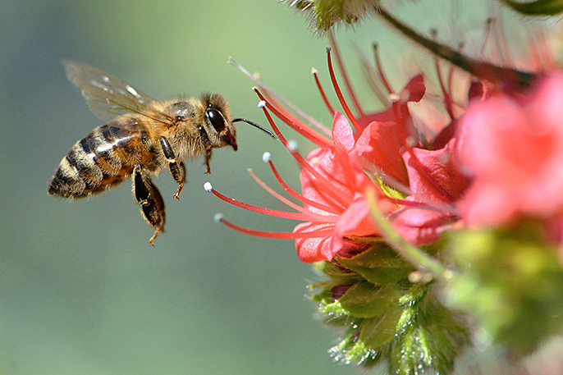
A Park to Enjoy and Discover
Notes:
The focus for both the library and park is Environmental literacy. The Santa Cruz mountain communities have a long history supporting the environment and

Slide 8
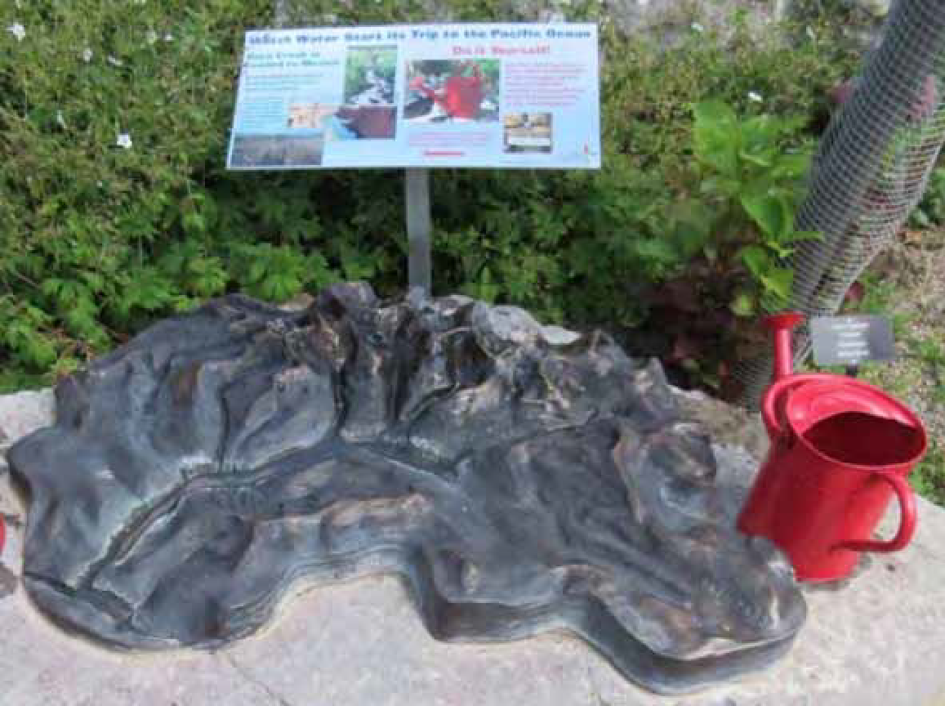
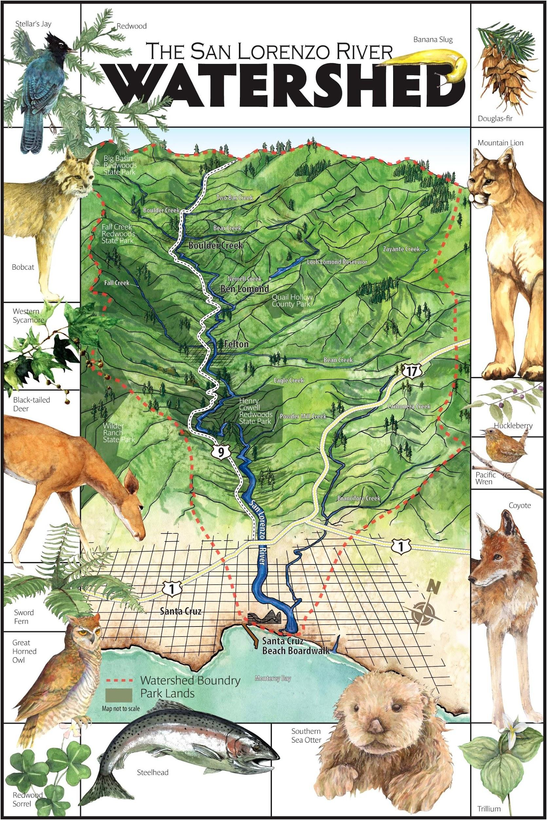
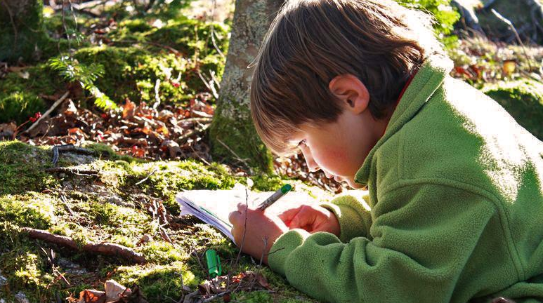
Notes:
Creekside watershed area. Gathering area for classes. Examples of interpretive sign and interactive watershed 3-D demonstration.

Slide 9
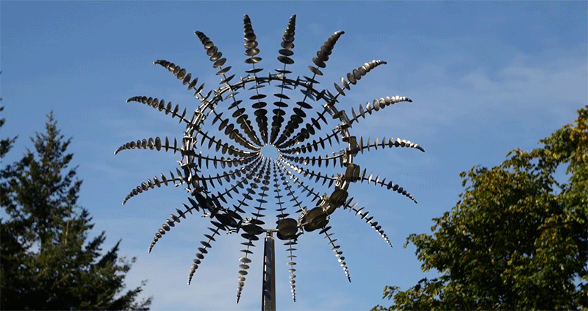
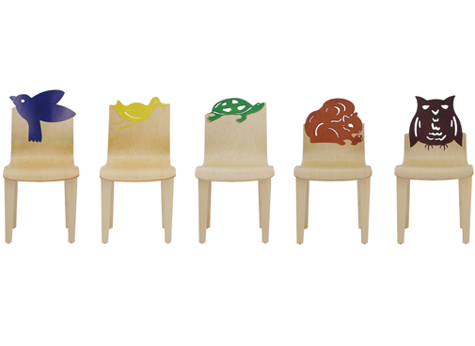
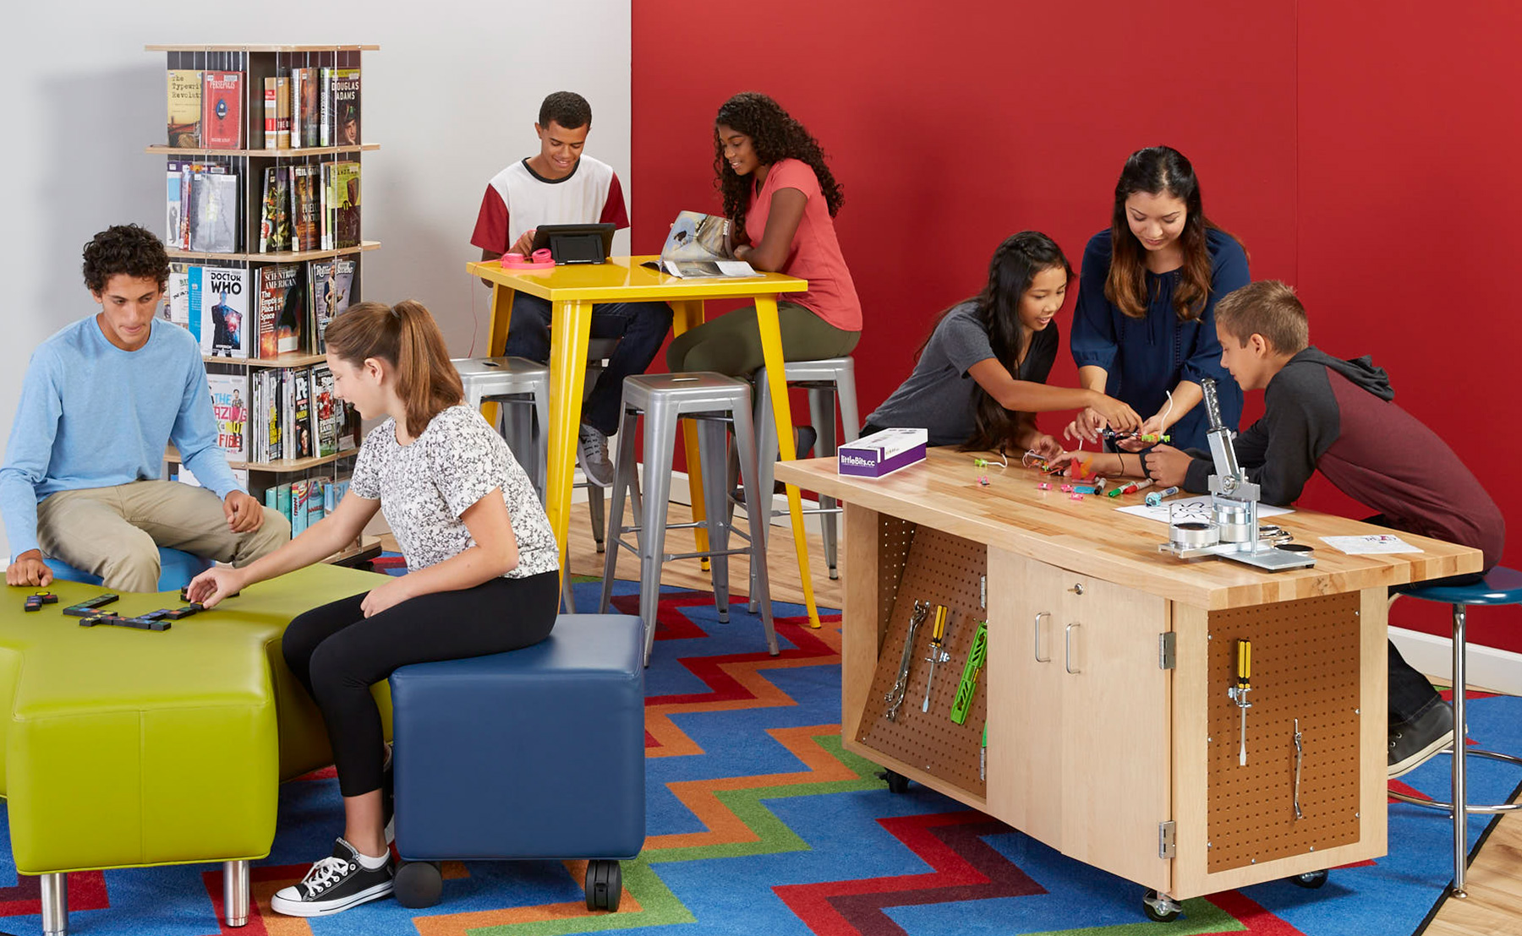
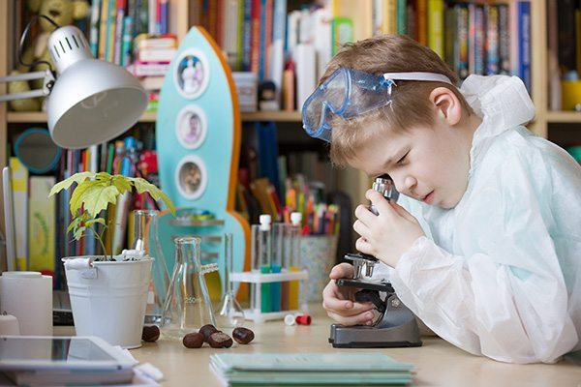
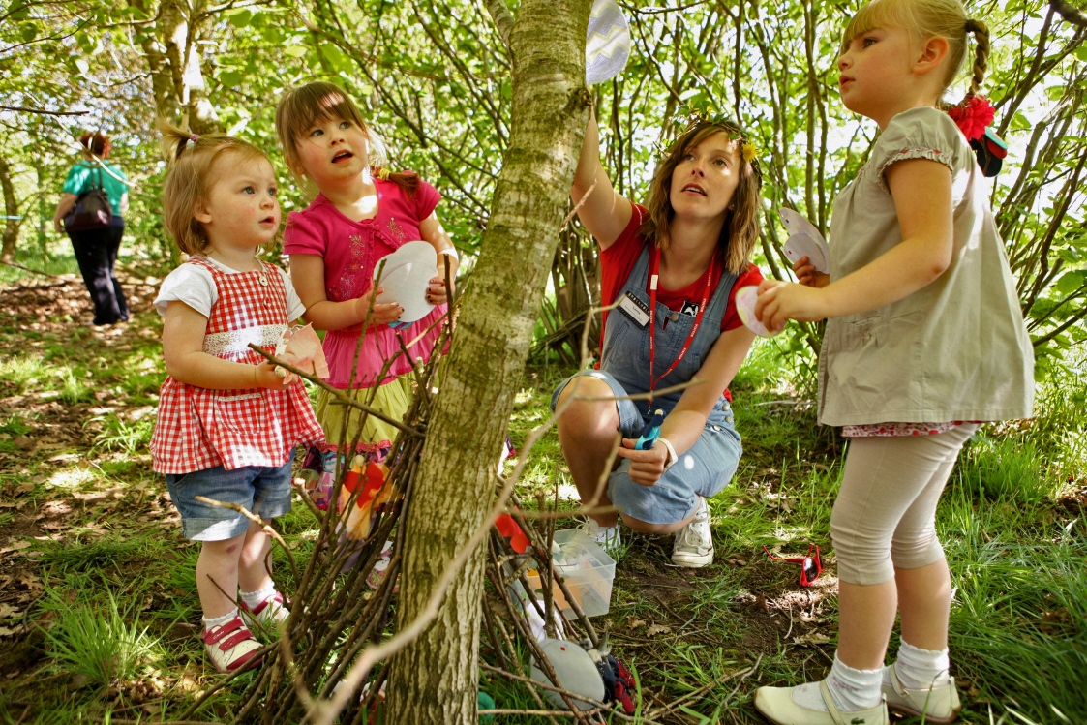
FLF is raising funds for items not covered by Measure S or Park budget.
Outdoor art, high quality benches, and other enhancements
Upgrades to furniture to create a warm welcoming place
Quality equipment for discovering and creating
A fund to support programming in both the library and park.
Notes:
FLF is raising funds for items not covered by Measure S or the Park budget. Public art, furniture upgrades, Citizen Science and maker space equipment are a few examples.

Slide 10
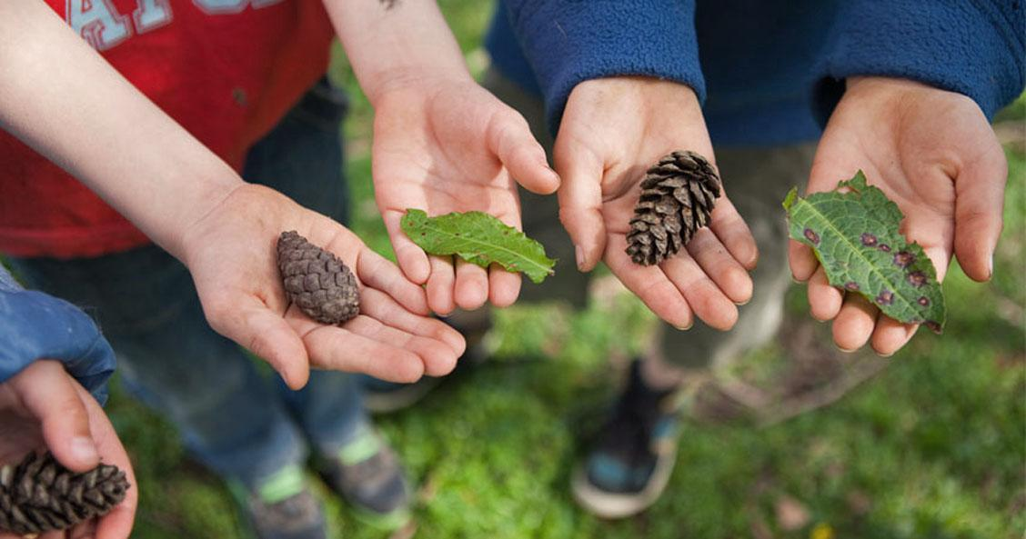
“Libraries matter for the same reason parks matter. Because to blossom,
human beings need public spaces that enable play, freedom
and social contact without any ties to consumption. “
LAIA JUFRESA
Notes:
In closing, thank you for inviting us here tonight. Many of you are familiar with the project and in fact

